Slide 1
Pharmacogenetics
Byron C. Jones, Ph.D.
Professor of Genetics, Genomics, and Informatics
Professor of Pharmacology, Addiction Science and Toxicology
The University of Tennessee Health Science Center
Memphis, Tennessee, USA

Slide 2
Lecture Outline
Individual differences in response to drugs
Inborn errors of metabolism
Origins of pharmacogenetics
Pharmacogenetics – human research
Pharmacogenetics – animal research
Toxicogenetics – merely an extension of Pharmacogenetics?
Individualized medicine

Slide 3
Individual differences in response to drugs
Differences in pharmacokinetics:
  Distribution
  Phase 1 metabolism
  Phase 2 metabolism
Differences in pharmacodynamics
  Receptors
  Transporters
  Biochemical pathways

Slide 4
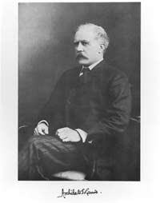
Inborn Errors of Metabolism
1908
Archibald E. Garrod (1857-1936) postulates that genetic defects cause many inherited diseases
In 1896, Archibald E. Garrod became interested in patients with a rare but rather harmless disorder known as alkaptonuria. When exposed to air, patients' urine turns distinctively dark. Garrod soon concluded that alkaptonuria is a congenital disorder, not the result of a bacterial infection as was commonly thought. Rare in the general population but frequent in children of first-cousin marriages, the incidence of alkaptonuria conformed to the pattern of recessive inheritance described by Gregor Mendel in his experiments with peas.

Slide 5
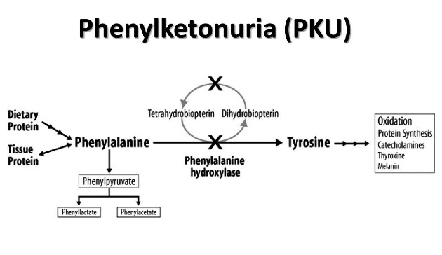
Inborn errors of metabolism -- Phenylketonurea
First described by Ivar Asbjørn Følling 1934
Autosomal recessive inheritance Treatment with phenylalanine-free diet for life
Symptoms
Intellectual disability
Delayed development
Behavioral, social and emotional problems
Psychiatric disorders
Neurological problems that may include seizures
Fair skin and blue eyes
Low birth weight

Slide 6
Pharmacogenetics – human vs. animal research
Most of the human research involved the genetics of pharmacokinetics, especially individual differences in metabolizing enzymes, including the cytochrome P 450 family and the isoenzymes
Most of the animal research involved the genetics of pharmacodynamics -- mostly in genetic reference populations of rodents
  Jorge Mardones, University of Chile, conducted selective breeding for alcohol consumption in rats – 1940s
  Gerald McClearn, University of California, Berkeley, conducted selective breeding for alcohol hypnotic sensitivity, i.e., long- and short-sleep mice – 1960s

Slide 7
Origins of pharmacogenetics
Werner Kalow, M. D., 1917-2008.
  Noticed that some individuals have difficulty in coming out of anesthesia
  Problem mainly with being able to regain movement
    Surgical patients are immobilized with succinylcholine. Surgeons hate it when those under general anesthesia move when getting cut!
    Succinylcholine is metabolized by cholinesterase (aka pseudocholinesterase, butyrylcholinesterase)
  Kalow discovered that those having difficulty were deficient in this enzyme

Slide 8
Pharmacogenetics: Drug metabolism
Occurs in 2 phases
  Phase I
Oxidation reactions (mediated by P450s, FMOs, ADH, AO, XO, MAO) – lots of polymorphisms in these
Reduction reactions (mediated by NTRs, GRX, TRX, GSH, AZORs, CBR)
Hydrolysis reactions (mediated by EH, CE, and various other peptidases, endopeptidases, and proteases)
  Phase II --Conjugation
    Glucuronic acid
    Sulfate group
    Glycine
    Methylation
    Acetylation
    Glutathione

Slide 9
Phase I enzymes
Cytochrome P450 enzymes (CYP---)
Metabolize about 60% of all prescribed drugs
CYP3A4 metabolizes about half of these

Slide 10
Phase I examples: Cyp3A4 – yep, the one inhibited by grapefruit juice
The majority of genetic polymorphisms to the CYP3A4 gene result
in decreased function of the enzyme activity. The result can be
Increased serum concentrations to toxic concentrations.
There are about 30 polymorphisms in the gene that codes for this
enzyme
With the exception of the genetic polymorphism
CYP3A4*1B, CYP3A4*10 in Hispanics, and CYP3A4*19 in
Indo-Pakistanis, the proportion of patients without a
genetic polymorphism appears low.

Slide 11
Phase I examples: ALDH2
This enzyme metabolizes various aldehydes, including acetaldehyde, the first metabolite of alcohol dehydrogenase.
30-40 percent of east Asians are deficient and suffer from it after consuming alcohol
  Flushing
  Headache
  Nausea

Slide 12
Phase II examples: Acetylation
Isoniazid. One of the agents to treat tuberculosis successfully
  Treatment for active infection
  May be prescribed for those showing PPD positive as prophylaxis
  Isoniazid (pyridoxal 5'-phosphate) kills or inhibits Mycobacterium
  Isoniazid also inhibits production of pyridoxine (Vitamin B6), an essential cofactor for the production of monoamine neurotransmitters
  Isoniazid overdose produces peripheral neuropathy, seizures and death
  Low therapeutic index – therefore accidental overdoses
  Bimodal metabolism at least 2 isoforms of N-acetyltransferase
    t_{1/2} <1 h – fast acetylators – slightly less common, more prevalent in East Asians
    T_{1/2} >3 h – slow acetylators – slightly more common

Slide 13
