Slide 1
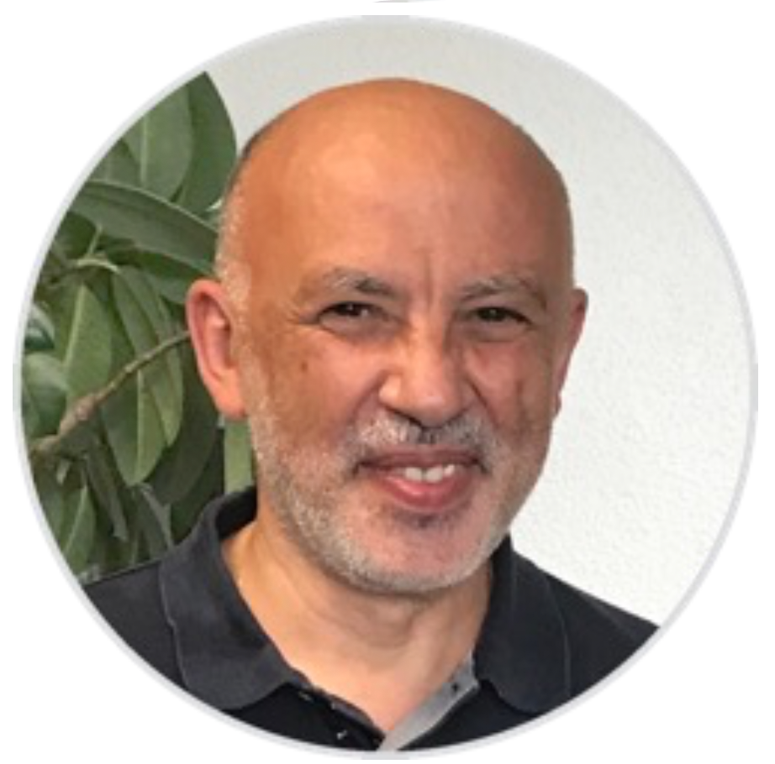
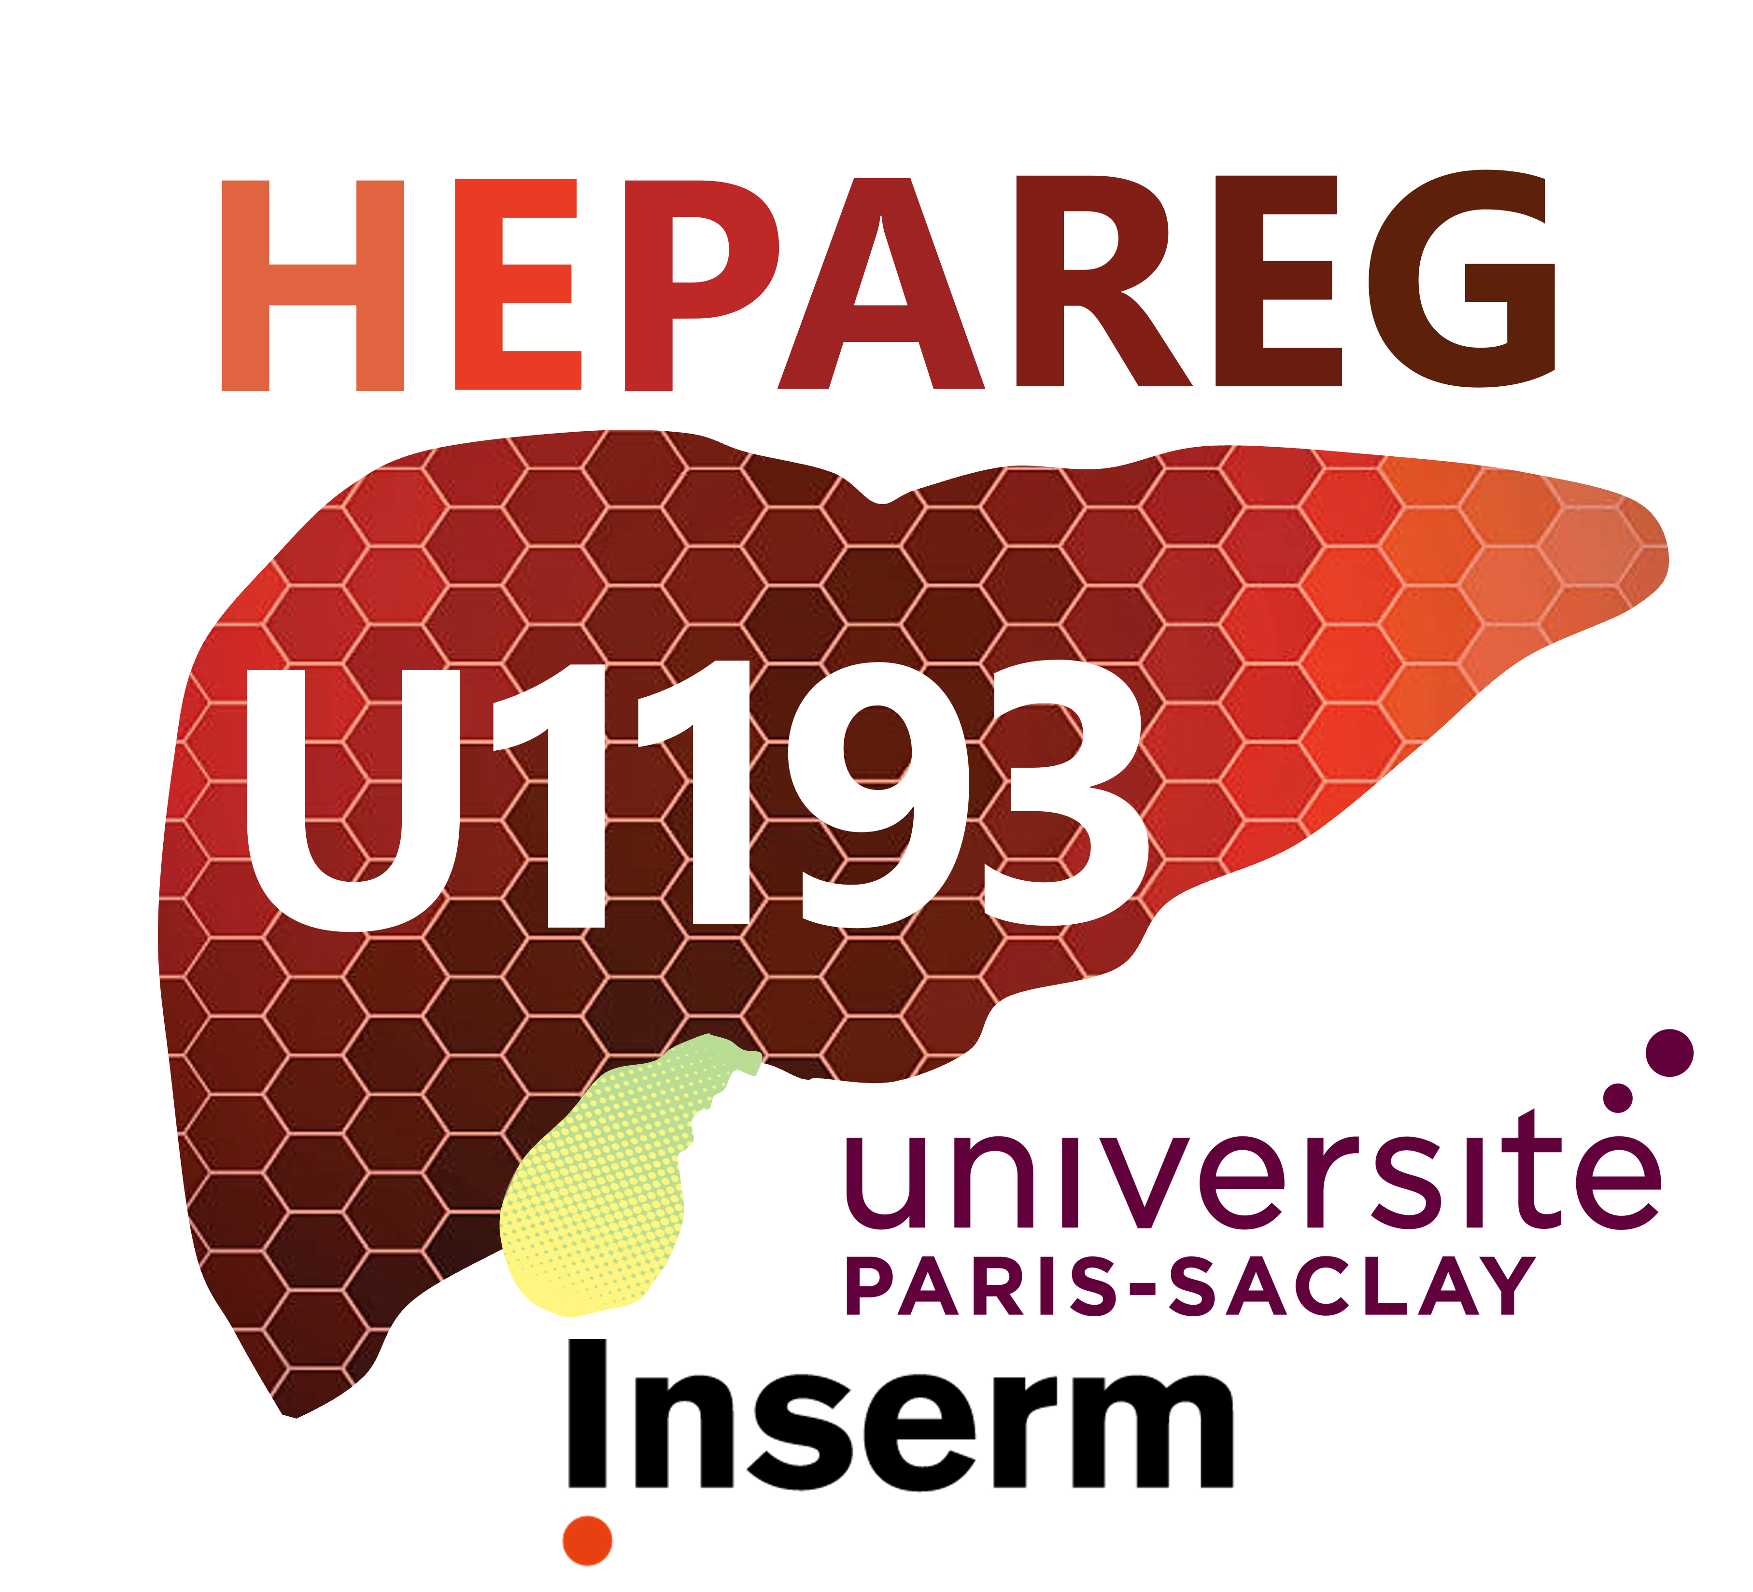
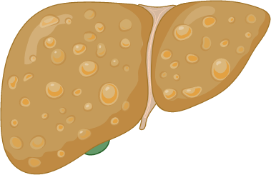
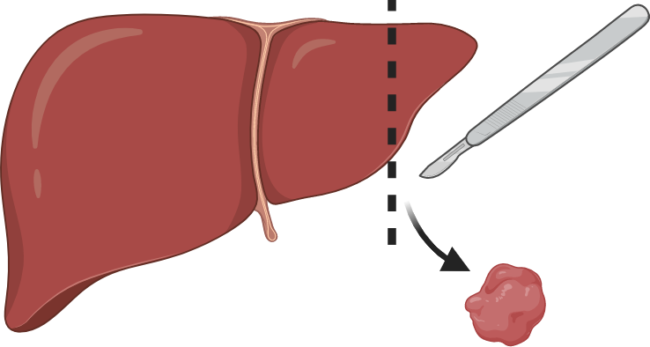
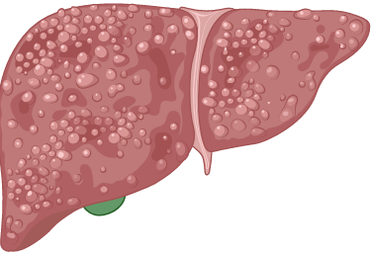
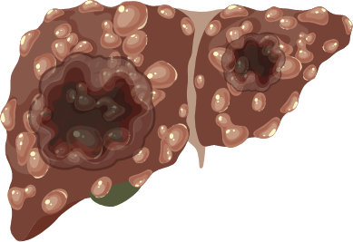
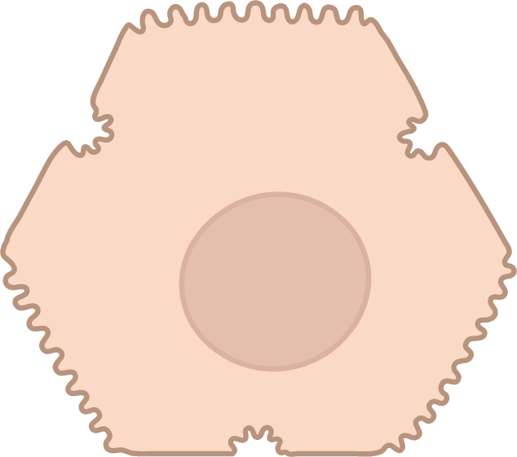
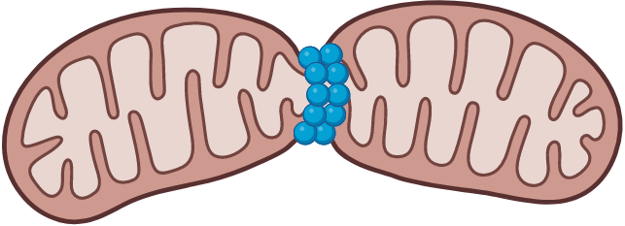
Context
Pr C. POÜS, University Paris-Saclay Pharmacy
INSERM 1193 - Team 5 - CCS1 - 2018-2023
Cellular and molecular response to stress and cancerogenesis
September 2022 : moving from Chatenay-Malabry to Henri Moissan Saclay
Presented by Béatrice BENOIT
Axis 1
Steatosis
resection
part.
MASH
fibrosis
chemo-resistance
HCC
cold
Adaptation to stress
Cytoskeleton
Organelles
stress
Immortalized
hepatocytes
HCCs
P
Ac
Biosensors
Targets
1
Notes:
Hi I am Béatrice Benoit, a teaching researcher in the Christian Pous lab
I will present our research concerning adaptation response mediated by the cytoskeleton and the organelles.
Which we study in « hepatocytes » subjected/exposed to stresses mimicking the ones encoutered in the liver

Slide 2
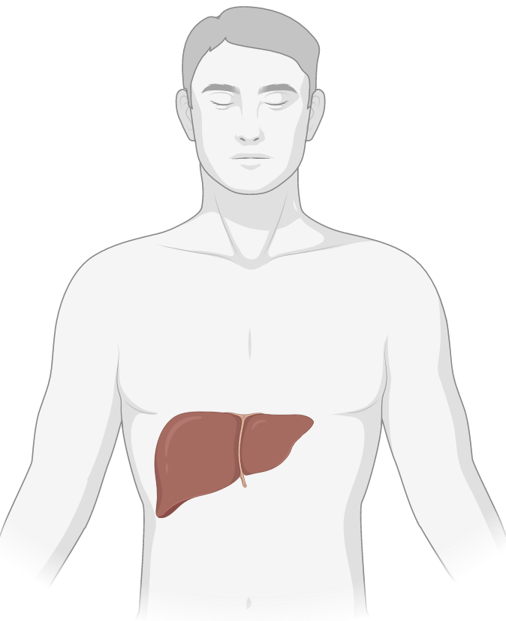
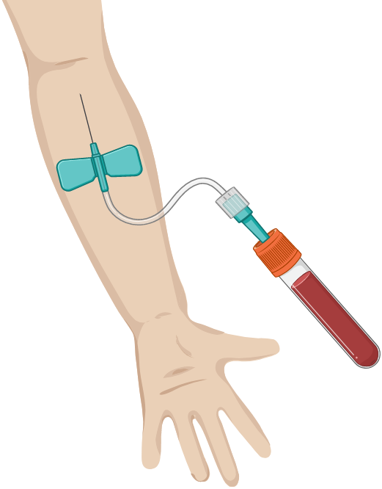
Context
Pr C. POÜS, University Paris-Saclay Pharmacy
INSERM 1193 - Team 5 - CCS1 - 2018-2023
Cellular and molecular response to stress and cancerogenesis
September 2022 : moving from Chatenay-Malabry to Henri Moissan Saclay
Presented by Béatrice BENOIT
Axis 1
Axis 2
Steatosis
resection
part.
MASH
fibrosis
chemo-resistance
HCC
cold
Secretion of
glycoproteins
Adaptation to stress
Congenital disorders of glycosylation CDG
Cytoskeleton
Organelles
Patient diagnosis
stress
Some CDGs with liver symptoms
Immortalized
hepatocytes
HCCs
P
Circulating glycoproteins
Ac
Biomarkers
Therapy follow-up
Biosensors
Targets
1
Notes:
And our research related to diagnostic of congenital disorders of glycosylation (CDG), including the ones with liver symptoms, through the study of circulating glycoproteins produced by the liver.
In both axis, our final goal is to discover new biosensors and biomarkers of liver stress
and potential new targets and tools for therapies.

Slide 3
Basic adaptation mechanisms involving the cytoskeleton
Axis 1
2018-2023
1. Remodeling of the cytoskeleton interplay
Chemoresistance
actin septin 9_i1 microtubule polyglutamylation
HHL16 Ctrl
HHL16 + taxane
taxane
9_i1
Preserves microtubule dynamics
Cell proliferation
Cell Death Dis 2019
Review Front Cell Dev Biol 2023
Review J Cell Sci 2021
Sept9_i1 intrinsic liver resistance ? Biosensor
First, Last, Corresponding
2
Notes:
Concerning how stress can reshape the cytoskeleton.
In hepatocytes, we observe that septin filaments (here in purple), relocalize from actin stress fibers (in red) toward MT (in blue)
upon treatment with the taxane chemotherapy
This relocalization (seen here with septin stained in green in immunofluorescence depends on the presence of the isoform 1 of sept9 and
keeps preserves microtubule dynamics, even in the presence of the stabilizing agent taxane,
allowing cell proliferation and therefore chemoresistance.
Thus this septin isoform, endogenously found in hepatocytes, might be responsible of the intrinsic liver resistance to taxanes
Thus, the intrinsic resistance of hepatocytes to taxanes is closely related to the expression of this isoform of sept9

Slide 4
Basic adaptation mechanisms involving the cytoskeleton
Axis 1
2018-2023
1. Remodeling of the cytoskeleton interplay
Chemoresistance
actin septin 9_i1 microtubule polyglutamylation
HHL16 Ctrl
HHL16 + taxane
taxane
9_i1
Preserves microtubule dynamics
Cell proliferation
Cell Death Dis 2019
BORGs Cdc42
proteasome
Review Front Cell Dev Biol 2023
Review J Cell Sci 2021
Cdc42 inactivation
BORGs proteolysis
Sept9_i1 intrinsic liver resistance ? Biosensor
Sept9_i1^{Δ}, BORGs++
Proteasome^{Δ}
Targets for taxane-treatment of HCC ?
First, Last, Corresponding
Current Biol 2021
2
Notes:
We further (then) demonstrated that this remodeling of the cytoskeleton (septin relocalization) relies on the inactivation of some BORG proteins (in light green) and on their subsequent proteolysis.
And we showed that forced maintenance of septin on actin, is a way to prevent chemoresistance.
Suggesting that all these actors might be targeted to allow taxane-treatment of hepatocarcinomas.
Conversely, forcing septins to stay along actin fibers, prevents cell adaptation, suggesting a way to keep hepatocarcinomas sensitive to taxanes.

Slide 5
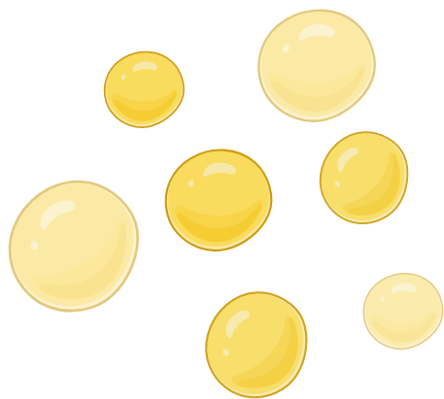
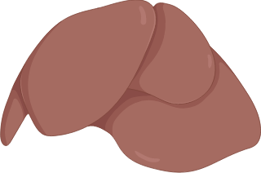
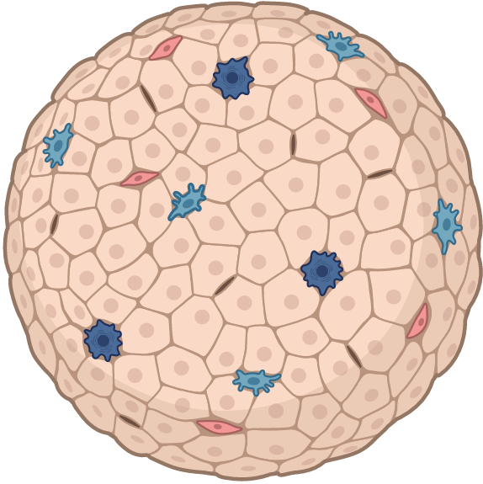
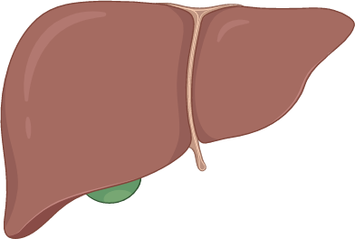
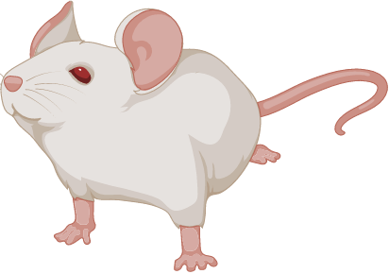
Basic adaptation mechanisms involving the cytoskeleton
Axis 1
2018-2023
1. Remodeling of the cytoskeleton interplay
4°C
Chemoresistance
Cold response
actin septin 9_i1 microtubule polyglutamylation
Composite network at 4°C
HHL16 Ctrl
HHL16 + taxane
HuH7 4°C 4h
keratin 8, 18-tubulin
taxane
9_i1
ker 8, 18 α-tubulin
Preserves microtubule dynamics
Cell proliferation
Golgi, lipid droplets normal clustering
Ongoing study
Cell Death Dis 2019
BORGs Cdc42
proteasome
Review Front Cell Dev Biol 2023
Review J Cell Sci 2021
Team 2
Team 1
Team 4
Cdc42 inactivation
BORGs proteolysis
Sept9_i1 intrinsic liver resistance ? Biosensor
Sept9_i1^{Δ}, BORGs++
Proteasome^{Δ}
Targets for taxane-treatment of HCC ?
Visualization in tissues &
function in liver graft cold preservation ?
First, Last, Corresponding
Current Biol 2021
2
Notes:
We also discovered a remodeling of the cytoskeleton during hypothermia of hepatocytes mimicking liver graft cold preservation on ice before transplantation.
Hepatocytes harbor a specific keratin cytoskeleton (stained in red here), that traps depolymerized tubulin (blue) upon cold treatment.
Interestingly, this new atypical composite network maintains/keeps proper Golgi and lipid droplets clustering upon cold.
A process that we try to visualize in tissues with our actual unit to assess its function in graft cold preservation.
Mimicking liver graft cold preservation, we also discovered an unexpected remodeling of the cytoskeleton of hepatocytes .
They harbor a specific keratin cytoskeleton (red on this immunoflorescence) that traps depolymerized tubulin (blue) upon cold treatment.
This new atypical composite network is capable to keep proper clustering of Golgi and lipid droplets upon cold.
We now try to reveal this process in tissues with the help of other unit teams, to assess its function in cell survival and in graft preservation.

Slide 6
Basic adaptation mechanisms involving the cytoskeleton
Axis 1
2018-2023
2. Microtubule and associated-proteins post-translational modifications (PTMs)
Phosphorylation
Stress
Na⁺
JNK
P
P
stress kinase
P
Clip-170
hyper-osmolarity
microtubule
Clip-170
tip
*
*
Favors MT regrowthafter depol.
Structural defects
(collision)
repair
remnants
*
Clip-170 lived cell
time
Microtubule rescues
& resistance to mechanical damages
First, Last, Corresponding
J Cell Biol 2020
Review Int J Mol Sci 2021
3
Notes:
Another way used by cells to adapt to stress is post-translational modifications of microtubules
Upon structural defects (here in red, due for example to MT collision), the stress kinase JNK phosphorylates CLIP-170 (purple), which is a growing-end MTs binding protein,
facilitating its transitory retention at damaged sites (here forming remnants behinds the growing tip) and facilitating MT repair (here in blue) & subsequent possible MT regrowth at that repaired sites after a depolylmerization.
So JNK-mediated phosphorylation favors MT rescues & resistance to mechanical damages.
Another way used by cells to adapt to stresses is to modify components of its microtubules
Here upon architectural defects (due to collisions for example), the stress kinase JNK phosphorylates CLIP-170 (purple), a protein that associates to growing ends.
These phosphorylations facilitate CLIP transient retention at damaged sites (here forming remnants behinds the growing tip) where they stimulate MT repair & subsequent regrowth to rescue MT depolymerization.
So JNK-mediated phosphorylation contribute to preserve MT integrity upon cell stresses.

Slide 7
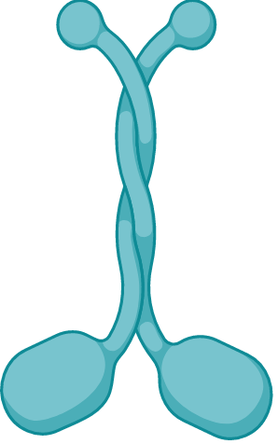
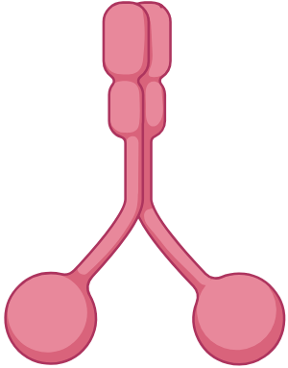
Basic adaptation mechanisms involving the cytoskeleton
Axis 1
2018-2023
2. Microtubule and associated-proteins post-translational modifications (PTMs)
Phosphorylation
Acetylation
Stress
Na⁺
JNK
P
P
Ac
stress kinase
P
Clip-170
hyper-osmolarity
Intraluminal acetylation
microtubule
Clip-170
Spastin
isoform
paraplegia
microtubule
tip
*
mechanical damage
(lattice opening)
ATAT1
*
entry
Favors MT regrowthafter depol.
time
Resistance to microtubule breakage
Structural defects
(collision)
repair
remnants
*
Clip-170 lived cell
motors
time
Hyperacetylation alterates
microtubule-mediated transport
➙ disease hallmarks
Microtubule rescues
& resistance to mechanical damages
Dis. Models Mech. 2018
collaboration
PLoS Pathog. 2022
First, Last, Corresponding
J Cell Biol 2020
Am J Phys Heart Circ Phys. 2022
Review Int J Mol Sci 2021
Microtubule PTMs for molecular adaptation to mechanical damages
Hallmarks of liver damages ?
3
Notes:
Also intraluminall MT acetylation, mediated by the acetyl-transferase ATA1, here upon lattice opening, is a way to resist to MT breakage.
However an hyperacetylation alterates microtubule-mediated transport by motors, for example here in a paraplegia caused by excessive MT damage.
So post-translational modifications of microtubule participate in the molecular adaptation to mechanical damages
And they might be used as hallmarks of liver damages, for example during lipid overload/steatosis.
Another way to resist MT breakage involves intraluminal tubulin acetylation. It is mediated by the acetyl-transferase ATAT1 that enters the MT lumen through lattice openings.
MT hyperacetylation can control microtubule-mediated transport, for example here together with a spastin mutant in spastic paraplegia.
So post-translational modifications of tubulin and microtubule-associate proteins participate in cell adaptation to mechanical damages
and they might be used as hallmarks of liver damages, for example during lipid overload.
(résultats préliminaires DP / Gual : LD overload = high Clip, high acetylation)

Slide 8
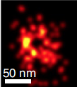
1. Cytoskeleton interplay / remodeling
2. Post-translational modifications
Cellular adaptation to stress
P
P
JNK
P
P
ATAT1
P
P
CLIP-170
P
Basic adaptation mechanisms involving the cytoskeleton
Axis 1
2018-2023
3. Cytoskeleton regulations & imaging
Microtubule
Imaging
Septin
Growing microtubule- binding proteins functions
diseases
Single molecule 3D microscope
dSTORM-SIM ModLoc 8 nm
Sept9i1
tubulin
PI4P
lumen
Golgi integrity
With Team 1
PNAS 2019
Philos Trans A Math Phys Eng Sci. 2022
iScience, 2019
Review J Cell Biol 2019
Nature photonics 2021
Nature, Ongoing
Axis 1
collaboration
First, Last, Corresponding
Stress & Organelles
4
Notes:
Note that we also worked on growing MT-binding proteins functions collaborated with physicians that develop single molecule 3D fluorescent microscope to visualize the lumen of MTs.
And showed a link betweeen septin and Golgi integrity.
Talking about golgi organelle, I will continue by presenting work s linking stress and organelles.
The third point that regards cytoskeleton regulation are :
- First the discovery of new biological tools to control and to visualize the occurrence of local architectural features or defects in MTs,
- Second, the development, in collaboration with physicists, of a new super-resolution 3D imaging technique that allows MT lumen visualization.
- Third, we participated in a study with team 1 that evidenced how septin binding to membranes can contribute to keep the morphological integrity of the Golgi complex.
This last point prompts me to transiton to how organelles contribute to cell adaptation to stress.

Slide 9
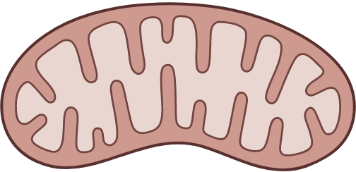
Basic adaptation mechanisms involving organelles
Axis 1
2018-2023
1. Mitochondria dynamics / 2. Autophagy & Lysosomes
Mitochondria
Environmental stresses
Ctrl
mitochondria
stress 1h
fragmentation
Viable cell 24h
Cytotoxic 24h
Mitochondrial fragmentation as early biomarker of cytotoxicity
Chemosphere 2019
First, Last, Corresponding
5
Notes:
Regarding mitochondria, we showed that diverse environmental stresses (such as « pesticides, plastic, industrial pollutants »), induce their rapid fragmentation
(here in immunofluorescence compared to control),
constituting an early effective biomarker of cytotoxicity
and that such fission is an early biomarker that is predictive of cell toxicity.

Slide 10
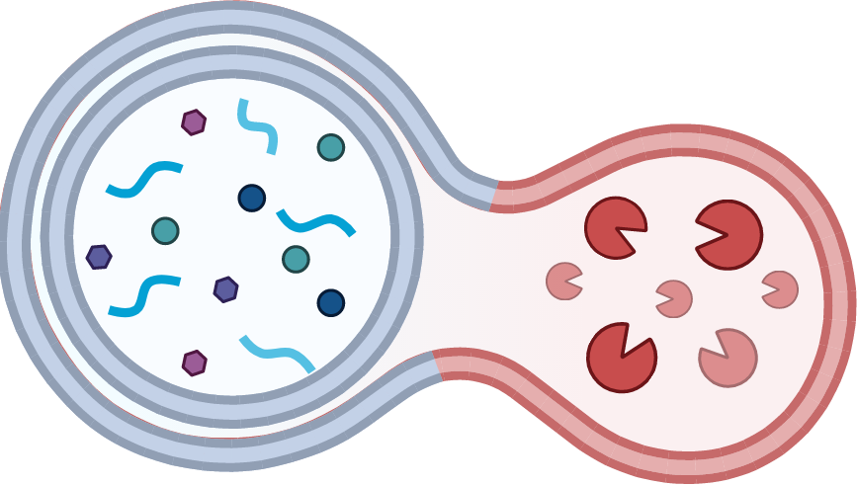
Basic adaptation mechanisms involving organelles
Axis 1
2018-2023
1. Mitochondria dynamics / 2. Autophagy & Lysosomes
Mitochondria
Autophagy
Environmental stresses
Infection
Drp1
Ctrl
mitochondria
stress 1h
Organelle damage mediated-autophagy
lysosome
autophagosome
New clinical targets to modulate immunity, immunotherapy
Autophagy 2021
Autophagy 2021
Cancer Cell 2022
fragmentation
collaboration
J Immunother Cancer 2022
Viable cell 24h
Cytotoxic 24h
J Cell Biol 2022
Review Autophagy 2021
Mitochondrial fragmentation as early biomarker of cytotoxicity
Chemosphere 2019
First, Last, Corresponding
5
Notes:
We also showed that autophagy mediated by organelle damages (for example mitochondria fission here during infection) can be used to modulate immunity and immunotherapy upon stress

Slide 11
Basic adaptation mechanisms involving organelles
Axis 1
2018-2023
1. Mitochondria dynamics / 2. Autophagy & Lysosomes
Mitochondria
Autophagy
Environmental stresses
Infection
Drp1
Ctrl
mitochondria
stress 1h
Organelle damage mediated-autophagy
lysosome
autophagosome
New clinical targets to modulate immunity, immunotherapy
Autophagy 2021
Autophagy 2021
Cancer Cell 2022
fragmentation
collaboration
J Immunother Cancer 2022
Viable cell 24h
Cytotoxic 24h
J Cell Biol 2022
Review Autophagy 2021
Mitochondrial fragmentation as early biomarker of cytotoxicity
Hallmarks of liver damages ?
Axis 2
Chemosphere 2019
Golgi
First, Last, Corresponding
5
Notes:
Thus we wonder if organelles and associated-proteins could be hallmarks of liver damages.
Actually we know that this is the case for the Golgi which is the central point of the second axis of our research
These findings suggest that organelles and associated-proteins could be hallmarks of liver damage.
Clearly this is already the case with the Golgi, which is the central point of our second axis of research.

Slide 12
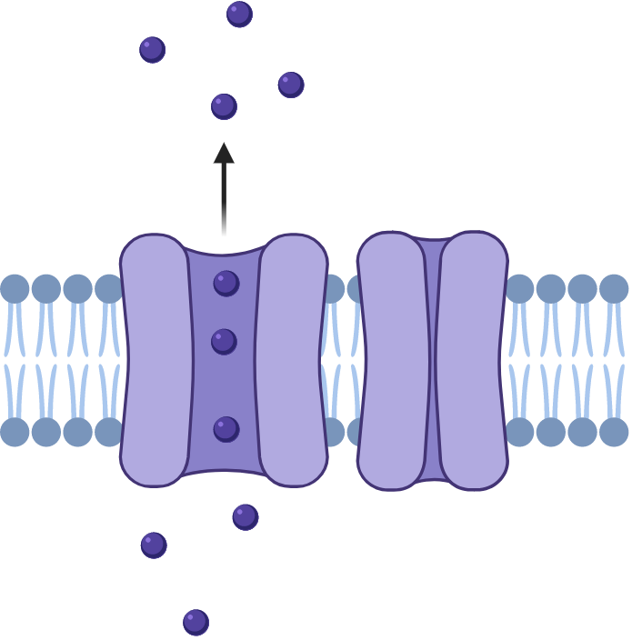
Biomarkers of CDG / Golgi stress
Axis 2
2018-2023
1. Glycosylation PTMs in the liver : circulating biomarkers of CDG
N-glycosylation
Transmembrane carriers : pH, metal ions, metabolites
Modifying enzymes of glycosylation
CDG
Plasma
circulating proteins
Transferrin
MGM Rep 2021, CCA 2021
J Thromb Haemost 2023, Haematologica 2018
First, Last, Corresponding
collaboration
National reference laboratory for CDGs diagnosis
LBMR accredited
Recognized worldwide
6
Notes:
Golgi in hepatocytes is where the circulating protein are glycosylated.
We used these proteins (for example transferrin which is N-glycosylated) to diagnose congenital disorders of glycosylation due to either mutations in the glycosylation enzymes or in transmembrane carriers that control enzyme activity through proper repartition of ions & metabolites in the Golgi.
The Golgi of hepatocytes is the organelle where secreted proteins are glycosylated.
We use the glycosylation of such proteins (illustrated here for the N-glycosylation of transferrin) as circulating biomarkers to diagnose congenital disorders of glycosylation. These pathologies result from mutations in the glycosylation modifying enzymes or in transmembrane carriers that control Golgi homeostasis through ions & metabolite transport.

Slide 13
Biomarkers of CDG / Golgi stress
Axis 2
2018-2023
1. Glycosylation PTMs in the liver : circulating biomarkers of CDG
N-glycosylation
Glycosaminoglycan & O-xylosylation linker
N
Transmembrane carriers : pH, metal ions, metabolites
HC1
Heavy chains (HCs) esterification
New
S
S
O-xylosylation
S
linker
S
S
O
HC2
S
S
Glycosaminoglycan GAG
disaccharide repeats
Chondroitin sulfate
Modifying enzymes of glycosylation
CDG
Bikunin forms
Plasma
circulating proteins
Transferrin
MGM Rep 2021, CCA 2021
J Thromb Haemost 2023, Haematologica 2018
O-glycosylation
New
CCA 2018
First, Last, Corresponding
collaboration
Review Gene 2021
Ctrl
National reference laboratory for CDGs diagnosis
LBMR accredited
Recognized worldwide
ApoC-III
CDG
J Chromato A 2018
Electrophoresis 2018
6
Review BBA Gene Subj. 2020
Notes:
The lab identifed Apolipoprotein CIII as a new marker of O-glycosylation, with here the modified profile of a CDG patient compared to Ctrl in 2D gel.
And the lab identified bikunin forms as very polyvalent biomarkers due to their polymodifications, including a short sugar linker associated to a long sulfated glycosminoglycan (GAG) that can carry Heavy protein chains, themself harboring N and O glycosylation.
Here you can see a the modified Bikunine profile of a CDG patient compared to 2 control in a classical WB.
The lab identifed Apolipoprotein CIII as a new marker of abnormal O-glycosylation, as shown here in 2D gels.
We also identified isoforms of bikunine as polyvalent biomarker of glycosylation due to its polymodifications, including a short sugar linker associated to a long sulfated glycosminoglycan (GAG) that can carry Heavy protein chains, themself harboring N and O glycosylation.
Here you can see a Bikunine profile of a CDG patient compared to 2 controls in SDS page gel.

Slide 14
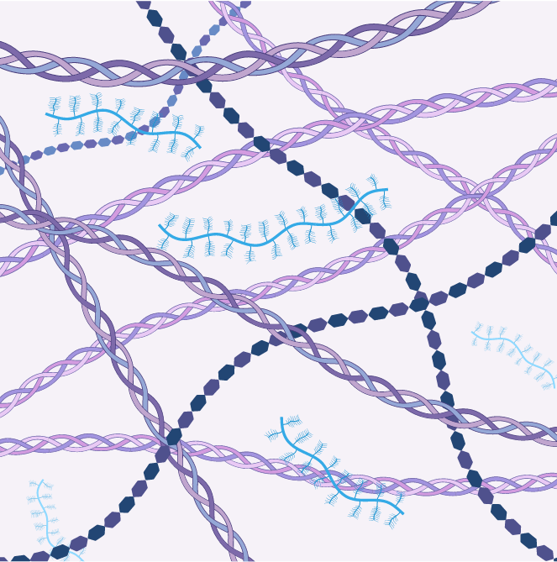
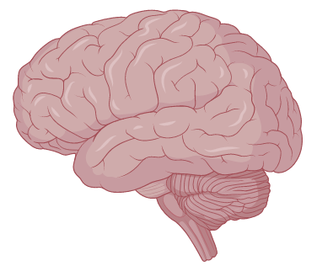
Biomarkers of CDG / Golgi stress
Axis 2
2018-2023
1. Glycosylation PTMs in the liver : circulating biomarkers of CDG
N-glycosylation
Glycosaminoglycan & O-xylosylation linker
N
Transmembrane carriers : pH, metal ions, metabolites
HC1
Heavy chains (HCs) esterification
New
S
S
O-xylosylation
S
linker
S
S
O
HC2
S
S
Glycosaminoglycan GAG
disaccharide repeats
Chondroitin sulfate
Modifying enzymes of glycosylation
CDG
Bikunin forms
Plasma
circulating proteins
Extracellular matrix (ECM)
Chondroitin sulfate
ECM
Transferrin
S
S
S
S
MGM Rep 2021, CCA 2021
J Thromb Haemost 2023, Haematologica 2018
sulfation
O-glycosylation
New
CCA 2018
Brain 2022
First, Last, Corresponding
collaboration
Review Gene 2021
Nat Commun 2018
Hum Mut 2021
Ctrl
National reference laboratory for CDGs diagnosis
LBMR accredited
Recognized worldwide
ApoC-III
CDG
J Chromato A 2018
Electrophoresis 2018
6
Review BBA Gene Subj. 2020
Notes:
Circulating Bikunine is also a precious biomarker to predict defects of GAGs in the extracellular matrix, of inaccessible patient’s tissues like bones or brain.

Slide 15
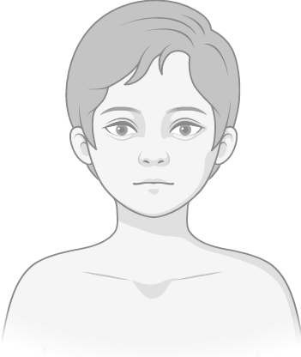
Biomarkers of CDG / Golgi stress
Axis 2
2018-2023
1. Glycosylation PTMs in the liver : circulating biomarkers of CDG
Mannose metabolism defect cohort : treated since 1991 (Necker)
Long term mannose-treated
Ctrl
CDG
2010
2013
2017
2018
2019
Biomarkers for
therapy follow-up
collaboration
Transferrin
Glycosylation rescue
JIMD 2020
Guidelines JIMD 2020
7
7
Notes:
Furthermore these biomarkers are efficient for therapy follow up, with here a patient showing a rescued glycosylation (compared to control) profile during long-term mannose-treatment.
Furthermore these biomarkers allow effective therapy follow up, here for example in a patient subjected to long-term mannose-treatment.

Slide 16
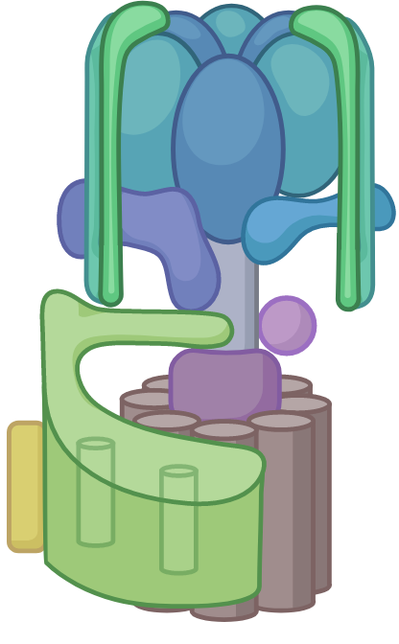
Biomarkers of CDG / Golgi stress
Axis 2
2018-2023
1. Glycosylation PTMs in the liver : circulating biomarkers of CDG
Mannose metabolism defect cohort : treated since 1991 (Necker)
Long term mannose-treated
Ctrl
CDG
2010
2013
2017
2018
2019
Biomarkers for
therapy follow-up
collaboration
Transferrin
Glycosylation rescue
JIMD 2020
Guidelines JIMD 2020
PNDS
Carrier mutations & Golgi stress
Carrier mutations & Golgi stress : molecular actors
Transferrin Bikunin ApoC-III
Altered glycosylations & Golgi homeostasis
Mn²⁺ galactose treatment
V-ATPase
G6PT
H⁺
TMEM165
Mn²⁺
H⁺
metabolic
RE + ectopic
metabolic
ionic
pH
fibroblast
Aberrant partitioning in the Golgi
Clin Chim Acta 2021
J Inherit Metab Dis 2020
Am J Hum Genet 2021
Transl Res 2024
Biosensors for liver Golgi stress
News The conversation 2024
First, Last, Corresponding
Mol Gen Metab. 2018
Clin Chim Acta 2021
7
Notes:
They are also usefull to unveil the molecular actors responsible of the Golgi stress, using patient blood or fibroblasts
Here some examples of mutated transporters leading to metabolic, ionic or pH perturbations through aberrant partitioning of Glucose, Manganese or protons in the Golgi.
Our secreted biomarkers are also innovative tools to unveil mechanisms of Golgi stress using patient blood or fibroblasts
They allowed the characterization of mutated transporters leading to metabolic (Glucose), ionic (Manganese) and pH (proton) perturbations in the Golgi.

Slide 17
9 patients MPI mannose isomerase
Biomarkers of CDG / Golgi stress
Axis 2
2018-2023
2. CDG with clinical liver symptoms
Mannose metabolism defect cohort : treated since 1991 (Necker)
Long term mannose-treated
Ctrl
CDG
2010
2013
2017
2018
2019
Biomarkers for
therapy follow-up
Hepatomegaly
fibrosis
collaboration
Transferrin
Glycosylation rescue
JIMD 2020
Guidelines JIMD 2020
PNDS
Carrier mutations & Golgi stress
Carrier mutations & Golgi stress : molecular actors
Transferrin Bikunin ApoC-III
Altered glycosylations & Golgi homeostasis
Mn²⁺ galactose treatment
V-ATPase
G6PT
H⁺
TMEM165
Transaminases⁺
coagulopathies
Mn²⁺
metabolic
H⁺
RE + ectopic
metabolic
ionic
pH
fibroblast
Cholestasis
steatosis
fibrosis
cirrhosis
Clin Chim Acta 2021
J Inherit Metab Dis 2020
Am J Hum Genet 2021
Transl Res 2024
Biosensors for liver Golgi stress
News The conversation 2024
First, Last, Corresponding
Mol Gen Metab. 2018
Clin Chim Acta 2021
7
Notes:
Note that in all these examples, CDG patients harbor liver symptoms ranging from
Increased transaminase, coagulopathy // hepatomegaly & fibrosis // as well as cholestasis & steaosis that can evolve toward cirrhosis.

Slide 18
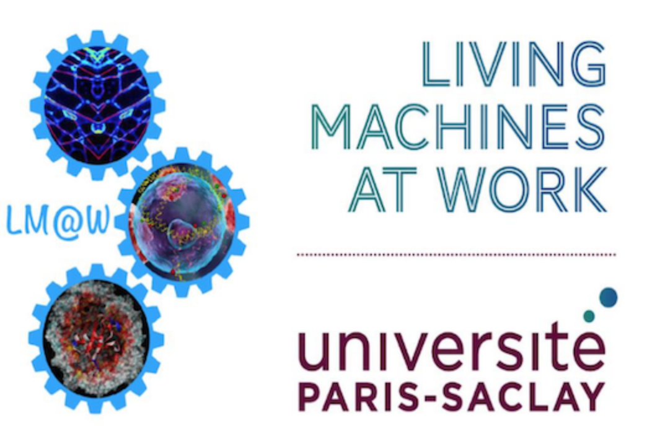
Team 5
Pr Christian POÜS, PU-PH
2023
Moissan
Pharma
Paris-Saclay
23 collaborations
Team 1, v
196 k€
13 FLC, 42 co-authors, 12 reviews
6 Teach-Res + 1 hired in 2020
= 2,9 ETP
4 Tech
3 PhD, 2 ongoing
2 PD
> 44 students
Project
8
Notes:
Before I switch to our projects
Here are the persons implicated in the studies I just presented, with our collaborators and common funding.
this slide sumarizes the persons implicated in our laboratory studies, with our collaborators and common funding.

Slide 19
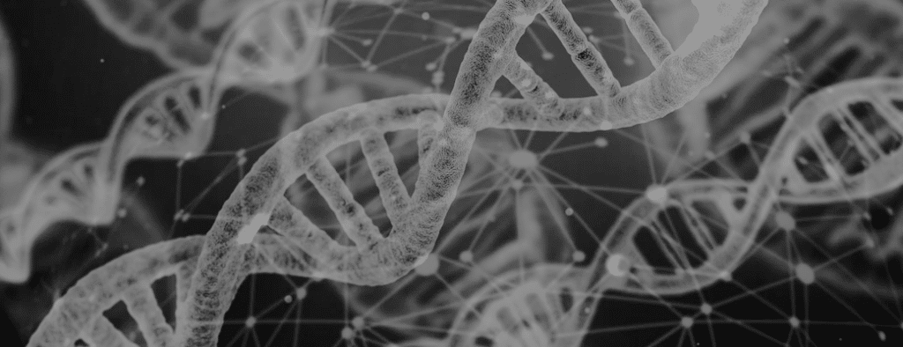
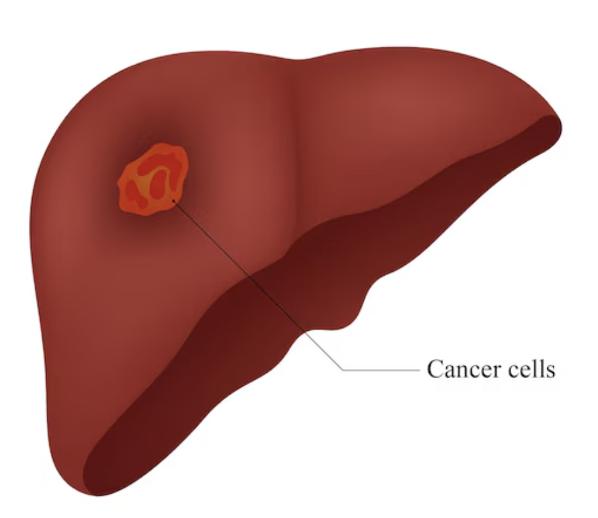
Team 5
Pr Christian POÜS, PU-PH
2023
Moissan
Pharma
Paris-Saclay
23 collaborations
Team 1, v
196 k€
13 FLC, 42 co-authors, 12 reviews
6 Teach-Res + 1 hired in 2020
= 2,9 ETP
4 Tech
3 PhD, 2 ongoing
2 PD
> 44 students
Oncogenetic
profiling
platform, CHB
2 Teach-Res-PH (0,6 ETP)
1 PhD
5 FLC, 13 co, 2 reviews
150 k€ platform
Primary liver cancer & metastases
Molecular profiling
Tumor heterogeneity
Project
Oncotarget 2018
BMC Cancer 2019
Cancers 2020
PLoS One 2023
8
Notes:
In the team we also have members that head & run the oncogenetic platform in Villejuif, and work on molecular profiling of primary liver cancer and metastases.
In the team we also have members that head and run the oncogentic platform in Villejuif. Their work on the molecular profiling of primary liver cancer and metastases also led to additional publications.

Slide 20
Hepatocyte stress in liver pathophysiology
Steatosis
Axis 1
Project
MASH
fibrosis
Hepatocyte mechanical stresses & cytoskeleton
Lipid overload
Microtubule damages
ECM
HuH7
Ac
JNK
P
ATAT1
P
P
LD (oleate) α-tubulin DNA
Clip-170
time
Internal compression
(cytosolic crowding)
PTMs for integrity preservation
9
Notes:
For our projet, thanks to our expertise, we propose to study links between lipid overload and the cytoskeleton in hepatocytes
Indeed, we have some evidences that internal compression due to cytosolic crowding could create MT damages, that can be overcomed by PTMs to preserve integrity.
Thanks to our expertise, we propose in our project to study links between lipid overload and the cytoskeleton in hepatocytes
Indeed, we have evidence that internal compression / cytosolic crowding could create MT damages that can be overcomed by PTMs such as CLIP-170 phosphorylation and tubulin acetylation to preserve network integrity and allow it to mediate some aspects of cell adaptation.
CLIP overexpression and hyperacetylation

Slide 21
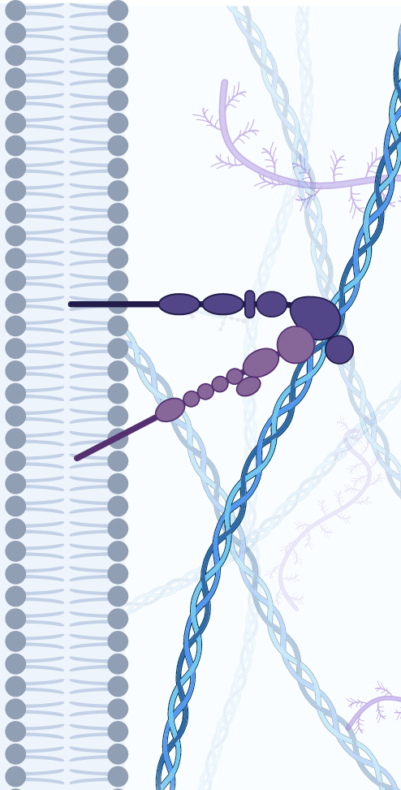
Hepatocyte stress in liver pathophysiology
Steatosis
Axis 1
Project
MASH
fibrosis
Hepatocyte mechanical stresses & cytoskeleton
Lipid overload
Microtubule damages
HuH7
actin
Altered actin
stress fibers
ECM
Ac
JNK
control
lipid droplets
P
ATAT1
P
P
Clip-170
time
nuclear
LINC
YAP
FA
LD (oleate) α-tubulin DNA
Reduced intracellular tension
Internal compression
(cytosolic crowding)
X
YAP
PTMs for integrity preservation
deformation
YAP
ECM
septins
Deregulated gene transcription (profibrotic ?)
9
Notes:
Also in the litterature, this crowding seems to correlates with altered actin stress fibers here seen in immunofluoresecence compared to control.
A phenotype also observed when we relocalize septins filaments to MT, by reducing intracellular tension either through focal adhesion or LINC disruption at membranes.
This loss of actin stress fibers should result in deregulated transcription that might be profibrotic in case of partial EMT (ECM stiffness, different EV = effect on stellate stem celll – myofibroblats ?).
Also in the litterature, cytoplasm crowding with abundant LDs correlates with altered actin stress fibers as shown here.
Strikingly, we already observed the same phenotype when intracellular tension is reduced by septin filaments relocalization to MTs or by focal adhesion or LINC complex disruption.
This loss of actin fibers should result in deregulated transcription that might be profibrotic in case of partial EMT (ECM stiffness, different EV = effect on stellate stem celll – myofibroblats ?).

Slide 22
Hepatocyte stress in liver pathophysiology
Steatosis
Axis 1
Project
MASH
fibrosis
Hepatocyte mechanical stresses & cytoskeleton
Lipid overload
Microtubule damages
HuH7
actin
Altered actin
stress fibers
ECM
Ac
JNK
control
lipid droplets
P
ATAT1
P
P
Clip-170
time
nuclear
LINC
YAP
FA
LD (oleate) α-tubulin DNA
Reduced intracellular tension
Internal compression
(cytosolic crowding)
X
YAP
PTMs for integrity preservation
deformation
YAP
ECM
septins
Internal compression
Cytoskeleton
Deregulated gene transcription (profibrotic ?)
Lipid overload
LD size, nature & distribution
PTMs for protection against disassembly & MT breakage
LDs
?
Septin relocalization
Altered mechano-transduction
& transcription
9
Notes:
So overall we will determine in cell culture how LD size, nature and distribution affect the above cytoskeleton parameters, but also mechanotransduction and transcription.

Slide 23
Hepatocyte stress in liver pathophysiology
Steatosis
Axis 1
Project
MASH
fibrosis
Hepatocyte mechanical stresses & cytoskeleton
Lipid overload
Microtubule damages
HuH7
actin
Altered actin
stress fibers
ECM
Ac
JNK
control
lipid droplets
P
ATAT1
P
P
Clip-170
time
nuclear
LINC
YAP
FA
LD (oleate) α-tubulin DNA
Reduced intracellular tension
Internal compression
(cytosolic crowding)
X
YAP
PTMs for integrity preservation
deformation
YAP
ECM
septins
Internal compression
Cytoskeleton
Deregulated gene transcription (profibrotic ?)
Lipid overload
LD size, nature & distribution
PTMs for protection against disassembly & MT breakage
LDs
?
External compression
Fibrotic environment
Septin relocalization
Altered mechano-transduction
& transcription
ECM stiffness & composition
Other mechanical stresses
9
Notes:
And also how these actors are affected by an external compression, mimicking a fibrotic environment or other mechanical stress encoutered in the liver
(nous regarderons également l’impact d’une compression externe comme un environnement fibrotique mais que ça pourrait aussi être le reflet de ce qu’il se passe quand on fait une hepatectomie ou une bile duct ligation)

Slide 24
Hepatocyte stress in liver pathophysiology
Steatosis
Axis 1
Project
MASH
fibrosis
Hepatocyte mechanical stresses & cytoskeleton
Lipid overload
Microtubule damages
HuH7
actin
Altered actin
stress fibers
ECM
Ac
JNK
control
lipid droplets
P
ATAT1
P
P
Clip-170
time
nuclear
LINC
YAP
FA
LD (oleate) α-tubulin DNA
Reduced intracellular tension
Internal compression
(cytosolic crowding)
X
YAP
PTMs for integrity preservation
deformation
YAP
ECM
septins
Internal compression
Team 1, 2, 4
Cytoskeleton
Deregulated gene transcription (profibrotic ?)
Lipid overload
LD size, nature & distribution
PTMs for protection against disassembly & MT breakage
LDs
New potential clinical targets to limit disease progression ?
?
External compression
?
Fibrotic environment
Septin relocalization
Altered mechano-transduction
& transcription
5 Teach-Res (including 2 PH) + 1 in 2025
4 Eng/Tech
1 M2 2024, 1 PhD to be recruited in 2024
7 collaborations
-
50 k€ Paris-Saclay Emergence
(ARC, Ligue, INSERM pending - Tordjmann)
ECM stiffness & composition
Other mechanical stresses
9
Notes:
We plan to validate these data in stressed organoids and livers.
And finally (Conversely) we will modulates these cytoskeleton elements in cells to see how they impact lipid droplets and fibrosis.
In order to highlight new potential clinical targets to limit disease progression.
For this project we already have human ressources fundings and that we are still actively reinforcing.
We plan to validate these data in organoids stressed by external compression and in livers subjected to fibrosis, and we will assess to which extent mechanical changes also apply to bile duct ligation or to partial hepatectomy.
Conversely, we will modulate cytoskeleton elements to see how they impact lipid droplets and fibrosis in order to highlight new potential clinical targets to limit disease progression.

Slide 25
Hepatocyte stress in liver pathophysiology
Axis 2
Project
New biomarkers of acquired metabolic liver diseases
Patients / mice
Plasma / cells
Glycosylation biomarkers, loss of hepatic Golgi homeostasis
Team 2
Team 4
Metabolic / ionic stresses
10
Notes:
In parallele we will test if glycosylation biomarkers could be additional markers of acquired metabolic liver diseases,
since we expect loss of hepatic Golgi homeostasis in these patients.
Using patient blood but also mouse & cells models, we will search for reproducible glycosylation defects highligting metabolic and ionic stresses.
In parallel, we will test if the circulating biomarkers we identify for CDGs could also reveal acquired metabolic liver diseases, since we expect abnormal Gogi homeostasis in patients' hepatocytes.
Using patient blood but also cells & mouse models, we will search for reproducible glycosylation defects highligting metabolic and ionic stresses.

Slide 26
Hepatocyte stress in liver pathophysiology
Axis 2
Project
New biomarkers of acquired metabolic liver diseases
Patients / mice
Plasma / cells
Glycosylation biomarkers, loss of hepatic Golgi homeostasis
Team 2
Team 4
Stiff ECM
Team 3
Metabolic / ionic stresses
Serum-derived Hyaluronan Associated Protein
(SHAP)
HC1/ HC2 proteins delivered by bikunin to ECM
crosslinking
& stiffning
Bikunin : regulates matrix stiffness ? Mechanotransduction ?
10
Notes:
Also since bikunine heavy chains can transfer to the extracellular matrix to crosslink hyaluronans, we will test if bikunin could regulate matrix stiffness and mechanotransduction during hepatic fibrosis.

Slide 27
Hepatocyte stress in liver pathophysiology
Axis 2
Project
New biomarkers of acquired metabolic liver diseases
Golgi-pH CDG
Patients / mice
Plasma / cells
Glycosylation biomarkers, loss of hepatic Golgi homeostasis
Cholestasis, steatosis, fibrosis, cirrhosis
Transaminases⁺
coagulopathy
Team 2
V-ATPase
H⁺
TMEM165
Team 4
pH
ionic
H⁺
Mn²⁺
30 patients
Mn²⁺ therapy OK
Stiff ECM
Team 3
Metabolic / ionic stresses
Treatable with Mn²⁺ supplementation ?
Serum-derived Hyaluronan Associated Protein
30 patients
1KO
(SHAP)
HC1/ HC2 proteins delivered by bikunin to ECM
crosslinking
& stiffning
+ Mn²⁺
Rescue of glycosylation /
clinical symptoms ?
+ Mn²⁺
Bikunin : regulates matrix stiffness ? Mechanotransduction ?
2 Teach-Res-PH
2 PhD (1 CEA, 1 APHP) 5 collaborations
4 Eng/Tech 50 k€ (600 k€ ANR DFG)
10
Notes:
A second aspect will be the therapy development for CDG patients mutated in the V-ATPase pump, with associated altered Golgi pH & strong liver symptoms.
We expect that these patients with pH anomaly would also have manganese desequilibrium by indirect perturbation of this carrier, which might be the cause of the observed glycosylation defects.
We will therefore test on cell patients Mn2+ supplementation efficiency to rescue glycosylation defects,
and then on mice model to also assess clinical symptoms rescues and then on patients.
Again for these projects we have already human ressources, and fundings (funded german collaboration).
A second aspect will be to explore if CDG patients mutated in the V-ATPase pump, who display altered Golgi pH & strong liver symptoms,
We expect that these patients with pH anomaly would also present Manganese imbalance by indirect carrier perturbation, which might be the cause of glycosylation defects..
We will therfore test Mn2+ supplementation efficiency to rescue glycosylation defects on cells of such patients
on mice model to also assess clinical symptoms rescue and then on patients.
Again for these projects we have already human ressources, and a funded collaboration with a german team.

Slide 28
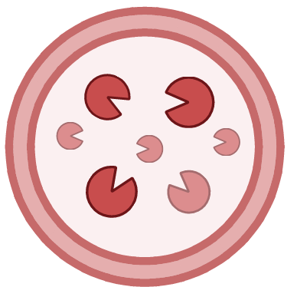
Unit : Therapeutic innovations / Hepatobiliary diseases
Project
Team 4 - Thierry Tordjmann - Henri Moissan Saclay
Biliary homeostasis and hepatobiliary pathophysiology
Cytoskeleton & hepatocyte stress
C. Poüs
LDs
P
Ac
Biosensors
Biomarkers
Clinical targets
11
Notes:
To conclude, we think that our team expertise in cellular biology and biomarkers

Slide 29
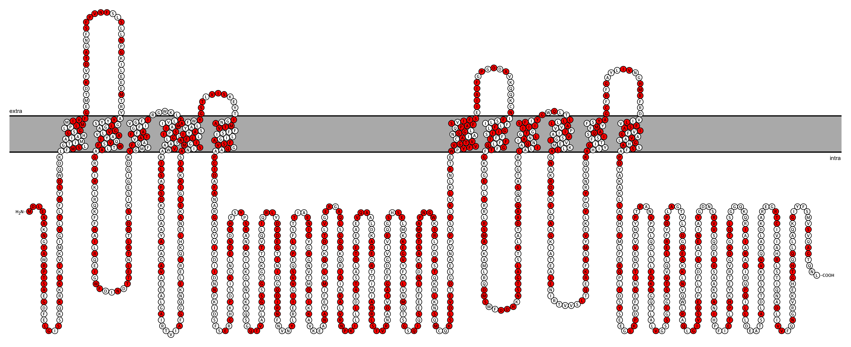
Unit : Therapeutic innovations / Hepatobiliary diseases
Project
Team 4 - Thierry Tordjmann - Henri Moissan Saclay
Biliary homeostasis and hepatobiliary pathophysiology
Cytoskeleton & hepatocyte stress
C. Poüs
Ciliopathies and biliary organogenesis
P. Dupuis-Williams
LDs
fundings
Shear stress ?
P
Ac
Biosensors
Biomarkers
Clinical targets
Joint meetings since
2023
Genetic Cholestasis
T. Falguières
4 fundings pending
ANR, ARC, Ligue, INSERM
Glycosylation for diagnosis ?
Purinergic and bile acid signaling
Platforms H. Moissan - Orsay
MIPSIT
. Light-sheet microscopy
. STED 3D facility microscopy
. Proteomic
T. Tordjmann
Mechanical stresses
11
Notes:
perfectly fits with the new team 4 in Moissan, with already common meetings and fundings and access to performant imaging platform

Slide 30
Unit : Therapeutic innovations / Hepatobiliary diseases
Project
Team 4 - Thierry Tordjmann - Henri Moissan Saclay
Villejuif CHB
Biliary homeostasis and hepatobiliary pathophysiology
Team 1
JC Duclos-Vallée
A Gassama
MA Allard (E Vibert Team2)
Cytoskeleton & hepatocyte stress
C. Poüs
Ciliopathies and biliary organogenesis
P. Dupuis-Williams
LDs
fundings
Shear stress ?
joint
meetings
P
Ac
Biosensors
Biomarkers
Clinical targets
Liver4life machine explant
Joint meetings since
2023
Genetic Cholestasis
fundings
T. Falguières
Team 2
E Vibert, N Golse
4 fundings pending
ANR, ARC, Ligue, INSERM
Glycosylation for diagnosis ?
Biopsies
Purinergic and bile acid signaling
Platforms H. Moissan - Orsay
MIPSIT
. Light-sheet microscopy
. STED 3D facility microscopy
. Proteomic
Team 3
N Monniaux
T. Tordjmann
Hôpital Bicêtre - CRB
Biological ressources
Mechanical stresses
11
Notes:
And we think that our expertise could be also beneficial for all the teams of the future unit and reversely.
I thank you for your attention and will be happy to answer your questions

Slide 32
2018-2019
Pr Bruno Baudin, PU-PH HDR Pr Philippe Billiald, PU-PH HDR
Dr Séverine Lorin, MCU
Dr Najet Medjoubi-Charef, MCU
Claude Mariette AJT UPS
Rita Maalouf PhD, 2015-18 (Museum P Billiald)
*Pr Anne-Marie Roque-Afonso, PU-PH HDR
Pr Jean-François Morère, PU-PH HDR
Dr Nelly Bosselut, PH
Dr Patrick Pham, PH
Dr Raphael Saffroy, PH
*Dr Christelle Vauloup-Fellous, MCU-PH
Dr Laure Izquierdo, AHU
*Lina Mouna, PostDoc 2017-19 (AM Roque-Afonso)
2018-2023
*Pr Christian Poüs, PU-PH HDR
*Dr Arnaud Bruneel, MCU-PH ongoing
*Dr. Antoine Pilon, MCU-PH
*Dr Anita Baillet, MCU
*Dr Béatrice Benoit, MCU ongoing
*Dr Daniel Perdiz, MCU HDR²⁰²⁰
Dr Elise Jacquin, MCU, 2020-2023
*Isabelle Cantaloube, AI UPS
*Ameetha Ratier, TCH UPS
*Hadidja Mdahoma AJT UPS, 2022
*Laïla Djambae AJT UPS, 2022
Joelle Salameh, PhD, 2017-21 (C Poüs / A Baillet)
Pierre Jouchet, PhD, 2017-20 (ISMO S Levêque-Fort / C Poüs)
Walid Haouari, PhD 2018-21 (C Poüs / A Bruneel)
*Samra Ouaras-Lounis, PhD, 2019 (C Poüs / A Bruneel)
*Yann Tenier, PhD, 2023 (CEA F Fenaille / A Bruneel)
Maya Talantikite, PostDoc 2017-18 (B Benoit / C Poüs / A Pilon)
Dalal Douaihy, PostDoc 2018-19 (B Benoit / C Poüs / A Pilon)
Pr Antoinette Lemoine, PU-PH HDR
Dr Jocelyne Hamelin, MCU-PH HDR
Marc-Antoine Allard, PhD 2013-2019 (A Lemoine)
Sara Merabet, AJT UPS 2019-22
*Members who joined team 1 in 2020
*Members joining T Tordjmann Team 4 in 2026
PhD
PostDocs

Slide 33
2018-2023
Cytoskeleton
5 Teach Res AB BB DP AP CP
2 Eng/tech IC AR
2 ADJ : HM LD
2 PhD JS PJ ISMO
2 Postdoc MT DD
50 k€ Fondation ARC 2020-22
50 k€ ANR 2017- 2021
30 k€ Cancéropôle IdF 2021-22
10 k€ Living machines @ work 2023
10 k€ Labex Lermit 2020-21
Pr L. Bertrand, UCL, Belgium
Dr A. Burgo, Inserm U1204, Univ. d’Evry
Pr A. Esclatine, I2BC, CNRS, Gif/Yvette
Dr A. Gassama, INSERM 1193, Villejuif
Dr B. Gigant, I2BC, CEA, Gif/Yvette
Pr J. Gleeson UCSD, La Jolla, CA, USA
Dr S. Levêque-Fort, ISMO, Paris-Saclay
Dr V. Stoppin-Mellet, GIN, Grenoble
Members
Funding 150 k€
Collaborations
Organelle
3 Teach Res EJ DP CP
2 Eng/tech IC AR
2 ADJ : HM LD
22,5 k€ La Ligue contre
le Cancer 2020-22
Pr A. Esclatine, I2BC, CNRS, Gif/Yvette
Pr O. Florey, Babraham Institute, Cambridge, UK
Dr J. Giustiniani, Inserm U1195, Le Kremlin-Bicêtre
Dr L. Oziol, UMR8079, AgroParisTech, Palaiseau
Dr L. Apetoh, Université Bourgogne, Dijon
Dr F. Ghiringhelli, Université Bourgogne, Dijon
Members
Funding 57k€
Collaborations
34,5 k€ Fondation de l’Avenir 2022
CDG
Dr A. Kauskot, INSERM, Saclay, K. Bicêtre
Pr P. de Lonlay, Inst Imagine, Necker, Paris
Pr G. Matthijs, KU Leuven, Belgium
Pr M. Taverna, IGPS, Univ Saclay, Orsay
2 Teach Res ABr, CP
2 PhD WH, SL APHP
1 Intern: AR APHP
26 k€ ANR 2019-21
Pr D. Borgel, Necker, Paris
Pr V. Cormier-Daire, Institut Necker, Paris
Dr F. Fenaille, CEA, Saclay, Gif/Yvette
Dr F. Foulquier, CNRS, Univ Lille
Pr H. Freeze, La Jolla, CA, USA
Members
Funding 115 k€
Collaborations
20 k€ H2020
ERA-Net 2019-21
Oncogenetic
2 Teach Res PH AL, JH
1 PhD
100 k€ INCa + 10 k€ GHU Saclay
40 k€ ICM Montpelier
….
Members
Funding 150 k€
Collaborations

Slide 34
Project
Cytoskeleton
5 Teach Res : AB, BB, DP, AP, CP
+1 to be recruited in 2025
2 Eng/Tech : IC AR
2 ADJ : HM LD
1 PhD to be recruited in 2024
1 M2 2024
50 k€ Emergence 2025
ANR, ARC & Ligue
Equipment INSERM S
applied with TT
Dr A. Bertin, Institut Curie, Paris
Pr R. Brandt University Osnarbrück, Germany
Dr C. Campillo, LAMBE, Univ. d’Evry
Dr F. Eghiaian, Abberior Instruments GmbH, Paris
Pr N. Galjart, Erasmus MC, Rotterdam, The Netherlands
Pr P Gual, C3M, INSERM U1065, Nice
Dr C. Janke, Institut Curie, Orsay
Dr Clara Nahmias, Inserm U981, IGR, Villejuif
Internal collaborations within the unit
Pr JC Duclos-Vallée (Team 1)
Dr N. Golse (Team 2)
In Team 4
Drs T. Tordjmann & G. Merlen
Pr P. Dupuis-William
Members
Funding 50 k€
Collaborations
CDG
2 Teach Res PH : ABr, CP
2 Eng/Tech : IC AR
2 ADJ : HM LD
1 PhD SL APHP, 1PhD YT CEA
50 K€ ANR-DFG Europe accepted
(600 K€ total)
Dr F. Fenaille, CEA, Saclay, Gif/Yvette
Dr F. Foulquier, CNRS, Univ Lille
Pr D. Lefeber Radboud Univ, Nijmegen, The Netherlands
Pr P. de Lonlay, Inst Imagine, Necker, Paris
Pr G. Matthijs, KU Leuven, Belgium
Members
Funding 50 k€
Collaborations
Within Team 4 of the unit
Drs T Tordjmann & G Merlen
Attractiveness
C Poüs and B Benoit: INSERM CSS1 committee members
C Poüs : ex-director of the doctoral school ‘Therapeutic Innovation from basic science to applications’
A Lemoine: Head of the oncogenetic platform at Paul Brousse
A Bruneel: Director of the national lab. reference for CDGs diagnosis at Bichat hospital
D Perdiz: Expert at the French National Health Safety Agency (ANSES)

Slide 35
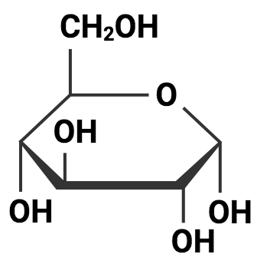
Inherited Paraplegia, spastin mutants
MT acetylation / bundling & slow axonal transport, Resistance Na+ & cold
Microtubule acetylation liver
Induced by alcohol steatosis … (not by LD only)
Affect MT molecular transport
Dis. Models Mech. 2018
Viral stress EBV, innate immunity escape,
mitochondria aggregation & mitophagy
Acetylation
PLoS Pathog. 2022
Metabolic stress
Glucose uptake
in diabetic heart
Ac
Intraluminal acetylation
Spastin
isoform
paraplegia
microtubule
Am J Phys Heart Circ Phys. 2022
mechanical damage
(lattice opening)
ATAT1
entry
time
Resistance to microtubule breakage
motors
Hyperacetylation alterates
microtubule-mediated transport
➙ disease hallmarks
Dis. Models Mech. 2018
PLoS Pathog. 2022
Am J Phys Heart Circ Phys. 2022

Slide 36
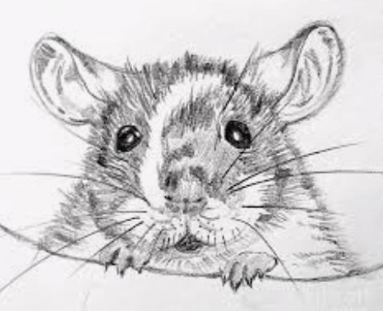
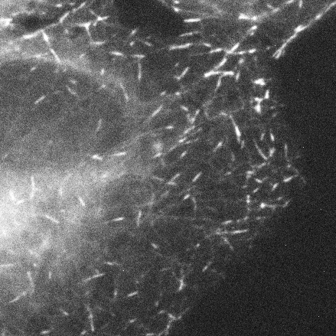
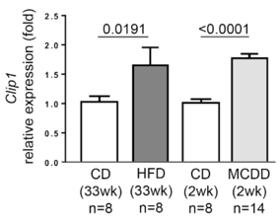
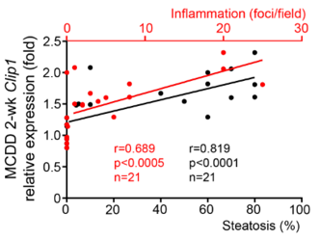
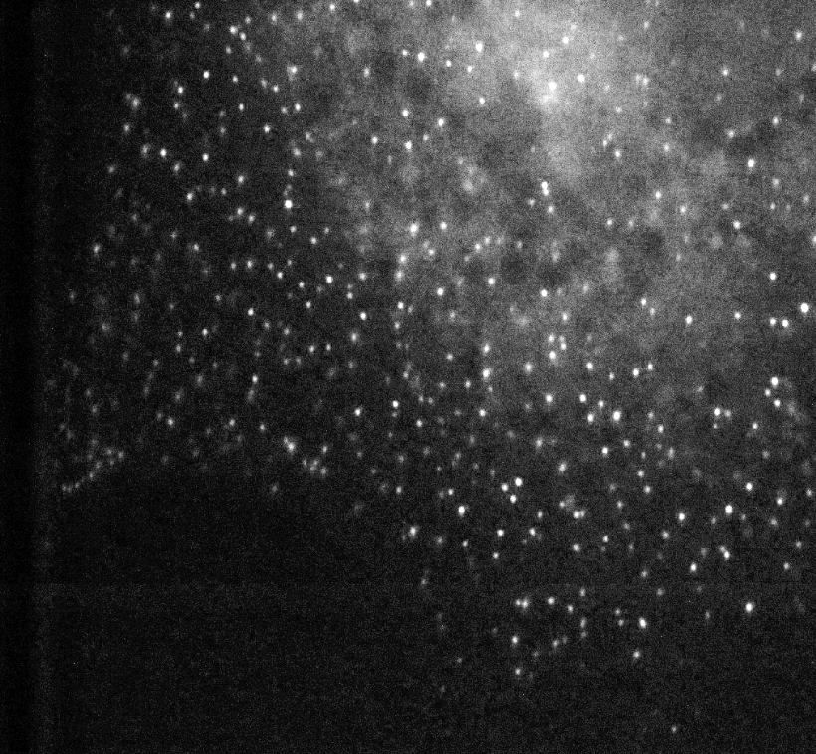
Basic adaptation mechanisms involving the cytoskeleton
Cytoplasmic linker protein-170 (CLIP-170) : stress sensor ?
Control
Acetylation of microtubules
Lipid overload
Architectural damages of microtubules
Expression of CLIP-170
± Relocalization of CLIP-170
MCDD
diet composed of high sucrose (40%) and fat (10%)
without methionine and choline
Factors for hepatic mitochondrial β-oxidation and synthesis of very low-density lipoprotein.
Develop steatohepatitis, necroinflammation, and fibrosis similar to human NASH
HFD : high fat diet
Lipid overload

Slide 37
Consequences of stress on hepatocytes
Alteration of mitochondria dynamics
Control
Lipid overload
DRP-1-dependent fragmentation
Expression of DRP-1 in Kupffer cells
Necrosis
Respiration (mitochondria)
Mitophagy induced by CCCP
Programmed necroptosis signaling pathway ?
DRP-1 biomarker ?
HMGB-1 and its PTMs ? Marher ?

Slide 38
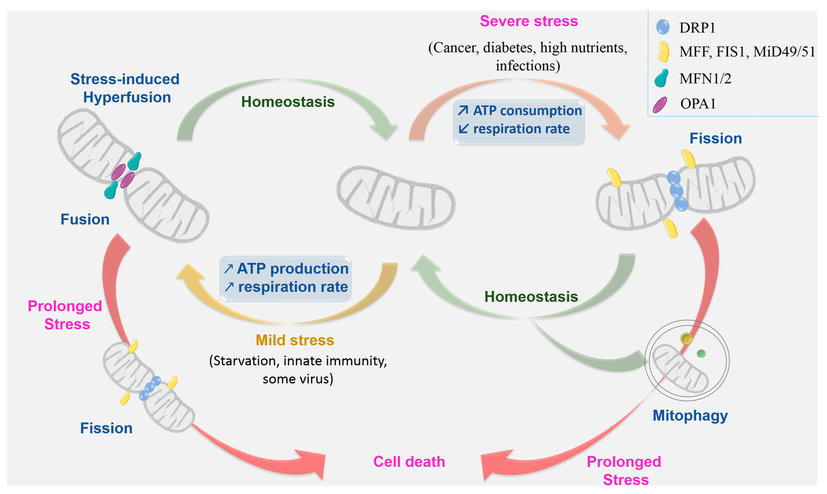
mitochondria dynamics in basal and stressful conditions
Zemirli et al, IJMS, 2018

Slide 39
Microtubule
Imaging
Septin
Growing microtubule- binding proteins functions
diseases
Single molecule 3D microscope
dSTORM-SIM ModLoc 8 nm
Sept9i1
tubulin
PI4P
lumen
Golgi integrity
With Team 1
PNAS 2019
Philos Trans A Math Phys Eng Sci. 2022
iScience, 2019
Review J Cell Biol 2019
Nature photonics 2021
Nature, Ongoing
Septin assembly domain, Golgi
Tubulin capping copN / microtubule nucleation
PNAS 2019
Spina bifida, CLIP-115 mutation
Nature, Ongoing

Slide 40
Mitochondria
Environmental stresses
HeLa
MTX methoxychlor : pesticide
Bisphenol A, BPA : plastic
4-nonylphenol NP : emulsifiant
Contaminant Seine
Ctrl
mitochondria
stress 1h
fragmentation
Viable cell 24h
Cytotoxic 24h
Mitochondrial fragmentation as early biomarker of cytotoxicity
Chemosphere 2019

Slide 41
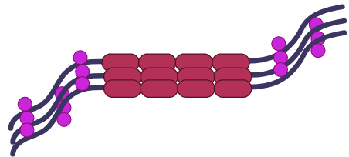
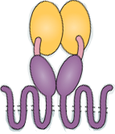
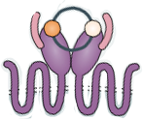
Infection
Autophagy
Drp1
Organelle damage mediated-autophagy
Bacterial stress (Salmonella) Endolysosomal single membrane,
New clinical targets to modulate immunity, immunotherapy
V-ATPase
H+ pump
lysosome
autophagosome
recruits ATG16L1
Autophagy 2021
Autophagy 2021
Cancer Cell 2022
J Immunother Cancer 2022
H⁺
J Cell Biol 2022
Viral stress (EBV) & innate immunity escape
Review Autophagy 2021
autophagy
Autophagy non canonical CASM
Drp1
BHRF1 Fragmentation+ mitophagy
Sting
Early actor of canonical autophagy
Autophagy 2021
J Cell Biol 2022
Proteotoxic neuronal stress
Tau
secreted
,
Anti-melanoma immunity, CD4-T cells, STING signaling
Lysosome clustering
INF immuno-therapy to increase
chemotherapy
mimic infection
Autophagy 2021
Lung cancer
Mitophagy to increase chemo-immunotherapy CD8
MEKi, optineurin
J Immunother Cancer 2022
Cancer Cell 2022
Review Autophagy 2021

Slide 42
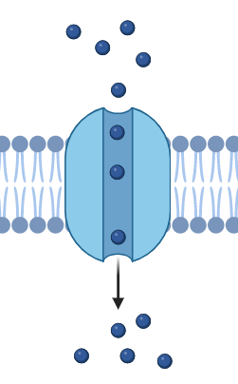
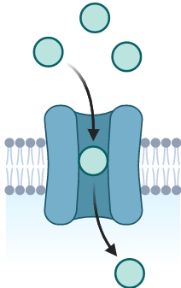
Extracellular matrix (ECM)
Chondroitin sulfate
ECM
S
S
S
S
sulfation
Hum Mut 2021
Brain 2022
Nat Commun 2018
Bone and brain chondrodysplasia, SLC35B2 PAPS transporter Golgi, proteoglycan sulphation
Platelet dysfunction XMEN disease, MAGT1 Mg²⁺ transporter, N-glycosylation
bikunin
Brain 2022
PAPS Golgi
transferrin
J Thromb Haemost 2023
Platelet aging sialylation senescence
= Heamatologica 2018
Skeletal dysplasia, SLC10A7 Ca²⁺ transporter plasma mb, GAG, (O,) N-glycosylation
Ca2+ PM
Nat Commun 2018
SSR4 translocon connective tissue
= Hum Mut 2021

Slide 43
Carrier mutations & Golgi stress
Carrier mutations & Golgi stress : molecular actors
Transferrin Bikunin ApoC-III
Altered glycosylations & Golgi homeostasis
Mn²⁺ galactose treatment
V-ATPase
G6PT
H⁺
TMEM165
Transaminases⁺
coagulopathies
Mn²⁺
metabolic
H⁺
RE + ectopic
metabolic
ionic
pH
fibroblast
Cholestasis
steatosis
fibrosis
cirrhosis
Clin Chim Acta 2021
J Inherit Metab Dis 2020
Am J Hum Genet 2021
Transl Res 2024
Biosensors for liver Golgi stress
News The conversation 2024
Mn2+ high 0,1-0,5mM
Low 56nM
Therapy 1μM
First, Last, Corresponding
Mol Gen Metab. 2018
Clin Chim Acta 2021
Coagulopathy / liver dysfunction, SLC37A4 Glc-6P transporter ER, N, O, GAG-glycosylation (ectopic) (biological liver disease transaminase coagulation factor)
Bikunin,, apo C-III, transferrin
Clin Chim Acta 2021
Am J Hum Genet 2021
Skeletal/ liver dysfunction Coagulopathy hepatomegaty biological liver disease TMEM165 Mn2+ transporter Golgi, N, O, GAG-glycosylation Mn²⁺ D-galactose treatment Girl
H⁺
Cholera toxin B CTB FITC
pH Golgi
Bikunin, apoC-III
J Inherit Metab Dis 2020
Transl Res 2024
News The conversation 2024
Neuro/ liver dysfunction fibrosis, cirrhosis autophagy, Coagulopathy biological liver disease V-ATPase H+ pump Golgi, COG4
O-glycosylation
ApoC-III versus transferrin
Mol Gen Metab. 2018
Clin Chim Acta 2021

