Slide 1



Vascular targeting of nanomedicines
Simona MURA
Institut Galien Paris-Saclay
UMR CNRS 8612
28 novembre 2024

Slide 2
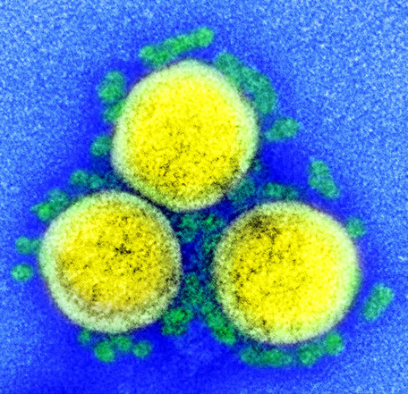
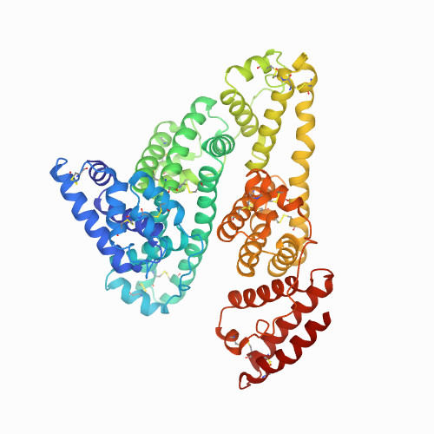
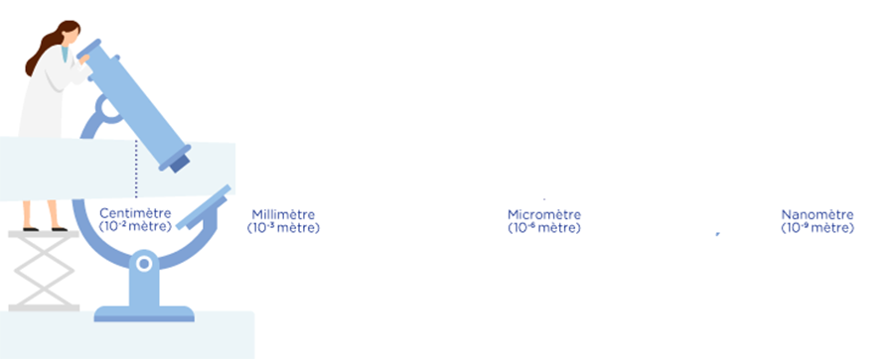
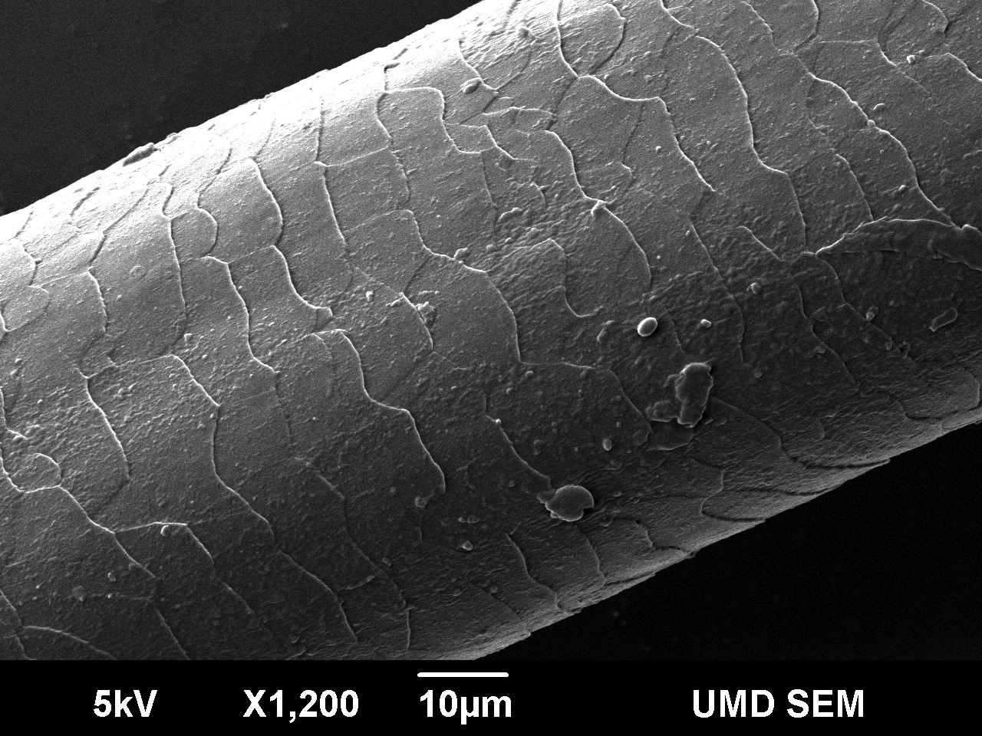
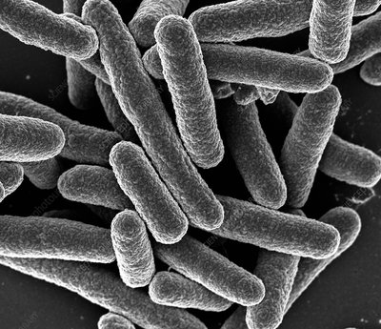
The scale of objects
Sand
100 μm - 5 mm
Red blood cells
7 µm
Virus
20 -400 nm
Protein
10 -20 nm
Molecule
< 10 nm
1000 nm
100 nm
1 nm
Millimeter
(10⁻ ³ meter)
Micrometer
(10⁻⁶ meter)
Nanometer
(10⁻⁹ meter)
Hair
10 μm
Bacteria
500 nm –10 μm
2
2

Slide 3
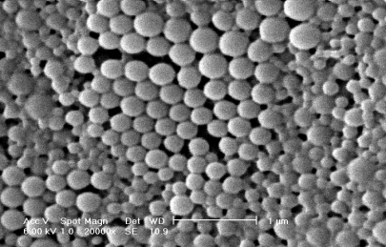
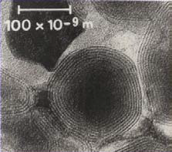
The scale of objects
Sand
100 μm - 5 mm
Red blood cells
7 µm
Virus
20 -400 nm
Protein
10 -20 nm
Molecule
< 10 nm
1000 nm
100 nm
1 nm
Millimeter
(10⁻ ³ meter)
Micrometer
(10⁻⁶ meter)
Nanometer
(10⁻⁹ meter)
Hair
10 μm
Bacteria
500 nm –10 μm
Polymer nanoparticle
Liposomes
3
3

Slide 4
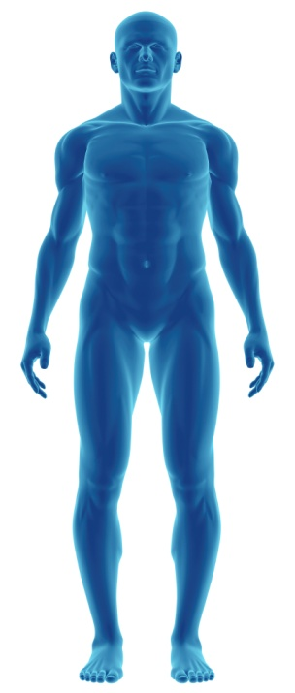
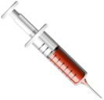

The magic bullet
Make the fate of a drug dependent from a carrier
Nanomedicines
Traditional chemotherapy
Ligand
Free drug
PEG
Imaging
Nanoparticle
100 nm
Distribution
Alternative Distribution
Size
Pka
Lipophilicity
Binding to plasma proteins
Biotransformations
Vector size
Lipophilicity
Stability
Cytotropism
4

Slide 5

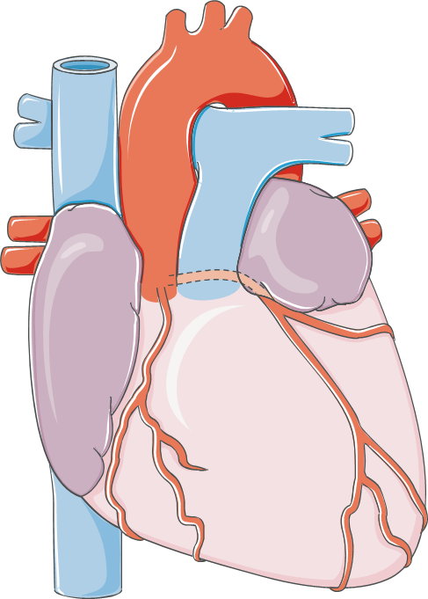
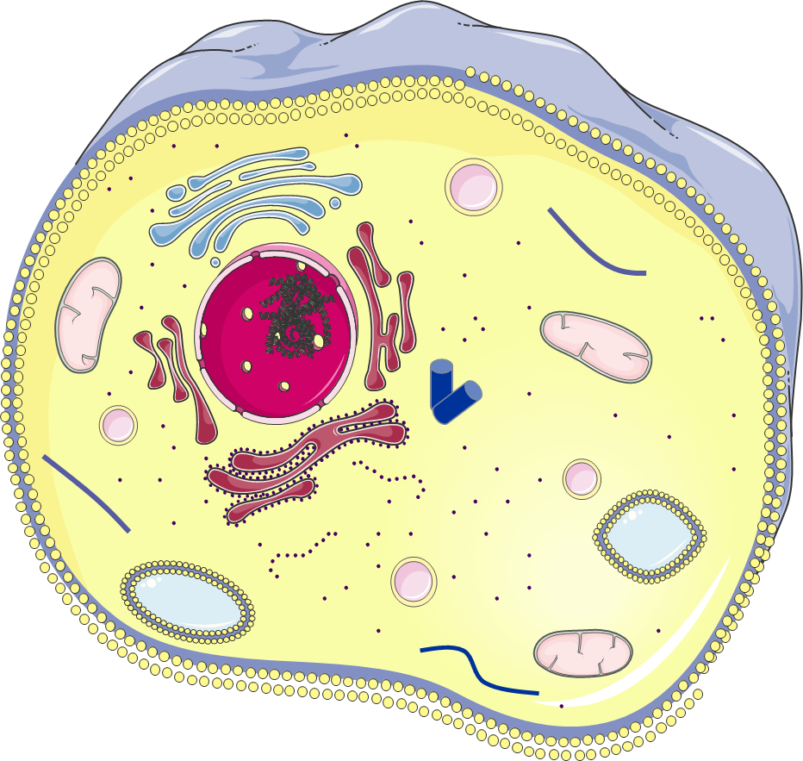

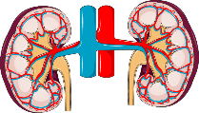
Optimization of drug pharmacokinetics and biodistribution
D
Distribution
Tissues
Cells
M
Metabolization
Liver
E
Elimination
Kidneys
Gall bladder
5
Adapted from Howard et al., ACS Nano 2014, 8 (5), 4100-4132

Slide 6
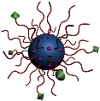

Optimization of drug pharmacokinetics and biodistribution
D
Distribution
Tissues
Cells
M
Metabolization
Liver
E
Elimination
Kidneys
Gall bladder
6
Adapted from Howard et al., ACS Nano 2014, 8 (5), 4100-4132

Slide 7
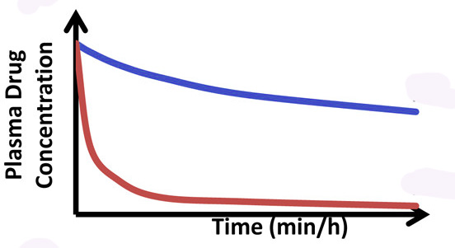
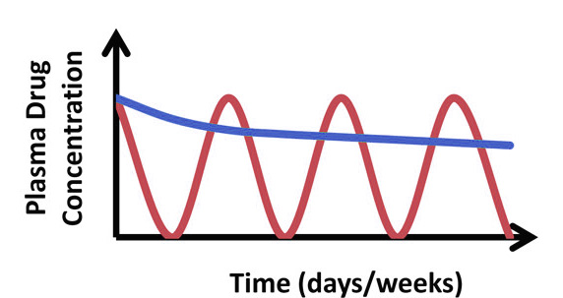
Optimization of drug pharmacokinetics and biodistribution
D
Distribution
Tissues
Cells
M
Metabolization
Liver
E
Elimination
Kidneys
Gall bladder
7
Adapted from Howard et al., ACS Nano 2014, 8 (5), 4100-4132

Slide 8
The magic bullet
Make the fate of a drug dependent from a carrier
Free drug
Nanoparticle
Traditional chemotherapy
Instability/metabolization
Limited intracellular accumulation
Lack of cell/tissue specificity
Induction of resistance phenomena
Nanomedicines
Protection from degradation
Increase intracellular penetration
Cell/tissue targeting
Overcome resistance
8

Slide 9
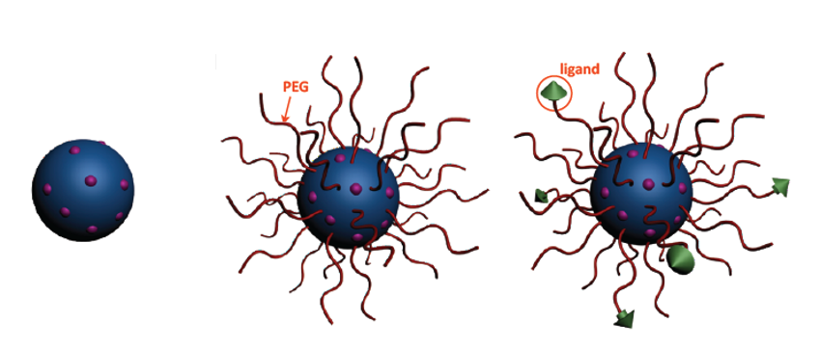
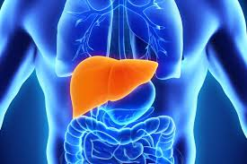
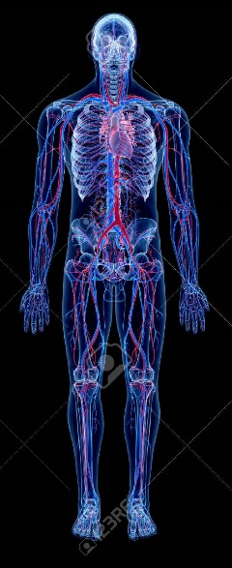
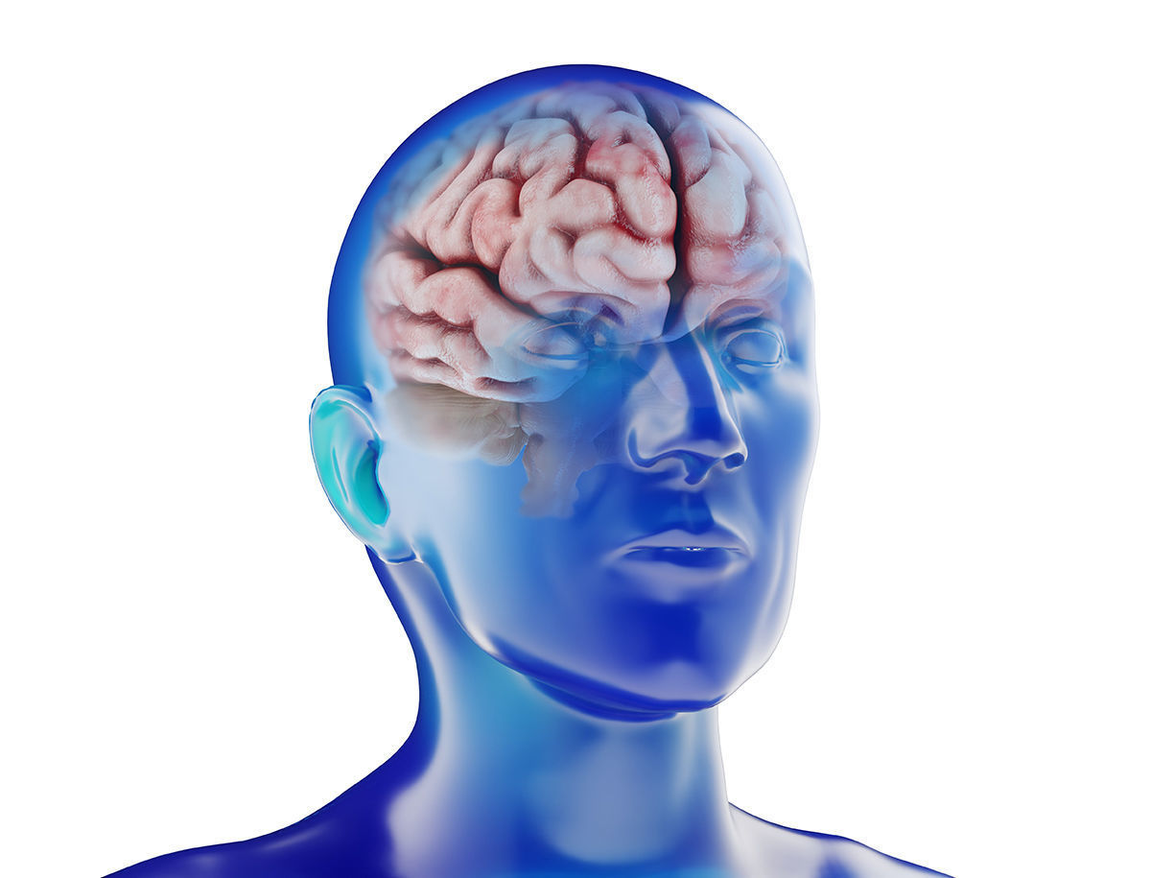
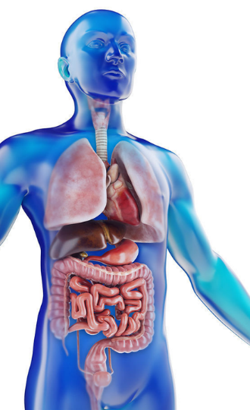
Different generations of nanomedicines
Drug
1st generation
2nd generation
3rd generation
Stealth/Long circulating
Stealth/Long circulating
Surface functionalized
9

Slide 10
Different generations of nanomedicines
Drug
1st generation
2nd generation
3rd generation
Stealth/Long circulating
Stealth/Long circulating
Surface functionalized
10

Slide 11




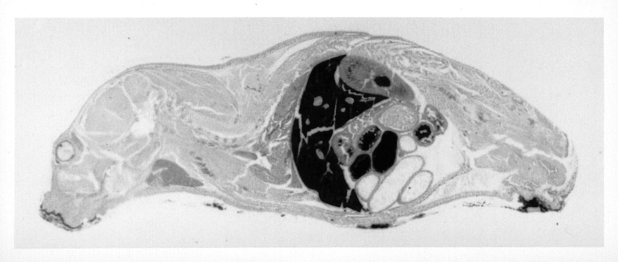
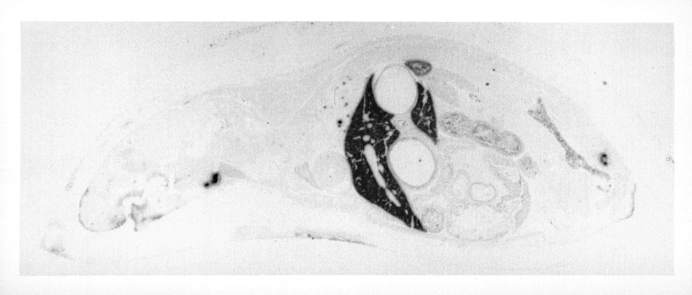

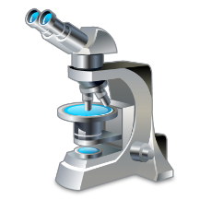
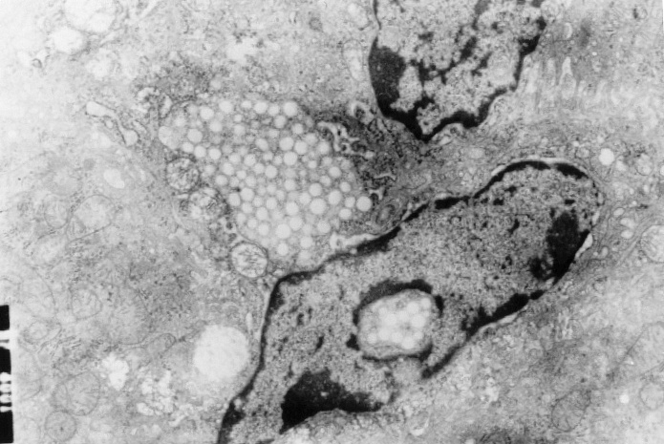
1st generation
Macrophage uptake and liver accumulation
Opsonization
Endothelium
Plasma proteins
Macrophages
Kidneys
Spleen
Internalization
Liver
Nanoparticle uptake
by Kupffer cells
Rapid removal from the circulation
11

Slide 12
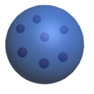
In vivo fate
Interactions in the biological medium_the protein corona
Hydrogen bonds
Electrostatic interactions
Hydrophobic interactions
Acid-base interactions
Hydration/solvation forces
Steric hindrance
Electrostatic repulsion

Slide 13
Different generations of nanomedicines
Drug
1st generation
2nd generation
3rd generation
Stealth/Long circulating
Stealth/Long circulating
Surface functionalized
13

Slide 14
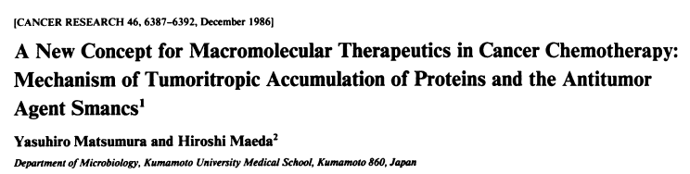
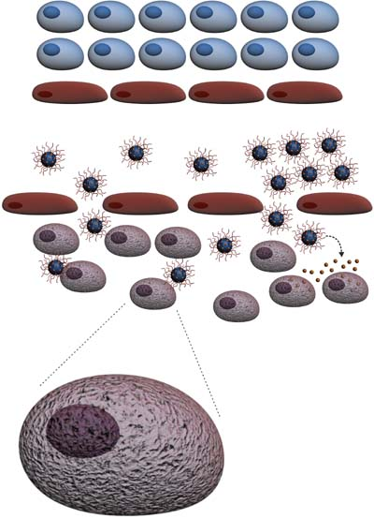
2nd generation: long circulating
The enhanced permeability and retention effect (EPR)
Enhanced permeability
Stimulation of the blood vessel production
Important vascularization (blood supply)
Wide fenestrations, abnormal architectures
Enhanced retention
Inefficient lymphatic drainage
Accumulation of nanoparticles in
tumor and inflammed tissues
14

Slide 15
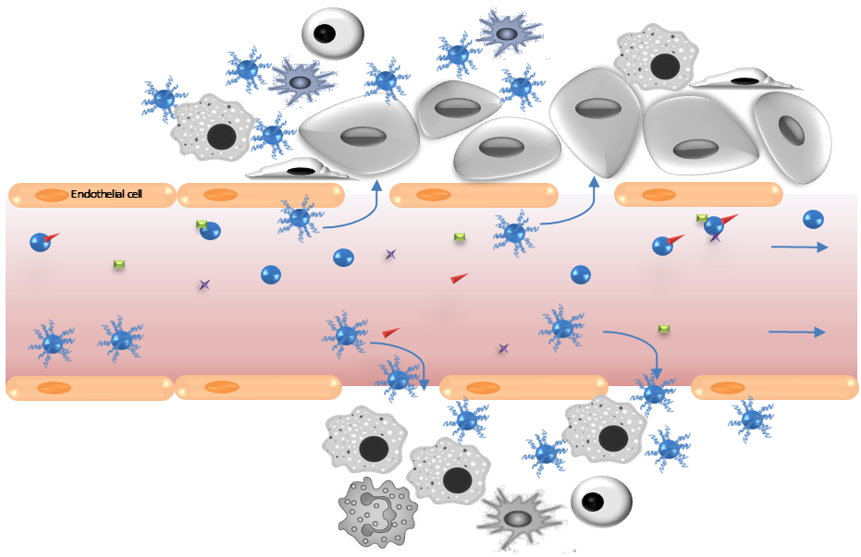
2nd generation: long circulating
The enhanced permeability and retention effect (EPR)
Tumor
Non stealth NPs
Opsonization
Prolonged blood circulation
Stealth NPs
Inflammation
15

Slide 16
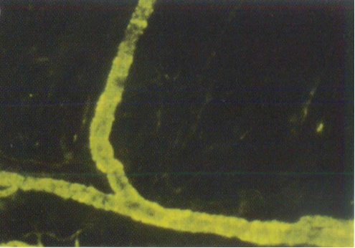
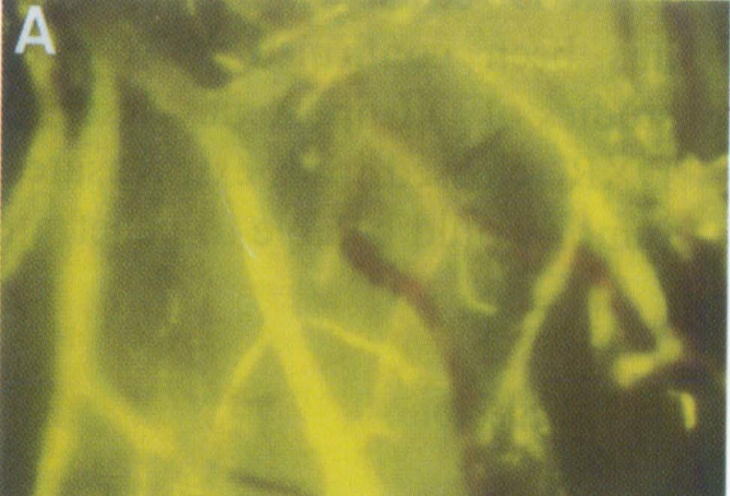
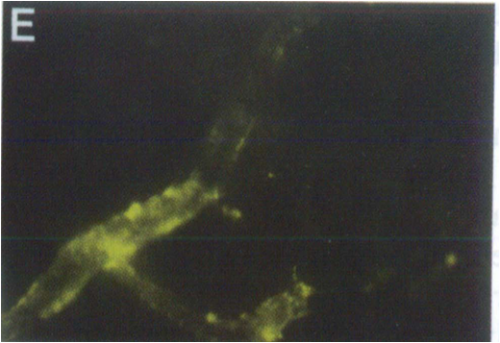
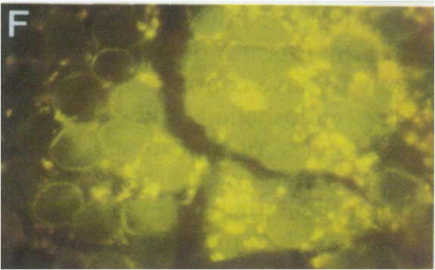
2nd generation: long circulating
Healthy tissue
Tumor tissue
@24h
@ 30’
@ 48h
@ 24h
16
S. Unezaki et al., International Journal of Pharmaceutics 1996, 144, 11
S. Unezaki et al., International Journal of Pharmaceutics 1996, 144, 11

Slide 17
Different generations of nanomedicines
Drug
1st generation
2nd generation
3rd generation
Stealth/Long circulating
Stealth/Long circulating
Surface functionalized
17

Slide 18
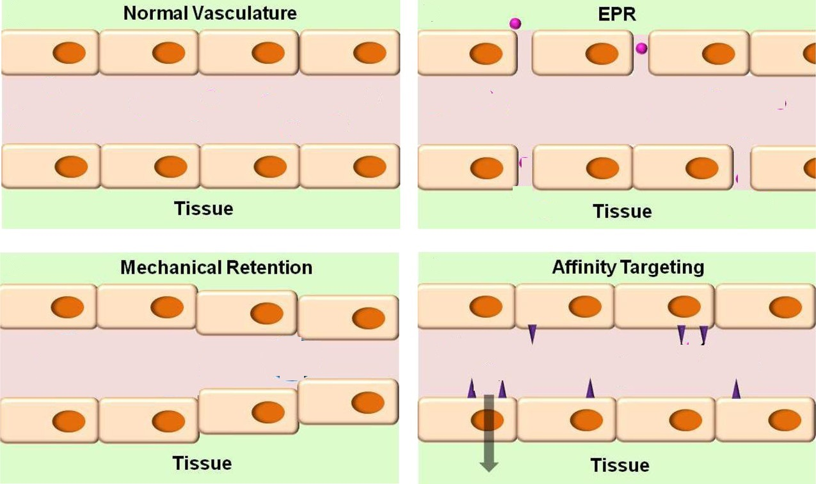
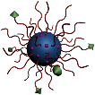


Nanocarrier Behavior in the Circulation
diameter 10–50 μm
18
Adapted from Howard et al., ACS Nano 2014, 8 (5), 4100-4132

Slide 19
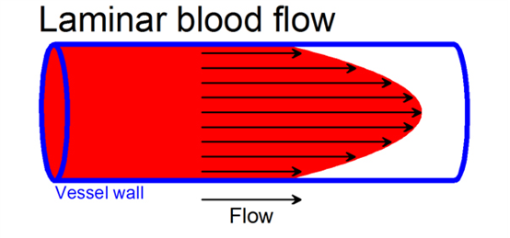
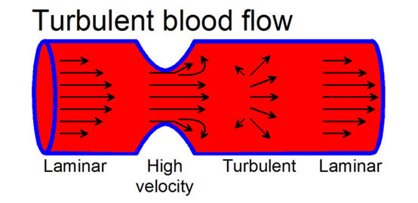
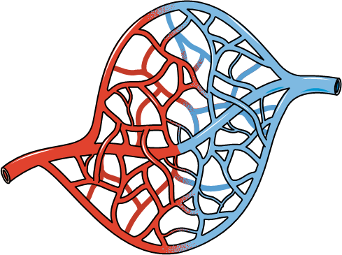
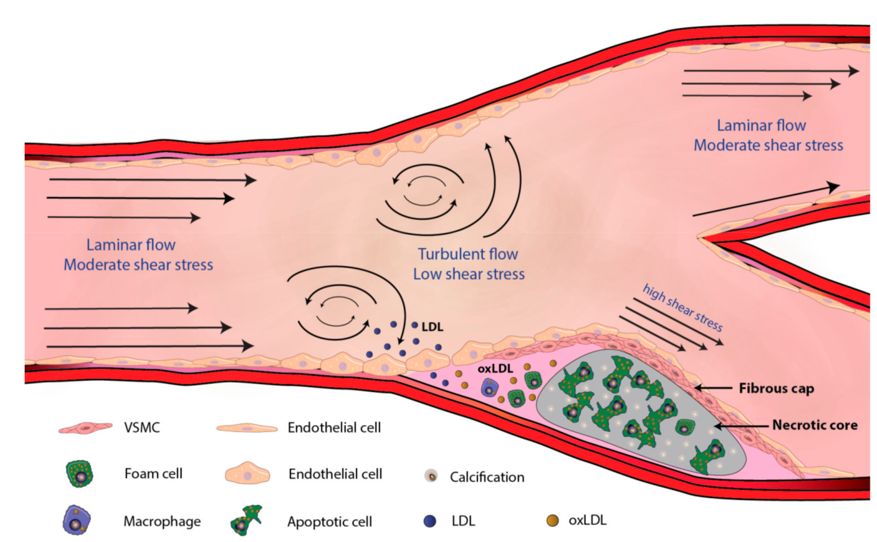
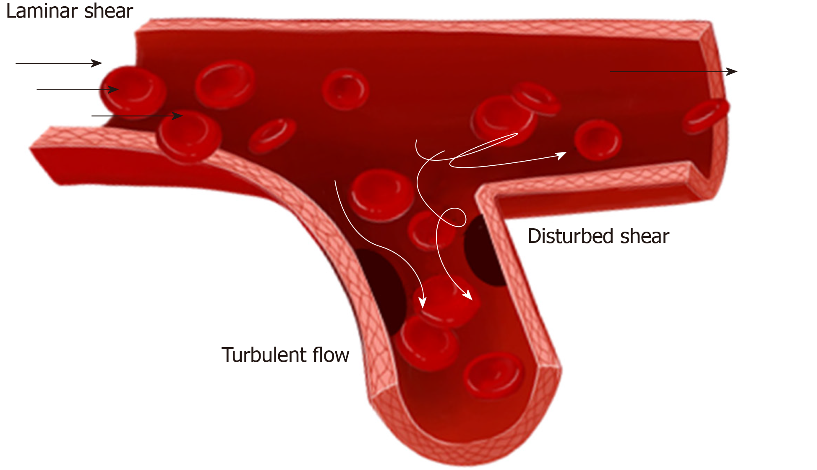
Nanocarrier Behavior in the Circulation
Microvasculature
Physiological
Pathological
Preferable target for endothelial nanomedicine
Extended luminal surface area
Micrometer-scale vessel caliber
Low flow rate
19
Tian GE et al., World J Stem Cells 2019; 11(12): 1104-1114 ; Jebari-Benslaiman S et al., Int. J. Mol. Sci. 2022, 23(6), 3346

Slide 20
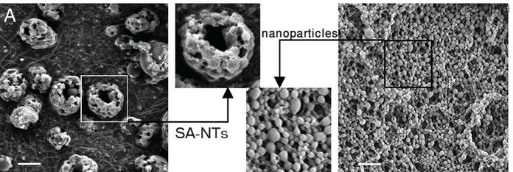
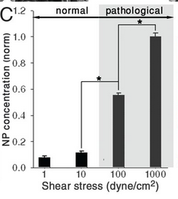
Shear-activated nanotherapeutics
Nanoparticle release
2 µm
Microparticles
Nanoparticles
High local shear stress
Stenotic and thrombosed vessels > 1000 dyne/m²
Normal vessel 70 dyne/cm²
Korin N et al., Science 2012, 337, 738– 742
20

Slide 21
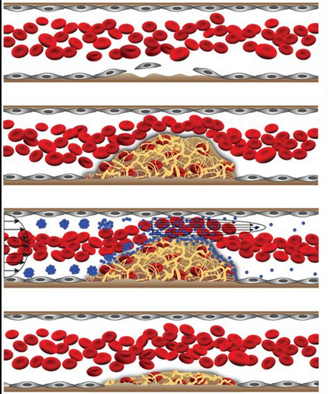
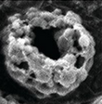
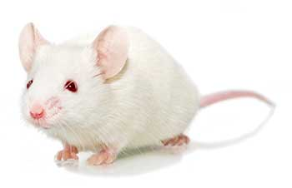
Shear-activated nanotherapeutics
Containing fluorescent NPs
Coated with tissue plasminogen activator (tPA)
(~5 × 10⁵ tPA molecules/micro-aggregate)
Arterial thrombus model
Direct exposure of the vessel wall to ferric chloride
Korin N et al., Science 2012, 337, 738– 742
21

Slide 22
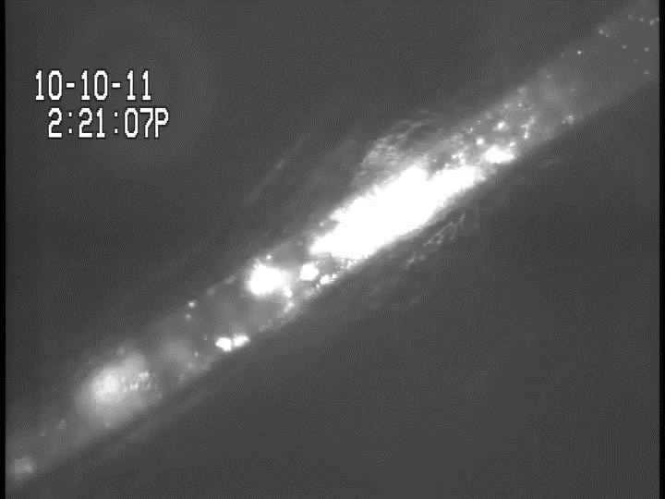
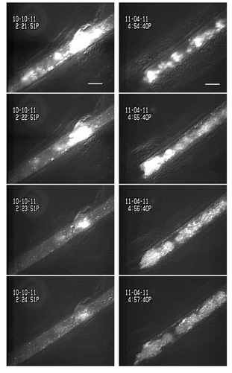
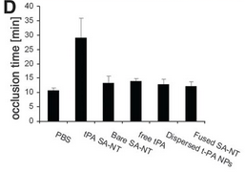
Shear-activated nanotherapeutics
SA-NTs
PBS
Fluorescently labeled platelets
Time to full vascular occlusion in FeCl-injured vessels
Korin N et al., Science 2012, 337, 738– 742
22

Slide 23
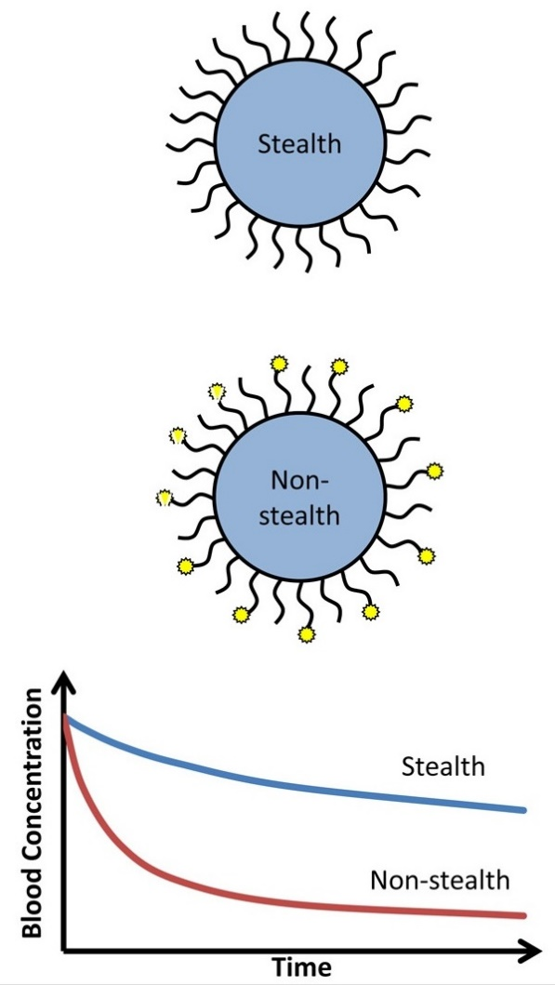
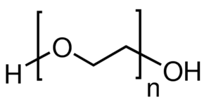
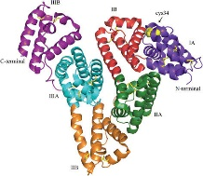

Nanocarrier Behavior in the Circulation
Prolonged circulation versus targeting
Poly(ethylene glycol)
Hydration Layer
Hydrophilic polymer
23
Adapted from Howard et al., ACS Nano 2014, 8 (5), 4100-4132

Slide 24

Nanocarrier Behavior in the Circulation
Prolonged circulation versus targeting
Poly(ethylene glycol)
Hydration Layer
Hydrophilic polymer
Ligand conjugation via PEG alleviates the masking effect.
24
Adapted from Howard et al., ACS Nano 2014, 8 (5), 4100-4132

Slide 25


Nanocarrier Behavior in the Circulation
Carrier geometry
flat face
Uptake is modulated by the axis of particle binding to cell surface
rounded end
Uncomplete internalization of disk-shaped particles contacting on their flat face
Prolonged circulation of elongated objects
25
Adapted from Howard et al., ACS Nano 2014, 8 (5), 4100-4132

Slide 26

Geometry_elongated nanoparticles
Loop & train structure
100 nm
Extended by the blood flow along streamlines
26
Maksimenko A et al., PNAS 2014, 111, E217

Slide 27




Geometry_elongated nanoparticles
Loop & train structure
100 nm
Extended by the blood flow along streamlines
Pharmacokinetics and biodistribution
27
Maksimenko A et al., PNAS 2014, 111, E217

Slide 28




Geometry_Long-circulating filomicelles
Filomicelles are self-assembled from di-block copolymers:
yellow/green: hydrophobic polymer
orange/blue : hydrophilic polymer
in vivo circulation for up to one week
28
Geng Y et al., Nat Nanotechnol 2007, 2, 249– 255

Slide 29



Geometry_Long-circulating filomicelles
Static conditions
Under flow, 25mm/s
Activated macrophages_24 h incubation
5 mm
Phagocytosis of filomicelles is a strong function of filomicelles lenght
Small micelles and vesicles are captured
Long filomicelles flow past the cells
29
Geng Y et al., Nat Nanotechnol 2007, 2, 249– 255

Slide 30


Geometry_Long-circulating filomicelles
In vivo antitumor efficacy (murine lung cancer model)
Apoptosis
Tumor Volume
30
Geng Y et al., Nat Nanotechnol 2007, 2, 249– 255

Slide 31

Carrier Binding to Endothelium
Endothelial Determinants for Nanocarrier Targeting
anchors a carrier to endothelium in the area of interest
provides desirable subcellular addressing
not adversely affected by carrier binding
Adequate level of expression/localization
31
Adapted from Howard et al., ACS Nano 2014, 8 (5), 4100-4132

Slide 32



Carrier Binding to Endothelium
Endothelial Determinants for Nanocarrier Targeting
anchors a carrier to endothelium in the area of interest
provides desirable subcellular addressing
not adversely affected by carrier binding
Adequate level of expression/localization
ICAM-1
Epithelial cells
Muscle cells
Fibroblasts
Endothelial cells
Comparable levels of expression
32
Adapted from Howard et al., ACS Nano 2014, 8 (5), 4100-4132

Slide 33

Carrier Binding to Endothelium
Endothelial Determinants for Nanocarrier Targeting
anchors a carrier to endothelium in the area of interest
provides desirable subcellular addressing
not adversely affected by carrier binding
Adequate level of expression/localization
ICAM-1
Epithelial cells
Muscle cells
Fibroblasts
Endothelial cells
Comparable levels of expression
BUT
Endothelial cells only are accessible
33
Adapted from Howard et al., ACS Nano 2014, 8 (5), 4100-4132

Slide 34

Carrier Binding to Endothelium
Endothelial Determinants for Nanocarrier Targeting
anchors a carrier to endothelium in the area of interest
provides desirable subcellular addressing
not adversely affected by carrier binding
Adequate level of expression/localization
ICAM-1
Cytokine and transporter receptors
Epithelial cells
Muscle cells
Fibroblasts
Expressed on cells in blood, RES, lymphoid tissues, hepatocytes
Lack of specificity
Not suitable for endothelial delivery
Endothelial cells
Comparable levels of expression
BUT
Endothelial cells only are accessible
34
Adapted from Howard et al., ACS Nano 2014, 8 (5), 4100-4132

Slide 35

Carrier Binding to Endothelium
Endothelial Determinants for Nanocarrier Targeting
Healthy endothelium
ICAM-1
intercellular adhesion molecule
ACE
angiotensin-converting enzyme
PECAM, platelet-endothelial cell adhesion molecule
APP, membrane-bound aminopeptidase P
PV-1, plasmalemma vesicle-associated protein
35
Adapted from Howard et al., ACS Nano 2014, 8 (5), 4100-4132

Slide 36


Carrier Binding to Endothelium
Endothelial Determinants for Nanocarrier Targeting
Healthy endothelium
ICAM-1
intercellular adhesion molecule
ACE
angiotensin-converting enzyme
PECAM, platelet-endothelial cell adhesion molecule
APP, membrane-bound aminopeptidase P
PV-1, plasmalemma vesicle-associated protein
Pathological conditions
Ex novo synthesis/ exposure
Re-arrangement
exposure of P-selectin from intracellular storage
de novo synthesis of E-selectin and VCAM-1
V
Cell contraction
Increase cell permeability
Access to PECAM, VE-cadherin
Masking
36
Adapted from Howard et al., ACS Nano 2014, 8 (5), 4100-4132

Slide 37

Carrier Binding to Endothelium
Endothelial Cell Adhesion Molecules (CAMs)
Constitutive
PECAM
ICAM-1
Inducible
VCAM-1
E-selectin
P-selectin
Exposed on the surface of activated endothelial cells
Facilitate the rolling phase of the vascular adhesion of leukocytes
Mobilization in sites of inflammation
37
Adapted from Howard et al., ACS Nano 2014, 8 (5), 4100-4132

Slide 38

Carrier Binding to Endothelium
Endothelial Cell Adhesion Molecules (CAMs)
Constitutive
PECAM
ICAM-1
Inducible
VCAM-1
E-selectin
P-selectin
Exposed on the surface of activated endothelial cells
Facilitate the rolling phase of the vascular adhesion of leukocytes
Mobilization in sites of inflammation
Therapeutic strategy
Blockage using antibodies
Drug delivery using nanoscale systems
38
Adapted from Howard et al., ACS Nano 2014, 8 (5), 4100-4132

Slide 39



Cell adhesion molecule (CAM)–mediated endocytosis
ICAM-1-mediated targeting
Up-regulated and functionally involved in vascular inflammation, oxidant stress, and thrombosis.
ICAM-1 recycling in endothelial cells
ICAM-1 reappears on HUVEC surface after internalization of anti-ICAM nanocarriers
Pathway for recurrent drug delivery permitting sustained effects
39
Muro S et al., Blood 2005, 105 (2), 650

Slide 40



ICAM-1-mediated targeting
Recurrent targeting of anti-ICAM nanocarriers to endothelium
in vitro
TNF-α–activated cells
2 subsequent doses of nanocarriers
40
Muro S et al., Blood 2005, 105 (2), 650

Slide 41







ICAM-1-mediated targeting
anti-ICAM-1 immunoliposomes
TNF-α induced ICAM-1 expression and cell binding
50 µm
t= 0
t= 1 h
t= 24 h
2 hours @ 4°C
Hua S et al., J. Liposome Res. 2011, 21, 95– 105
41

Slide 42







ICAM-1-mediated targeting
anti-ICAM-1 immunoliposomes
TNF-α induced ICAM-1 expression and cell binding
50 µm
t= 0
t= 1 h
t= 24 h
2 hours @ 4°C
Hua S et al., J. Liposome Res. 2011, 21, 95– 105
anti-ICAM-1 peptide-functionalized nanoparticles
Fibrinogen
Fibrinogen γ chain
ICAM-1 binding
42
Garnacho C et al., J. Pharmacol. Exp. Ther. 2012, 340, 638– 647

Slide 43


Carrier Binding to Endothelium
Polymer nanoparticles
Role of size and hemodynamics
flow chamber model
IL-1β-activated endothelial cells
30–50% hematocrit
Sialyl lewis a: P-selectin targeting ligand
43
Charoenphol P et al., Biomaterials 2010, 31, 1392–1402

Slide 44

Carrier Binding to Endothelium
Polymer nanoparticles
Role of size and hemodynamics
flow chamber model
IL-1β-activated endothelial cells
30–50% hematocrit
Sialyl lewis a: P-selectin targeting ligand
Effect of diameter
From 100 nm to 10 µm
Wall shear rate 200 s⁻¹
Particle binding (#/mm²)
0.1
0.5
2
5
10
Particle size (µm)
44
Charoenphol P et al., Biomaterials 2010, 31, 1392–1402

Slide 45

Carrier Binding to Endothelium
Polymer nanoparticles
Role of size and hemodynamics
flow chamber model
IL-1β-activated endothelial cells
30–50% hematocrit
Sialyl lewis a: P-selectin targeting ligand
Effect of diameter
From 100 nm to 10 µm
Effect of wall shear rate
From 200 to 1500 s⁻¹
Wall shear rate 200 s⁻¹
Particle binding (#/mm²)
Particle binding (#/mm²)
0.1
0.5
2
5
10
0.5
2
5
10
Particle size (µm)
Particle size (µm)
Existence of a critical wall shear rate
Disruptive hemodynamic forces
45
Charoenphol P et al., Biomaterials 2010, 31, 1392–1402

Slide 46

Carrier Binding to Endothelium
Polymer nanoparticles
Role of size and hemodynamics
flow chamber model
IL-1β-activated endothelial cells
30–50% hematocrit
Sialyl lewis a: P-selectin targeting ligand
Effect of diameter
From 100 nm to 10 µm
Effect of wall shear rate
From 200 to 1500 s⁻¹
Effect of ligand number
From 800 to 2000/µm²
Wall shear rate 200 s⁻¹
Particle binding (#/mm²)
Particle binding (#/mm²)
0.1
0.5
2
5
10
0.5
2
5
10
Particle size (µm)
Particle size (µm)
Existence of a critical wall shear rate
Disruptive hemodynamic forces
Larger particles need more target molecules to anchor on the cell
46
Charoenphol P et al., Biomaterials 2010, 31, 1392–1402

Slide 47



Carrier Binding to Endothelium
Role of hematocrit
$Dispersion factor$: $\frac{radial velocity (toward the vessel wall)}{longitudinal velocity (toward the vessel end)}$
Intermediate range of hematocrit could be better for allowing maximum dispersion of nanoparticles towards the edge of the vessel
47
Fullstone G et al., Sci Rep 2015, 5, 10649

Slide 48



Carrier Binding to Endothelium
Geometry and Plasticity: forces acting on particles under flow
Polystyrene spheres
1 µm
elongated particles stretched from the 200 nm spheres
48
Adapted from Howard et al., ACS Nano 2014, 8 (5), 4100-4132 and Kolhar P et al., Proc Natl Acad Sci U S A. 2013, 10 (26), 10753-8
Notes:
Specifically, polystyrene nanorods (aspect ratio ∼3) functionalized with anti-ICAM showed upward of 3-fold attachment to brain endothelial cells in static cell culture. (271) Higher association of rod-shaped particles with endothelial cells was also exhibited in vivo as anti-ICAM coated rods exhibited ∼2-fold higher accumulation in target tissue (lungs) than that of spheres of identical volume. This was further investigated by coating nanorods and spheres with anti-transferrin-receptor monoclonal antibody. Rods exhibited almost an order of magnitude fold enhancement in attachment to brain endothelium

Slide 49
Carrier Binding to Endothelium
Geometry and Plasticity: forces acting on particles under flow
Polystyrene spheres
1 µm
elongated particles stretched from the 200 nm spheres
shape change
lateral diffusion of ligands
higher number of productive anchoring engagements
49
Adapted from Howard et al., ACS Nano 2014, 8 (5), 4100-4132 and Kolhar P et al., Proc Natl Acad Sci U S A. 2013, 10 (26), 10753-8
Notes:
Specifically, polystyrene nanorods (aspect ratio ∼3) functionalized with anti-ICAM showed upward of 3-fold attachment to brain endothelial cells in static cell culture. (271) Higher association of rod-shaped particles with endothelial cells was also exhibited in vivo as anti-ICAM coated rods exhibited ∼2-fold higher accumulation in target tissue (lungs) than that of spheres of identical volume. This was further investigated by coating nanorods and spheres with anti-transferrin-receptor monoclonal antibody. Rods exhibited almost an order of magnitude fold enhancement in attachment to brain endothelium

Slide 50





Carrier Binding to Endothelium
The Optimal Carrier Avidity and Ligand Density
A
B
C
suboptimal targeting
multiple binding firm binding
steric limitations competition
50
Adapted from Howard et al., ACS Nano 2014, 8 (5), 4100-4132

Slide 51


Carrier Binding to Endothelium
The Optimal Ligand Density
in vitro
in vivo
4100 Ab/μm²
1100 Ab/μm²
Non specific Ab
51
Calderon AJ et al., Journal of controlled release. 2011, 150, 37-44

Slide 52

Carrier Binding to Endothelium
Multiple targeting: dual functionalization
NO binding
Scarce expression in the area of interest
Equal binding
Too similar distribution
Preferential binding
Combine basal adhesion with binding to low expressed targets
52
Adapted from Howard et al., ACS Nano 2014, 8 (5), 4100-4132

Slide 53





Vascular Targeting: Perspectives
Adequate understanding of biomedical factors
Quantitative real-time tracing of both carrier and cargo
Atheroma
Blood brain barrier
Relevant models for predictive screening
Optimal nanocarrier design
Balanced combination of stealth and targeting features
53

Slide 54






Microfluidic devices
Perfusable microvascular network
Angiogenesis
Vasculogenesis
Fluidic medium channel
Fibrin gel channel
Stroma channel
(with fibroblasts)
Vasculogenesis
Angiogenesis
700 µm
Posts : paracrine interaction
Endothelial cells
50 µm
Sudong k et al., Lab on a chip 2013, 13, 1489

Slide 55







Microfluidic devices
Perfusable microvascular network
Perfusable and intact lumina
Flow-induced endothelial responses
Flow
Static
7 µm beads
F-actin
20 µm
20 µm
20 µm
70 kDa dextran
Endothelial NO synthesis
50 µm
No leakage
Intact barrier
200 µm
Sudong k et al., Lab on a chip 2013, 13, 1489

Slide 56






Microfluidic devices
Perfusable microvascular network
Optimised pore design
NO gel leakage
Vasculogenesis, Sprouting & Anastomosis
Wang X et al.,. Lab on a Chip 2016, 16,282; Sobrino A et al., Scientific reports 2016, 6, 1.

Slide 57


Microfluidic devices
Optimised pore design
NO gel leakage
Vasculogenesis & Anastomosis
Wang X et al.,. Lab on a Chip 2016, 16,282; Sobrino A et al., Scientific reports 2016, 6, 1.

Slide 58






Microfluidic devices
Perfusable microvascular network
Coculture with cancer cells: Vascularized Micro-Tumors
Drug treatment: cancer or endothelial cell targeting
100 µm
100 µm
Ctrl
FOLFOX
Suitable for the development of novel treatment with multiple targets
Stromal cells in
perivascular position
Basement membrane deposition
Wang X et al.,. Lab on a Chip 2016, 16,282; Sobrino A et al., Scientific reports 2016, 6, 1.

Slide 59




Microfluidic devices
Open top device for nanomedicine screening
Confluent HUVEC monolayer
Chip Design
Ovarian cancer cells (SKOV3) spheroids
Steady medium perfusion for culturing endothelial cells
Central region for trapping tumor spheroids
Wang HF et al., ACS Nano 2018, 12, 11600

