Slide 1


nanotechnologies pour l'administration des acides nucléiques
François Fay
Institut Galien Paris-Saclay, UMR CNRS 8612
francois.fay@universite-paris-saclay.fr

Slide 2
Conflict of interest:
These CIFRE SANOFI

Slide 3
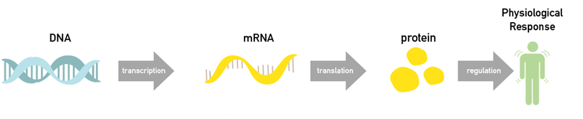
Introduction nucleic acids
Stimulus
Figure from http://www.bonac.com/global/en/nucleic/about/

Slide 4
Introduction nucleic acids
Stimulus
Figure from http://www.bonac.com/global/en/nucleic/about/

Slide 5
Introduction nucleic acids
Add DNA
Add mRNA
Remove DNA
Replace DNA
Destroy mRNA (prevent translation)
Modify mRNA (modify translation)
Figure from http://www.bonac.com/global/en/nucleic/about/

Slide 6
Introduction nucleic acids
Plasmids
Viral vectors
mRNA
CRISPR/cas9
miRNA / antimiRNA
siRNA
ASOs (antisense oligonucleotide)
Figure from http://www.bonac.com/global/en/nucleic/about/

Slide 7
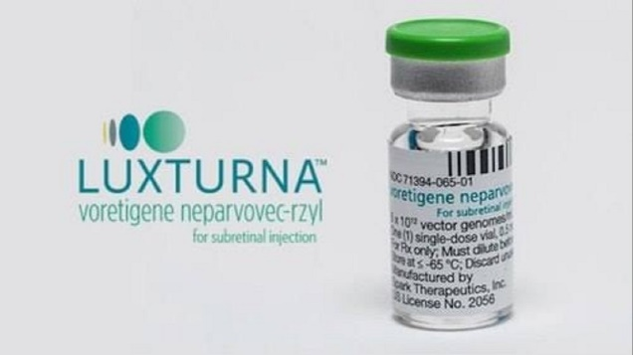
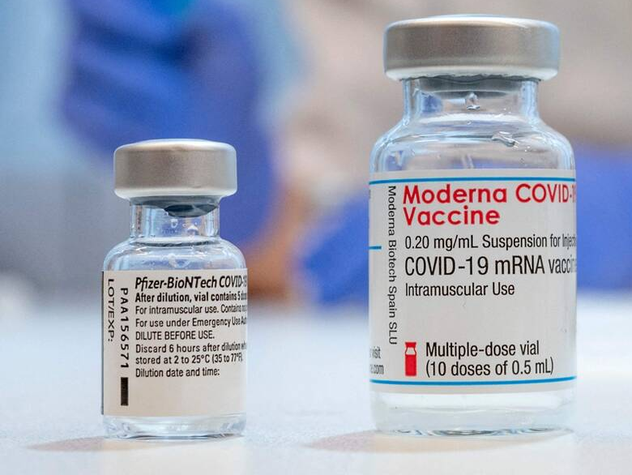
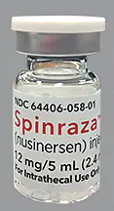
Acides nucléiques à visées thérapeutiques
2018 retinal dystrophy
2020/21 Covid vaccine
2018 transthyretin-mediated amyloidosis
2016 spinal muscular atrophy
Tiré de http://www.bonac.com/global/en/nucleic/about/

Slide 8

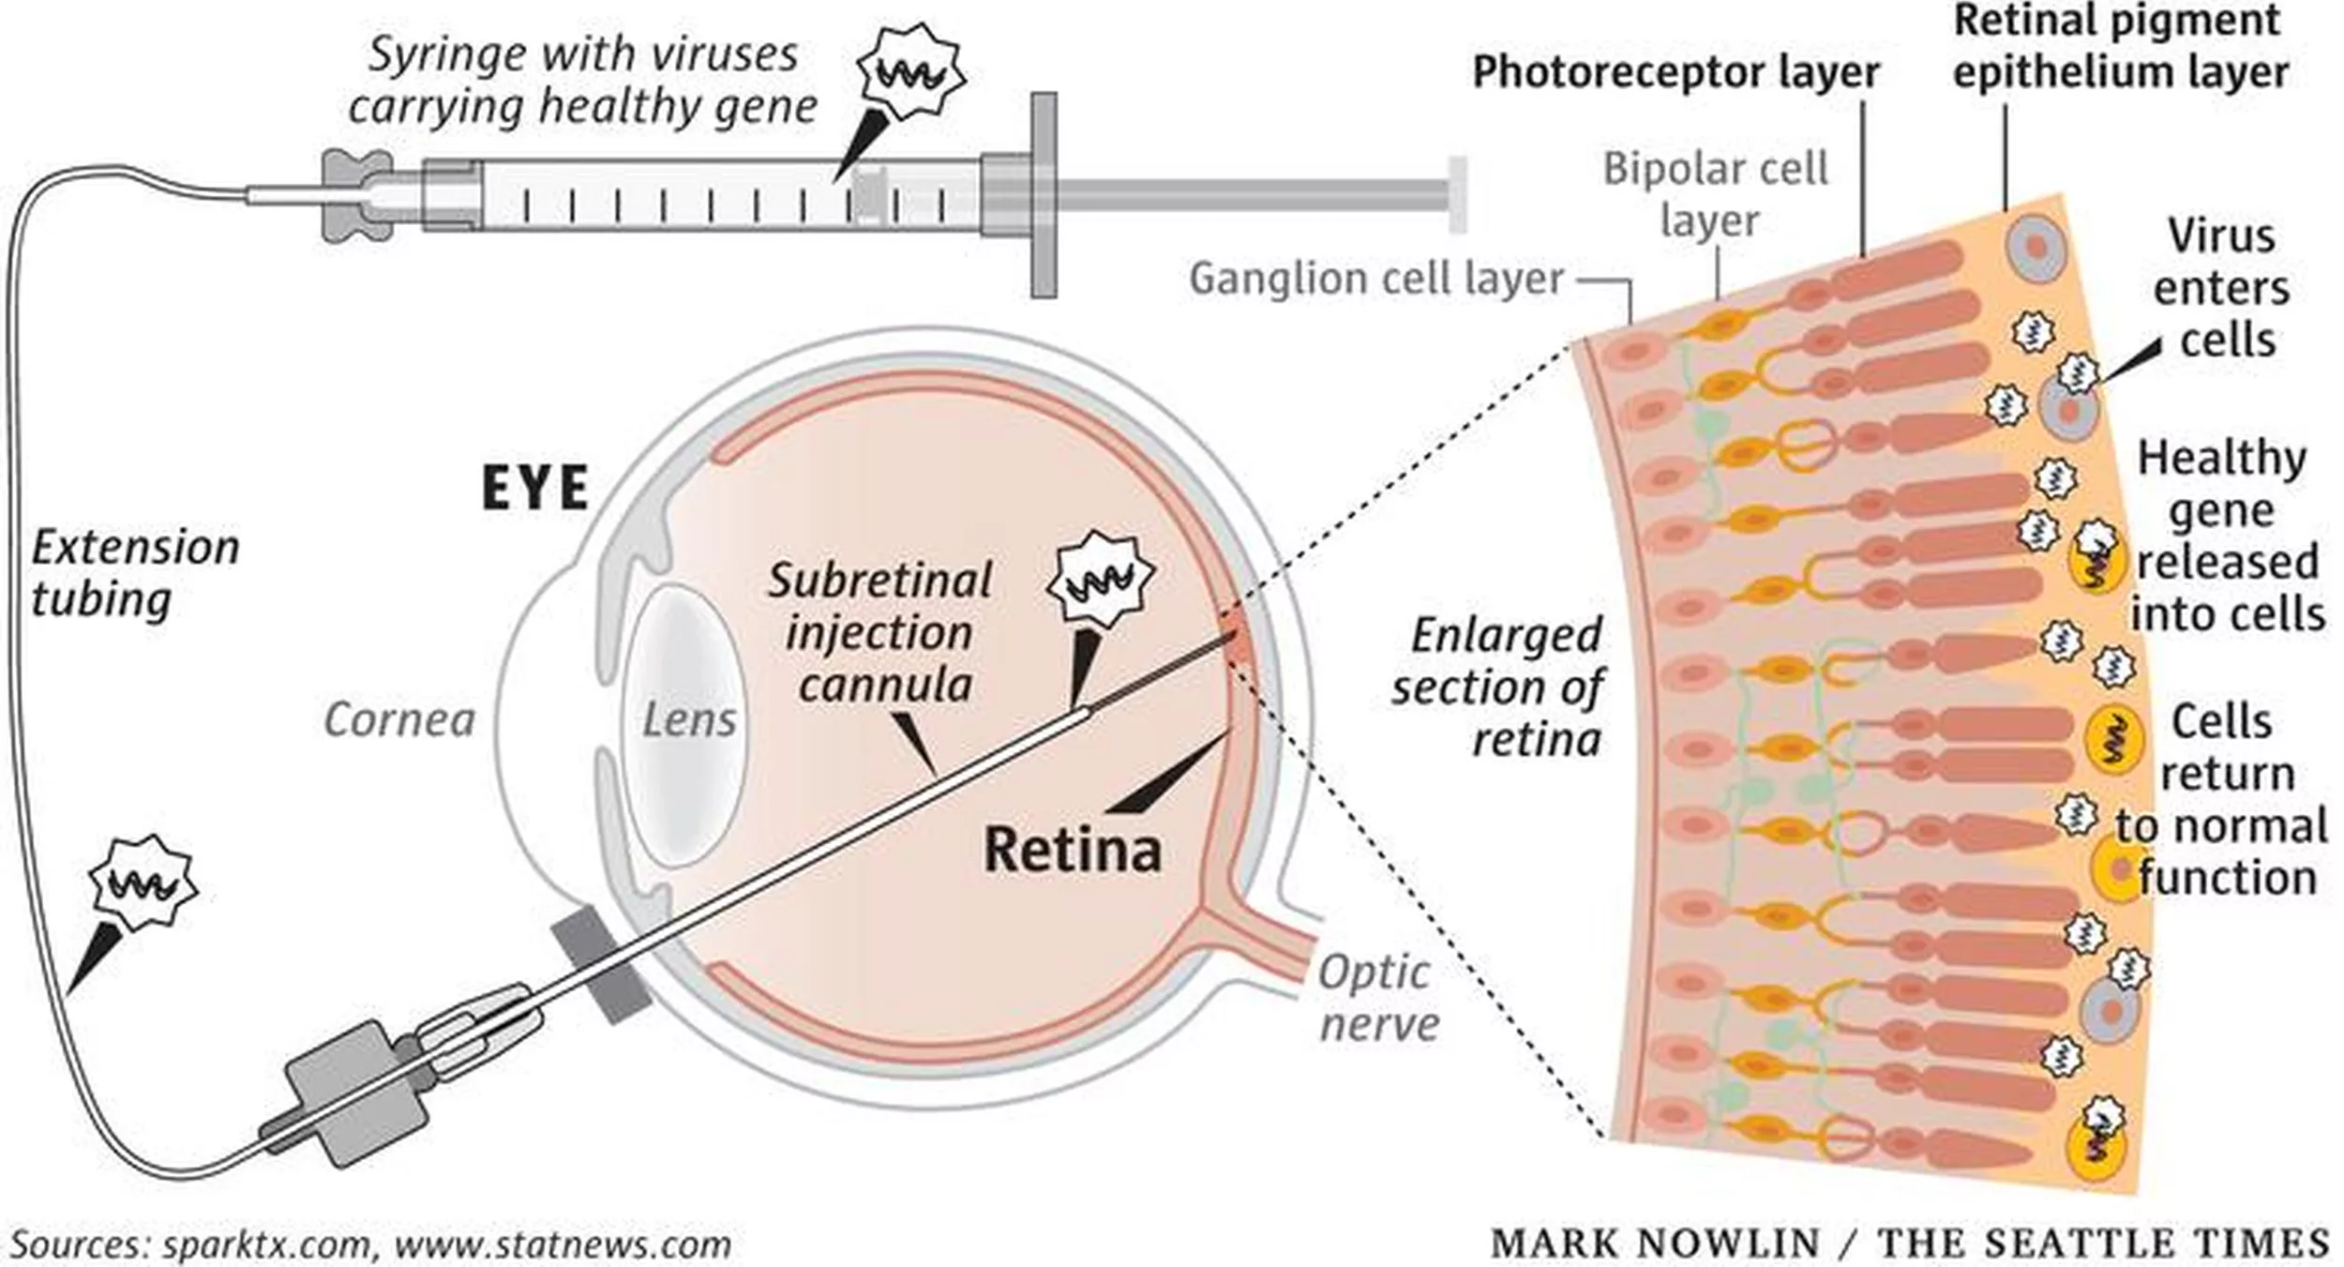
Modalities of gene therapy
Add DNA : Luxturna
FDA approval: 2017 / EMA : 2018
Treatment biallelic RPE65 mutation-associated retinal dystrophy
Adeno-associated viral vector serotype 2, containing improved human RPE65 gene.
https://www.spokesman.com

Slide 9
Acides nucléiques à visées thérapeutiques
2018 retinal dystrophy
2020/21 Covid vaccine
2018 transthyretin-mediated amyloidosis
2016 spinal muscular atrophy
Tiré de http://www.bonac.com/global/en/nucleic/about/

Slide 10
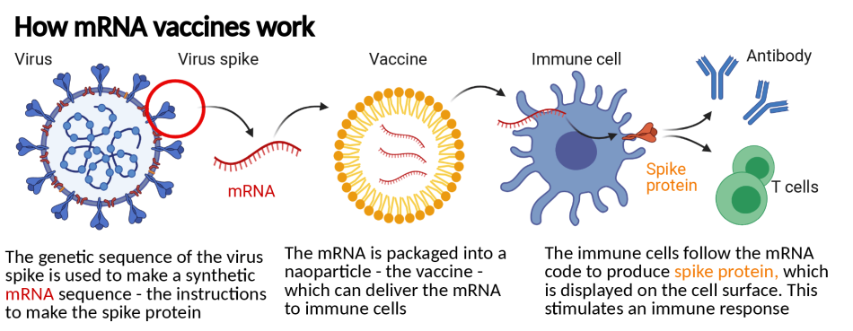
Modalities of gene therapy
Add mRNA: vaccines
https://www.benaroyaresearch.org

Slide 11
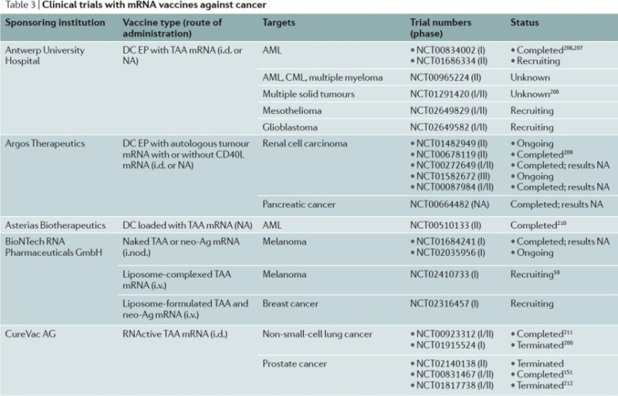
Modalities of gene therapy mRNA as vaccines cancer therapy
(As in2017)
TAA tumor-associated antigen

Slide 12
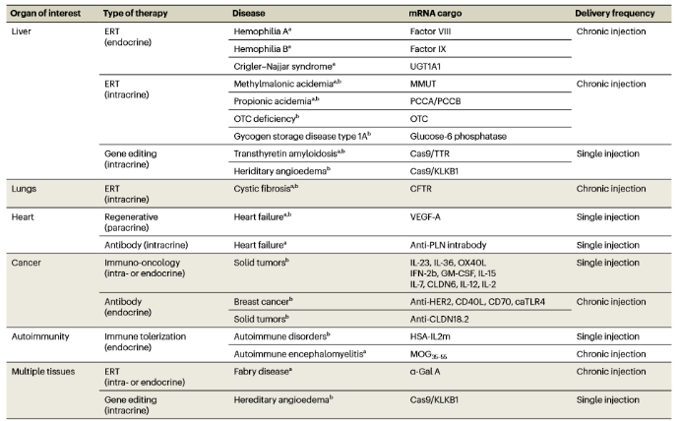
Modalities of gene therapy
non-cancer therapy
Rohner, E. Nat Biotechnol (2022). https://doi.org/10.1038/s41587-022-01491-

Slide 13
Acides nucléiques à visées thérapeutiques
2018 retinal dystrophy
2020/21 Covid vaccine
2018 transthyretin-mediated amyloidosis
2016 spinal muscular atrophy
Tiré de http://www.bonac.com/global/en/nucleic/about/

Slide 14
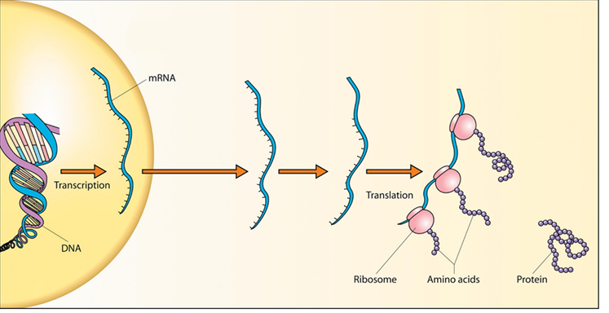
Modalities of gene therapy

Slide 15
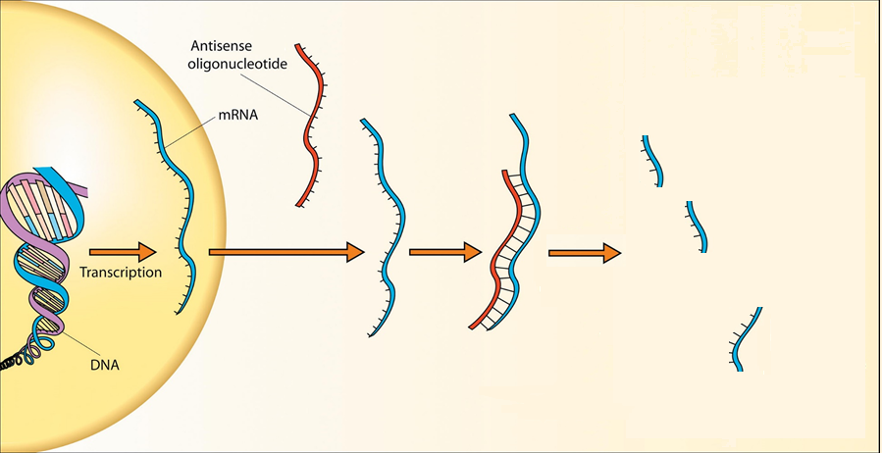

Modalities of gene therapy
blocking/destroying mRNA
MicroRNAs (miRNA)
Small interferent RNAs (siRNA)
Antisense oligonucleotides (ASO)
U
U
A
C
G
C
A
G
C
A
U
U
A
G
U
A
A
A
U
G
G
U
U
C
U
A
A
G
C
C
A
A
U
U
RNAse H
Adapted from R Robinson PLoS Biol 2(1): e28 2004

Slide 16
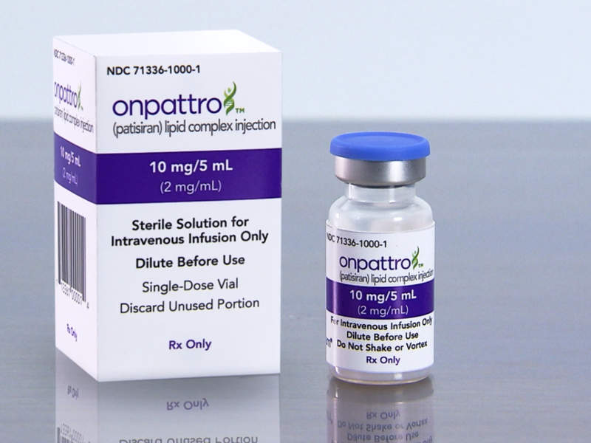
Modalities of gene therapy siRNA
Onpattro (Patisiran)
        FDA approval: 2018
        EMA approval: 2018
Lipid nanoparticles for the liver delivery of SiRNA targeted against TTR mRNA
Alnylam
Notes:
Les équipes du Professeur Adams de l'hôpital Bicêtre

Slide 17
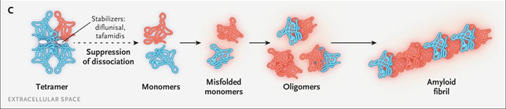
Modalities of gene therapy siRNA
Onpattro (Patisiran)
        FDA approval: 2018
        EMA approval: 2018
Lipid nanoparticles for the liver delivery of SiRNA targeted against TTR mRNA
  Transthyretin-related hereditary amyloidosis
  Rare but fatal, neurodegenerative disease.
  Mutation of the TTR gene
→ Production in the liver of misfolded monomers
→ Unstable tetramer
→ Aggregated structure including amyloid fibrils.
Alnylam
Notes:
Les équipes du Professeur Adams de l'hôpital Bicêtre

Slide 18
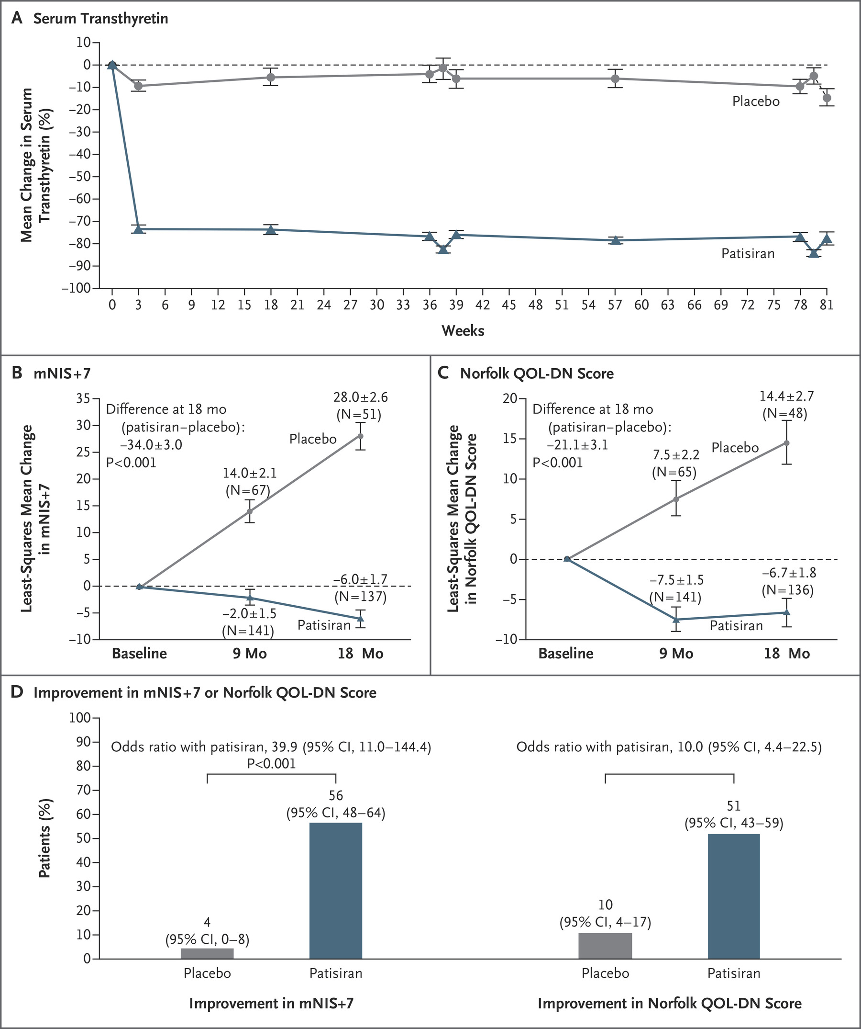
Modalities of gene therapy
Destroy mRNA: Patisiran
SiRNA targeted against TTR mRNA (both WT and mutated)
→ Less monomers → Less tetramers → Less amyloid fibrils
Adams et al N Engl J Med 2018; 379:11-21

Slide 19
Introduction nucleic acids
Plasmids
Viral vectors
mRNA
CRISPR/cas9
miRNA / antimiRNA
siRNA
ASOs (antisense oligonucleotide)
Figure from http://www.bonac.com/global/en/nucleic/about/

Slide 20
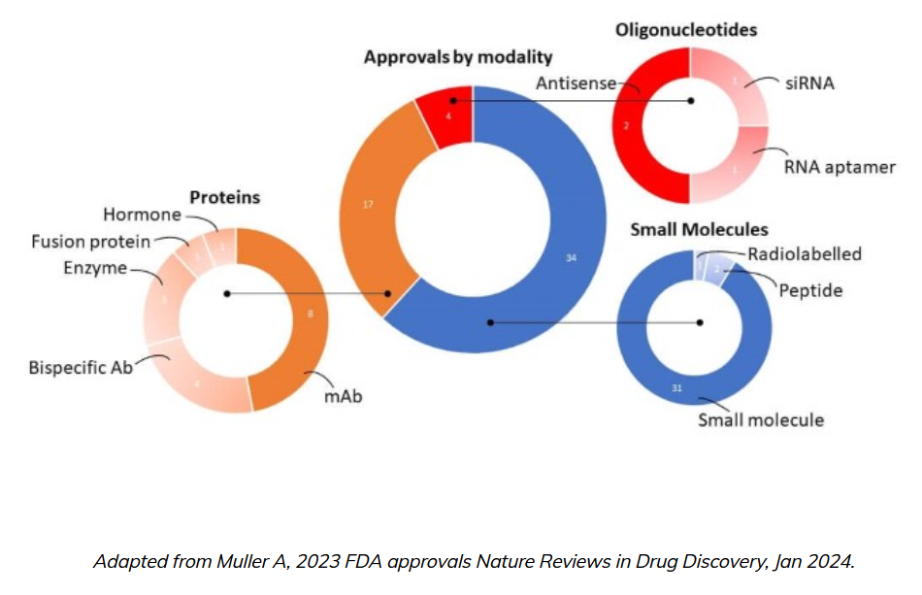
FDA approvals in 2023
www.lgcstandards.com

Slide 21
Add DNA
Add mRNA
React with protein
Remove DNA
Replace DNA
Destroy mRNA (prevent translation)
Modify mRNA (modify translation)
Natural barriers?
Figure from http://www.bonac.com/global/en/nucleic/about/

Slide 22
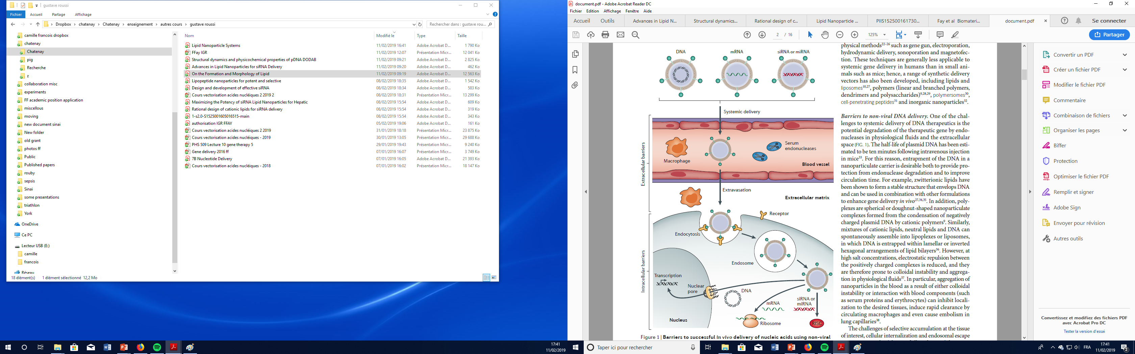
Natural barriers
Physiological barriers
Yin et al Nature Reviews Genetics 2014

Slide 23
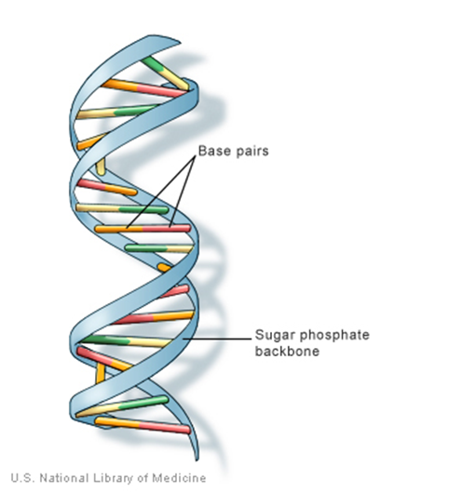
Natural barriers
DNA / RNA Biochemistry
NIH

Slide 24

Natural barriers
DNA / RNA Biochemistry
Aspirin 0,18 kda
RNA ?
Antibodies 150 kda
NIH

Slide 25
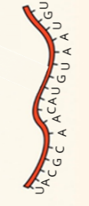
Natural barriers
DNA / RNA Biochemistry
Aspirin 0,18 kda
iRNA ∼10 kDa
Antibodies 150 kda
NIH

Slide 26
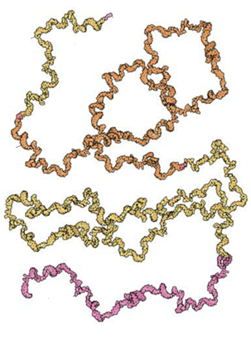
Acides nucléiques à visées thérapeutiques
Aspirine 0,18 kda
mRNA ∼400 kDa
Antibodies 150 kda
Adapted from R Robinson et al PLoS Biol 2004
Adapted from U. Elia et al ACS Nano 2021
NIH
Notes:
Half life RNA 5 min

Slide 27

Natural barriers
DNA / RNA Biochemistry
Low stability
High molecular weight
Negative charge
Hydrophilicity
NIH

Slide 28
Natural barriers
DNA / RNA Biochemistry
Low stability
High molecular weight
Negative charge
Hydrophilicity
→ Need modification and/ or vectorisation!
NIH

Slide 29
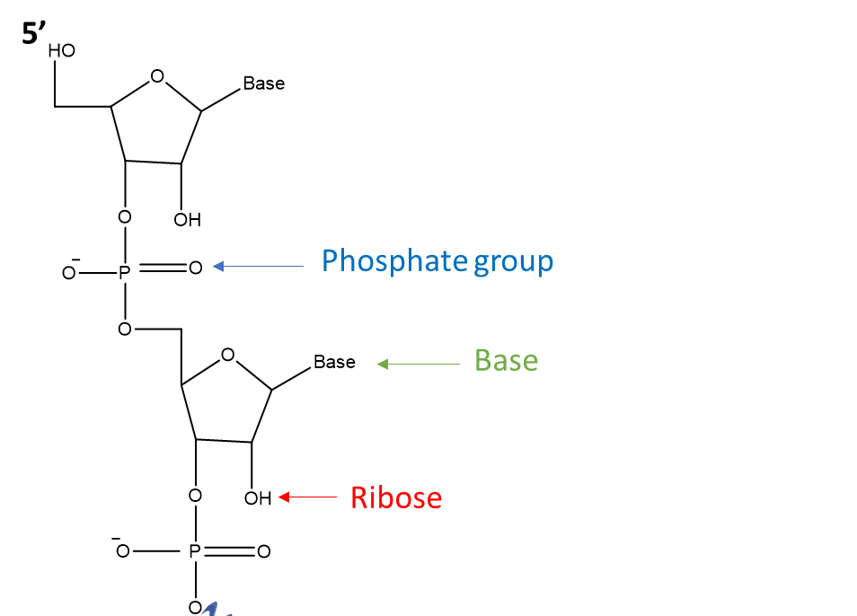
DNA / RNA Biochemistry

Slide 30
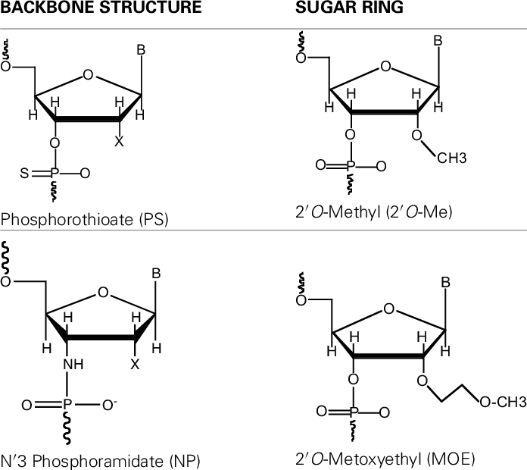
DNA / RNA Biochemistry
Duarte Moreno DOI:10.3389/fchem.2014.00087

Slide 31
Vectors

Slide 32
Viral Vectors
Viral Vectors
Strengths
High transfection efficiency
Natural tropism (ability to infect different cells)
Evolved mechanisms for endosomal escape
Natural transportation mechanism of DNA into nucleus
Weaknesses
Strong immune reactions against viral proteins prohibit multiple administrations
Possibility of chromosomal insertion and protooncogene activation
Complicated synthesis process
Limitation on gene size
Toxicity, contamination of live virus

Slide 33
Non-viral vectors
Design criteria
?
Verbeke et al Nanotoday
https://doi.org/10.1016/j.nantod.2019.100766
Yin et al Nature Reviews Genetics 2014

Slide 34
viral and non-viral vectors
Some design criteria
• Packaging of large DNA/RNA quantities
• Easy administration
• Serum stability
• Targetability to specific cell types
• Inexpensive synthesis
• Easy purification
• Robustness/stability
• Cell Internalization
• Endolysosomal escape
• Nuclear transport
• Efficient unpackaging
• Infection of non-dividing cells
• Safety
• Non-toxic
• Non-immunogenic
• Non-pathogenic

Slide 35
Non-viral vectors
Huang https://doi.org/10.3390/pharmaceutics14081586

Slide 36
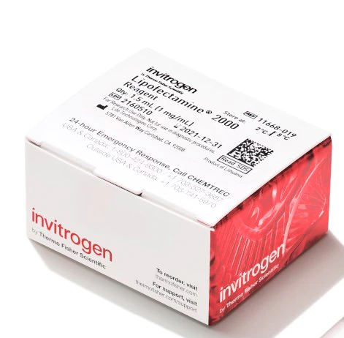
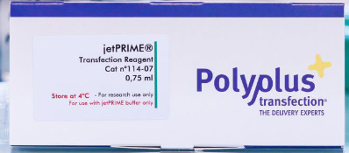
Non-viral vectors
Invitrogen / Polyplus

Slide 37
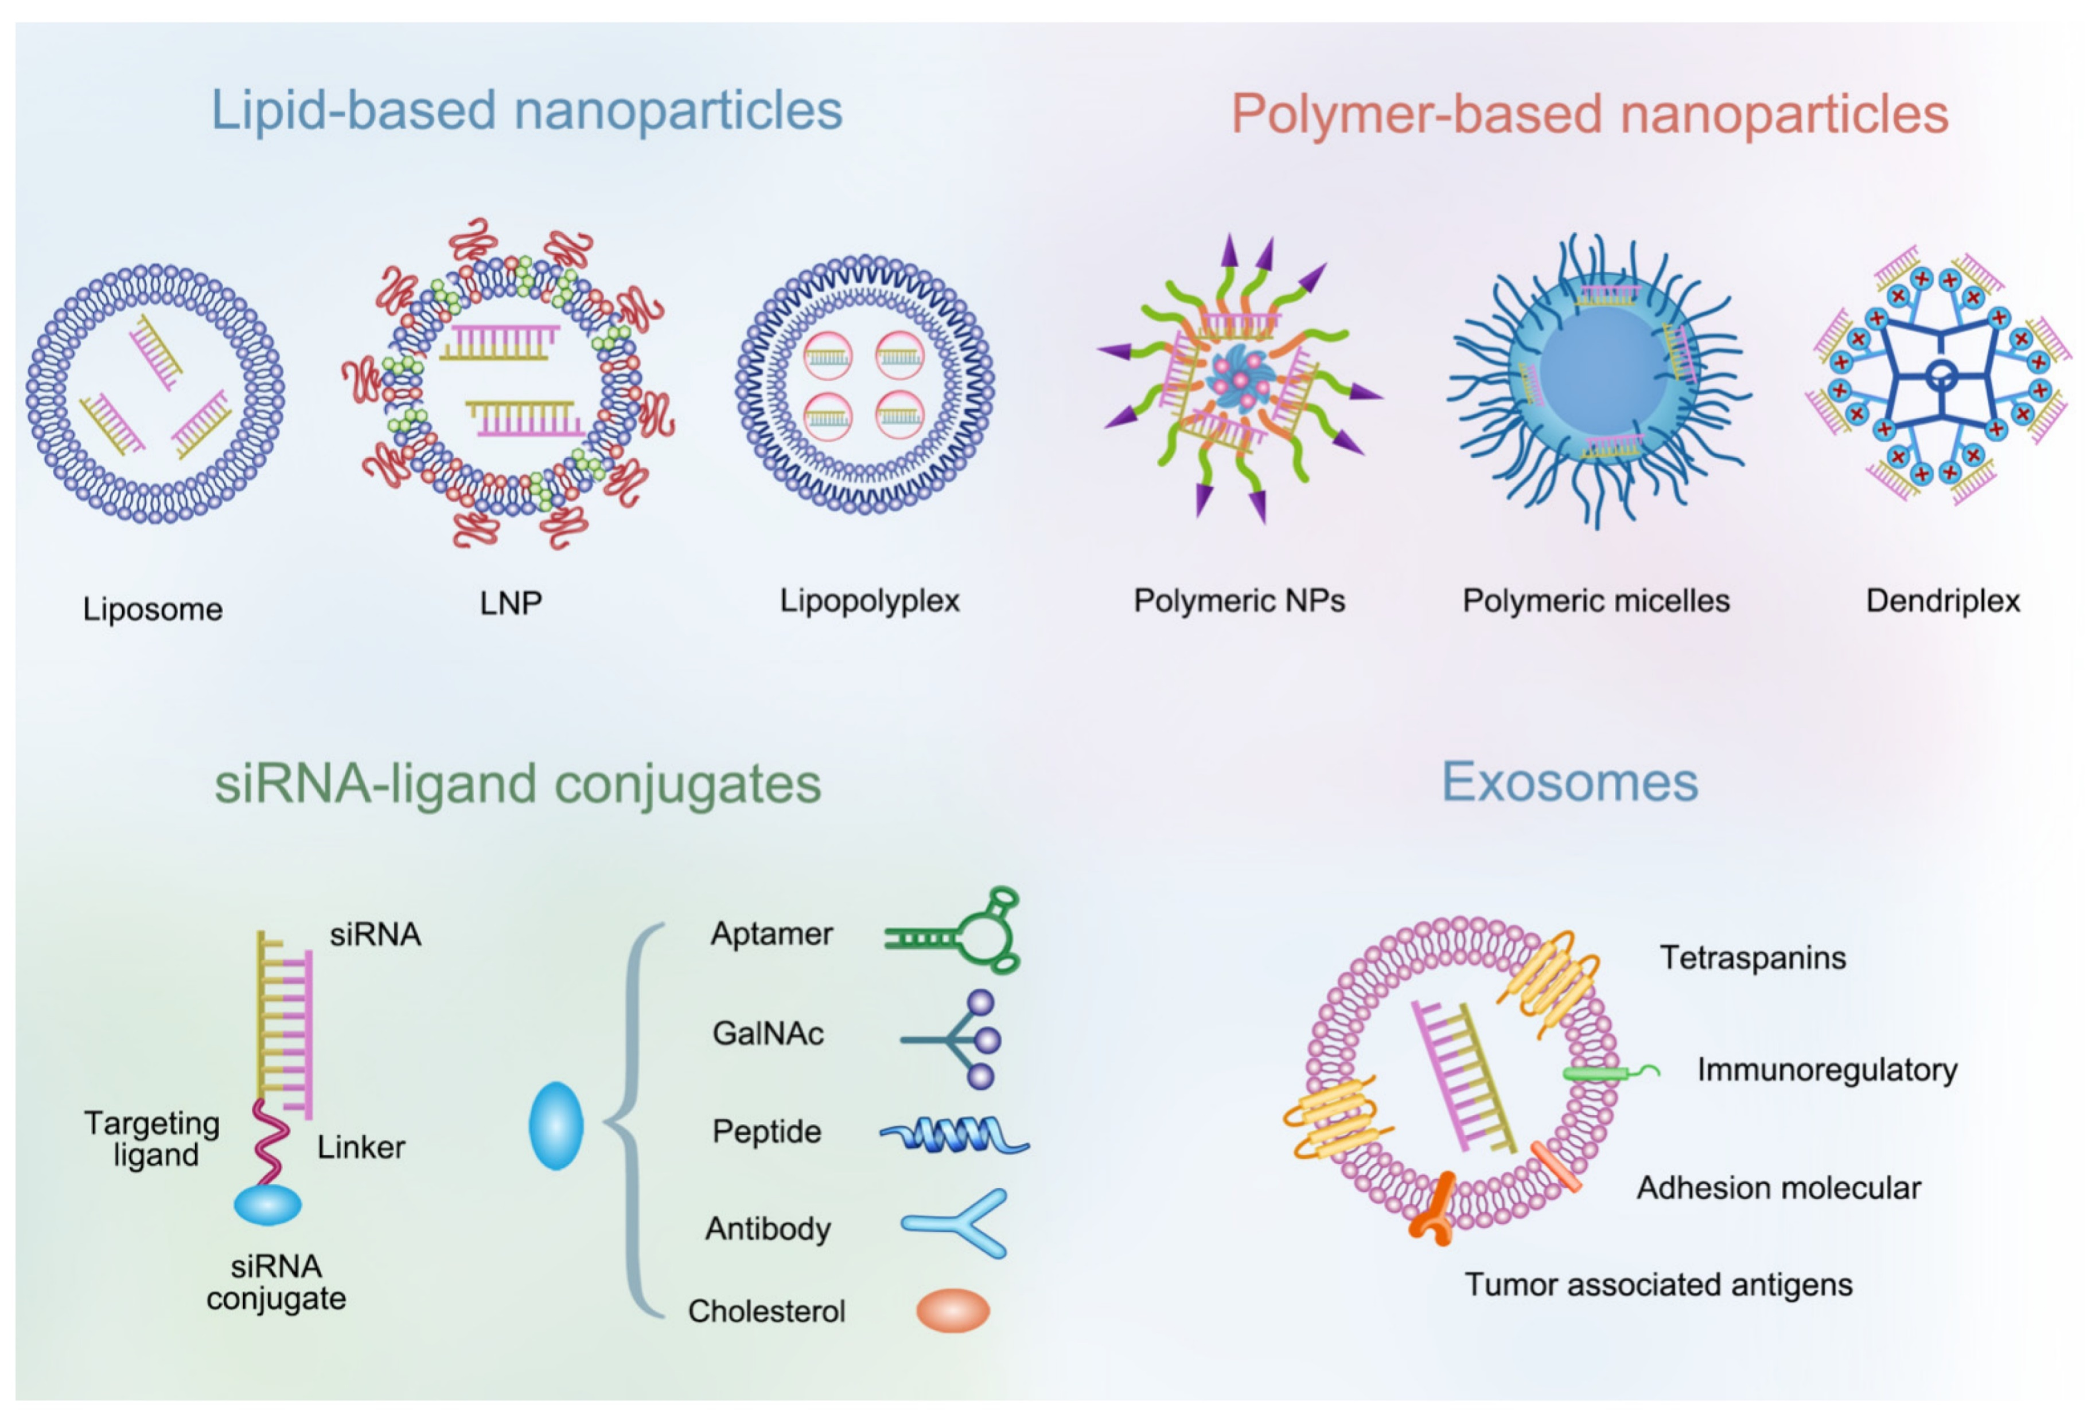
Non-viral vectors
Huang https://doi.org/10.3390/pharmaceutics14081586

Slide 38
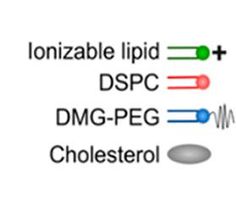

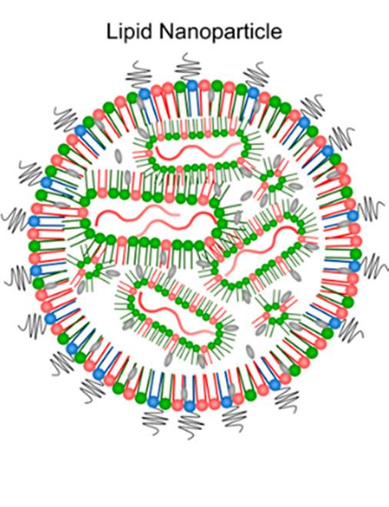

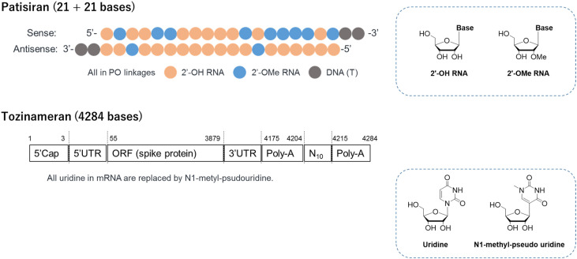
Lipid NanoParticles
Ionisable lipid
Cholesterol
% molar ratio : 30-50%
% molar ratio : 30-50%
- pKa <7, usually around 6
- Electrostatic interactions with RNA
- Involved in endosomal escape
-Stability and membrane fluidity
-Helps cellular internalization
Helper lipid
PEGylated lipid
% molar ratio : 10-30%
% molar ratio : <2%
-Influence LNP structure
-Involved in endosomal escape
- Surface protein interaction
→ in vivo behavior ?
- Promotes colloidal stability
- Prevents protein aggregation
- Modulate size, transfection efficiency
Adapted from Yuen et al 10.3390/pharmaceutics5030498

Slide 39
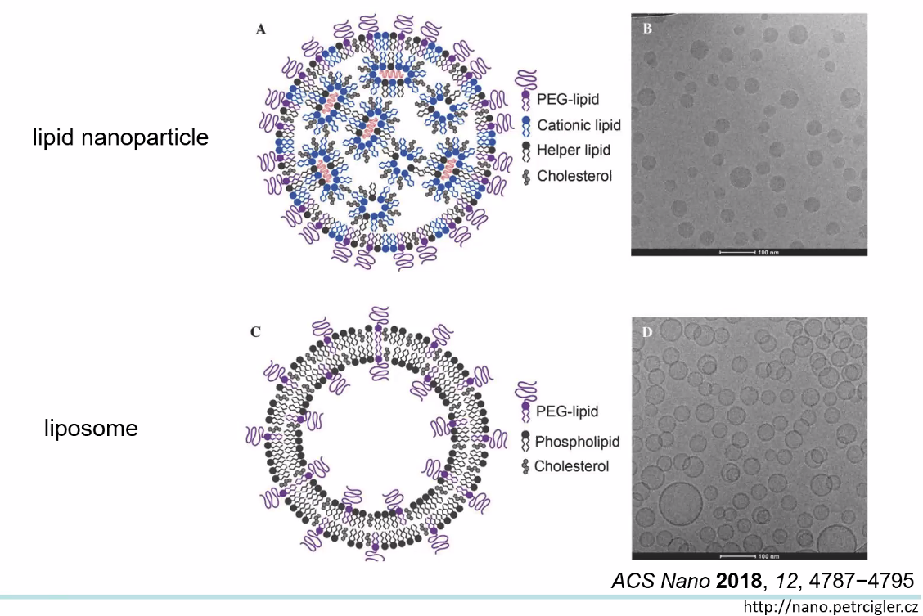
Lipid NanoParticles
From a Presentation by Petr Cigler

Slide 40
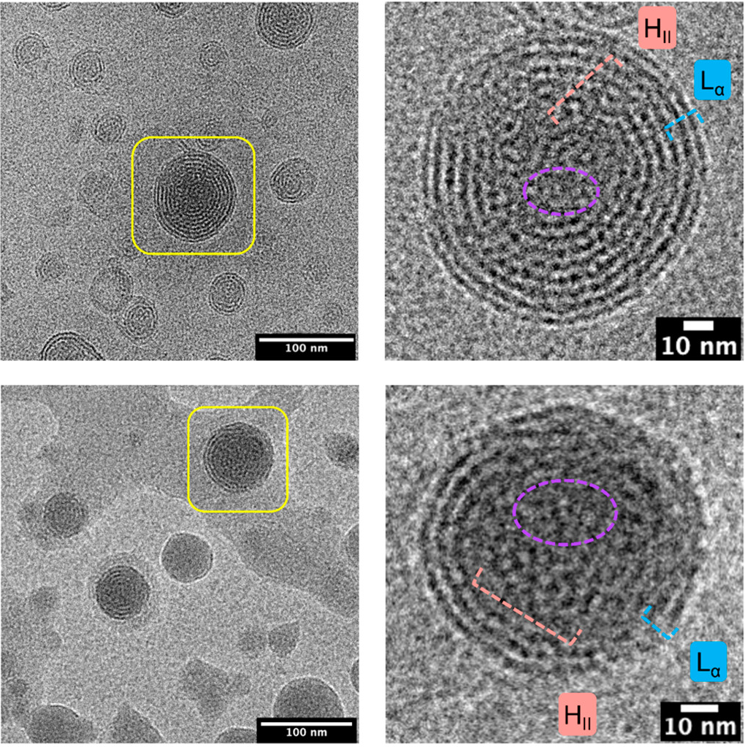
Lipid NanoParticles
DOI: (10.1021/acsnano.3c01186U. Elia [D.Peers] et al ACS Nano 2021, Yin et al Nature Reviews Genetics 2014

Slide 41
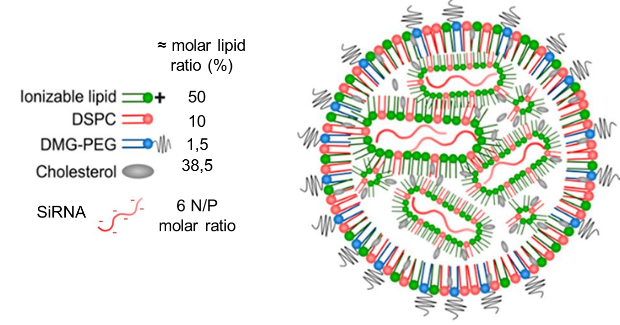
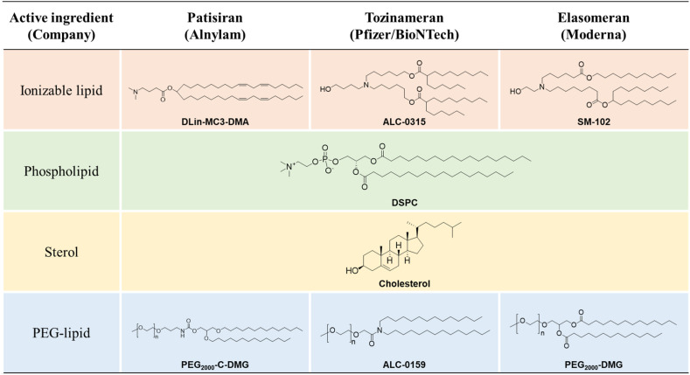
mRNA LNP formulation
Onpattro
Comirnaty
Spikevax
Adapted from U. Elia [D.Peers] et al ACS Nano 2021

Slide 42
mRNA LNP formulation
Onpattro
Comirnaty
Spikevax
Adapted from U. Elia [D.Peers] et al ACS Nano 2021

Slide 43
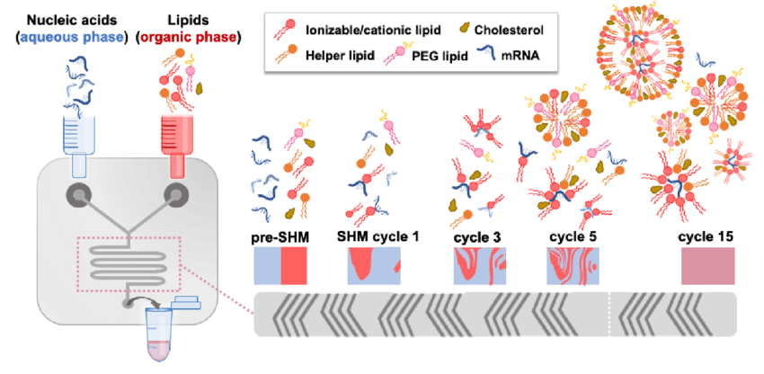
In pH 4
DOI:10.1016/j.actbio.2021.06.023

Slide 44
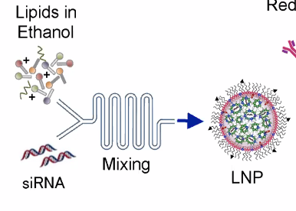
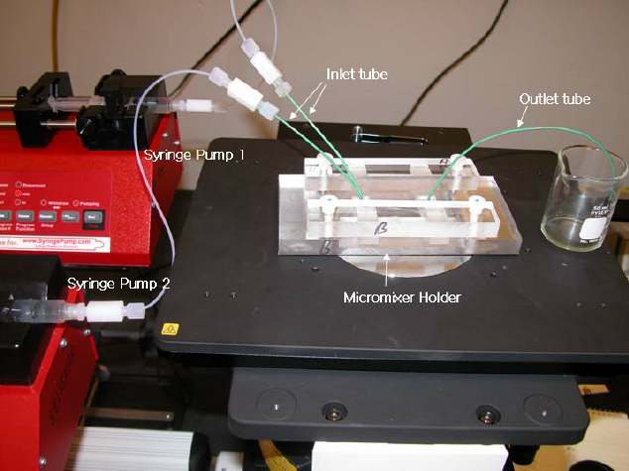
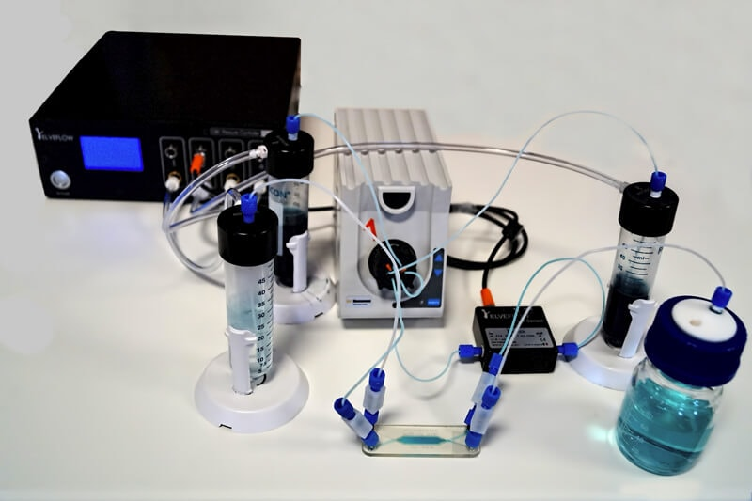

Slide 45
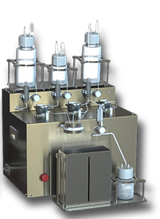
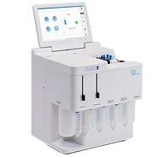
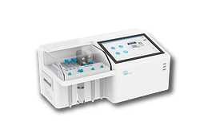
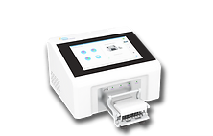
https://www.precigenome.com/lipid

Slide 46
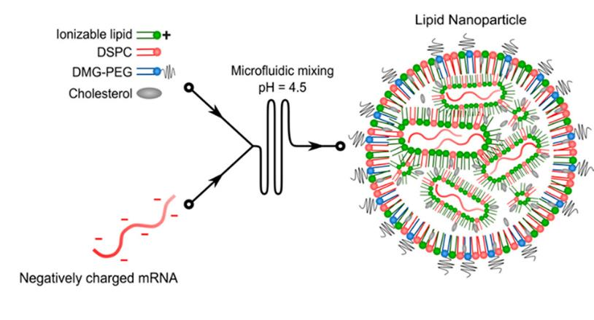
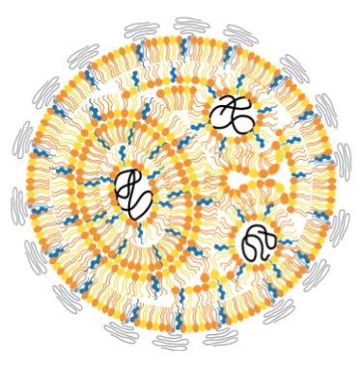

LNP
2) mixing
In pH 4
2) dialyse PH 7,4
pH 4
pH 7,4

Slide 47
Natural barriers
Physiological barriers
pH 4
pH 7,4
PEGylated lipid
% molar ratio : <2%
- Promotes colloidal stability
- Prevents protein aggregation
- Modulate size, transfection efficiency
Yin et al Nature Reviews Genetics 2014

Slide 48
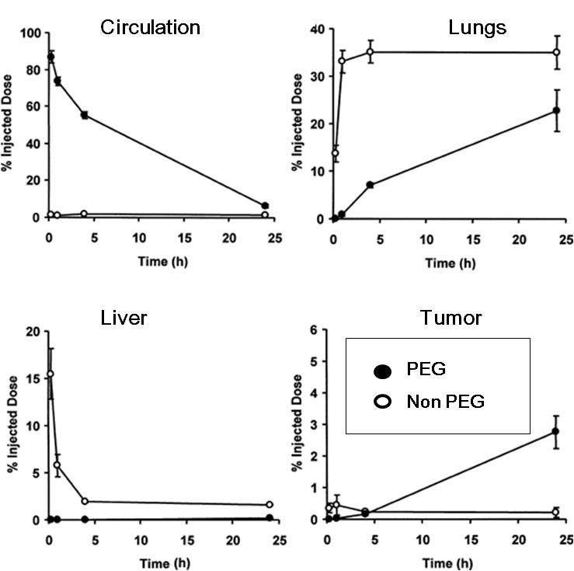
Non-viral vectors
Improved PK
Pharmacokinetics of pegylated and non pegylated plasmid DNA-cationic liposome complexes following intravenous administration in tumor-bearing mice
pH 4
pH 7,4
PEGylated lipid
% molar ratio : <2%
- Promotes colloidal stability
- Prevents protein aggregation
- Modulate size, transfection efficiency
Yin et al Nature Reviews Genetics 2014

Slide 49
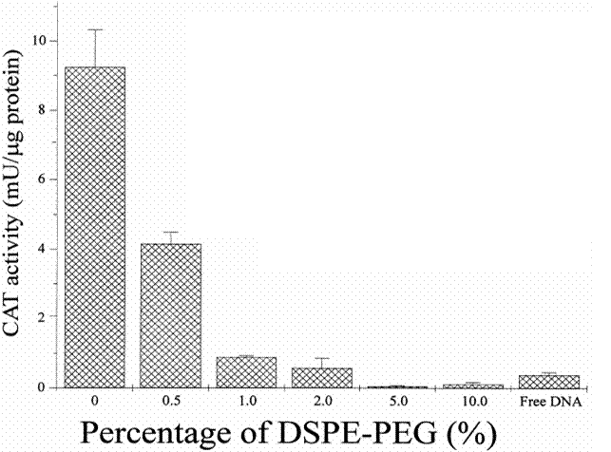
Non-viral vectors
PEG
Chloramphenicol acetyl transferase activity after transfection of B16/BL16 melanoma cells with lipoplex formulations
pH 4
pH 7,4
PEGylated lipid
% molar ratio : <2%
- Promotes colloidal stability
- Prevents protein aggregation
- Modulate size, transfection efficiency
DODAC:DOPE and increasing percentages of a DSPE:PEG (2000 MW)
Yin et al Nature Reviews Genetics 2014

Slide 50
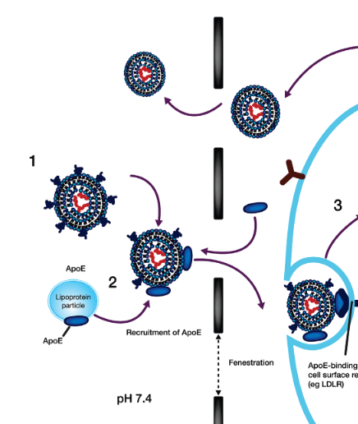

Non-viral vectors
PEG
pH 4
pH 7,4
PEGylated lipid
% molar ratio : <2%
- Promotes colloidal stability
- Prevents protein aggregation
- Modulate size, transfection efficiency
Zhang e al J Clin Pharmacol 2019 Nov 27;60(5):573-585. doi: 10.1002/jcph.1553..

Slide 51
Natural barriers
Physiological barriers
Yin et al Nature Reviews Genetics 2014

Slide 52
Natural barriers
Endosomal escape
Ionizable Cationic Lipids: pKa 6.2–6.5
pH 4
pH 7,4
pH 5
Yin et al Nature Reviews Genetics 2014

Slide 53
Natural barriers
Endosomal escape
Ionizable Lipids: pKa 6.2–6.5
Cullis et al Mol Ther. 2017

Slide 54
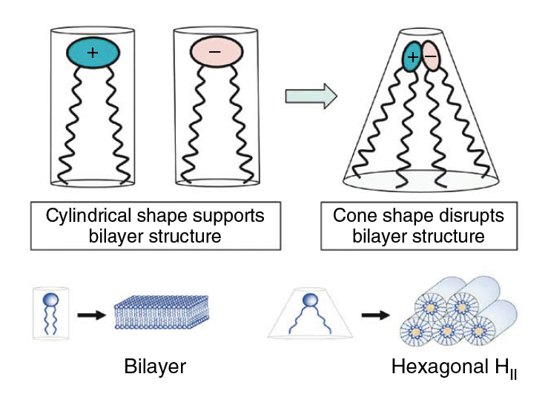
Natural barriers
Endosomal escape
Ionizable Lipids: pKa 6.2–6.5
Effect
Cullis et al Mol Ther. 2017

Slide 55
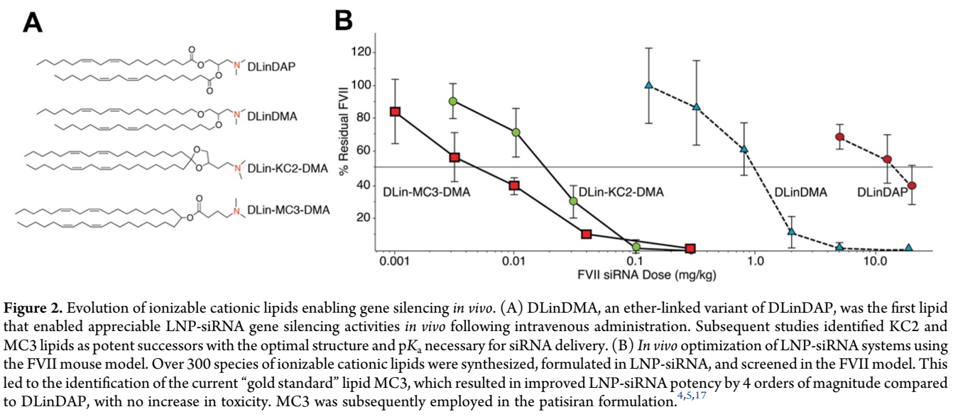
Ionizable Lipids (pKa 6.2–6.5)
Evolution of ionizable lipid during Patisiran development
Kulkarni [Cullis] et al ACR 2019

Slide 56
Lipid NanoParticles
Ionisable lipid
Cholesterol
% molar ratio : 30-50%
% molar ratio : 30-50%
- pKa <7, usually around 6
- Electrostatic interactions with RNA
- Involved in endosomal escape
-Stability and membrane fluidity
-Helps cellular internalization
PEGylated lipid
Helper lipid
% molar ratio : <2%
% molar ratio : 10-30%
- Promotes colloidal stability
- Prevents protein aggregation
- Modulate size, transfection efficiency
-Influence LNP structure
-Involved in endosomal escape
- Surface protein interaction
→ in vivo behavior ?
Organ/cell targeting
RNA half-life
off target effect
Price
Inflammation
Adapted from Yuen et al 10.3390/pharmaceutics5030498

Slide 57
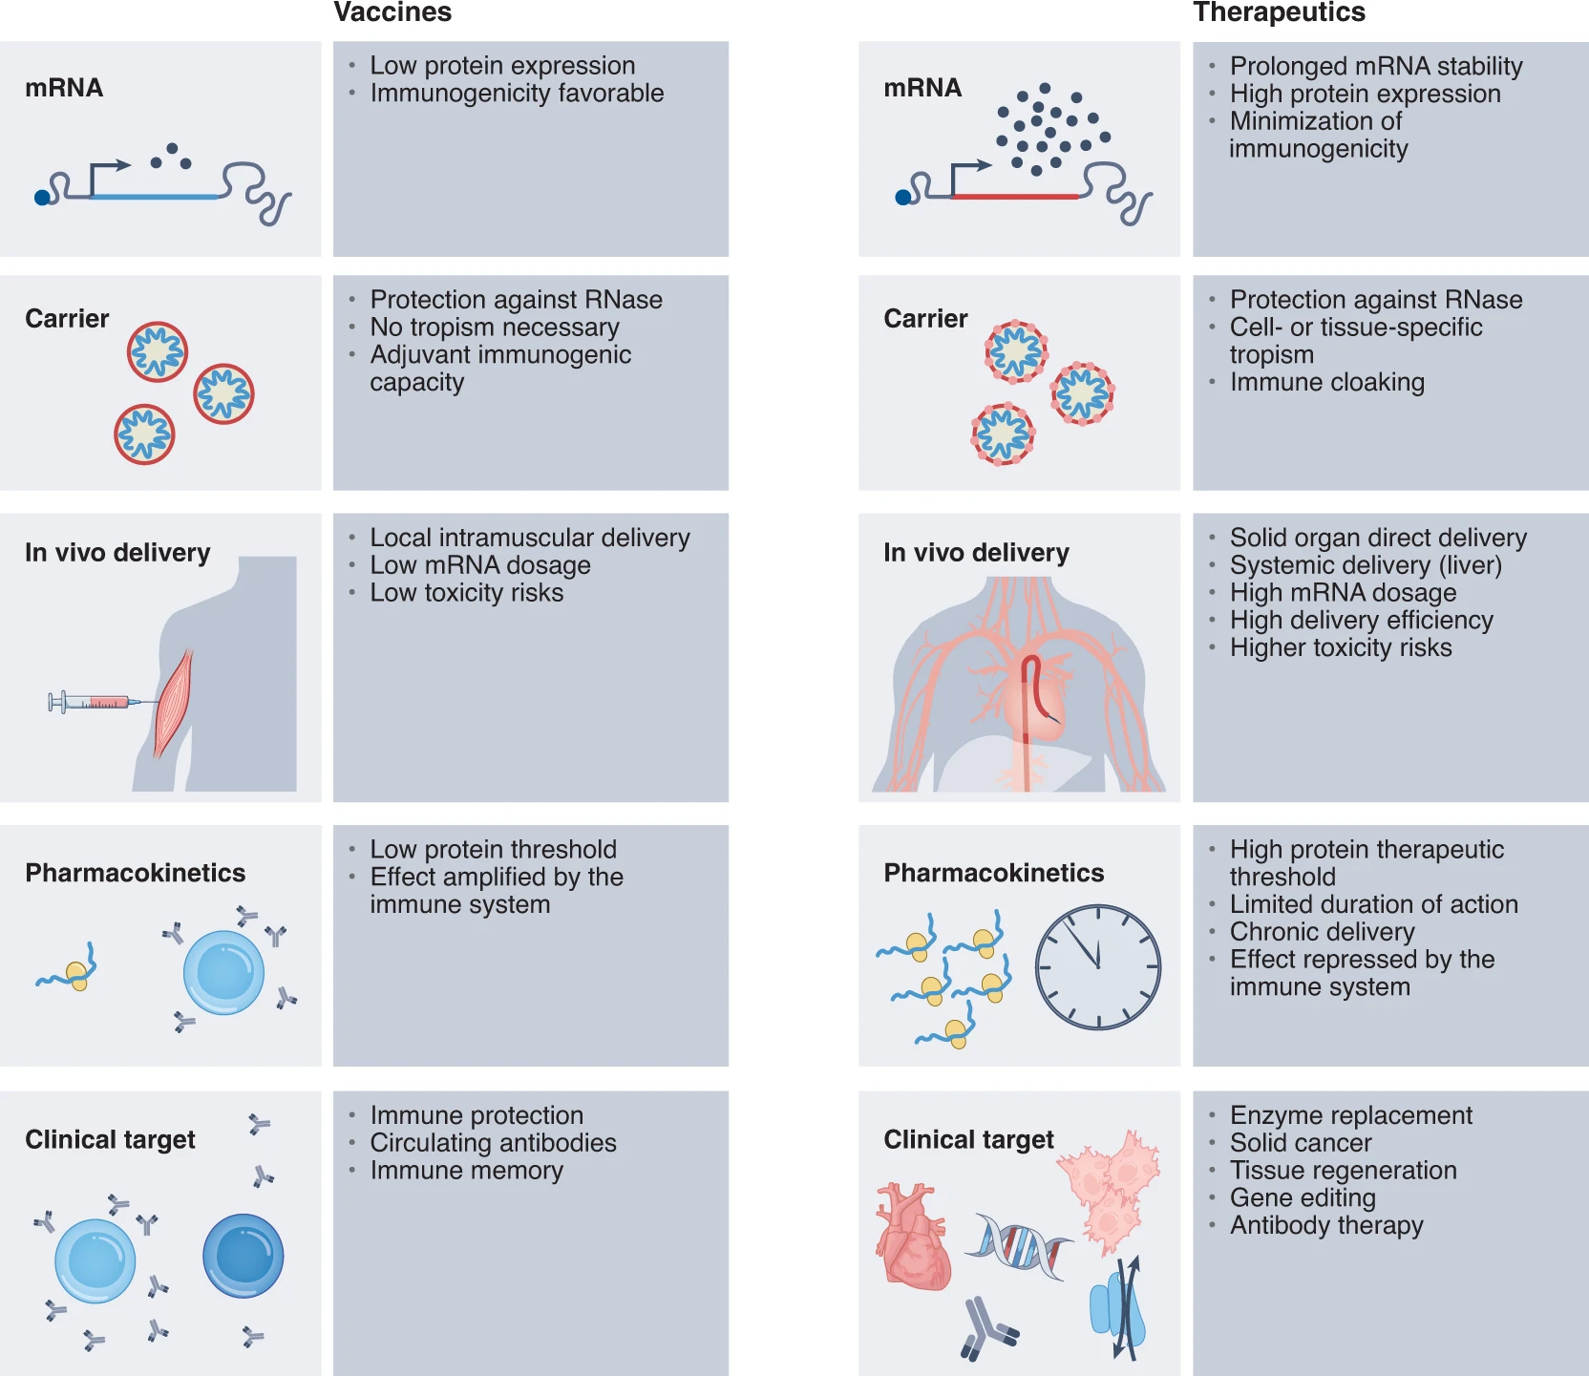
Different need
Example mRNA
Pb: Chronic delivery may induce activation of innate immunity
Rohner, E. Nat Biotechnol (2022). https://doi.org/10.1038/s41587-022-01491-

Slide 59

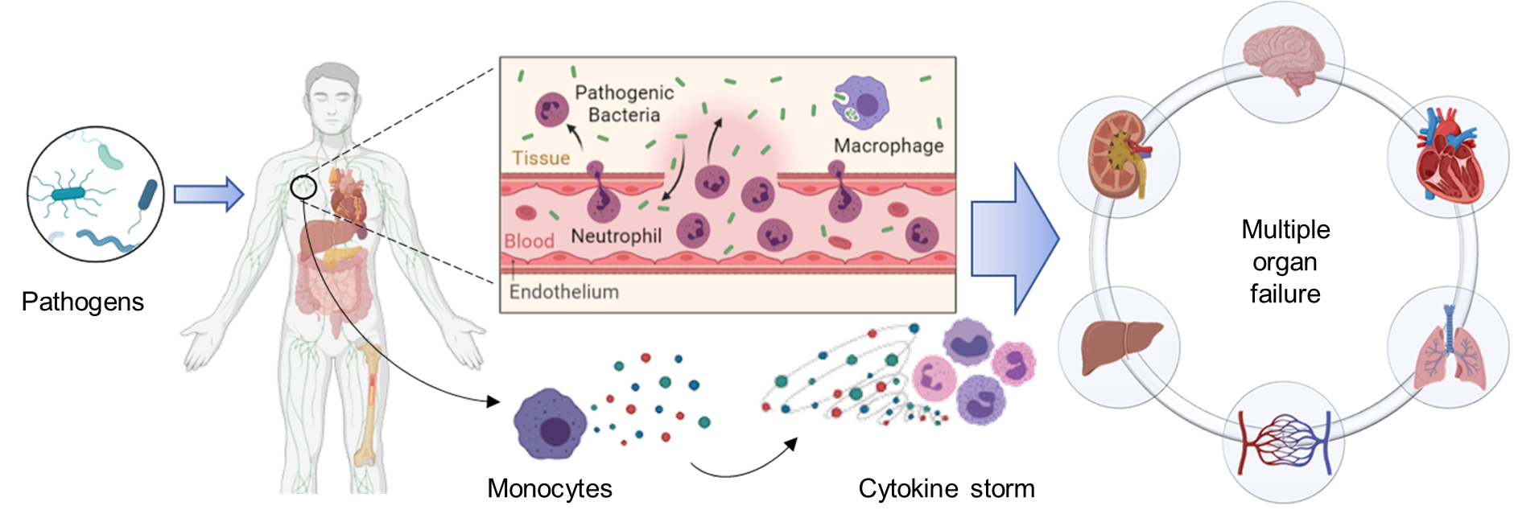
Qinglin Wang
3nd year PhD student

Slide 60
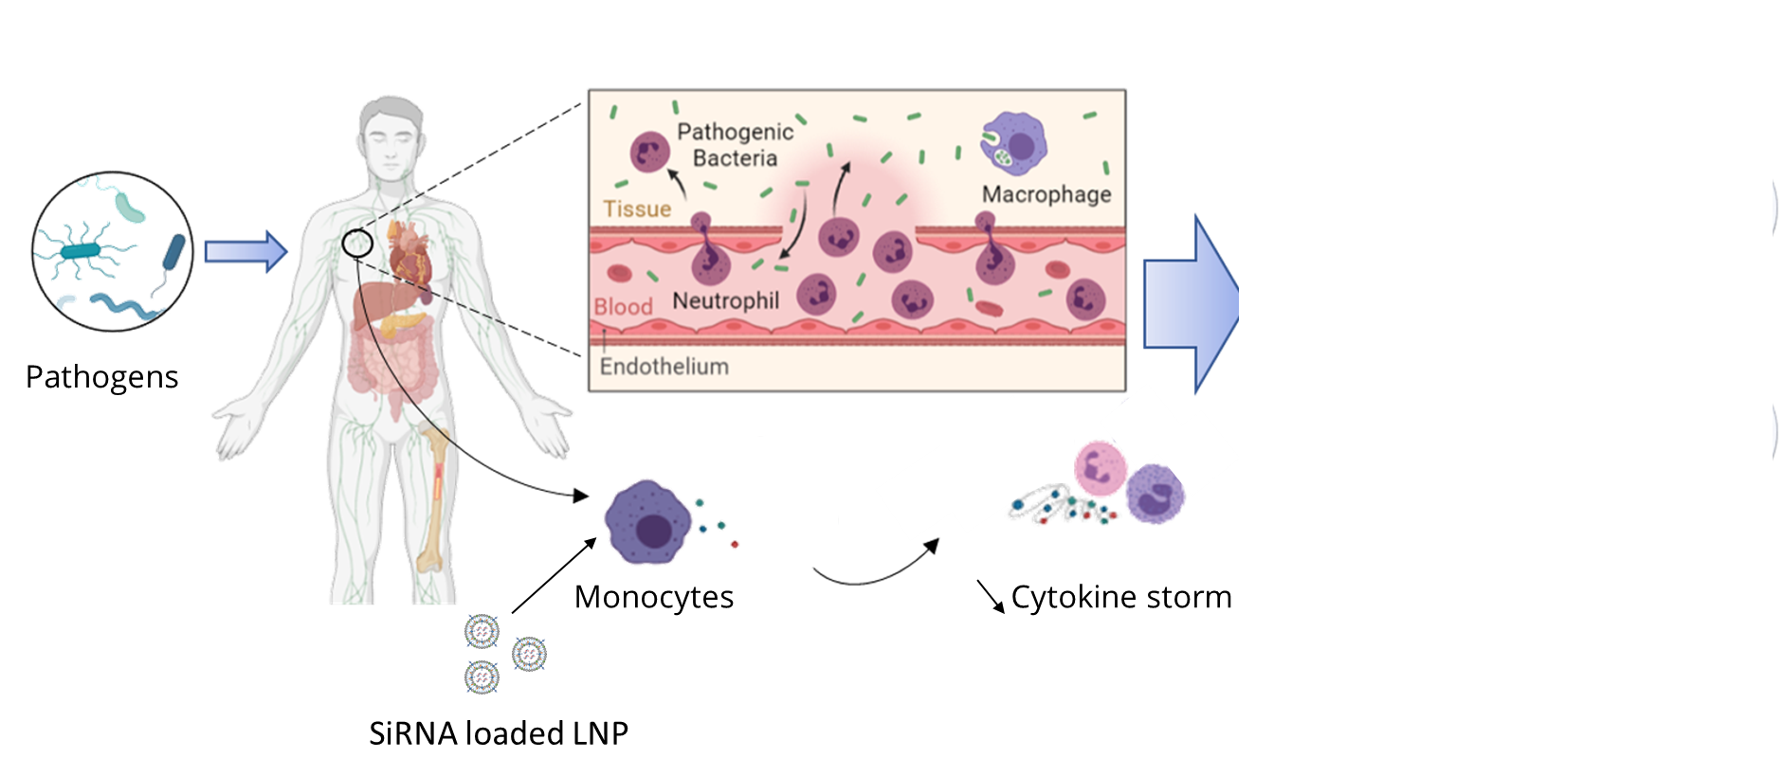

Slide 61
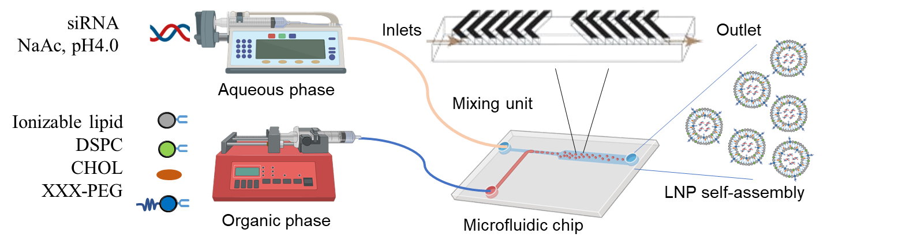
Characterization
pH | Size(nm) | Z-Potential | Encapsulation
7.0 | 70 | -7.6 | > 90%
4.0 | 70 | +11.9

Slide 62
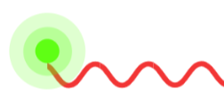





In vitro evaluation
6-FAM siRNA
Count
RFU
LPS- Activated macrophages
(Raw264.7)
Lipo:6-FAM siRNA
6-FAM signal
Time (h)
Preliminary data
Work by Qinglin Wang

Slide 63
In vitro evaluation
Raw264.7
LNP:siRNA incubation
LPS activation
IC₅₀= 51.6 nM
% viability
[TNF-α]-pg/ml
% inhibition
SiRNA (nM)
SiRNA (nM)
SiRNA (nM)
Preliminary data
Work by Qinglin Wang

Slide 64




Evaluation on acute lung injury model
LPS
Intranasal
injection
PBS/
Rhod-LNP TNFa siRNA/
Rhod-LNP SCR siRNA
BAL
&
Lung digestion
24 h
Biodistribution Analysis
(2/4/6/16/24 h)
s
Work by Qinglin Wang

Slide 65
Cytokines in BALF
LPS
Intranasal
injection
PBS/
Rhod-LNP TNFa siRNA/
Rhod-LNP SCR siRNA
BAL
&
Lung digestion
24 h
Work by Qinglin Wang

