Slide 1

CRISPR-Cas systems: from a phage defense system to biotech tools
David Bikard
^{Synthetic Biology lab}

Slide 2
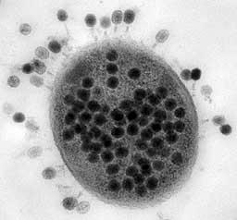
Outline
History & definitions
Three main steps of CRISPR-Cas system
  Spacer acquisition
  Biogenesis of crRNAs
  Interference
Phages counter attack
CRISPR as a technological tool
  Gene editing
  Other applications
  Beyond Cas9
Conclusions / perspectives

Slide 3
History of CRISPR

Slide 4
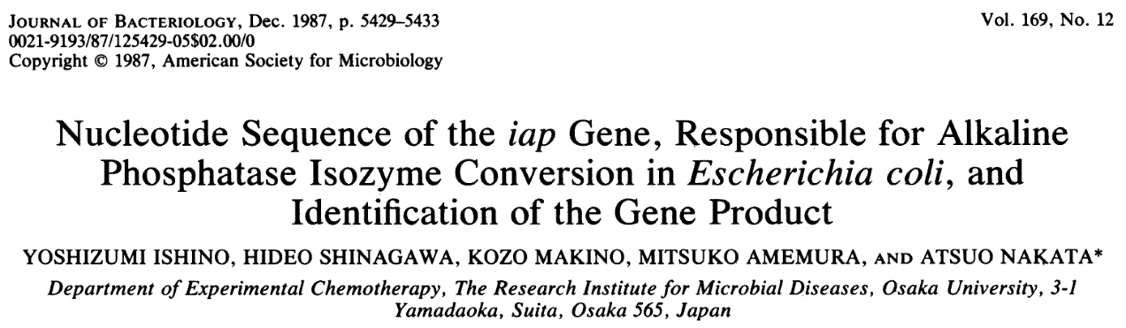
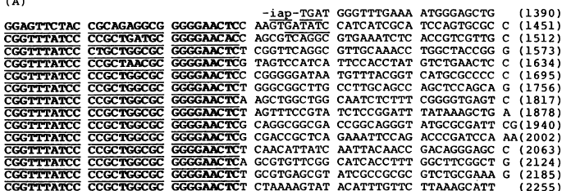
History of CRISPR: first observation
(1987)
Direct Repeats (29 pb)
Variable region = spacers (32-33 pb)

Slide 5
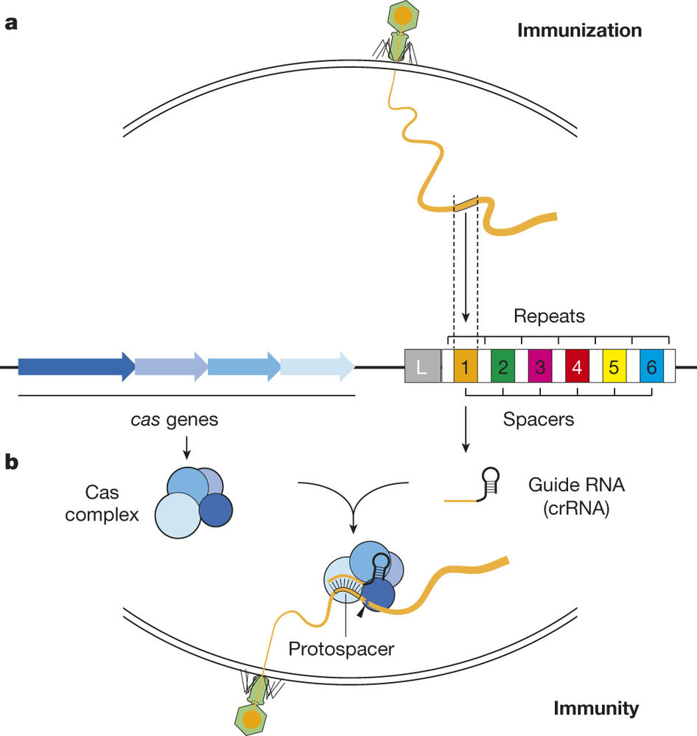
History of CRISPR:
weird repeats in the genomes of bacterial and archaea (1987-2002)
DVR (Direct Variable Repeats),
TREP (Tandem Repeats),
LTRR (Long Tandemly Repeated Repetitive Sequences),
SRSR (Short Regularly Spaced Repeats),
LCTR (Large Clusters of Tandem Repeats),
SPIDR (Spacer Interspersed Direct Repeats)
CRISPR
Clustered Regularly Interspaced Short Palindromic Repeats
Jansen et al., molecular microbiology 2002

Slide 6
History of CRISPR:
Spacers sequences match foreign DNA
(2005)
Mojica, F. J., Diez-Villasenor, C., Garcia-Martinez, J. & Soria, E.
J. Mol. Evol. 2005
Pourcel, C., Salvignol, G. & Vergnaud, G.
Microbiology 2005
Bolotin, A., Quinquis, B., Sorokin, A. & Ehrlich, S. D.
Microbiology 2005

Slide 7

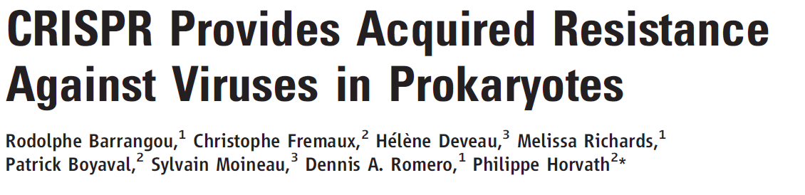
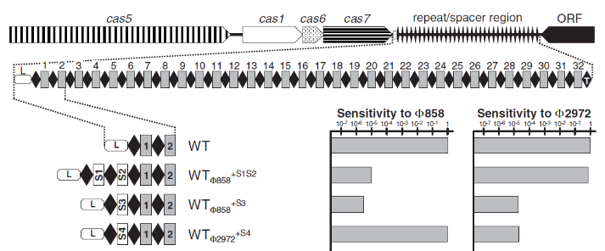
History of CRISPR:
Experimental evidence
(2007)

Slide 8
Marraffini, Nature 2015

Slide 9
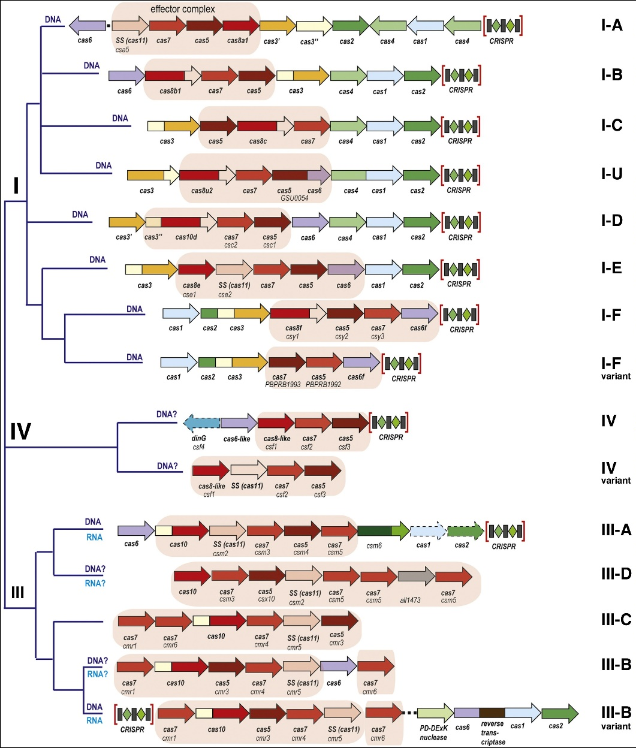
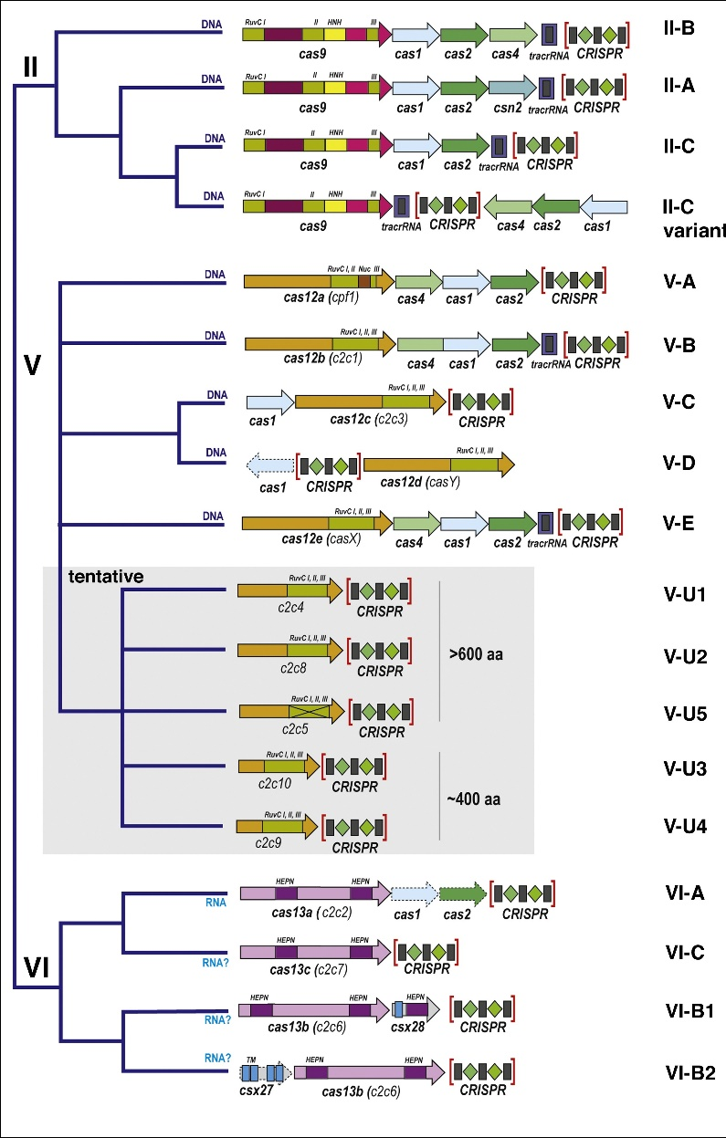
The diversity of CRISPR-Cas system
Class 1
Class 2
Koonin & al., Current Opinion in Microbiology 2017

Slide 10
CRISPR mechanism
Spacer acquisition
crRNA biogenesis
Interference

Slide 11
History of CRISPR:
Experimental evidence
(2007)

Slide 12
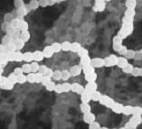
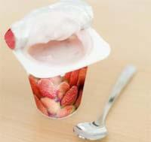
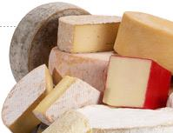
Streptococcus thermophilus
Non-pathogenic streptococci
Use to make cheese, yogourt
Industrial ST : transform a phage-sensitive into a phage-resistant strains

Slide 13
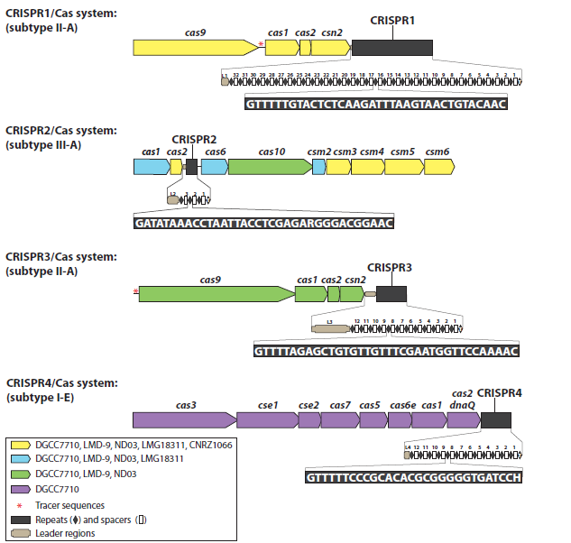
CR1
CR2
CR3
CR4
32 spacers
12 spacers

Slide 14
CR1
CR2
CR3
CR4
32 spacers
12 spacers

Slide 15
Signature genes/proteins
Type II-A
Repeats
Spacers
  Cas9: two domains, cleaves dsDNA
Cas1: binds DNA, DNA cleavage
Cas2: RNAse, DNAse
  Csn2: binds dsDNA

Slide 16
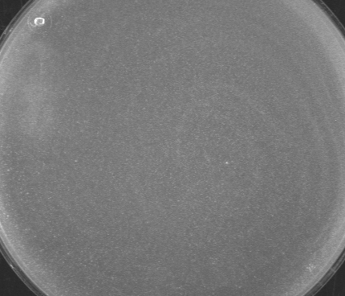
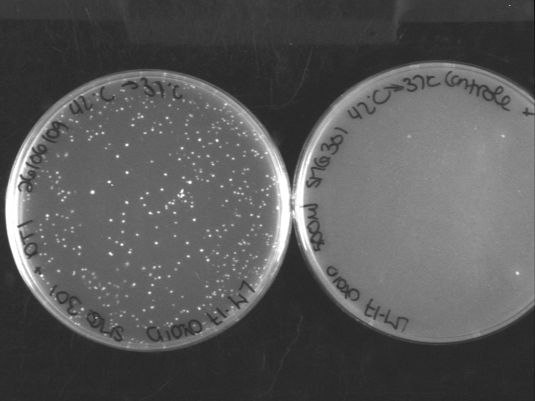

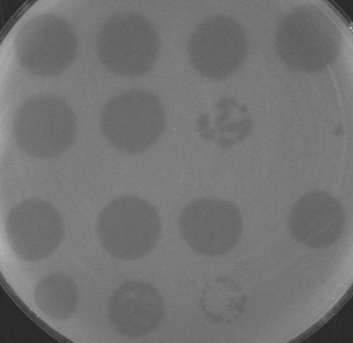
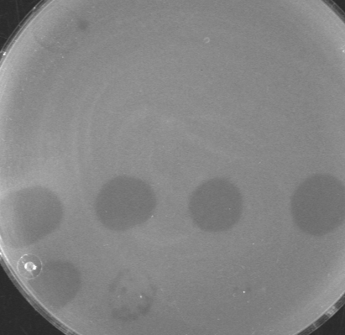
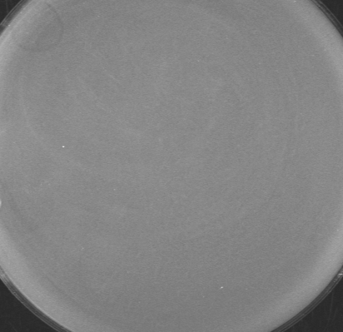
Selection of BIMs (frequencies ≈ 10⁻⁷)
Bacterial lawn
Bacteria + phages
10⁻¹ 10⁻² 10⁻³ 10⁻⁴
10⁻⁵ 10⁻⁶ 10⁻⁷ 10⁻⁸
2972
2972
858
858
Wild-type BIM # 1 BIM #4

Slide 17
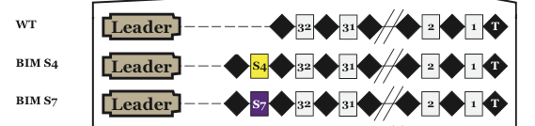


Bacteria + phages
CR1 CR3
+ 66 bp
Analysis of CRISPR by PCR
+ sequencing

Slide 18
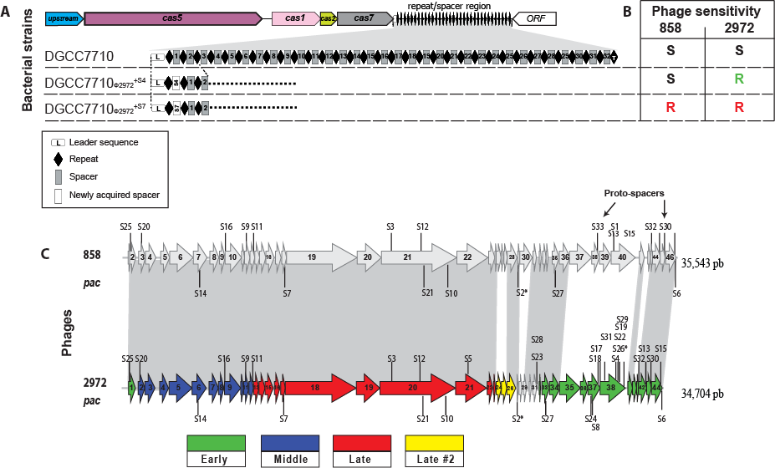
Origin of spacers: phage genome (proto-spacers)
Sensible
BIM #1
BIM #4
Barrangou et al., Science, 2007

Slide 19

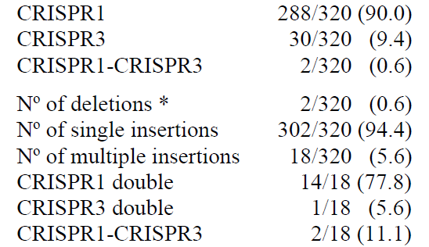
Spacer acquisition in CR1 and CR3 of S. thermophilus DGCC7710
⬅ Purified colonies
Magadan et al. PLOS One 2012

Slide 20
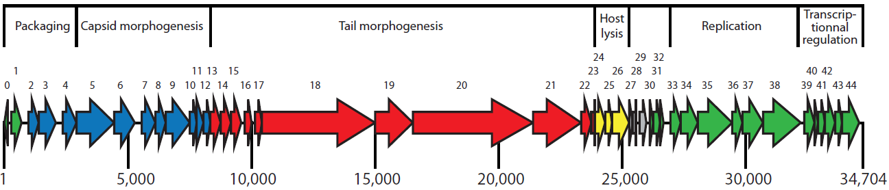
BIMs and spacer analysis
Dupuis et al., unpublished

Slide 21
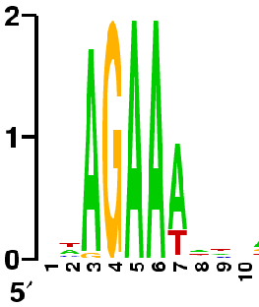
Proto-spacer adjacent motif
(PAM) in the phage genome : CR1
GCTCTACGACTTCTTCCACGAGTTCCTGCCTCAGAAT
TGAATAAGCAGTTCTTGACGACCAACCGACATAGAAA
TTACTAGAGCGTGTCGTTAACCACTTTAAATCAGAAT
TTACGTTTGAAAAGAATATCAAATCAATGACGAGAAA
GAAGTAGCCATACAAGAAGATGGATCAGCACCAGAAA
TTCGTTAAAGTCACCTCGTGCTAGCGTTGCATAGAAA
TACCGAAACGACTGGTTTGAAAAATTCAAGGAAGAAA
CTCAGTCGTTACTGGTGAACCAGTTTCAATTGAGAAA
ATTGTCTATTACGACAACATGGAAGATGATGTAGAAA
TCCAAGTTATTTGAGGAGTTATTAAGACATGAAGAAA
GCCCTTCTAATTGGATTACCTTCCGAGGTGTTAGAAT
233 PAM
phage 2972
Deveau et al., J. Bacteriol., 2008
Horvath et al., J. Bacteriol., 2008

Slide 22
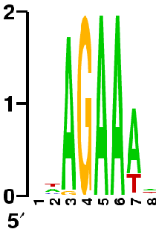
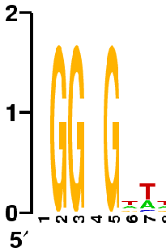
Proto-spacer adjacent motif
(PAM) in the phage genome :
CR1 & CR3
CR1
233 PAM
phage 2972
CR3
483 PAM
phage 2972
PAM are specific to each Cas9 ortholog

Slide 23
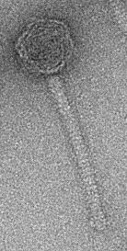
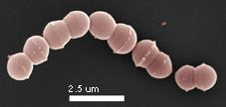
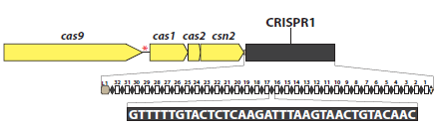

spacer vs proto-spacer
Spacer bacteria R- CTCAGTCGTTACTGGTGAACCAGTTTCAAT -R
Proto-spacer phage CTCAGTCGTTACTGGTGAACCAGTTTCAATTGAGAAAAA
PAM
Spacer Proto-spacer

Slide 24
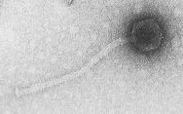

Selection of BIMs in
S. thermophilus
  « Old » BIM
  Infection with another phage
  Selection of a new BIM
  (Bacteriophage-Insensitive Mutant)
+

Slide 25

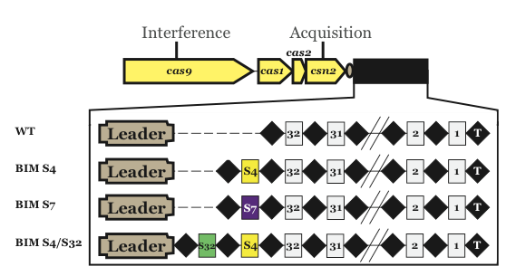
New BIMs !

Slide 26
Adaptive immune system !
Spacers represent a molecular book-keeping, a memory of past phage infections
This “memory” allows the cell to defend itself against phage infections

Slide 27
CRISPR mechanism
Spacer acquisition
crRNA biogenesis
Interference

Slide 28
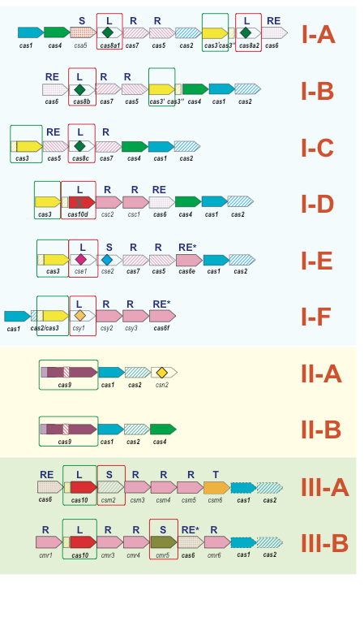
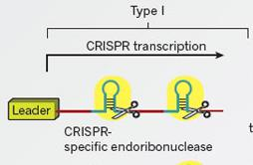
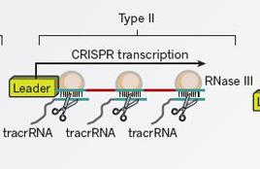
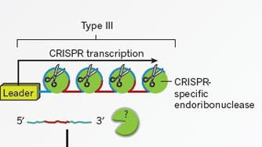
Makarova et al., Nature Rev. Microbiol., 2011
Wiedenheft et al. 2012, Nature

Slide 29
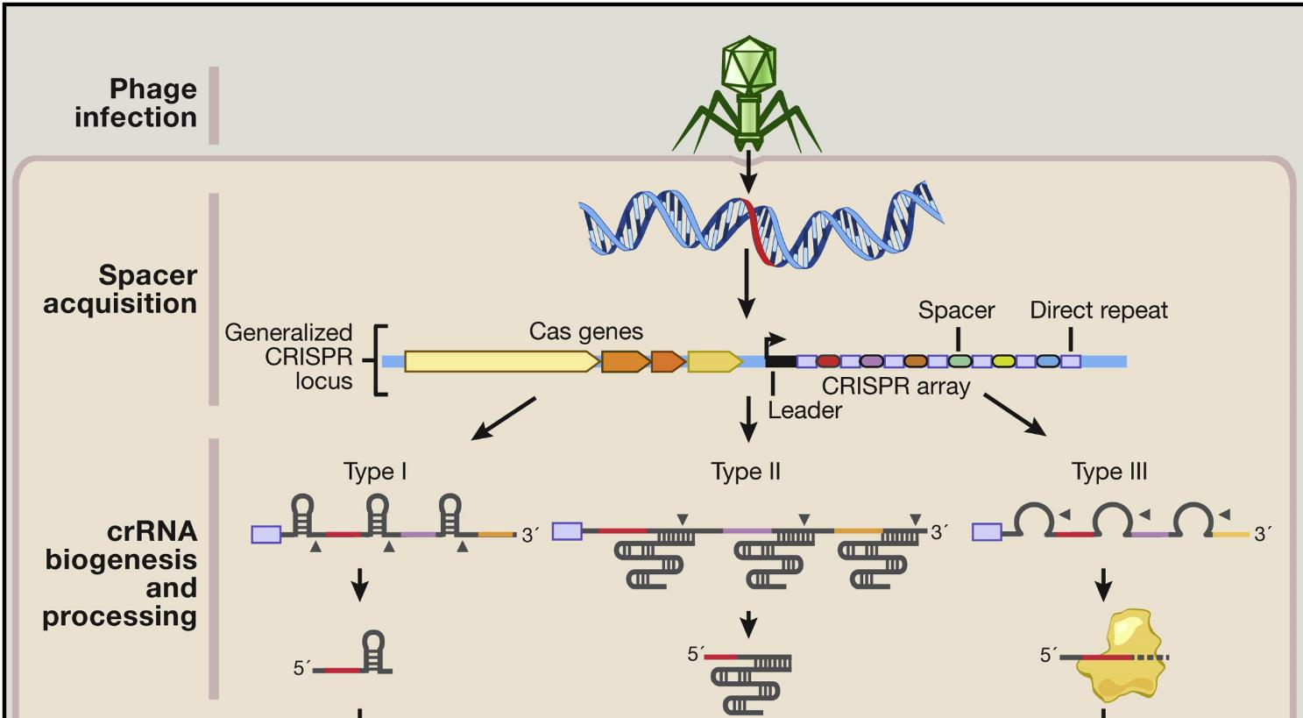
Hsu et al. 2014, Cell

Slide 30
CRISPR mechanism
Spacer acquisition
crRNA biogenesis
Interference

Slide 31
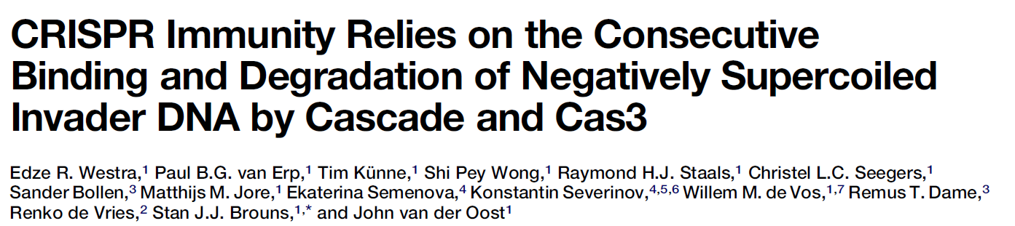
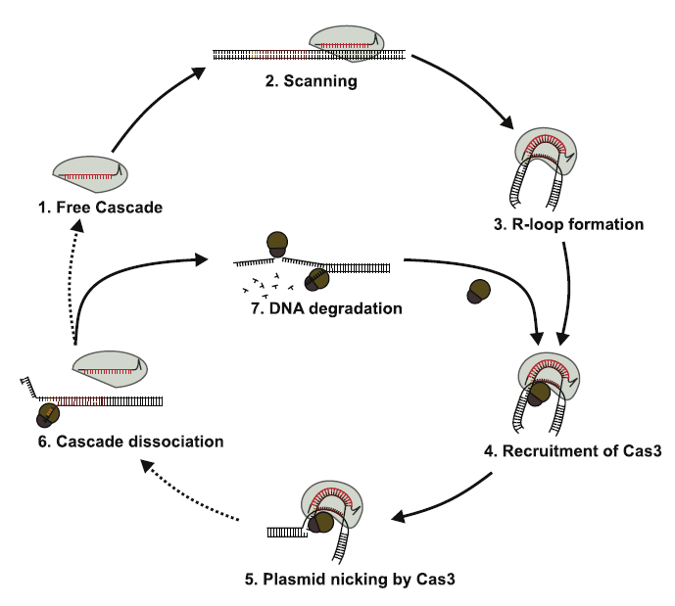
Type I interference

Slide 32

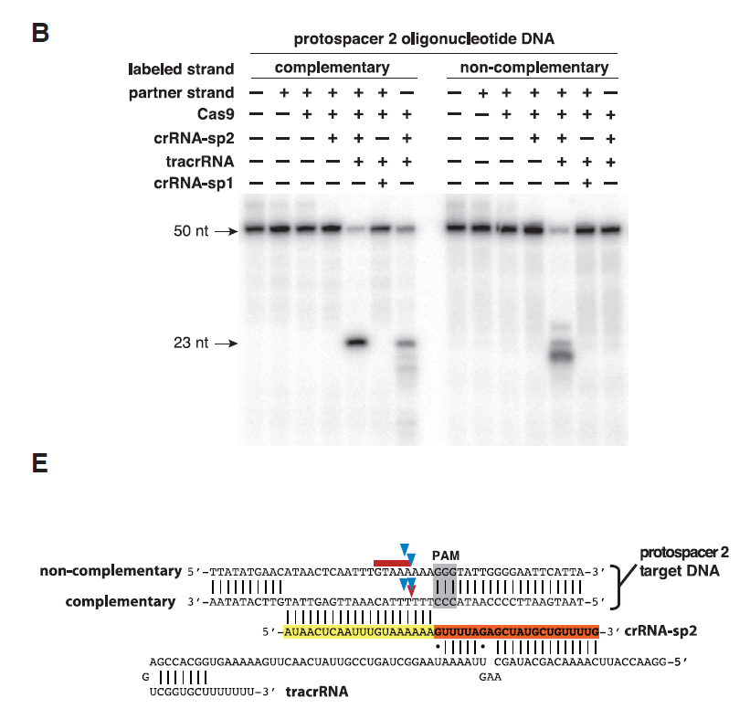
Type II interference

Slide 33
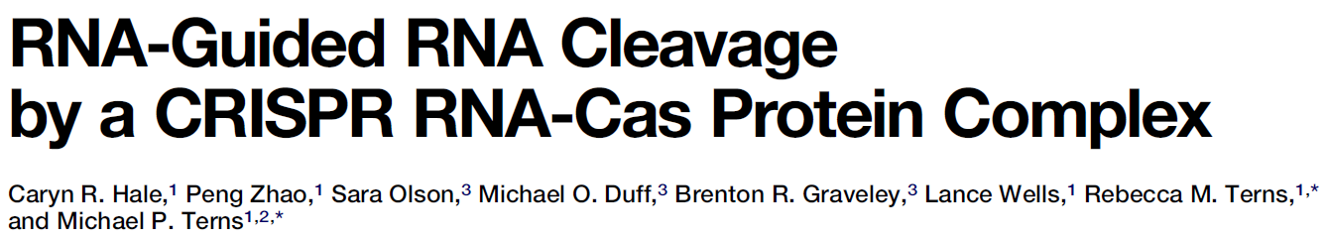
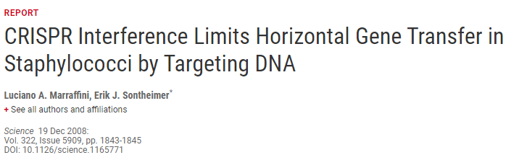
Type III interference
Years of conflict in the CRISPR community

Slide 34
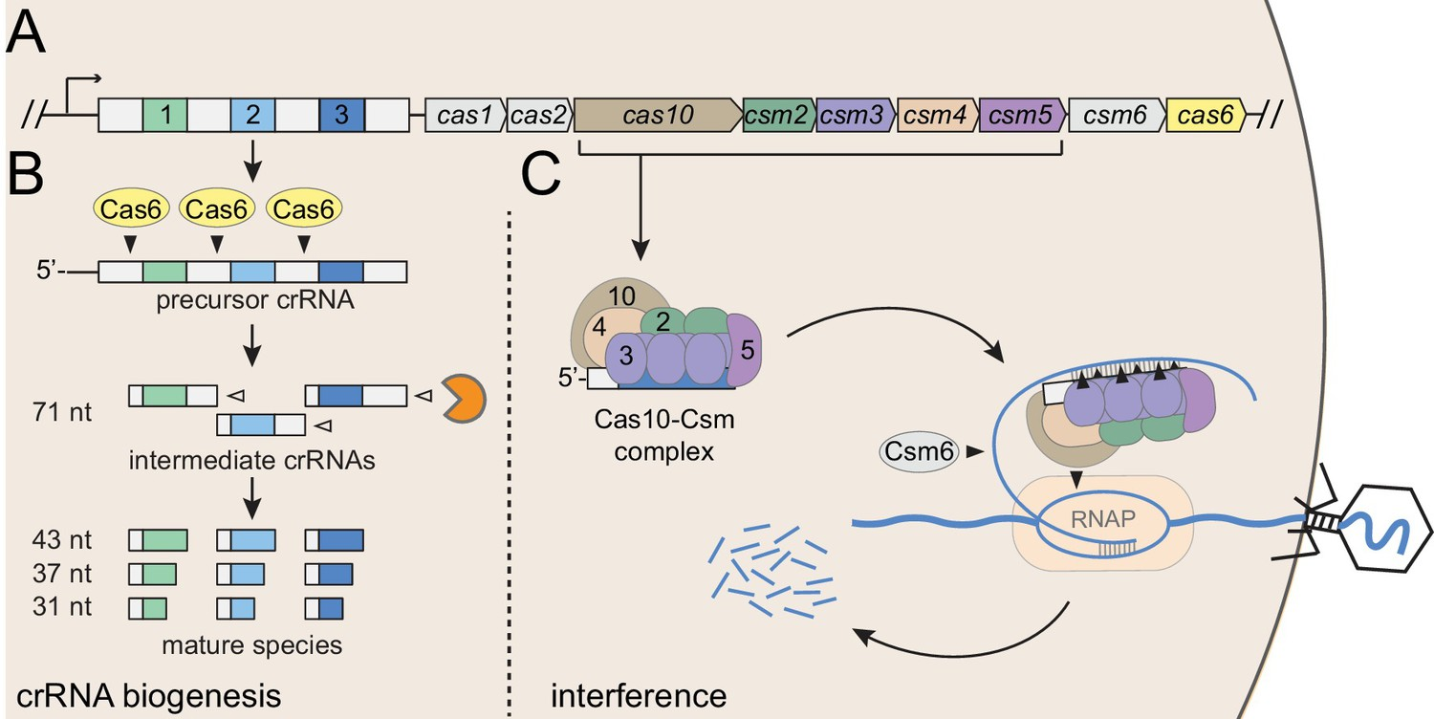
Type III interference
Chou-Zheng, e-life 2019

Slide 35
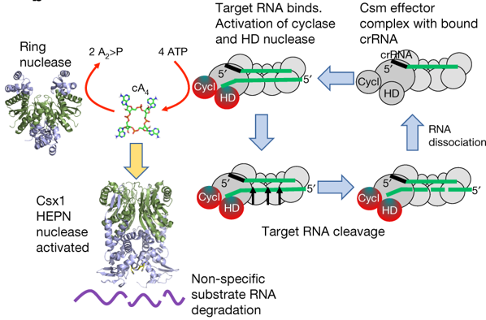
Cyclic messengers in type III immunity
Athukoralage, Nature 2018

Slide 36
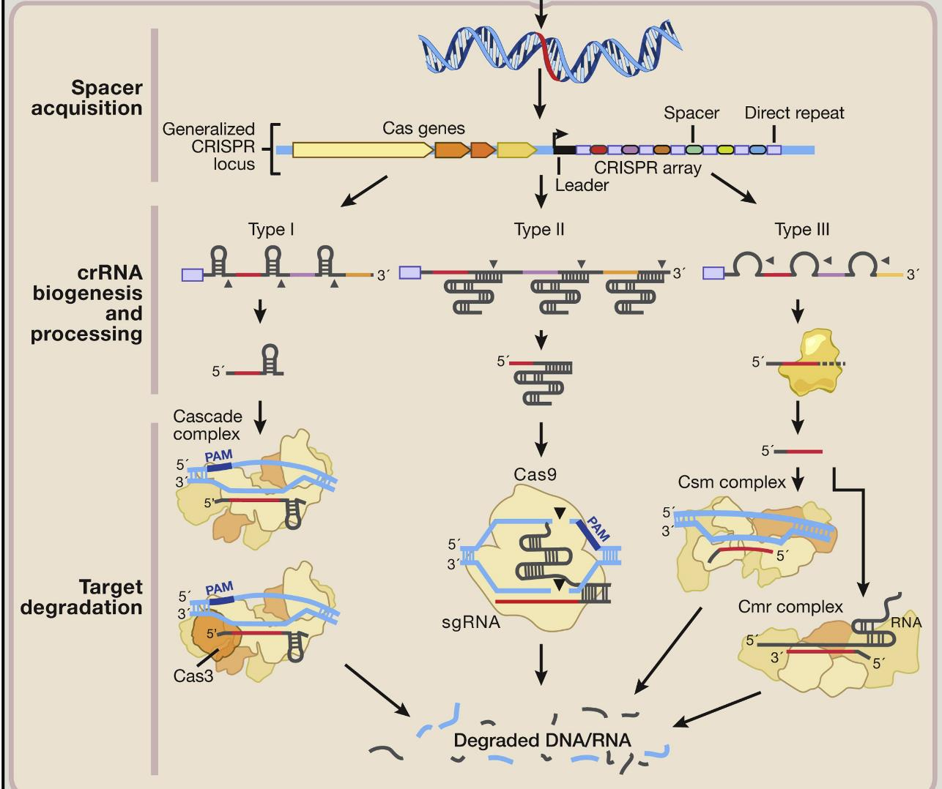
Hsu
et al.
2014
Cell

Slide 37
Type IV, V, VI

Slide 38
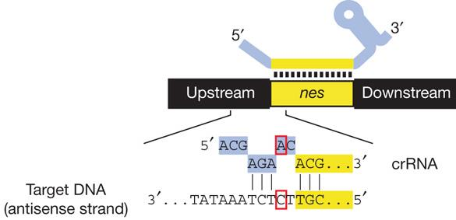
Self VS non-self recognition
Type I, II and V
Spacer bacteria R- CTCAGTCGTTACTGGTGAACCAGTTTCAAT -R
Proto-spacer phage CTCAGTCGTTACTGGTGAACCAGTTTCAATTGAGAA
PAM
Type III

Slide 39

Nature Rev. Microbiol. 2013
10⁻¹ 10⁻² 10⁻³ 10⁻⁴
10⁻⁵ 10⁻⁶ 10⁻⁷ 10⁻⁸
2972
2972
858
858
Sensitive BIM # 1 BIM #4

Slide 40
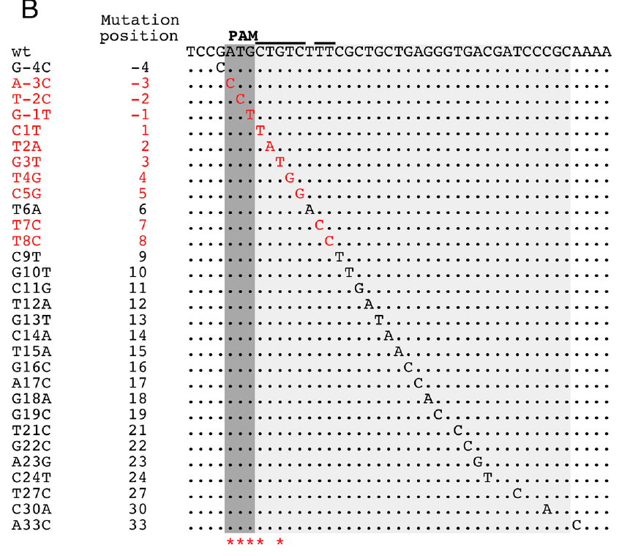
Phages counter-attack !
  Phage mutants can bypass the CRISPR/Cas system with a point mutation within the proto-spacer or the PAM

Slide 41
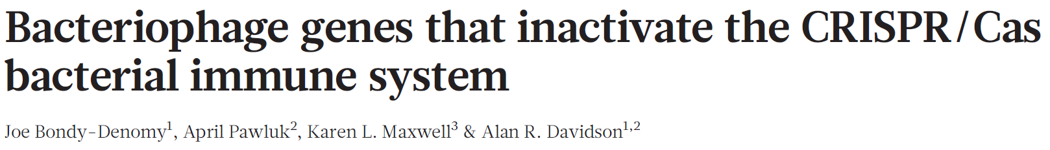

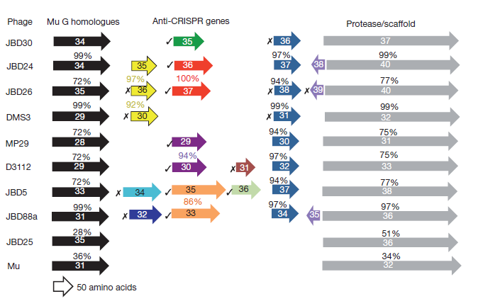
Phages of Pseudomonas:
anti-CRISPR type 1-F

Slide 42
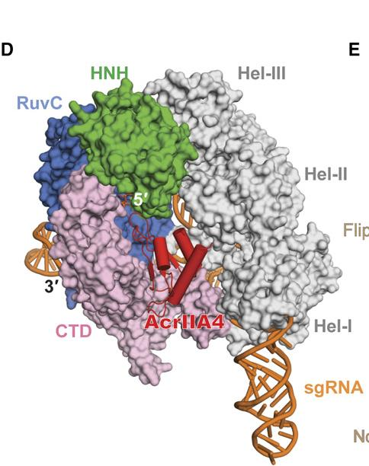

Slide 43
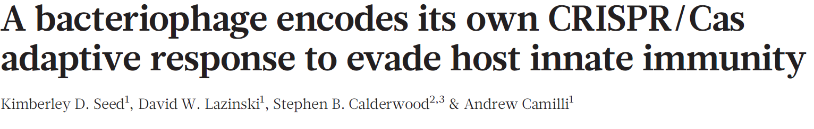
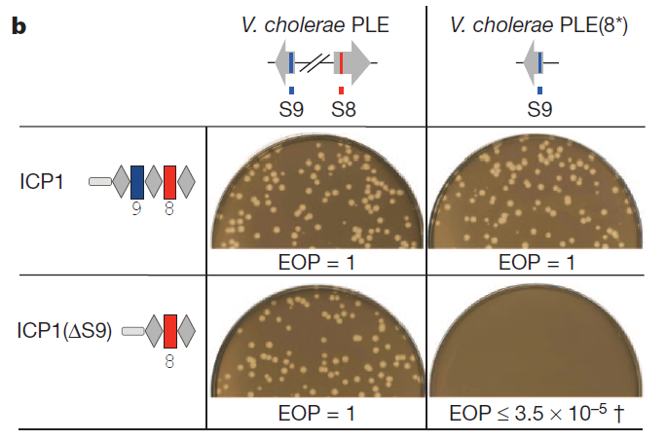
Vibrio
phages

Slide 44
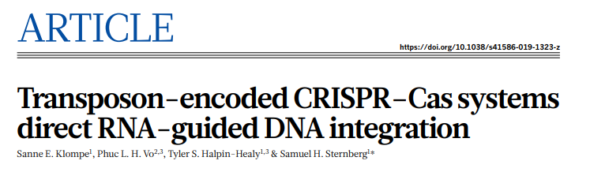
Other roles of CRISPR
CRISPR against horizontal gene transfer
CRISPR control of gene expression
CRISPR guided transposons !!!!

Slide 45


Slide 46
CRISPR biotechnological applications

Slide 47


Slide 48












Genome Editing
S. pneumoniae (Jiang, Bikard et al, 2013, Nat. Biotechnol.)
E. coli (Jiang, Bikard et al, 2013, Nature Biotechnol.)
Human cells (Le Cong et al., 2013, Science)
Monkeys (Niu et al., 2014, Cell)
Livestocks (Tan et al., 2013, PNAS)
Mice (Wang et al., 2013, Cell)
Frogs (Blitz et al. and Nakayama et al., 2013, Genetics)
Zebrafish (Hwang et al., 2013, Nature Biotechnol.)
Insects (Wang et al., 2013, Cell. Res.)
Plants (Li et al. , Shan et al., 2013, Nature Biotechnol.):
Flies (Gratz et al., 2013, Genetics)
Nematodes (Lo et al., 2013, Genetics)
Yeast (DiCarlo et al., 2013, NAR)

Slide 50
CRISPR gene therapy
Ex-vivo therapies:
  CAR-T to treat cancer
  Hematopoitic stem cells
    Sickle cell anemia(Mattew Porteus, Stanford)
    beta-thalassemia (CRISPR Therapeutics)
In-vivo therapies:
  Duchenne muscular distrophy (Rodney Howell, Charles Gerbach)
  Leber Amaurosis (Editas)

Slide 51
Technical hurdles
Monogenic vs. Polygenic disease
  Consequences of mutations can be hard to predict
Hard to deliver CRISPR-Cas9 to a large number of cells in vivo
  Genes that are responsible for cystic fibrosis have been known for a long time but we still cannot cure it
Off-target effects
Undesired on-target effects
Mosaicism

Slide 52


Slide 53







Base Editing Overview
sgRNA
dCas9
3’
5’
genomic DNA binding
and opening
G
cytidine deaminase
3’•••
•••5’
5’•••
•••3’
C
protospacer
PAM
3’•••
•••5’
deamination of target C in ssDNA bubble
G
5’•••
C
•••3’
genomic DNA
3’
DNA replication
or repair
5’
3’•••
•••5’
G
A
3’•••
•••5’
5’•••
T
•••3’
5’•••
•••3’
base-edited DNA
(no longer a substrate for base editing)
U
Komor, Kim, Packer, Zuris, Liu Nature 533, 420 (2016)

Slide 54


Slide 55

Prime editing
Anzalone, Nature, 2019

Slide 56


Genetic engineering
Editing humanity

Slide 57



He Jiankui: les bébés CRISPR

Slide 58

Editing the germline
Disease prevention vs. Genetic enhancements
George Daley, HMS

Slide 59



Slide 60
Other applications

Slide 61


CRISPR as a sequence specific antimicrobial

Slide 62

Catalytically dead Cas9 (dCas9)
RuvC
*
5’
3’
3’
*
HNH
5’
20nt
Bikard* , Jiang* & al., NAR, 2013
Notes:
What we found is that mutations of these catalytic domains abolishes cutting, but the protein can still bind DNA at high affinity.

Slide 63

dCas9-mediated repression
Qi et al, Cell. 2013
Bikard* , Jiang* & al., NAR, 2013

Slide 64

dCas9-mediated activation
dCas9-mediated activation
Bikard* , Jiang* & al., NAR, 2013
Notes:
We also sought to convert dCas9 to a transcription activator. To this end, we fused dCas9 to the w subunit of RNAP, which can recruit the polymerase to the promoter.

Slide 65

High throughput screens
Doench, Nat. Rev. Genetics, 2018

Slide 66

Pooled CRISPR screens
Cui et al., Nat. Comm., 2018
Rousset et al., Plos Genetics, 2018

Slide 67
Using dCas9 screens in E. coli
Detection of essential genes
Rousset et al., Plos Genetics, 2018

Slide 68



Slide 69

Gene drives

Slide 70
Beyond Cas9

Slide 71


The diversity of CRISPR-Cas system
Class 1
Class 2
Koonin & al., Current Opinion in Microbiology 2017

Slide 72

Cas9
Cas12
Cas13

Slide 73



Slide 75
Perspectives
The last mysteries of CRISPR systems:
  Spacer selection?
  Can CRISPR regulate gene expression?
  How are CRISPR systems transferred between strains?
  Relationship between CRISPR systems and other defense systems
  More unexpected discoveries?
More technological applications ?

Slide 77


CRISPR as a biotechnological tool
Cas9
Homologous
Recombination
Point mutation
Gene insertion …
NHEJ
Small indels
No repair
NHEJ = Non-Homologous End Joining

Slide 78


Slide 79

Directed evolution using dCas9 mediated mutagenesis

Slide 80

Does CRISPR interference limit Horizontal Gene Transfer ?

Slide 81



Slide 82



Griffith, J Hyg (Lond), 1928

Slide 83
Competition with non-targeted strain
KanR
KanS
OD (600nm)
GFP
Time (min)
Bikard & al., Nat Biotech, 2014

Slide 84
Competition with non-targeted strain
KanR
KanS
OD (600nm)
GFP
Time (min)
Bikard & al., Nat Biotech, 2014

Slide 85
Competition with non-targeted strain
KanR
KanS
OD (600nm)
GFP
Time (min)
Bikard & al., Nat Biotech, 2014

Slide 86
Competition with non-targeted strain
KanR
KanS
OD (600nm)
GFP
Time (min)
Bikard & al., Nat Biotech, 2014

Slide 87

Sequence specific killing of MRSA (USA300) in a mixed population

Slide 88
Plasmid curing in USA300

Slide 89


Mice experiments
Chad Euler, Rockefeller
Vince Fischetti, Rockefeller

Slide 90


Off targets !
June 2013
PAM: NGG vs NAG !
Cas9 can tolerate mismatch within the target sites

Slide 92
Extending the target space
PAM recognition
Hirano, 2016

Slide 94














Slide 95


Slide 96










Bacteriophages
Number: >10³⁰: A trillion phages for every grain of sand in the world (Keen E., Bioessays 2015)
Size: from 3.4 kb to almost 500 kb
Phages kill and lyse between 15% and 40% of the ocean’s bacteria every day (Danovaro R et al., 2011)
(www.phage.ulaval.ca)

Slide 97


Slide 98



Slide 100



