Slide 1



Synthetic biology: Gene Circuits
Meriem El Karoui
Meriem.el_karoui@ens-paris-saclay.fr
http://www.elkarouilab.fr

Slide 2
Outline
  Systematic engineering design approach
Building: BioBrick parts and other parts
  “Metrology standard” for biological parts: measuring activity
  Modelling biological module behaviour
  Implementation – build a genetic device
  What is it useful for? Some examples

Slide 3
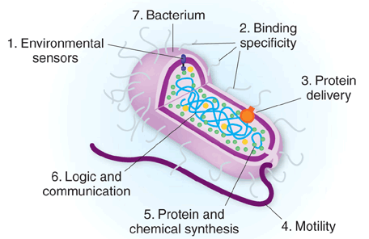
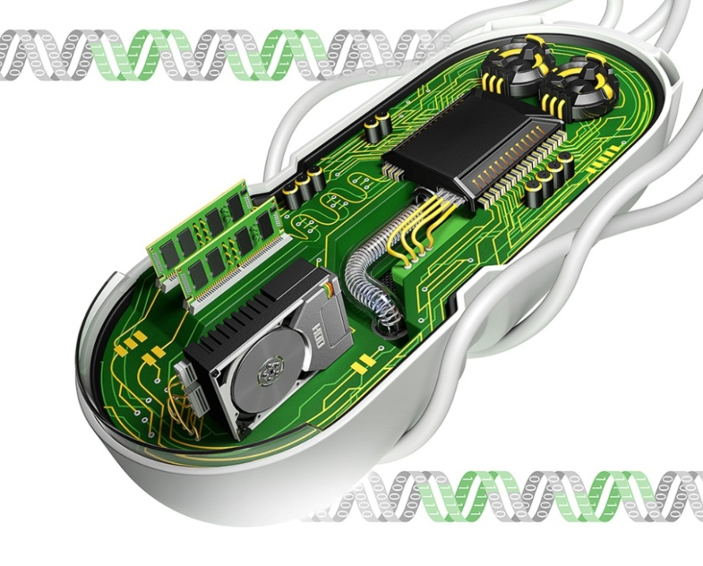
Designing customised gene circuits
IMAGE: LIANG ZONG AND YAN LIANG
Escherichia coli
Notes:
Cells live in an ever-changing environment and continuously sense, process and react to environmental signals using their inherent signaling and gene regulatory networks.
There is a long-standing interest in the ability of the cell to sense various extracellular signals with extreme specificity, and decide precisely what response should be initiated to adapt to the ever-changing environment.
Like an elec-tronic biosensor, cells typically have three interconnected modules to accomplish the task, that is, the input sensors, the internal gene regulatory networks and the output actuators (Figure 1) [1,2]. The input sensors are receptors either embedded in the cell membrane or inside the cyto-plasm, which the cell uses to detect what and how much of the input signals are present, e.g., small molecules, heat, light, and transduce them into differential gene transcriptional levels or post-translation-al modifications. Next, the transduced information is pro-cessed combinatorially by the downstream gene regulatory network, mimicking the logic circuit in electronic circuitry [3], and integrated logically before an output decision is made. According to the decision, the gene expression machineries are then altered to produce different levels of cognate proteins and biochemicals as the output actuators, resulting in final phenotypic changes in motility, growth, morphology, metabolism and so on.
In this sense, cells can be viewed as replicating living computers but with biological inputs and outputs. The internal gene regulatory networks could be viewed as assemblies of digital logic and analogue circuits which cells use to cascade and integrate multiple environmental and cellular signals

Slide 4
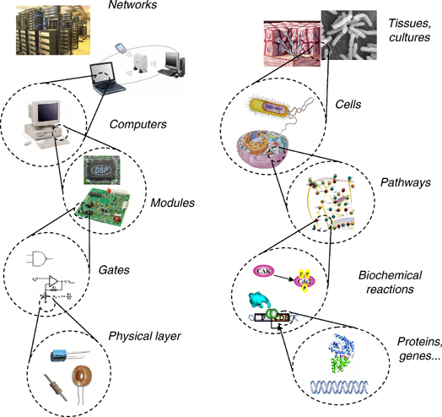
An analogy between synthetic biology and computer engineering

Slide 5
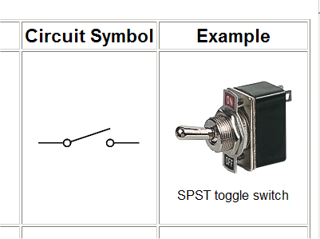
Toggle Switch
Notes:
Interrupteur à bascule

Slide 6
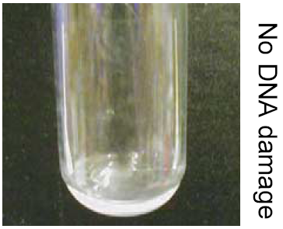
Biologically based devices
A genetic toggle switch that switches engineered bacteria to form a biofilm.
Bistable switch
No DNA damage
DNA damage
Collins et al. PNAS, 2004

Slide 7
Systematic Design
The basis of all engineering - parts, devices and systems

Slide 8


The Engineering Approach to Design
Modularity
Standardisation
Modelling

Slide 9
The Engineering Approach to Design
Engineering systems are built from a hierarchy
  Parts
  Devices
  Systems
At each level the characteristics of the Part, Device or System are well defined and reproducible
In engineering the aim is to build a system on the basis of devices which comprise standard parts

Slide 10
Synthetic Biology: aims to build applications from standard biological components - BioBricks
Parts – encode biological functions (ie often modified DNA)
Devices – made from a collection of parts and encode human-defined functions (eg logic gates)
Systems – perform tasks, eg counting

Slide 11
Engineering Biology
Modularity, Standardisation, Abstraction
A hierarchy for synthetic biology
Typical gene transcription module
Ribosome binding site
Protein coding sequence
Terminator
Transcription factor
TF

Slide 12




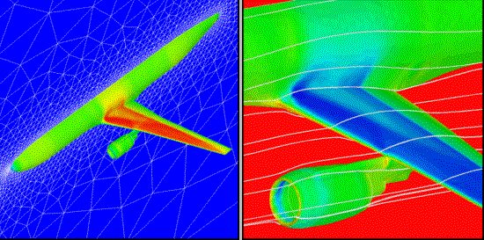
The Engineering Approach
Specifications
Testing/Validation
Design
Standard
Engineering
Practice
Certified
Implementation
Modelling
Notes:
Illustrate the traditional engineering approach with an engineering success story (….)
Present our attempt to use this powerful methodology on our project (iterative process, documentation, modelling to save some money….)
Slide:
Be visual on the kind of documents produced by each step on a given system

Slide 13
Building : the parts

Slide 14
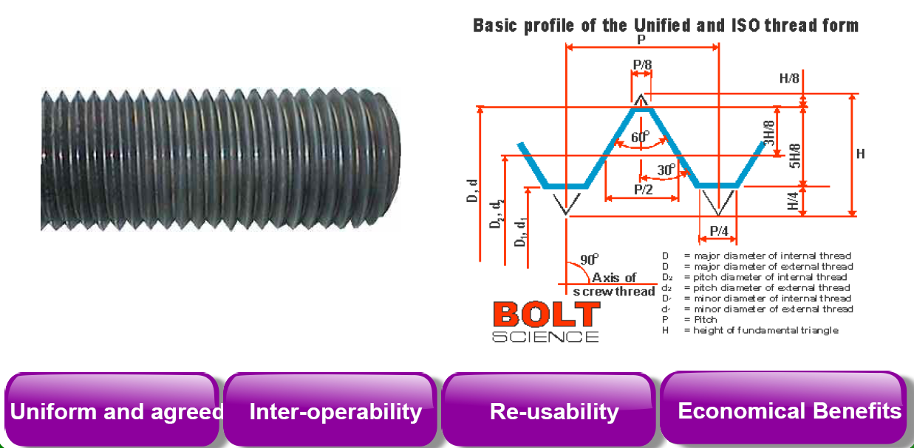
Standard principle

Slide 15
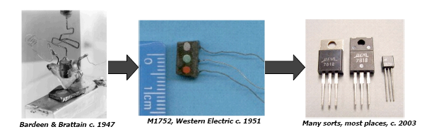
Lessons from engineering
Standardization of components (mechanical engineering, 1800s).
Libraries of standard interchangeable parts that allow a combination of systems to be designed and assembled.
Notes:
To enable the routine production of many-component integrated biological
systems we should develop libraries of standard biological parts. Initially,
most parts will be “harvested” from natural systems. Development of domain
specific parts would enable the engineering of systems responsive to different
applications of biological technology. Parts specific to the following application areas
would find immediate use: biological information processing and control, material
fabrication, metabolism and energy production, and human health.

Slide 16

The iGEM Registry

Slide 17
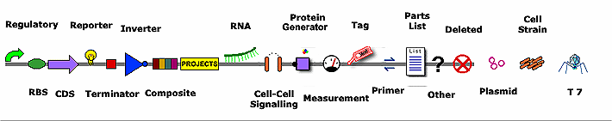
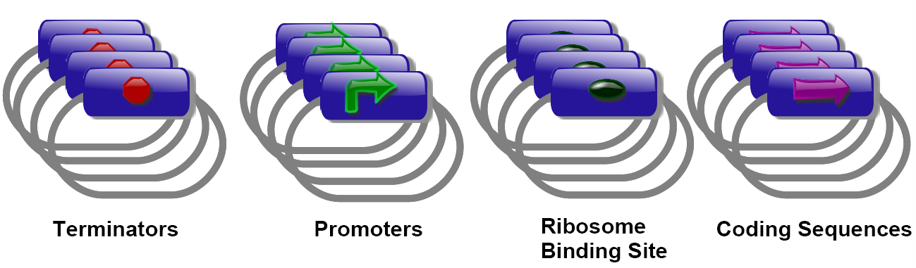
Examples of Parts
To see the catalogue of standard parts from the diagram above, refer the website below
http://parts.igem.org

Slide 18
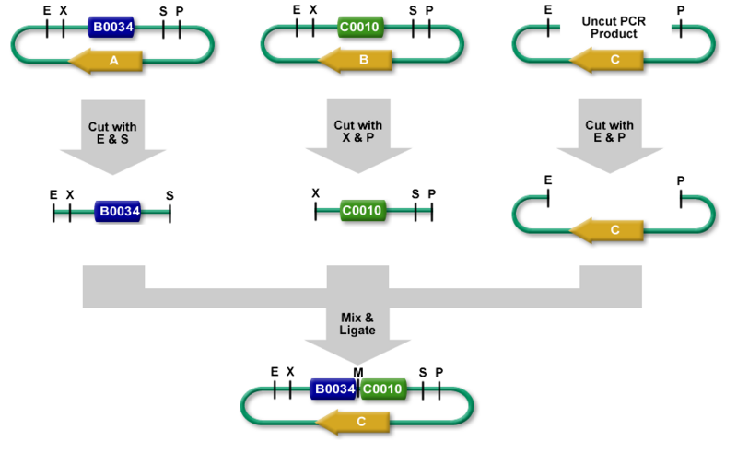
BioBrick standard genetic parts
EcoRI XbaI
BioBrick prefix: GAATTCGCGGCCGCTTCTAGAG
BioBrick suffix: TACTAGTAGCGGCCGCTGCAG
The scar between two joint BioBrick parts:
GAATTCGCGC…CGCTTCTAGTAGC…CCGCTGCAG
SpeI PstI
EcoRI PstI
Notes:
X et S sont compatable mais la cicatrice ne sera pa digestible

Slide 19
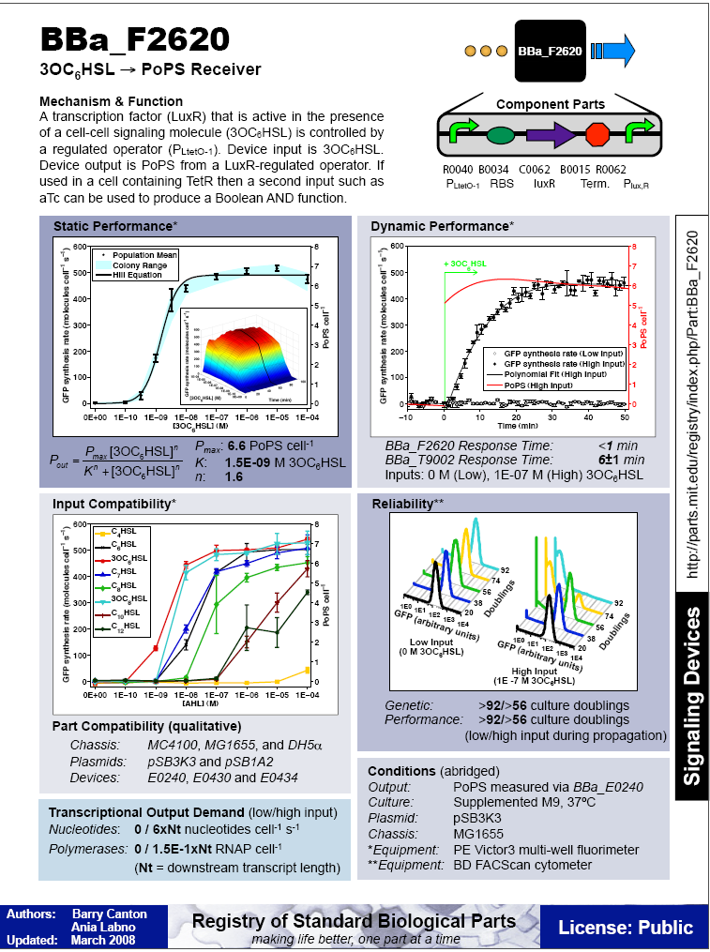

Biobrick BBa_F2620

Slide 20
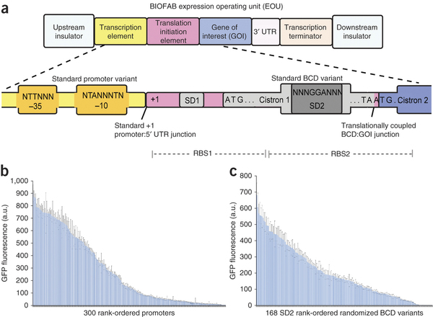
BIOFAB the EOU
Vivek K Mutalik Nature Methods 10, 354–360 (2013) doi:10.1038/nmeth.2404

Slide 21
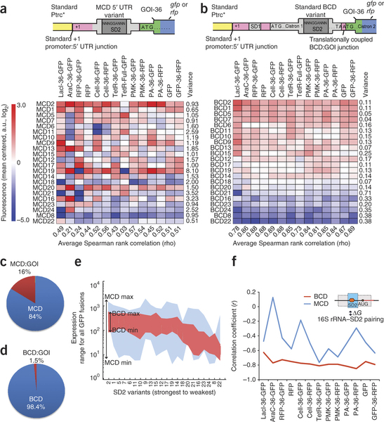
It’s more complicated than that…

Slide 22
A possible solution: Bi-cistronic design (BCD)

Slide 23
BCD allows better predictability
Notes:
a) Gene expression via a regularized medium-strength promoter (Ptrc; asterisk indicates an absent operator sequence) and 22 monocistronic design (MCD) 5′ UTRs of varying expression strength. Eight GOIs coding for a total of 14 chimeric reporter fusions with either gfp or rfp (columns) are shown. The 14 chimeric reporter GOIs are encoded via the first 36 nt of the N-terminal coding sequences of lacI, araC, rfp, gfp, tetR and genes encoding putative cellulase (Cell), phosphomevalonate kinase (PMK) and penicillin acylase (PA) and via the full-length coding sequence of tetR (Online Methods). Variance in mean-centered log2 expression (left) from each MCD across all GOIs sequences (right) and average Spearman rank correlations (bottom) as given (Supplementary Fig. 8). a.u., arbitrary units. (b) The same SD sequences used in a encoded within bicistronic designs (BCDs). Rank orderings for a and b were established via data of b. Variance in mean-centered log2 expression from each BCD across all GOIs (right) and average Spearman rank correlations (bottom) as given (Supplementary Fig. 6).

Slide 24

Distribution?
https://www.addgene.org

Slide 25
Standard – Metrology
Measuring activity

Slide 26
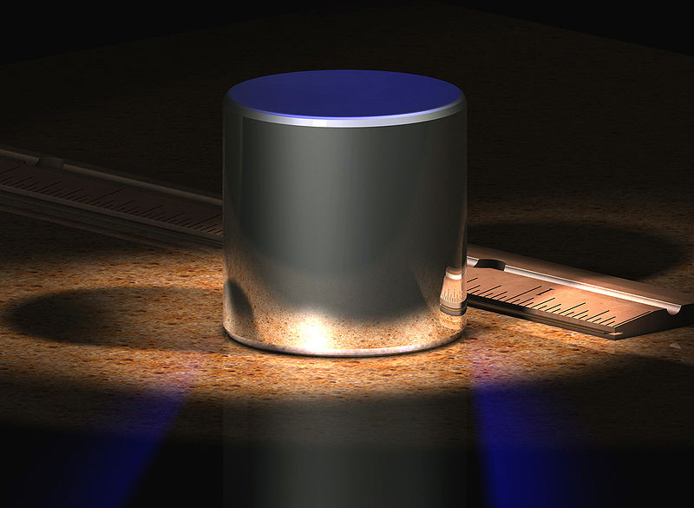

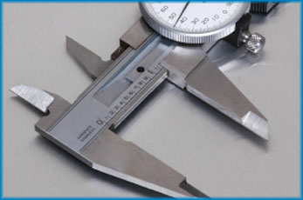
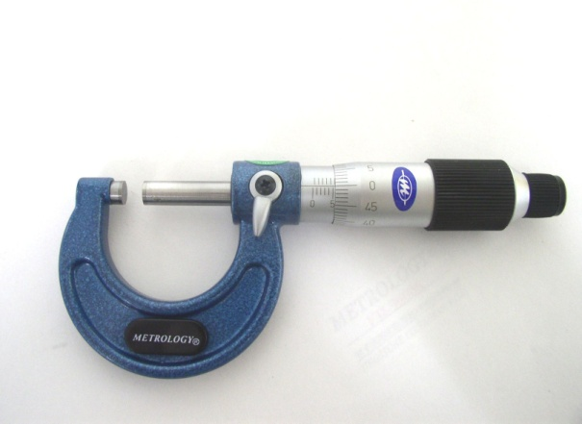
Standard (metrology)
International Prototype kilogram
(IPK), made from an alloy of 90% platinum and 10% iridium and machined into a right-circular cylinder (height = diameter) of 39.17 mm.
tape measure 0.1 mm vernier caliper 0.01 mm micrometer 0.001 mm
Notes:
tape measure 0.1 mm
A tape of cloth, paper, or steel marked off in a linear scale, as of inches or centimeters, for taking measurements.Also called tapeline
vernier caliper 0.01 mm
A measuring instrument consisting of an L-shaped frame with a linear scale along its longer arm and an L-shaped sliding attachment with a vernier, used to read directly the dimension of an object represented by the separation between the inner or outer edges of the two shorter arms.
Micrometer 0.001 mm
A device for measuring very small distances, objects, or angles, especially one based on the rotation of a finely threaded screw, as in relation to a microscope.

Slide 27

Standardise biological measurements ?

Slide 28
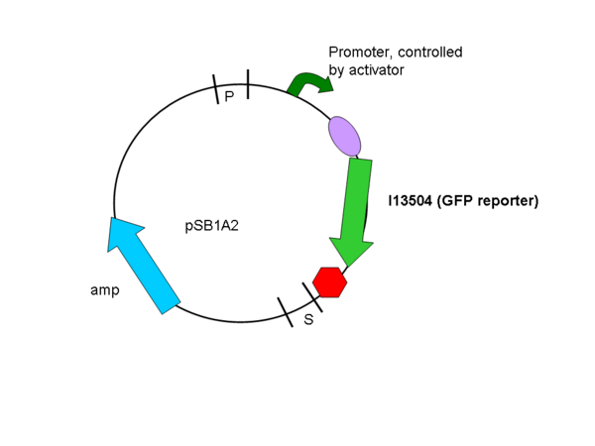
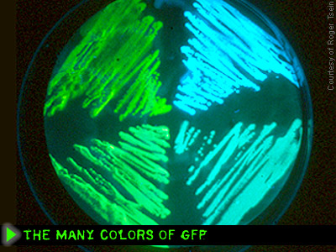
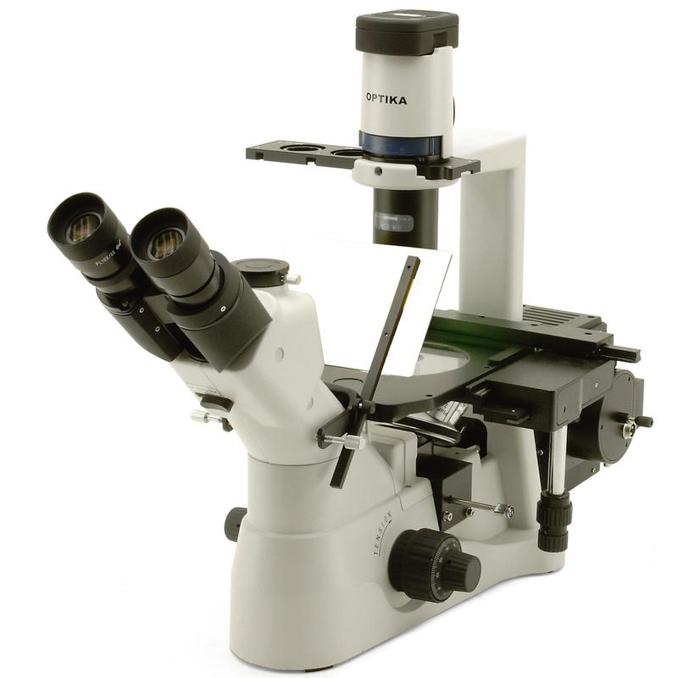


Common biological reporter and measure

Slide 29
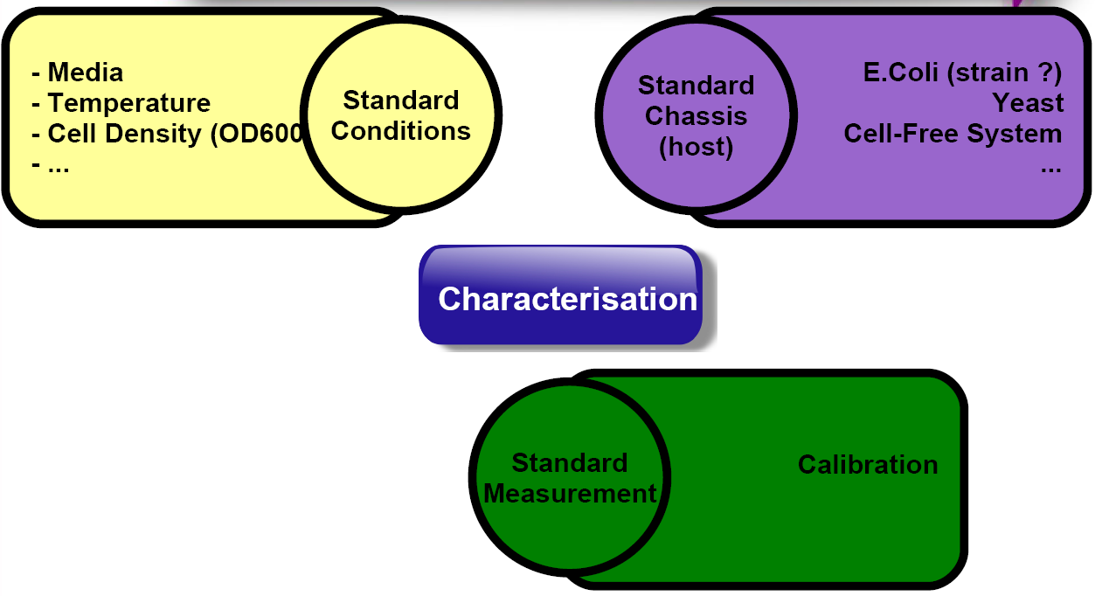
Standard characterisation

Slide 30
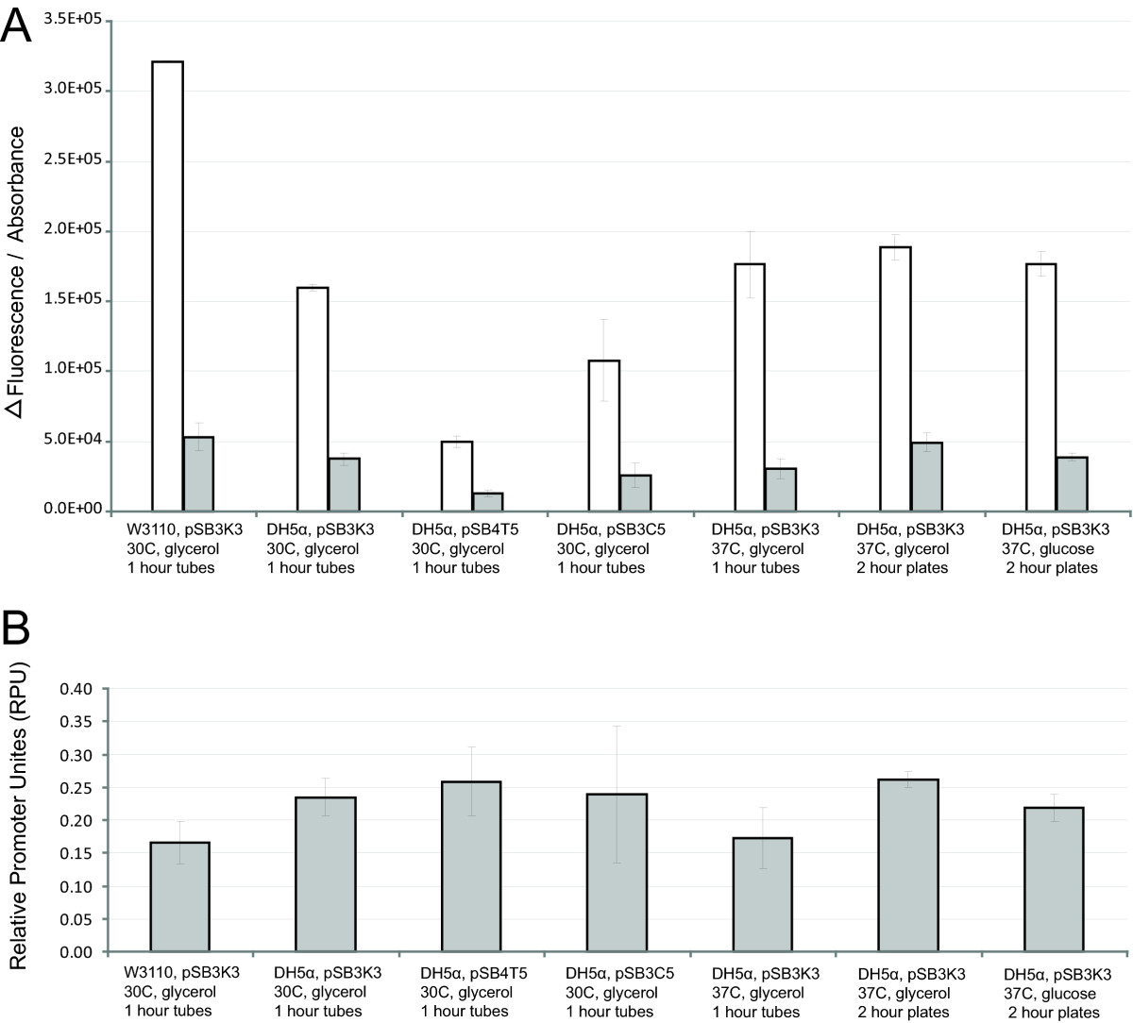
Measuring promoter strength without and with a reference
J23101 (white bars)
J23150 (grey bars)
across 7 different testing conditions
Ratio J23150/J23101
Kelly et al 2009, Journal Biol. Eng.

Slide 31
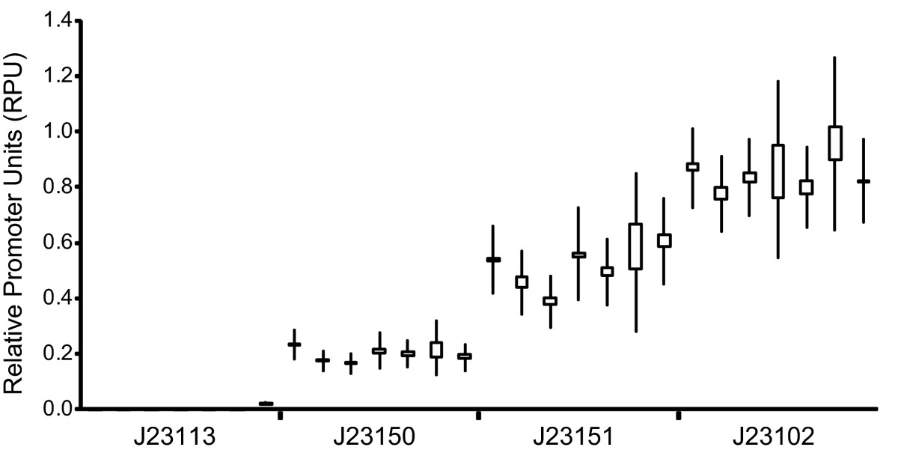
Measuring the activity of BioBrick promoters using an in vivo reference standard (J23101)
Kelly et al 2009, Journal Biol. Eng.

Slide 32
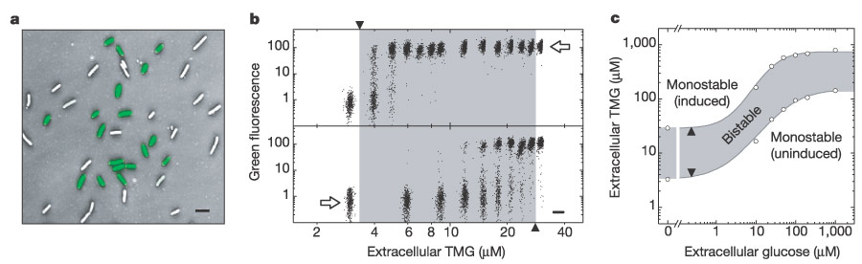
Measure population or cells?
The lactose operon, and many other inducible systems are bistable
This induces heterogeneity in the population
Collins et al. PNAS 2004

Slide 33
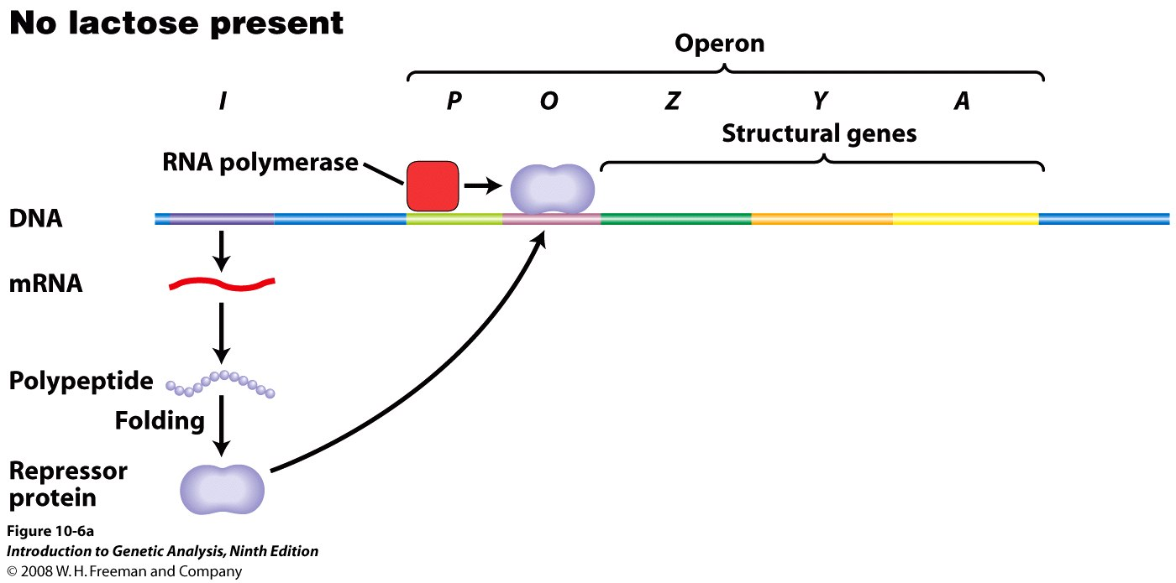
The lactose operon is negatively regulated
Transcription of Z, Y, A genes are repressed by the lacI gene product which binds to the operator DNA sequence and transcription is blocked

Slide 34
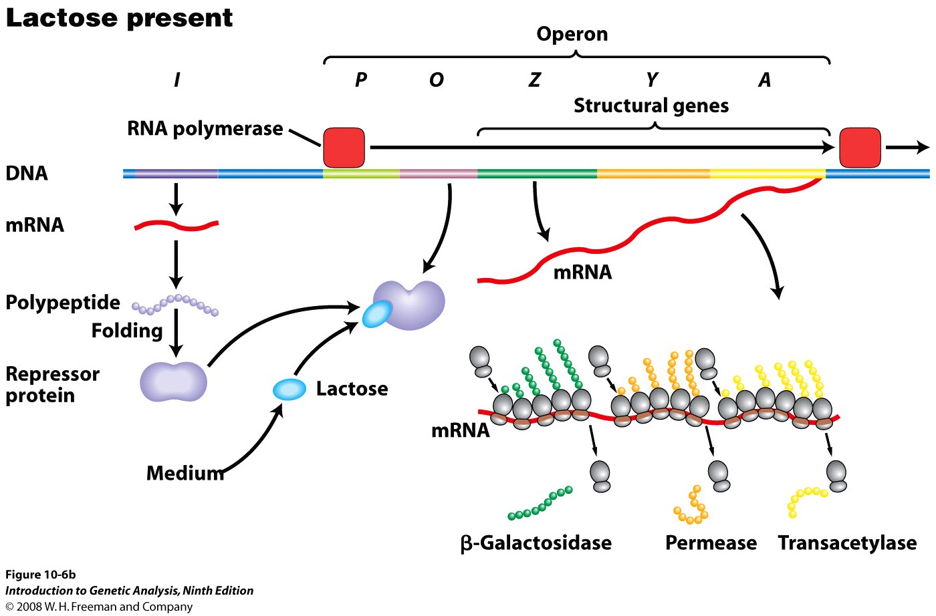
The lactose operon is de-repressed by lactose.
Lactose (allolactose) binds to the LacI repressor and produces a conformational change (allostery) - the repressor cannot then bind to the operator, allowing transcription

Slide 35
Why is it important?
Positive feedback builds bi-stability
Sensitivity of sensor possibly affected

Slide 36
Any better reference standard?
Dual colour ratiometric (gfp and rfp) in the same cell host
Can we design a circuit to control/minimise variation of part behaviour in different contexts ?
Systematically measure single cells

Slide 37
Modelling

Slide 38
A typical transcriptional regulatory device
Currently ODEs (ordinary differential equations) are mainly used for modelling in Synthetic Biology

Slide 39
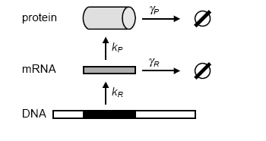
Modelling a single gene expression dynamics

Slide 40
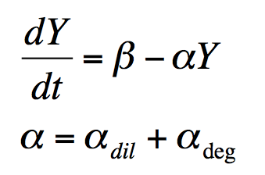
Expression of protein Y
Because of separation of time scales we “forget”
about transcription

Slide 41
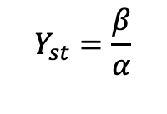

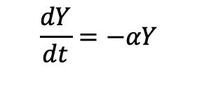
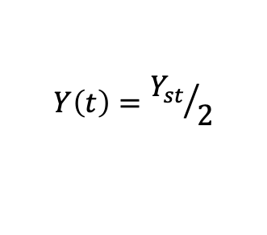
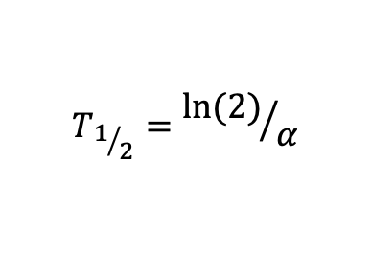
Steady state and response time
At steady state
Y dynamics:
Response time depends only on α !!

Slide 42
Reverse case
At t=0 Y=0 and I start translating
What is the response time?

Slide 43

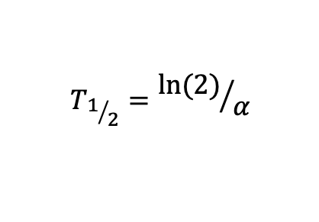
Reverse case
At t=0 Y=0 and I start translating
What is the response time?
It does not depend on β!!!
The response time is very slow

Slide 44

Response time
After translation stops
When translation starts
Slope

Slide 45
Implementation

Slide 46
Building a genetic AND gate
[I₁] | [I₂] | [O]
0 | 0 | 0
0 | 1 | 0
1 | 0 | 0
1 | 1 | 1
AND gate (I₁ & I₂):
Notes:
takes both R and S to bind to RNA for ATP hydrolysis and subsequent reactions
Second I1 should be an I2, according to the legend
R and S together both bind to the DNA which activiates the transciption of hrpL promoter, ans subsequently GFP.

Slide 47
Background
Terms:
  Digital system: on/off – 1/0
  Forward engineering: classifying/evaluating components before choosing the parts to build the system
  Modular: can change inputs and outputs and logic gate will still work
  Orthogonal: no cross-talk to existing or endogenous genetic parts
Notes:
digital system: one response at "low" concentration (below some threshold), much different response at higher concentrations
- Should look like a step function
"...incorporate all of those ideas into..... the paper"

Slide 48
Project Overview
Objective: to engineer digital-like genetic devices using modular and orthogonal parts via forward engineering
Design AND gate
Component characterization
Modelling & validation
Test Modularity
Chassis Compatibility

Slide 49
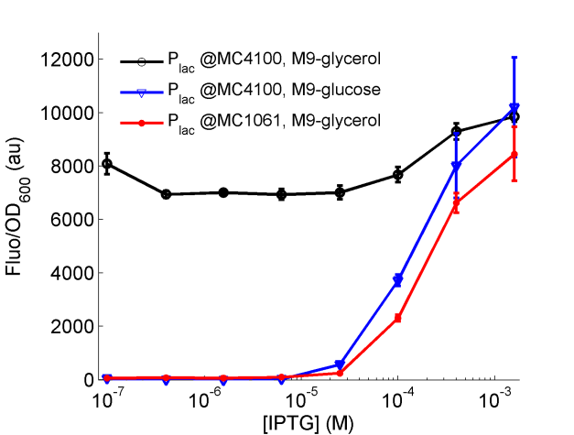
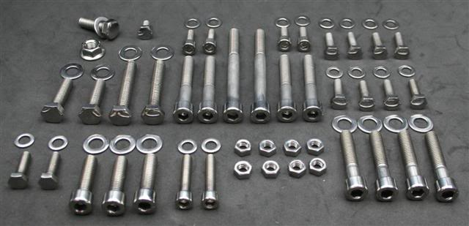
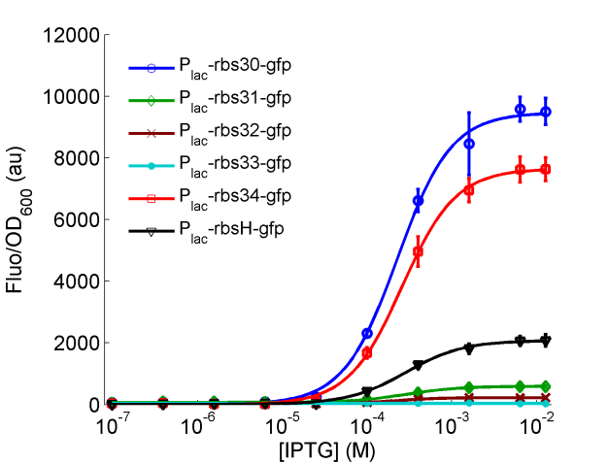
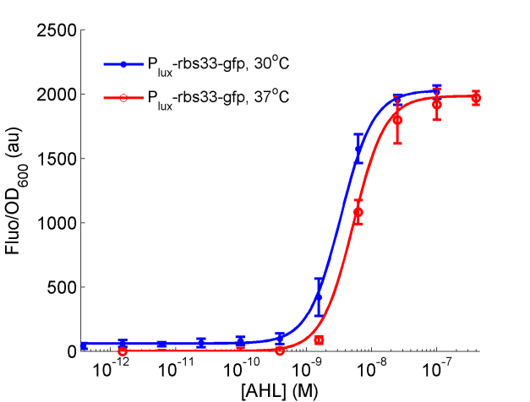
A parts-based engineering approach
a
Chassis
Media
b
6 RBSs
c
Temperature

Slide 50
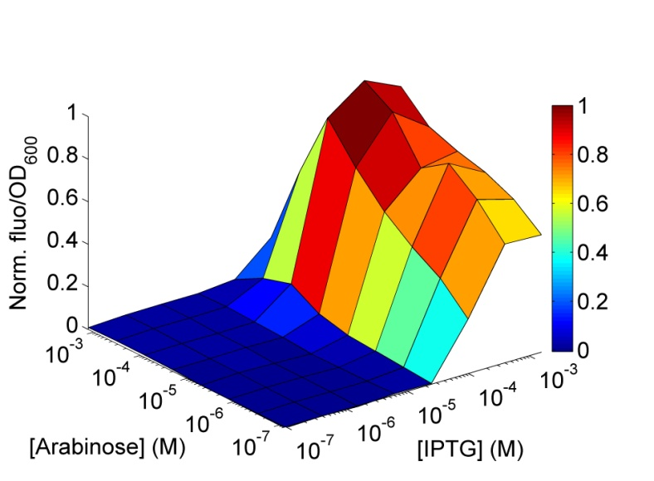
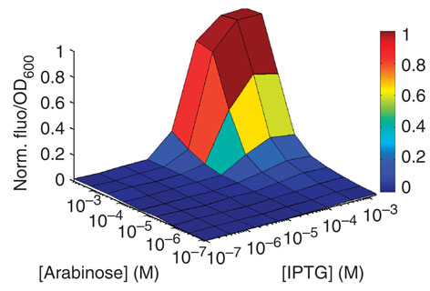
Forward engineer the genetic AND gate
Tuning rbs
(a) AND gate constructed in trial and error
(b) Forward engineered AND gate
In E. coli MC1061, M9-glycerol, 30˚C

Slide 51
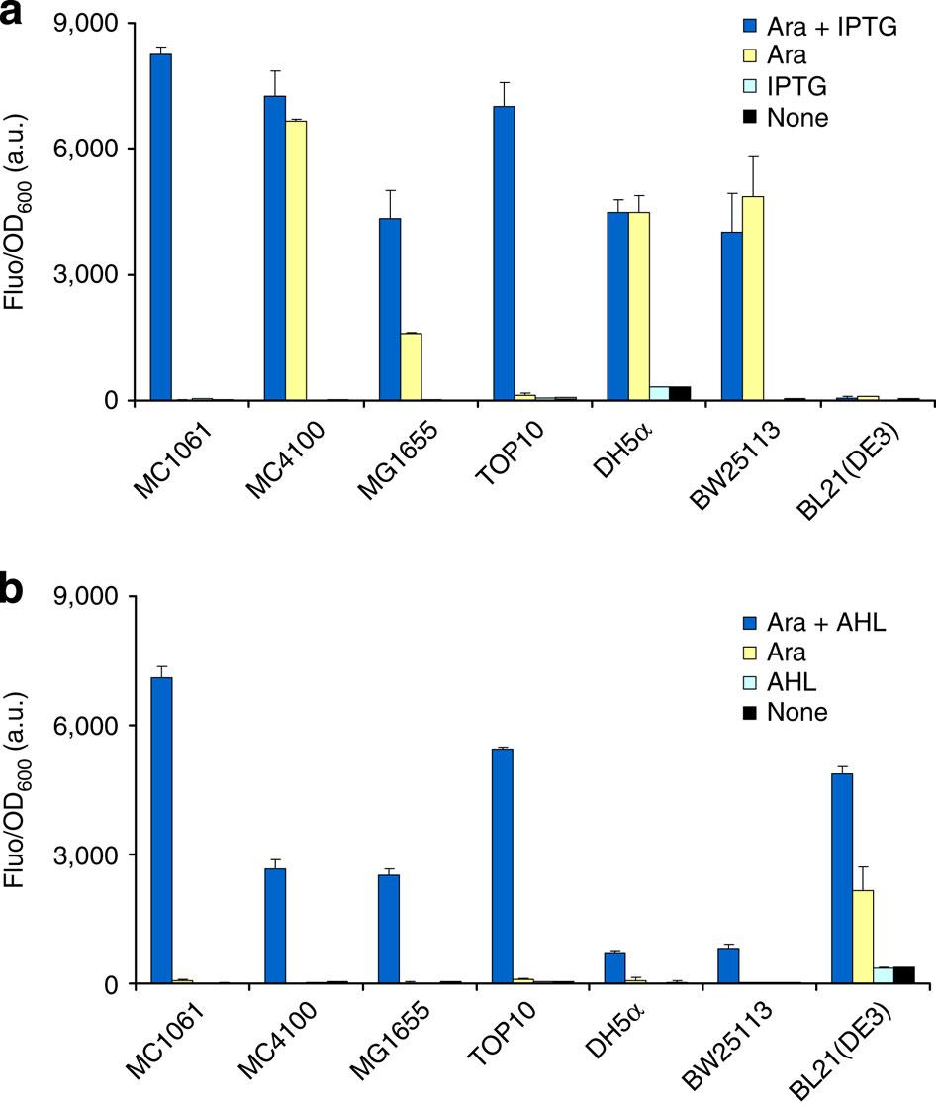
Chassis compatibility
✗
Performance of AND gate across 7 E. coli chassis
Top: Gate 1 (P_{lac} + P_{BAD})
Bottom: Gate 2 (P_{lux} + P_{BAD})
✗
✗
✗
✗
✗
Notes:
Ara + IPTG = on
Ara }
IPTG }= off
None }
Gate 1: only 2/7 worked
Gate 2: 6/7 worked, bc Plux not found in E coli, so no crosstalk
--> AND gate compatible with cell, but promoters have to be chosen carefully based on host chassis

Slide 52
Real Life applications

Slide 53
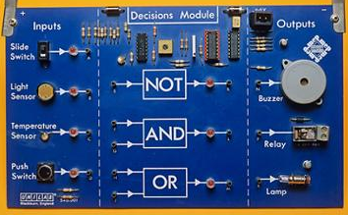
Application – synthetic cellular biosensors
Inputs
Outputs
metal ions
chemicals
light
heat
antigens
R₁
gfp
rfp
reporters
pigments
motility
electrons
chemicals
P₁
luxAB
lacZ
P
P
cheZ
R₂
P
P₂
luxI
lasI
P
Sensors
Genetic logic circuits
Actuators
Modular; Programmable; Multi-input
Wang et al, Trends in Microbiology, 2012
Wang et al, Biosensors & Bioelectronics, 2013
Notes:
Architecture of a synthetic modular cell-based biosensor. The cellular sensor comprises three interconnected and exchangeable modules, i.e. the input sensors, the internal genetic information processing circuits and the output actuators. The cells are engineered using various natural or synthetic sensors such as sensor kinases or intracellular receptor proteins to detect environmental signals and genetic circuits such as AND and NOT logic gates to modulate and integrate these multiple input signals. The programmed cells can then initiate customized responses by activating different output genes according to the logic decision transmitted upstream
Figure 1. Designing customized cell signaling responses by harnessing the inherent modularity of cell signaling and gene regulatory networks. Genetically engineered cells typically comprises a cascade of three exchangeable modules, that is, the sensors such as sensor kinases or intracellular receptor proteins (R) for detecting surrounding chemicals, nucleic acids, proteins, light, pH and heat, etc., the internal information processing circuits for integrating these multiple input signals to make a logic decision, and finally the output actuators for producing reporters, toxins, chemicals, electrons, motility, growth changes, etc. By designing different synthetic logic circuits to connect the various natural or synthetic sensors and the selected output genes, we can program cells to carry out novel customized tasks.

Slide 54
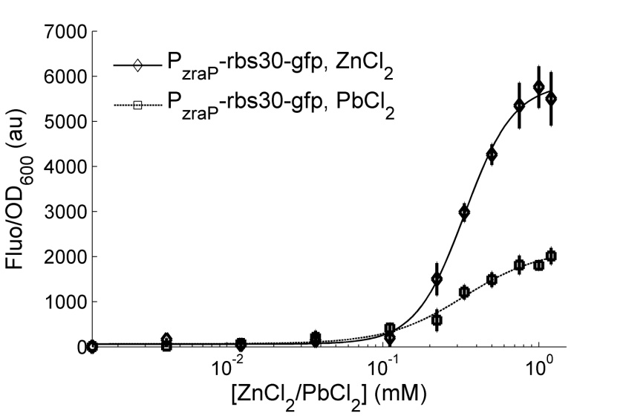
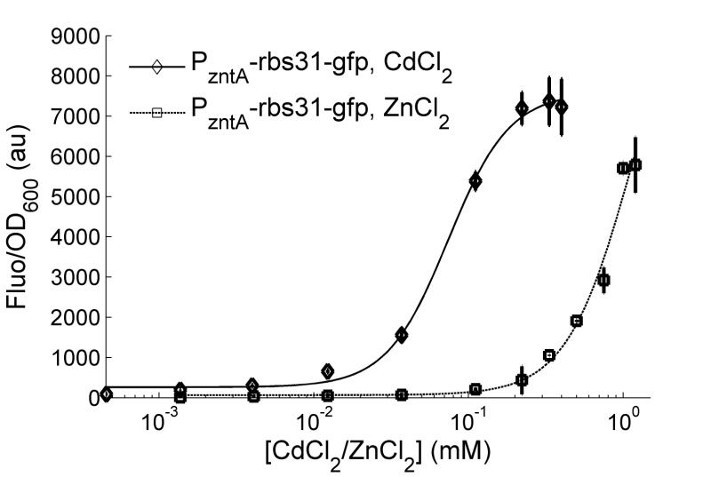
Problem: non-selective zinc, cadmium sensors

Slide 55
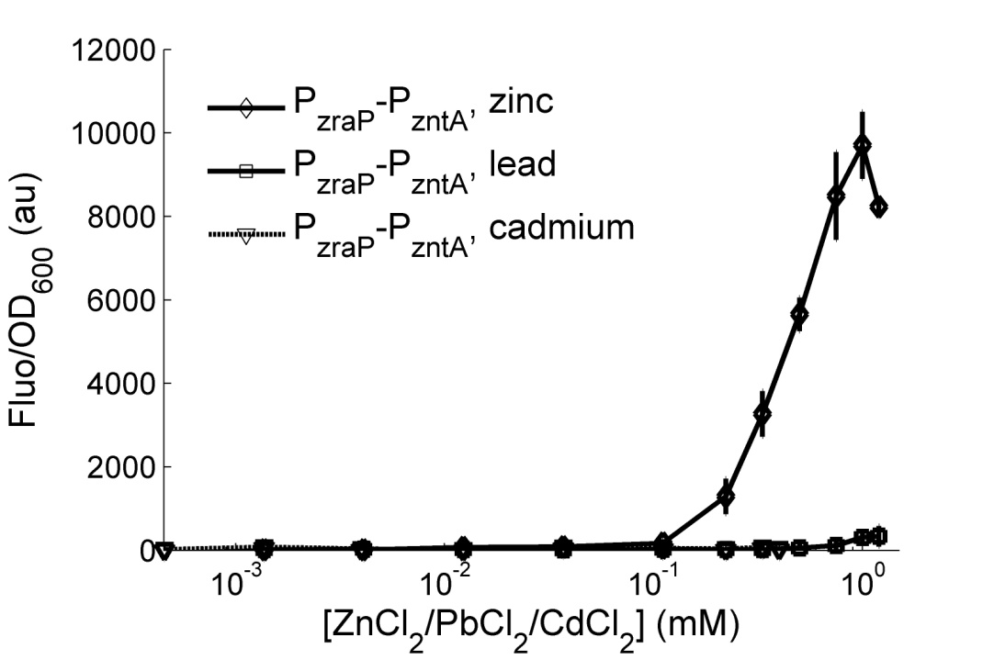
Solution: selective sensor by an AND gated filter
Wang et al, Biosensors & Bioelectronics, 2013

Slide 56
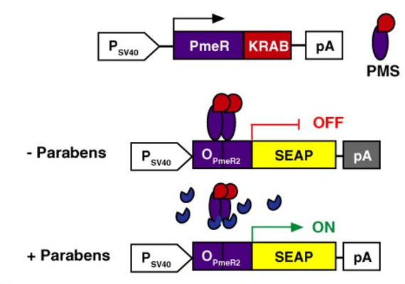
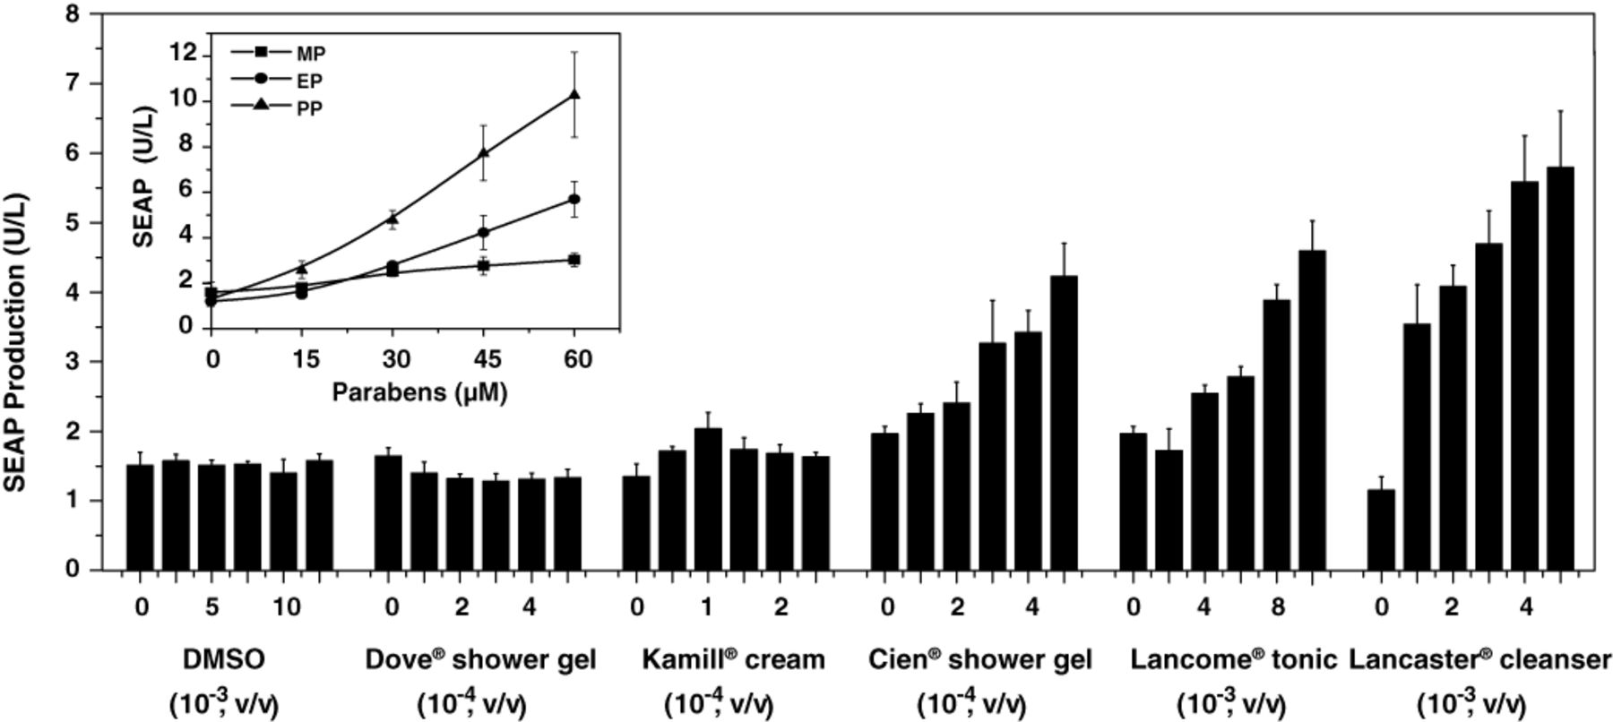

Cosmetics-induced PAR-ON dependent SEAP expression in mammalian cells
Hui Wang et al. Nucl. Acids Res. 2015;43:e91
© The Author(s) 2015. Published by Oxford University Press on behalf of Nucleic Acids Research.
Notes:
Cosmetics-induced PAR_{ON}-dependent SEAP expression in vitro. HeLa cells were co-transfected with pWH9 and pWH5 and cultivated in cell culture medium containing different cosmetic products (Dove® shower gel, Kamill® hand-cream, Lancôme Paris® Tonic, Cien® shower gel, Lancaster® Express Cleanser) at different dilutions (v/v) or different concentrations (0–60 μM) of various parabens (MP, methylparaben; EP, ethylparaben; PP, propylparaben) (insert). Addition of the DMSO was used as solvent control. Forty-eight hours after addition of cosmetics, SEAP levels in the culture supernatant were profiled. All data are shown as the mean ± SD, n = 3 independent experiments.

Slide 57
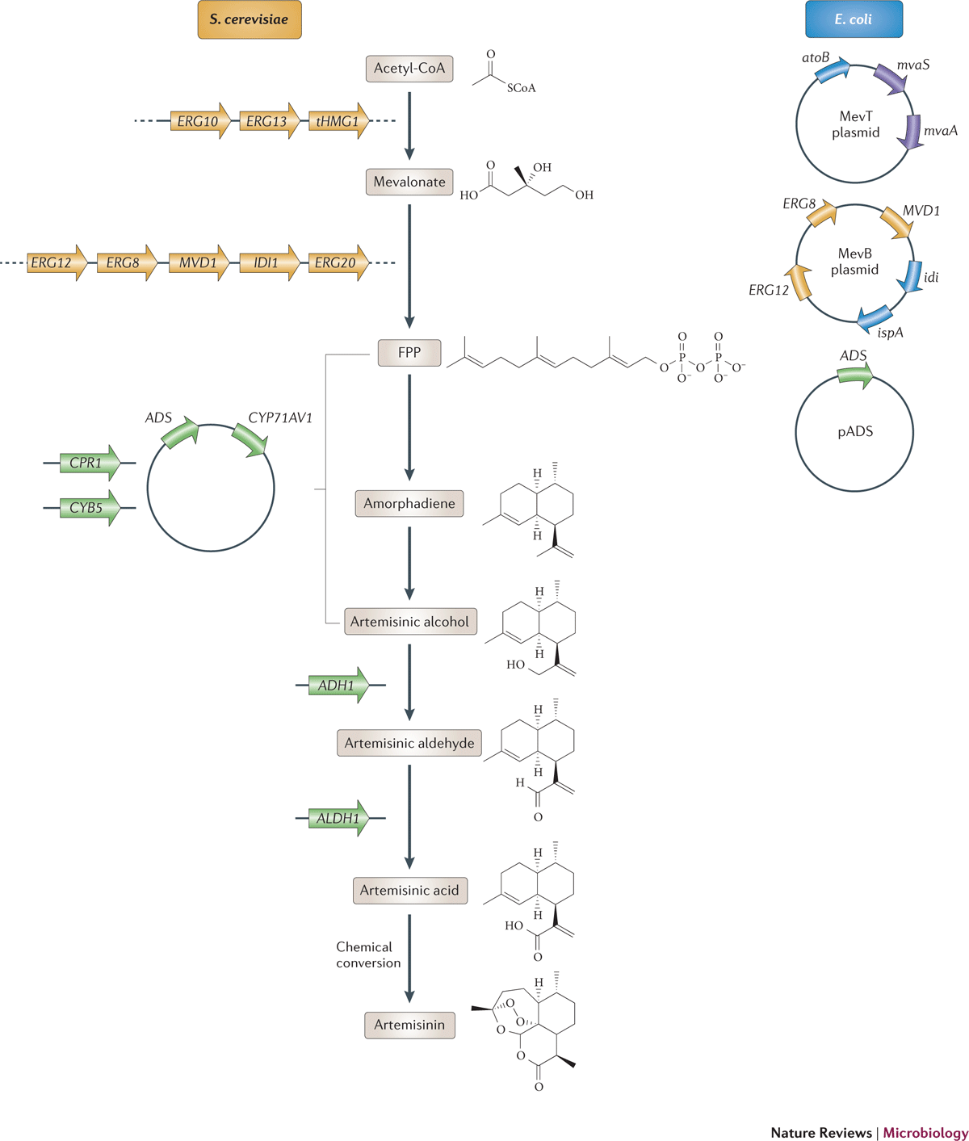
Artemisinin bio-synthesis (Amyris and sanofi)
Paddon, Keasling, Nat. Rev. Microbiol, 2014

Slide 58
The Engineering Approach
Specifications
Testing/Validation
Design
Standard
Engineering
Practice
Implementation
Modelling
Notes:
Illustrate the traditional engineering approach with an engineering success story (….)
Present our attempt to use this powerful methodology on our project (iterative process, documentation, modelling to save some money….)
Slide:
Be visual on the kind of documents produced by each step on a given system

Slide 59

The End
Many thanks to Baojung Wang ( University of Edinburgh)
for his help in preparing this lecture

