Slide 1
Class 4 – PeiP1
OCTOber 7

Slide 2
Recap + homework
Listening - Engineering at the university of Cambridge and Birmingham
⇨ What is Polytech like?
Text – Fixing the freshman year – here’s what college sophomores say
Listening - differences between the French and British education systems
⇨ What problem(s) do Polytech students face?

Slide 3
The cost of studies
Tuition fees:
How do universities spend tuition fees?

Slide 4
The cost of studies in the US

Slide 5
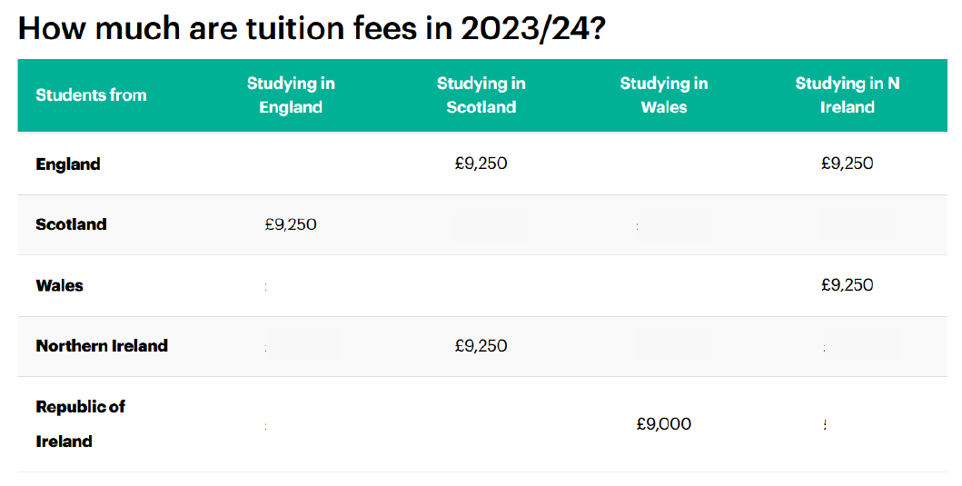
The cost of studies in the UK

Slide 6
Which system is the best?
You will participate in a class debate about the different higher-education systems.
Complete the grid below with what you think are the advantages (+)/ disadvantages(-) of each system. Think of the consequences of each advantage or disadvantage.

Slide 7
Homework for October 14
Review comparative (eCampus)
Reading : UK tuition fees for international students p.19-20
Get ready for the debates: prepare your arguments

