Slide 1
Virtual Exchange Project
Autumn 2024

Slide 2
General Information
Bi-Lingual Virtual Exchange: English & French
Tandems or triads: One UL student and one Paris-Saclay student or one UL student and two Paris-Saclay students
Duration: 12 weeks
Number of tasks: 3 Types of communication: - primarily via online synchronous tools (e.g. Zoom, WhatsApp, FaceTime) - interaction fifty-fifty in both languages
Assignments submission: on Brightspace (UL) / eCampus (Paris-Saclay)
Grading: 25% (UPSay)
Submission dates: Task 1 - Friday 4 October Task 2 - Friday 08 November Task 3 - Friday 06 December

Slide 3
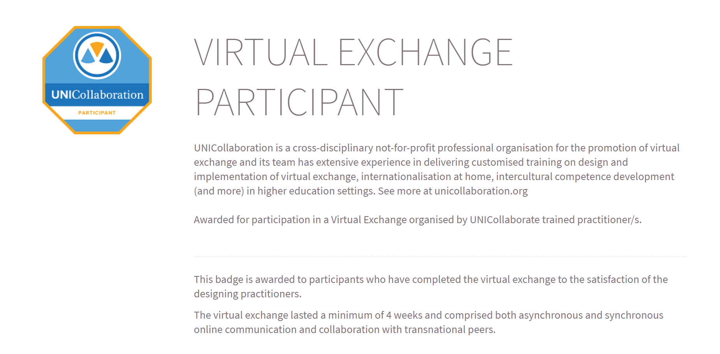
Participant UNICollaboration.png

Slide 4
Task 1 (10%) Cultural Biographies: Insights into Partner’s Cultural Life and Favourite Place
Format:
2 Multimodal presentations (= text, picture and audio/video)
One in English and one in French
In the Target Language
Maximum 5 slides
Circa 3-5 minutes of audio/video comments
Slides should include the name of your partner, key points noted from your discussion, and a screenshot of your online interaction.
Submission:
Upload the presentation in your target language on Brightspace/eCampus by Friday 4 October 5pm

Slide 5
Task 1 (10%) Cultural Biographies: Insights into Partner’s Cultural Life and Favourite Place
Step-by-Step Task Template for tandems
1. Organise a videoconference and introduce yourselves.
2. Give a personal insight into your respective student life/ experience at Limerick and UPS to your partner. i.e. exchange on a number of topics relating to your hobbies, your favourite place / tourist spot in your region/country (avoid clichés, make it personal, share personal photos)
3. Each student chooses two striking aspects of his/her partner’s narrative. Each student includes these aspects in the presentation they submit.
4. Draft & record your audio commentary in the target language using a multimodal presentation (e.g. PowerPoint, Prezi, Padlet). Bring your story to life with digital storytelling.
5. The final presentation should include (i) text, images/video describing partner and (ii) an audio comment with own voice.

Slide 6
Task 1 (10%) Cultural Biographies: Insights into Partner’s Cultural Life and Favourite Place
Step-by-Step Task Template for triads
1. Organise a videoconference and introduce yourselves.
2. Give a personal insight into your respective student life/ experience at Limerick and UPS to your partner. i.e. exchange on a number of topics relating to your hobbies, your favourite place / tourist spot in your region/country (avoid clichés, make it personal, share personal photos)
3. The UL student chooses one striking aspect of each of his/her two partners’ narrative. Each of the two UPS students chooses two striking aspects of the UL partner. Each student includes these aspects in the presentation they submit.
4. Draft & record your audio commentary in the target language using a multimodal presentation (e.g. PowerPoint, Prezi, Padlet). Bring your story to life with digital storytelling.
5. The final presentation should include (i) text, images/video describing partner(s) and (ii) an audio comment with own voice.

Slide 7
Task 2 (10%) Cultural Chat-Show or Podcast
Format:
2 Radio Interviews;
One in English and one in French
In the Target Language
Circa 3-5 minutes each
Submission:
Upload the podcast in your target language on Brightspace / eCampus by Friday 08 November 5pm

Slide 8
Task 2 (10%) Cultural Chat-Show or Podcast
Step-by-Step task template for tandems
1. Partners select together two cultural artefacts (e.g. novel extract/ poem/ play/ song/ art work) of their choice in their respective native language.
2. Read / Listen to / Access your partner’s artefact. Optional: do the same with your own artefact if needed.
3. Share reactions with each other commenting on elements of interest (author, context, themes, styles, etc. ) of the two artefacts.
4. Record Interview 1: The UL partner takes the role of interviewer/ journalist and conducts a short interview (on the English-speaking cultural artefact). The interviewer gives a short introduction addressing the target audience and asks a minimum of 3 questions in English, which will be the language of the interview. Interviewee is encouraged to share the results of their discussions (e.g. impressions upon discovering the artefact, themes, styles, etc.).
5. Record Interview 2: The UPS partner takes the role of interviewer/ journalist and conducts a short interview (on the French-speaking cultural artefact). The interviewer gives a short introduction addressing the target audience and asks a minimum of 3 questions in French, which will be the language of the interview. Interviewee is encouraged to share the results of their discussions (e.g. impressions upon discovering the artefact, themes, styles, etc.). 6. Each interview should include elements to make it realistic (e.g. an intro/outro specifying name of programme, name of interviewer, guest(s), music, etc.)

Slide 9
Task 2 (10%) Cultural Chat-Show or Podcast
Step-by-Step task template for triads
1. Partners select together two cultural artefacts (e.g. novel extract/ poem/ play/ song/ artwork) of their choice in their respective native language. Students from UPS agree on one artefact on their side.
2. Read / Listen to / Access your partner’s artefact. Optional: do the same with your own artefact if needed.
3. Share reactions with each other commenting on elements of interest (author, context, themes, styles, etc. ) of the two artefacts.
4. Record Interview 1: The UL partner takes the role of interviewer/ journalist and conducts a short interview with the 2 UPS partners (on the English-speaking artefact). The interviewer gives a short introduction addressing the target audience and asks a minimum of 4 questions in English, which will be the language of the interview. Interviewees are encouraged to share the results of their discussions (e.g. impressions upon discovering the artefact, themes, styles, etc.).
5. Record Interview 2: The UPS partners take the role of interviewers/ journalists and conduct a short interview (on the French-speaking artefact). Interviewer A gives a short introduction addressing the target audience, and Interviewer B asks a minimum of 4 questions in French, which will be the language of the interview. Interviewees are encouraged to share the results of their discussions (e.g. impressions upon discovering the artefact, themes, styles, etc.). 6. Each interview should include elements to make it realistic (e.g. an intro/outro specifying name of programme, name of interviewer, guest(s), music, etc.)

Slide 10
Task 3 (10%) Flyers on an environmental initiative on your campuses [Tracts écologie] (1 targeted at staff and 1 targeted at students)
Format:
4 flyers
Two flyers in English (1 in neutral register aimed at the general public and 1 in youth language aimed at students) and two flyers in French (1 in neutral register aimed at the general public and 1 in youth language aimed at students)
Circa 75-150 words per flyer. The word count may differ based on the language register used.
Submission:
Upload the 2 flyers in the target language + short commentary in your native language on Brightspace /eCampus by Friday 06 December 5pm

Slide 11
Task 3 (10%) Flyers on an environmental initiative on your campuses [Tracts écologie] (1 targeted at staff and 1 targeted at students)
Step-by-Step task template for tandems
1. Brainstorm and identify 1 or 2 environmental issue(s) of interest to your group relating to your university campus.
2. Suggest ‘green’ initiatives that could resolve the above issue(s) and adapt to each target audience.
3. Create a first draft of flyers inviting a specific community to take action in your respective languages/cultures; the flyers about the campus in France will target English-speaking readers (international staff/students). The flyers about the campus in Ireland will target French-speaking readers (international staff/students).
4. With the help of your partner, ensure the appropriate language / register is adequate for each flyer.
5. Each flyer should include a logo, illustration(s), a catchphrase and a few sentences/paragraphs providing a rationale/explanation. 6. Submit a short commentary (separate from the flyer) which explains your choices (topics, illustrations, colours and message) in English. (100-150 words) + a short commentary about the choice of expressions used in your flyer in French. (100 words)

Slide 12
Task 3 (10%) Flyers on an environmental initiative on your campuses [Tracts écologie] (1 targeted at staff and 1 targeted at students)
Step-by-Step task template for triads
1. Brainstorm and identify 1 or 2 environmental issue(s) of interest to your group relating to your university campus.
2. Suggest ‘green’ initiatives that could resolve the above issue(s) and adapt to each target audience.
3. Create a first draft of flyers inviting a specific community to take action in your respective languages/cultures; the flyers about the campus in France will target English-speaking readers (international staff/students). The flyers about the campus in Ireland will target French-speaking readers (international staff/students).
4. With the help of your partners, ensure the appropriate language / register is adequate for each flyer.
5. Each flyer should include a logo, illustration(s), a catchphrase and a few sentences/paragraphs providing a rationale/explanation. 6. Submit a short commentary (separate from the flyer) which explains your choices (topics, illustrations, colours and message) in English. (100-150 words) + a short commentary about the choice of expressions used in your flyer in French. (100 words)

Slide 13
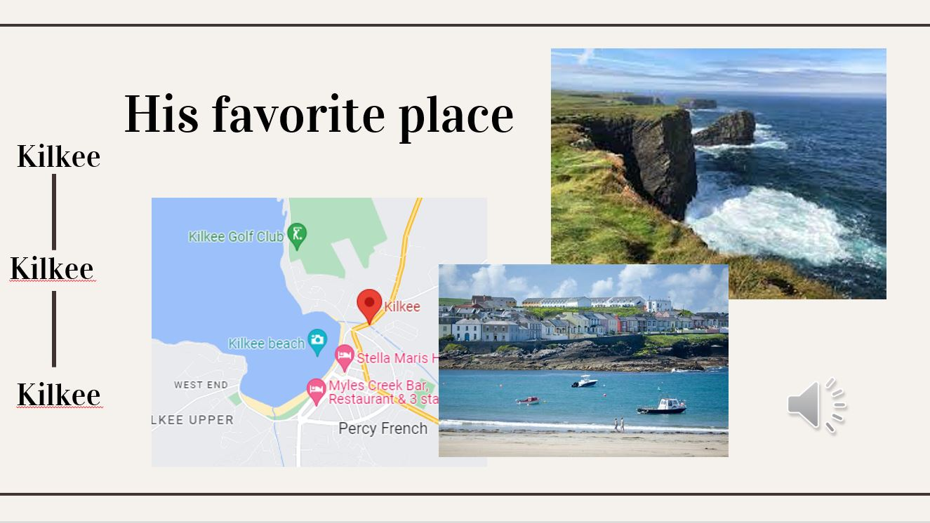
Task 1 - Submissions from previous years

Slide 14
Task 1 - Submissions from previous years

Slide 15
Task 2 - Submissions from previous years
YouTube Podcast
(in English)

Slide 16
Task 3 - Submissions from previous years

Slide 17
Task 3 - Submissions from previous years (c-ed)

