Slide 1
Presentation of the course
Course R5-BI-12 : International trade techniques - 2
Targeted skill :
Managing international operations
Contribution to the development of the targeted skill(s) :
Understand how export documents are exchanged and their significance
Understanding customs procedures
Understanding payment and risks
Volume : 25 hours in 10 classes of 2,5H

Slide 2
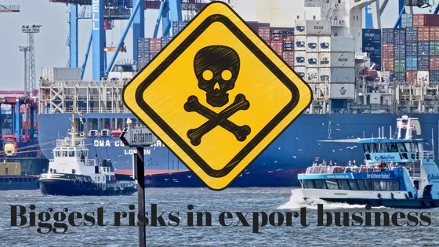
Resource R5-BI-12 : Course content
Session 1/ Prospecting risk
Sessions 2 & 3/ Exchange rate risk
Session 4 / Export document / Payment instruments & focus on LCR Session 5/ Hedging credit risk
Session 6/ AQL standards / Customs clearance risk
Session 7 to 9/ Import case
Session 10/ QCM
Notes:
Toutes les situations présentées ne permettent pas la réalisation d’un atelier d’entrainement, je vous invite donc à adapter 1 ou 2 ateliers par séance.

Slide 3
Resource R5-BI-12 : Course assessment
Individual or group works grade(s) : coefficient 0,6
Final QCM : coefficient 0,4

Slide 4
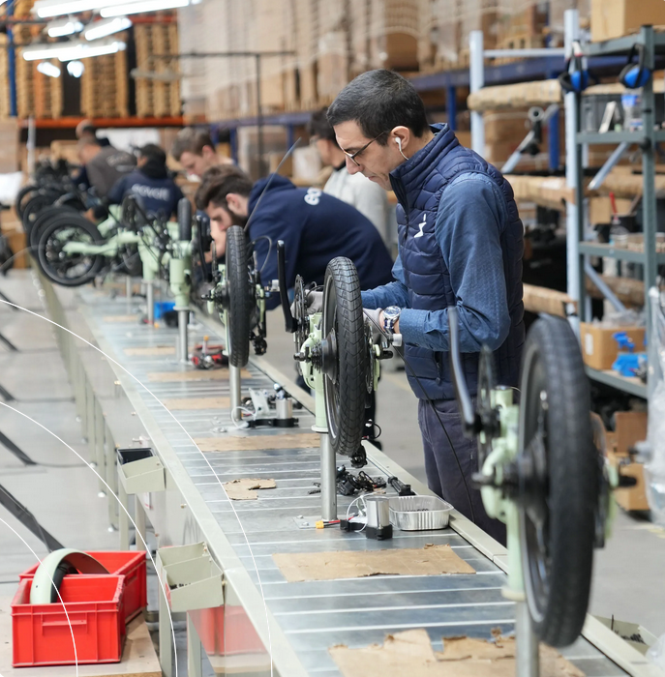
Case Eovolt / French electrical bikes
Manufactured in France Eovolt (Lion Distribution) is a lightweight, folding electric bike.
They are sold in specialized retailers.
Turnover in 2022 : 3,37 millions euros, increasing by 207% compared to year 2021.
https://eovolt.com/

Slide 5
The ecological bonus for the purchase of an electric bicycle has been reduced. The 500-euro bonus will be reduced to 400 euros on April 2024.
Septembre 2024 – Mr Hakimi is reporting to the Board : following the reduction in government subsidies, our sales forecasts in France are likely to decline, so we need to open up new export markets.
Capacity of produce used only by 65% with a new factory built.
Positive margins (64,4% in France in 2023)
The company is ready to spend and take risks
START EXPORT PROCESS

Slide 6
Where to sell to?
EXPORT
Sources of information (desk research):
Business and specialised media
Trade shows, conferences
Trade associations / HKTDC / ODCE
Government agencies and chambers of commerces
Private market research and business intelligence agencies

Slide 7
Studying canadian market? / Desk research
It is a necessary phase to have a better visibility of the targeted market. It aims to avoid scattering efforts and therefore to focus its resources to confirm or not a potential market.
The completion of the desk study must result in the following datas:
- Country analysis and notation
- Market study (analysis of the demand and offer)
- Examination of import statistics (trademap)
- Overview of competitors / benchmarking
We will not develop this step

Slide 8
Studying Canadian market
Notes:
How to start exporting? What should be the export strategy? Start with countries closeby? Countries with tfree trade agreement? what are the first steps?

Slide 9
Find what / Market trends
Export Trends: The best way to know the prospects of buying a product in a given market is to know whether or not this market is importing that product. This information is generally available because most countries quantify their imports / exports.
Let’s go to TRADEMAP website
https://www.trademap.org/Index.aspx?lang=fr&AspxAutoDetectCookieSupport=1
First step : open an account
Second step : find the right nomenclature in the web
Third step : Collect and analyze the data
If you were Mr Hakimi, will you follow with the idea to export to Canada?
Notes:
Code SH 87116010 - Cycles électriques assistance ≤ 250W

Slide 10
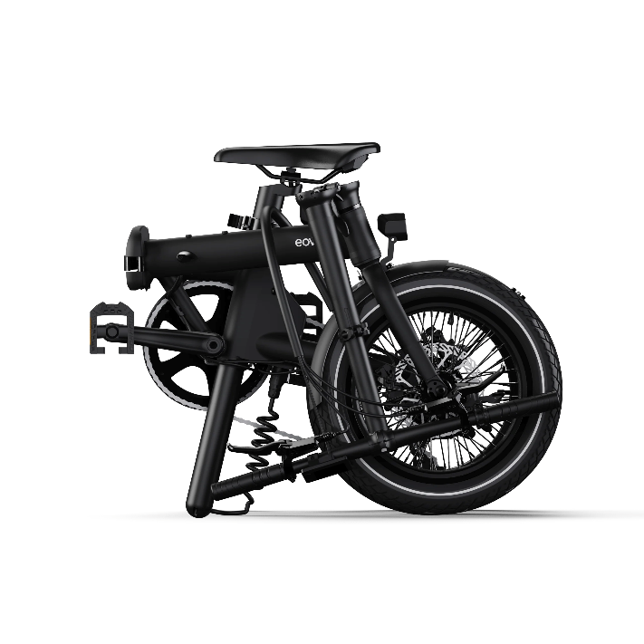
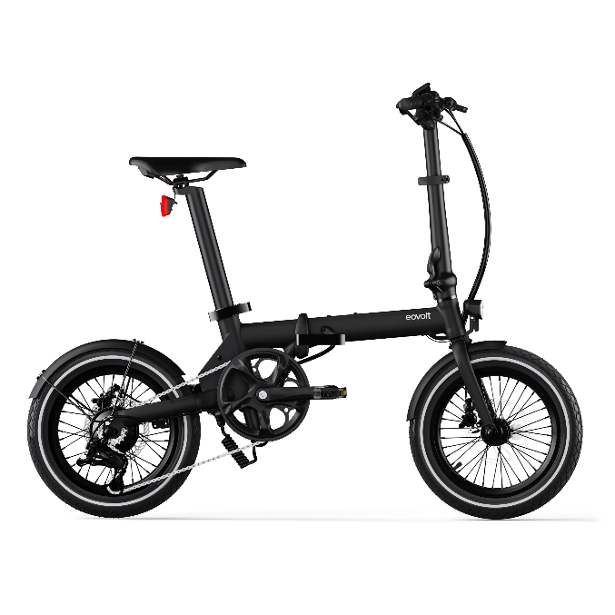
Export model & bicycle for the targeted market
We want to sell to an exclusive importer : we plan to be present on a trade show
We prefer to start with our best model: the Eovolt morning

Slide 11
Which trade show : using Team export
You can use all the services given by Team export to find the best trade show in Canada.
https://www.teamfrance-export.fr/iledefrance
We will go to the TORONTO BICYCLE SHOW AND E-BIKE EXPO
https://bicycleshowtoronto.com/spring-show
We will have a nice booth to present our Eovolt morning bikes to prospect an exclusive canadian importer.
importer.

Slide 12
Prospection risk
Is is really possible to hedge this risk?
Yes, French gvt like french exporters.
Bpifrance can help us to hedge this risk.
Individual work : job 1 (1,5H)
You are working in Eovolt but no one never heard about hedging prospection risk? It really can happen.
Oral presentation (15 to 20mn) :
Using the resources of e-campus, prepare an oral presentation to present to your CEO the prospecting risk insurance provided by Bpifrance.

Slide 13
Well done!
Congratulation, the trade show has been a success in Toronto.
We managed during these days to establish a cooperation with a Canadian importer : 02 ride
https://o2ride.ca/slane-ebike-canada-dealerships-find-your-store/
O2 ride is interested to order 500pcs of Eovolt morning and a first PI has been signed during the fair on March 10 2025.
The total deal has reached the amount of $446 000

Slide 14
What is the second export risk we might encounter?

Slide 15
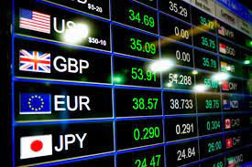
Exchange rate risk
let me explain you (do not focus on the date, we are in a fiction!)
This case is simplified compared to the real business one.
Just in order to explain easily the exchange rate risk.
Total amount of the deal is $446 000 on March 10.
The currencies spot rate EUR/USD was on March 10 2025 :
1 EUR = 1.09 USD
It is planned that the goods will be shipped to “02 ride” on May 15.
Payment will be done 30 days after shipment by TT (Telegraphic Transfer) Estimated payment date : June 15.

Slide 16
Exchange rate risk
Exchange rates change every second, and these aggregate variations can cause large swings.
we can confirm then that we will normally receive $446 000 on June 15.
You can understand that this amount will have to be exchanged in Euro (in order to pay our employees…).
What will happen if the currencies spot rate change in June 15 2025 to :
1 EUR = 1,12 USD

Slide 17
Exchange rate risk
Is there a risk links to the exchange rate?
Individual work : job 2 (5mn) :
1/Please calculate and write down,
the amount planned to be received in Euros when we signed the contract on March 10
the new amount that we will get in Euros on June 15
2/Please make a conclusion :
What happens in an export context when our customer's currency weakens?
What happen in an export context when our customer’s currency appreciates?

Slide 18
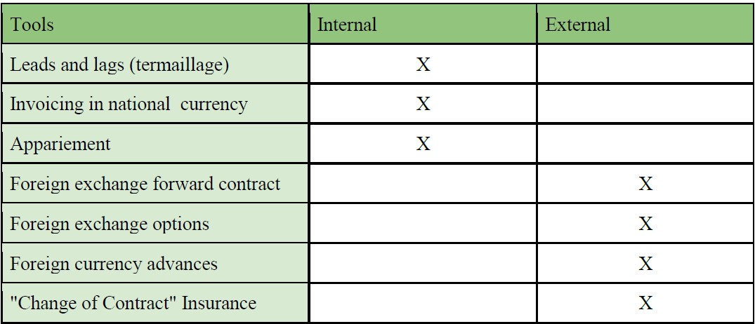
Exchange rate risk
Groups work (2 people) / job3 / 75mn
Learn, Master &
1/Analyse in a written report (advantages, disadvantages, limits and costs) the internal and external tools listed below that are usually used to hedge the exchange risk.
2/Select a real foreign exchange risk insurance contract for Eovolt, justify.

Slide 19
Exchange rate risk
Suggested correction

Slide 20
Payments in international trades
The documents in international trades
What is a proforma invoice?
What is a packing list?
What is an international invoice?
What is a B/L (Bill of loading)?
What is an LTA ?
What is a CMR?

Slide 21
P/I : a key doc to avoid problems
Please check the first draft of our P/I (doc PI first draft in e-campus)
What do you think about it?
List all the problems.
Quick look to a professional P/I
Individual work : job 4 (1,5H)
Establish a professional P/I to secure the deal.

Slide 22
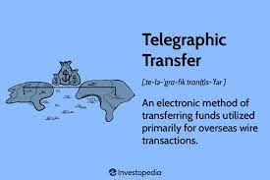
Let’s go back to our case
As we said before, when we established our first P/I, we decided to accept a
payment by TT 30 days after shipment in our deal with 02Ride .
Who is taking in his side the credit risk?

Slide 23
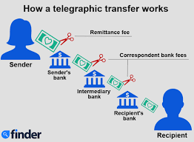
Explaining the limits of simple international collections
In our case, it is too risky to accept a TT payment after shipment.
we can ask for a TT payment before shipment
(using this term to limit the credit risk)?
But usually this payment condition is used when :
credit worthiness of customer is poor,
economic/political conditions in country of the customer are unstable,
the goods are shipped by air,
for electronic appliances.
In our case, the customer will probably not accept this payment term.

Slide 24
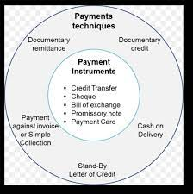
How to solve this dilemma?
To solve this dilemma, the best is to use what we called : the documentary payment techniques.
payment will be subject to the presentation of various documents by the exporting seller (invoice, packing list, transport document (BL, AWB), conformity doc, QC doc…).
There are three main documentary payment techniques:
Letter of credit / documentary credit
Documentary remittance
The stand-by letter of credit

Slide 25
The letter of credit / documentary credit
“A documentary credit is an undertaking by a bank to pay a specified amount to the supplier of a good or service in return for delivery, within a specified period, of the documents proving that the good has been shipped and and in accordance with the commercial conditions laid down.”
This mean that we will involved new actors in our trade : the banks

Slide 26
Notes:
Issuing the Letter of Credit
Sending goods and documents
Payment and shipment arrive

Slide 30
Focus on LCR
It is really important that the LCR is done without any error, and all futur
documents will have to match with the LCR requests.
You need to tell exactly to 02 ride all the informations needed and document linked to the process because it is the importer that will request to his bank to open the LC. Any error from him will have an impact in the export process.
Do not forget, you are the beneficiary, any mystakes on the LC will put your
collection in danger.
Individual work : job 5 (20mn)
Fill the document “LC Guidelines” to give all the informations to 02 ride regarding the LC.
Individual work : job 5 (1,5H)
You are working in 02 ride and Eovolt, your supplier, ask you to request an LC to your bank.
Please fill the request using the P/I already established.

Slide 31
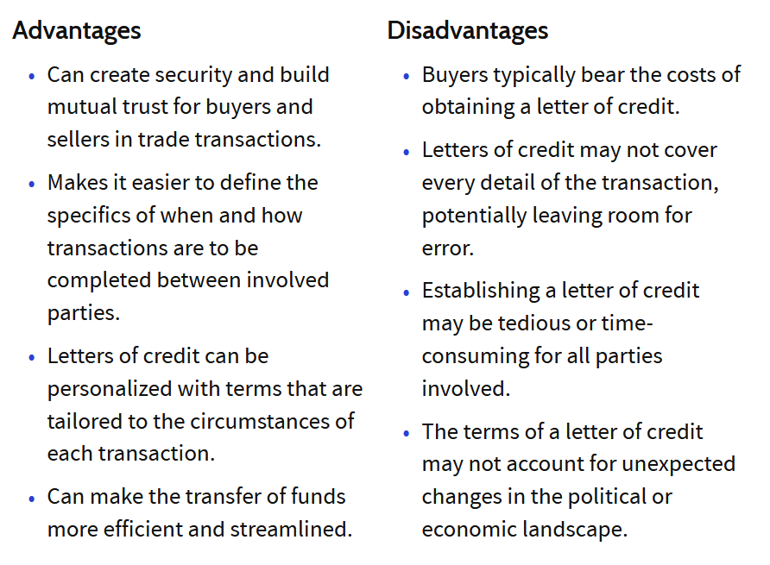
Focus on LCR

Slide 32
Documentary remittance
Group work : job 6 (60mn)
Please prepare an oral presentation (5 to 10mn) to present to your staff the
difference between a letter of credit and documentary remittance.
Also the advantages and disadvantages of each technic.
What will be the most appropriate payment technic for Eovolt and 02ride?
To help you :
https://international.groupecreditagricole.com/en/solutions/solution/681,docu
entary-remittance
https://www.allianz-trade.fr/blog/remise-documentaire.html

Slide 33
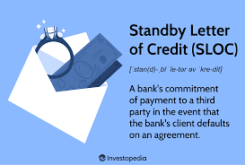
The Standby Letter of Credit
The SLOC is a bank guarantee with where the importer
guarantees to his supplier that his bank will replace it if it
fails, if the exporter presents the requested documents as
proof of the existence of the customer debt.
Unlike documentary credit, which must be realized, the SLOC
is not intended to be put into play. So this is not exactly a
payment instrument, it is a financial contract independent of
the commercial contract.

Slide 34
Hedging credit risk
How to hedge credit risk?
Of course, using the best payment techniques.
But we can also hedge our credit risk with another methods, three main types of
technique for external management of the risk of non-payment:
using a credit insurance company
using of a factoring company
using of a forfaiting company.
Let’s focus on the credit insurance.

Slide 35
Credit insurance
Credit insurance protects companies against the risk of non payment from domestic
or international customers (referred to as export credit insurance).
It insures the supplier against the risk of non payment for goods delivered or services
provided to the customer.
The insurer also informs the supplier about the solvency of its customers.
https://youtu.be/vdUXtqXoWxU?si=0xrO3xGcT2InmGtM

Slide 36
QC and AQL standards
Quality control does not refer to quality standards but to controls carried out on
production.
Control is an operation intended to determine whether the product (including services, documents, source code) controlled conforms or not to its pre-established specifications or requirements and includes a decision of acceptance, rejection or retouching.
This part is quite important in an international business trade.

Slide 37
QC
A quality control is defined by a number of parameters:
the frequency of control: systematic, by sampling
the product characteristic(s) that must be controlled
the control method: internal and/or external
In our case, we will set up an internal QC for each e-bike produced.
O2 ride will also probably organize a QC :
by sampling
with a specialised partner

Slide 38
AQL standards
The most common method for inspections is established by ISO 2859-1 (ANSI/ASQC ZI.4-2003).
It refers to the concept of AQL: Acceptable Quality Limit.
AQL is defined as the maximum rate of defective products tolerated which, in a set of samples, can be considered satisfactory to represent a set.
The sample size, based on AQL criteria, will be selected and then carefully inspected.
Defects are divided into three categories: Minor, Major and Critical.

Slide 39
AQL standards
The typology of defects:
Minor defects: a small difference in the reference product. Usually they do not affect the use of the product.
Major defects: which will certainly deprive the product of its expected use.
Critical defects: which will present a danger during use.

Slide 40
AQL standards
Based on the number of defects found for each category and the number of defects authorized (figures given by the AQL table), the company accepts or refuses the order.
The AQL tables help determine the size of the sample that the inspector will check by taking into account two criteria: the size of the quantity ordered and the severity level chosen. You can choose level I, II or III. Level III being the strictest and Level I the most lenient. The most answered, by default and by 98% of importers, is level II.
It remains up to you to determine with your customer the level of the QC.

Slide 41
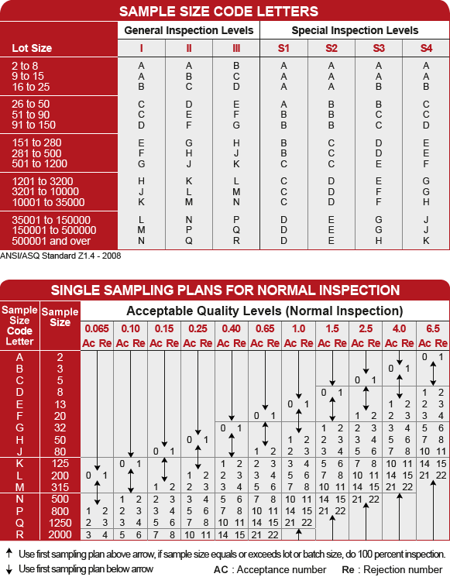

Slide 42
AQL standards
To find the ideal sample size to be inspected, you must first rely on the first table and find at the row level the total quantity produced.
For example, in our case, at level II, we have the letter H, which corresponds in the second table to sample size of 50 e-bikes.
At the top of the second table, you have the defect levels, ranked from 0 to 6.5 (the highest values ​​are absent because they are not that significant for buyers of consumer products). You can choose the level you want to apply for the defect categories: critical, major and minor. Referring to 0/2.5/4 with a sample size of 50, we see that if you have more than 0 critical defects, 3 major defects, or even 5 minor defects, 02 ride will probably reject our production.

Slide 43
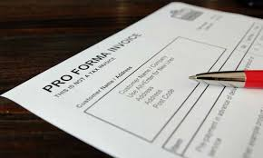
AQL standards
Let’s check our PI

Slide 44
Customs clearance risks
Let’s go back to our case.
As you probably learned before (when you studied incoterms), the export and import
customs are always a risky part in an international trade.
Many companies broke up because their goods stayed blocked in customs.
And I really experiences hard times when I had my import companies.
What will happen if our E-bikes stayed blocked on the Canadian customs?

Slide 45
Customs clearance risks
No insurance and no banks will help you.
Your best partners will be :
the conformity manager
the standards organization
the international laboratory
And why it is so complicated : different economic areas have different norms.
How is it working in Europe?

Slide 46
Customs Union
The Customs Union is an example of a territory where countries apply a uniform system for processing goods (import, export and transit) and implement a common set of rules (the Union Customs Code).
It brings together the 28 EU Member States.
A uniform system of customs duties is applied to imports from third countries
and there are no customs duties at internal borders between EU countries.
Duties on goods from third countries are generally paid when they enter the EU, and goods can move freely within the European Customs Union: no more duties to pay, no more additional controls.

Slide 47
Customs Union
One main point of the custom union is the consumer safety!
European Directives / Consumer Safety
For example: DIRECTIVE 2009/48/EC OF THE EUROPEAN PARLIAMENT
AND OF THE COUNCIL of 18 June 2009 on the safety of toys
European standards have been developed to translate the essential safety requirements of the directives into detailed technical specifications. These harmonized standards shall be notified to the Official Journal of the European Union
Any product manufactured in accordance with these standards is presumed to comply with the essential requirements of the directive.

Slide 48
To be sure that the product involved in the deal is in conformity with the standards required, the seller or the buyer used international laboratories.
There are worldwide lab, present in all parts of the world :
TUV / SGS / INTERTEK / LNE / CMA
Example of a lab tests : Beany test reports
Who can help us to determine the standards needed for our e-bike in Canada?
We are going to suffer, this part is really hard!

Slide 49
Customs clearance
Group work : job 7 (30mn)
You are the export manager of Eovolt and you decided to sell DDP to O2Ride.
it means that we will have to manage the customs clearance of the e-bikes in Canada.
This situation can really happen, sometimes companies policies are risky.
Please prepare a written report with a complete guideline to clear without problems
the Canadian customs.
What will be the regulation, the norms?
Will we need to provide lab tests?
https://www.pcb.ca/industries-2/electric-bike
https://www.pcb.ca/post/everything-you-need-to-know-to-import-your-e-bike-into-canada

Slide 50
New case / Import case
You are working as a young buyer in an import company called “BI Import”
Your company address is 8 avenue Cauchy in Sceaux.
“BI import” started its activities on January 2020.
The turn over of the company was on 2022 : 1,8 million euros.
There are 4 employees.
Main business of the company : importing general items to sell them to general
distribution stores.
In order to understand better our case, let’s check the different actors in
international trades.

Slide 51
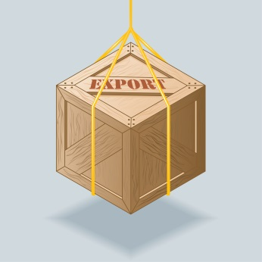
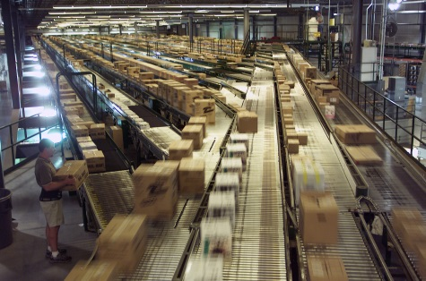
Players of International Trade

Slide 52
Manufacturer
A manufacturer of goods or a provider of services is a company that is responsible for creating the goods or services that will be sold.
Some of them have their own export department and export directly, others will outsource their export function to a trading company. Especially if they do not have export licence.

Slide 53
Trading company
A trading company is a intermediary between the manufacturers and the import companies.
The trading company will buy and resale the goods.
They usually take between …% to …% margin.
They usually provide QC services.

Slide 54
Why it is so important to identify if our potential supplier is a trading company or a manufacturer?

Slide 55
Forwarders / Agents / Transport companies
The forwarders can manage transport / logistic/and customs steps. They organize ROAD / RAIL / SEA / AIR shipments by cartons or ctnr.
They work with transport companies and local agents. They are usually worldwide companies.
They work for the exporter or the importer (or for both).

Slide 56
Importer
An importer buy foreign made products and sells them to distributors.
Some businesses are involved both in the importing and exporting

Slide 57
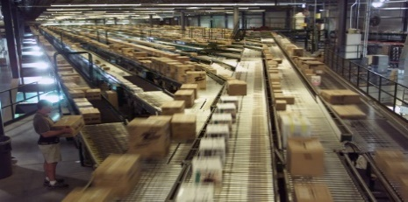
Distributor / Agent
The distributor sell the goods B to B (wholesaler) or B to C.
A distributor can also be importer (like GIFI) and distribute overseas, therefore export.
The agent is a sales intermediary but never buys or sells the goods.

Slide 58
New case / Context
You've just come from a meeting attended by your general manager, a sales
representative and two GIFI buyers.
GIFI would like to place an order for 10,000 pcs of heated blankets at a price of 8.50 euros ex VAT/PC.
Goods news, the Guangzhou fair will start in few days. It is a good opportunity to
find your supplier there.
Did you heard about this fair before? Let’s check some essential advises.
https://youtu.be/6O9ZoslvNDs?feature=shared

Slide 59
Reading a business card
How to read a business card in international business?
Let’s work on that

Slide 60
Discovering a potential supplier
You already find this item in a booth
http://www.beijirengroup.com/smart-electric-blanket/b217.html
How to start the relation in the booth?
Simulation teacher / students

Slide 61
Check list of subjects to discuss
Kind of player
Price / incoterm
Product info (size / thickness / material)
Packaging and packing details
Norms
Social responsibility
Customers in Europe
Packing details
Then start the negotiation
The size request by GIGI : 150cmx80cm
Price that you need to reach : $5,59

Slide 62
AMFORI BSCI AUDIT
The Amfori BSCI audit is usually asked to the supplier to ensure that all suppliers are treating workers ethically and legally and with a good level of security.
This is usually the document given to their customers.
Shijiazhuang Beijiren Electric Appliance Co., Ltd’s AUDIT

Slide 63
AMFORI BSCI AUDIT
Finally : in terms of social responsability, you will determine your level of requirement.

Slide 64
Agreement
Congratulations, you managed to find a trade agreement with Shijiazhuang Beijiren Electric Appliance Co.
Item number : B217
Description of the item
Quantity : 10 008pcs
Price : $5,59 FOB Tianjin
Packaging : PVC Bag
Packing : 12pcs/ctn
Norms request : LVD test report (EN60335) will be organise by Shijiazhuang Beijiren but paid by BI import.
Shipment date : 25/12/2023
Payment terms : Red clause LC with 20% pre-shipment finance
QC : AQL Standards 0/2,5/4 QC will be paid by the buyer
Total volume of the order : 61CBM
SIZE:150*80CM
VOLTAGE:230V POWER:60W
ONE RU9 CONTROLLER
VDE PLUG WITH 1.8 METER WIRE WITH
0.5*2mm WIRE,WHITE COLOR
DOUBLE-LAYER ALL CIRCUITRY SAFE PROTECTION ELECTRIC HEAT WIRES POLYESTER BLANKET (470g/M2+_10g)
2 FUSES TO PROTECT THE HEATING
BLANKET IN THE CONTROLLER
FIXED CONNECTOR

Slide 65
How to receive a good PI?
We already studied how to establish a right PI.
But if you are a buyer, you will need to help your supplier regarding the level of formalization request to secure a good relation, especially if you are working directly with a factory.
Let’s have a quick show to a matrix which will help you to receive a complete PI from your supplier.
Individual work : job 8 (30mn)
Please fill the matrix using the data of our case.

Slide 66
PI received
Your job is to check the PI and to revise if all details are ok.
Next step : you have to sent all elements requested (artworks of the stickers and packaging & manual).
Then you have to organize the external QC control.
It is time now to organize the transport with our forwarder!

Slide 67
Freight forwarder quotation & negotiation
Let’s finish with the transport part (international logistic).
Usually, the importer or exporter uses freight forwarders to transport the goods.
Shipment may be done by road, sea, air, rail or a combination of these: air and sea,
rail and truck (China to France), truck and sea (Turkey to Italy).
Transport is linked to delivery time or type of goods shipped / size of goods shipped
/ value of goods shipped.

Slide 68
Freight forwarder quotation & negotiation
First step : In our case, what was the volume of our order?
What will be the best mode of transport?

Slide 69
Maritime transport
The shipowner is the person who deals with maritime transport. Whether he is owner,
operator or simple charterer his role is to transport the goods from point A to point B
by sea, in good time and in good condition.
To keep his business afloat, he is in contact with many other stakeholders:
freight forwarders or commission agents who are intermediaries, or
agents, between shippers and carriers of the goods,
dockers who carry out port operations,
marine insurers who insure the ship, cargo and assume liability in the
event of an accident (P&I protection and indemnity club).

Slide 70
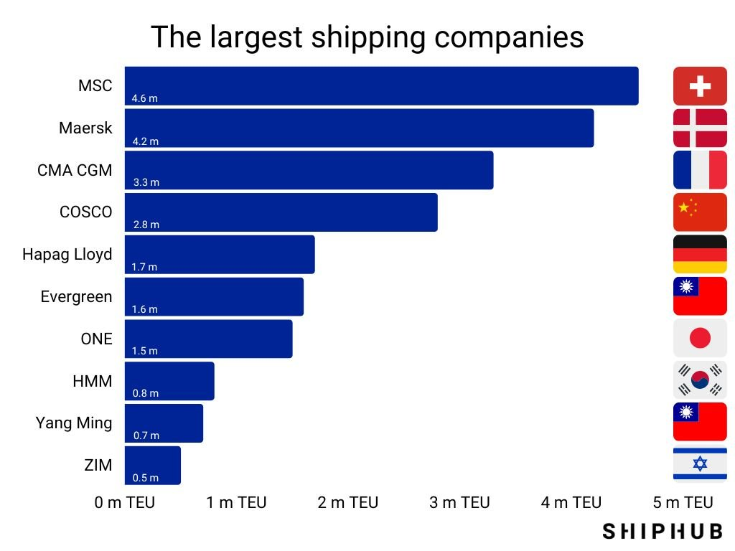
Maritime transport

Slide 71
Search for shipowners for a transport
Logistics field is moving, depedency to fowarder is changing in now days,
we have now new digital tools.
https://www.searates.com

Slide 72
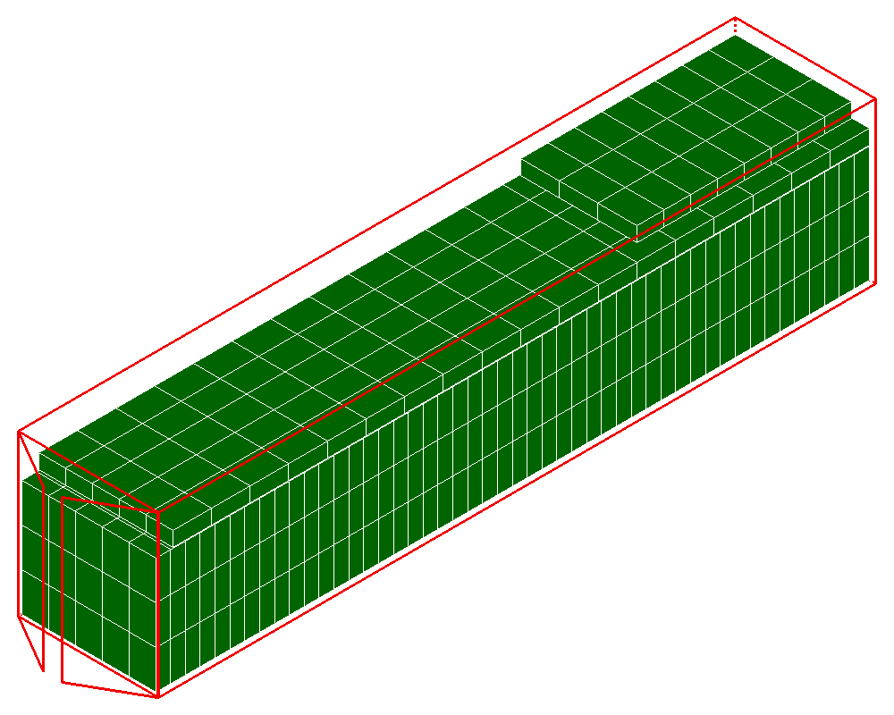
Load calculator
Let’s start with the solution «load calculator»
Please log to the application.
Usually this solution is used by the exporter to find the best arrangement of
master cartons to optimise the volume of the ctnr.
But let’s check how it works.
In our case, the size of the master in our case is 65cm x 45cm x25cm.
Number of cartons : 834

Slide 73
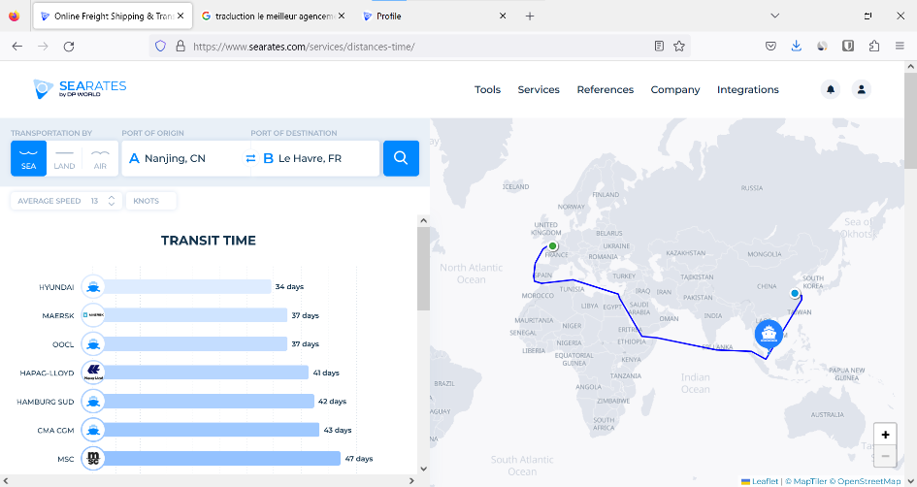
Distance and time app
Let’s follow with the solution «distance and time app»
Please log to the application.
https://www.searates.com/services/distances-time
Usually this solution is used by importer to identifiy the fastest ownership.
Let’s use it.
What will be the fatest vessel from Tianjin to Antwerp?

Slide 74
Pricing of maritime transport
CTNR package or m3 (volume) and ton (gross weight) or number of paid units UP = Max (Vol; Gross weight).
Basic freight is given from a price per UP
UP in maritime: t or m3 / Equivalence: 1t = 1m3 / Unit + high

Slide 75
Pricing of maritime transport
There is also a set of possible surcharges on freight: - PSS (Peak Season Surcharge) - IMP2020 ou LSS (Low Sulphur Surcharge) - ECA Surcharge - PCS (Port Congestion Surcharge) - EIS (Equipment Imbalance Surcharge) - CAF (Currency Adjustment Factor) - BAF (Bunker Adjustment Factor)
All these surcharges can be taken into account in the proposed pricing, this is called "all in" quotation.

Slide 76
Shipping Pricing / Arrival Fees
Maritime transport must also be addressed in its together. It implies
optionally (except incoterm CIF) transportation insurance costs.
Sea freight involves possible or certain specific arrival shipping costs: - THC (Terminal Handling Charges) - Taxes ISPS (International Ship and Port facility Security) - Tax B/L or B/L Issuance
Other costs on arrival, not specific to maritime transport are: - customs formalities and duties - post-delivery costs

Slide 77
Maritime transport / LCL
Full Container Load = Full Container Load (FCL)
If our order does not fill a ctnr = possibility to do "Less than container load" (LCL)
This service provided by freight forwarders allows customers to reserve part of the container. The freight forwarder has several customers with similar needs for the transport of small shipments within the same destination (port, station, etc...) and he proposes to group these shipments in a shared container.
Thus, shipping costs are divided among customers based on the space they occupy in the container.

Slide 78
Getting a cotation with searate by DP world
Let’s use the logitstic explorer.
Departure port : Tianjin
Arrival port : Antwerp
Kind of ctnr : 40HQ (FCL shipment)

Slide 79
Do we still need forwarder?
Group (2 students) work : job 9 (1H)
Is an application like Searates the beginning of the end for physical freight forwarders?
Use a argumentation that puts the use of digital tools like Searate into
perspective versus the traditional use of physical forwarders?
Please prepare an oral presentation regarding this issue.

Slide 80
What will be the final cost per item (in our warehouse in Sceaux)

Slide 81
Individual work : job 10 (30mn)
Calculate the final cost of the blanket (unit cost price per blanket delivered to Sceaux)
Use the P/I
Cours EUR/USD SPOT : 1.07 USD
Duty taxes : 4% of the total value (goods + maritim transport)
Use the cotation sent by Dachser
Unloading goods from the ctnr cost 150 euros

Slide 82
Cost price calculation with the FOB incoterm (for the importer)
Product price (currency of the exporting country)
Maritime cost of international transport (in dollars)
Influence of the exchange rate
Customs duties taxes
Arrival costs (ctnr unloading, ctnr transport and formalities)
Unloading goods from ctnr
Unit cost price per unit

