Slide 1
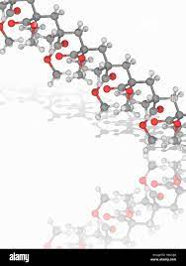
Polymers prepared through an “ATRP
polymerization–esterification” strategy for dual temperature- and reduction-induced paclitaxel delivery
JingWen Xu, ZhuoMiao Cui, Xin Ge, YanLing Luo and Feng Xu
The Royal Society of Chemistry, 2020
Armel, Arton, Mohammad et Victoire
UE 2A : POLYMERES
MASTER 2 Pharmacotechnie et Biopharmacie
21/10/2024

Slide 2
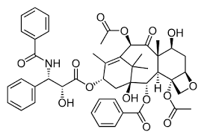
Introduction
Libération de médicaments anticancéreux : défi majeur :
Faible stabilité
Biodisponibilité limitée
Effets secondaires toxiques des traitements conventionnels.
Paclitaxel (PTX), (médicament chimiothérapeutique largement utilisé) particulièrement concerné par ces limitations :
hautement hydrophobe
difficultés à atteindre efficacement les tissus tumoraux sans affecter les cellules saines.
Paclitaxel
Nanovéhicules composés de polymères amphiphiles auto-assemblés : voie prometteuse pour la vectorisation et la libération de principes actifs.
Encapsulation et assemblement dans des polymères
Polymères amphiphiles à blocs forment spontanément des systèmes de libération nanométriques dont le coeur hydrophobe contient le PA : libération cellulaire

Slide 3
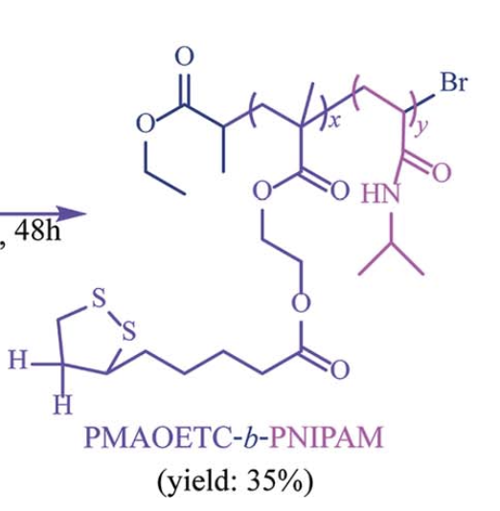
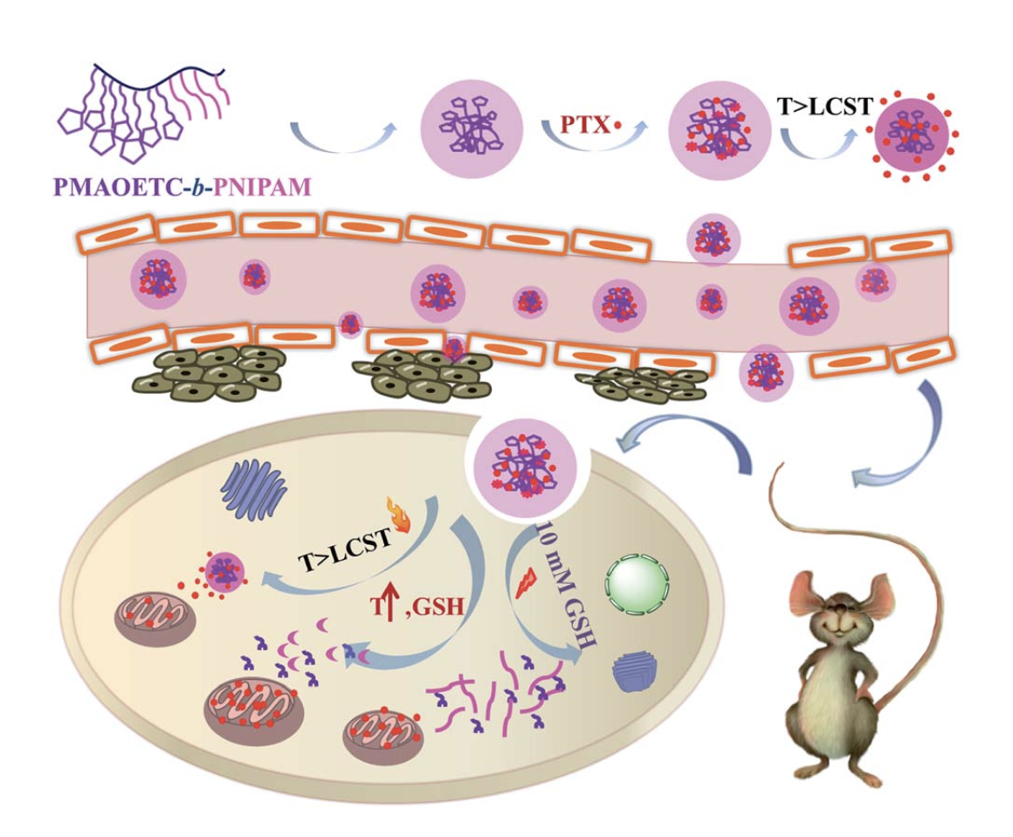
Concept de l'étude
1/ Fabrication d'un polymère amphiphile par une stratégie de polymerization–esterification ATRP (polymérisation par transfert d’atomes)
Double sensibilité à la température + agents réducteurs pour la délivrance de paclitaxel.
Polymère PMAOETC-b-PNIPAM→ encapsule efficacement le paclitaxel
interactions hydrophobes
Liaisons hydrogène.
2/ Développement d’un système de micelles sensibles aux stimuli (température et réduction) pour la libération ciblée de paclitaxel dans les environnements tumoraux.
longues chaînes alkyle
gp ester
très hydrophobe
amide
interaction avec l'eau à basse température
moins hydrophile, thermosensible à température plus élevée.
thermosensible

Slide 4
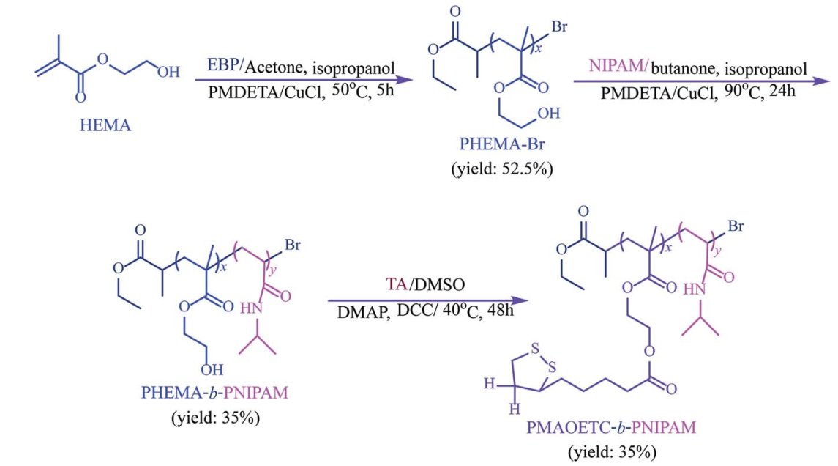
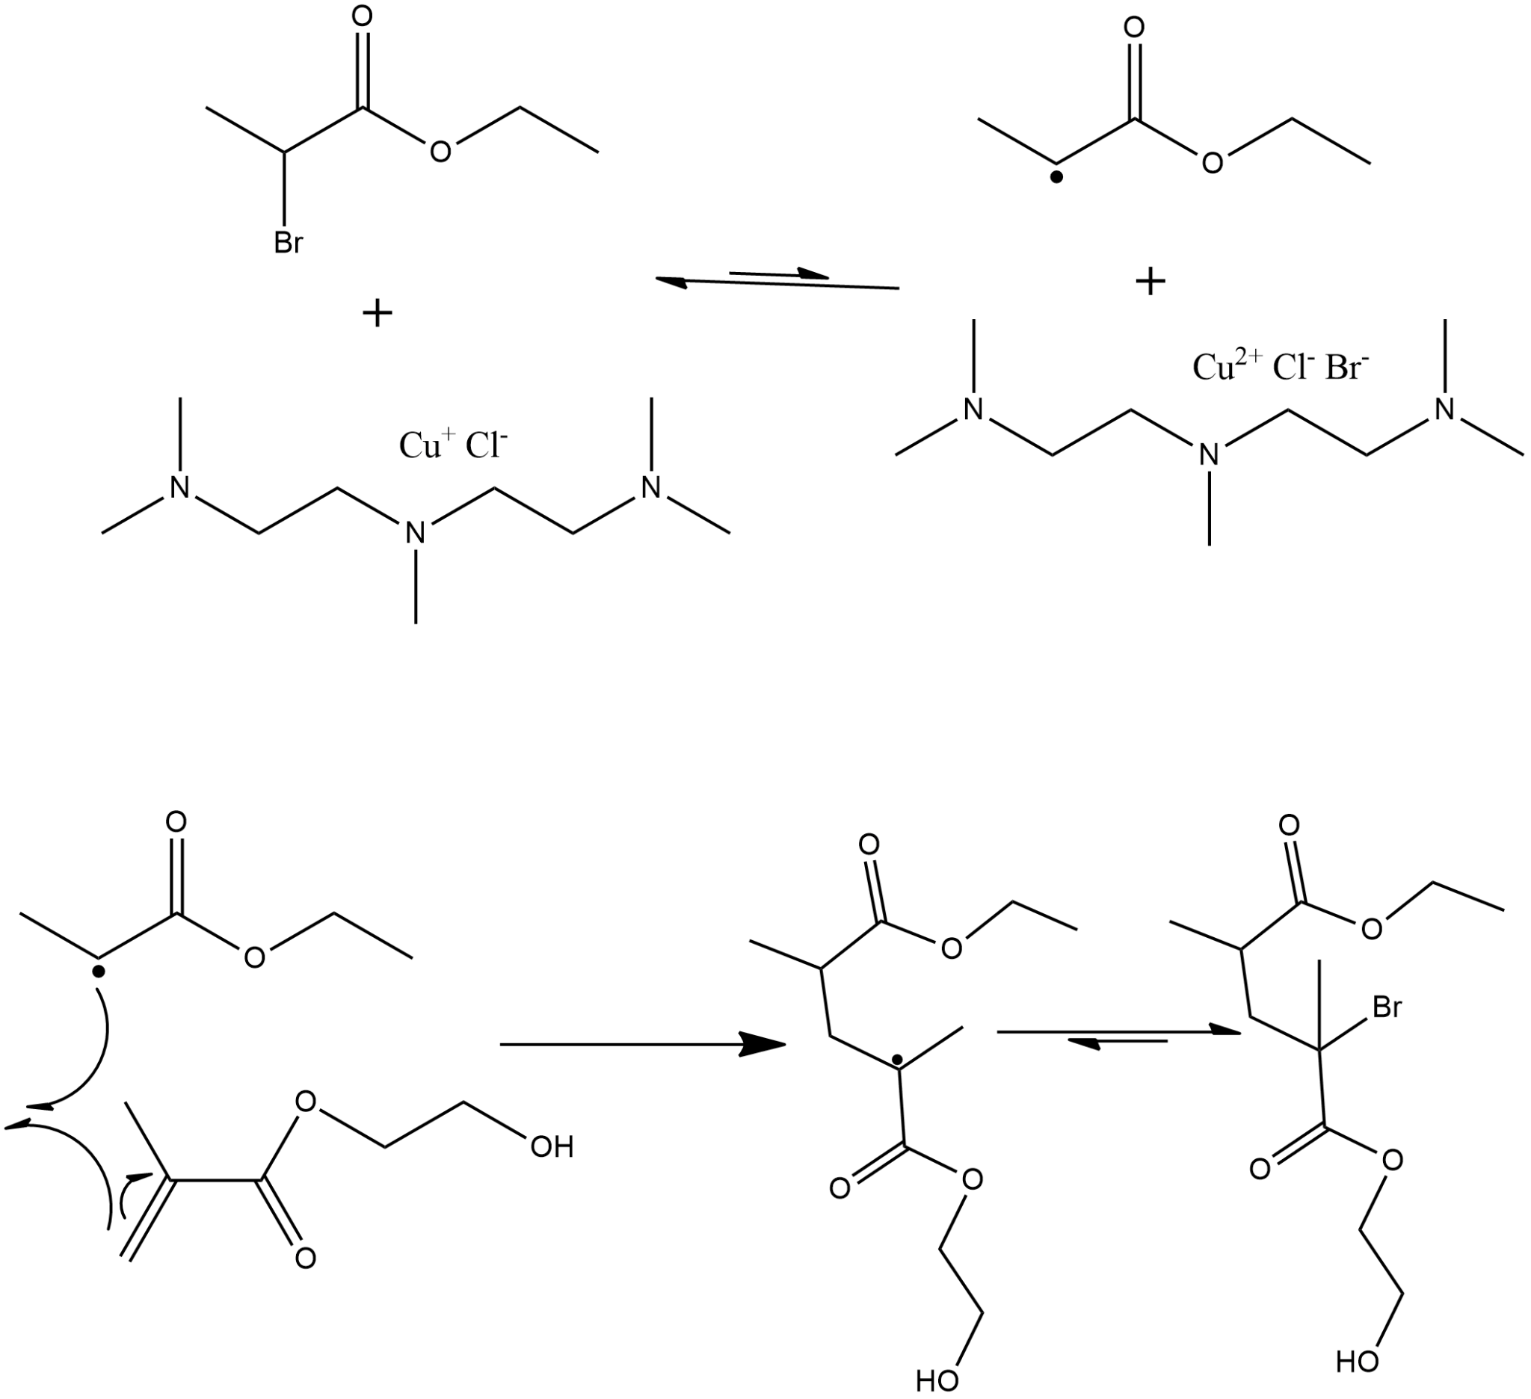
POLYMERISATION
INITIATION
EBP
PMDETA/CuCl
PMDETA/CuClBr
PROPAGATION
・Br
PMDETA/CuClBr
CARACTERISATION
SEC : Mw et Mn
RMN ¹H : Structure chimique du polymère
HEMA
PHEMA en formation
PHEMA-Br en formation

Slide 5
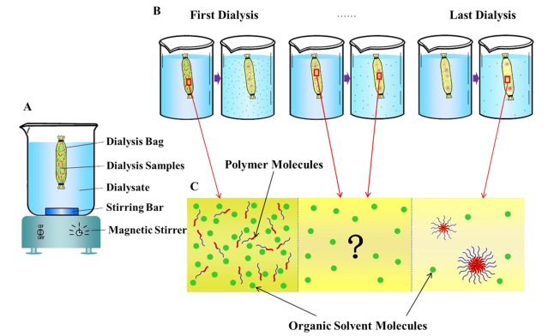
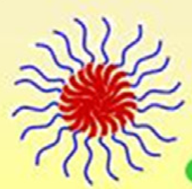
FORMATION DE MICELLES
30 mg polymère + 10 mL DMSO / 2L eau / 72 H
PMAOETC
PNIPAM
CARACTERISATION
Zetasizer : diamètre hydrodynamique, potentiel zeta
spectrométrie à fluorescence : CMC
TEM : morphologie des micelles
spectrophotométrie UV-Vis : LC (%), EE (%) et influence de la température
Yun H. F. et al, Chemical Physics Letters, 2022

Slide 6
The key physicochemical findings of the study (1) :
Micelle formation and their structure (PMAOETC hydrophobic-core and PNIPAM- hydrophilic shell).
Physicochemical properties: low CMC, high zeta potential, and responsiveness to temperature and GSH.

Slide 7
The key physicochemical findings (2):
Temperature and Reduction Responsiveness:
The micelles exhibited dual responsiveness:
Temperature-sensitive phase transition around 36.1°C to 39.48°C, which is in line with typical body and tumor temperatures, allowing for triggered drug release in tumor sites.
Reduction sensitivity due to the presence of disulfide bonds that break down in the presence of glutathione (GSH), prevalent in cancer cells, resulting in drug release.
Zeta potential increases with increasing the length of the NIPAM block, while there was a negligible effect from PMAOETC on z in the presence of identical PNIPAM block lengths.

Slide 8
P1:
Composition: PMAOETC₈-b-PNIPAM₁₀
This version has a smaller PNIPAM block, leading to lower overall molecular weight.
Properties:
CMC: 19.49 mg/L Zeta potential (ζ): 69.83 mv
LC Loading capacity: 12.70%
EE Entrapment Efficiency: 46.83%

Slide 9
P2:
Composition: PMAOETC₂₈-b-PNIPAM₂₁
Higher PNIPAM and PMAOETC content, resulting in better drug encapsulation and release control.
Properties:
CMC: 26.74 mg/L (for blank micelles)
LC: 22.53%
EE: 69.60%
Zeta potential (ζ): 35.53 mv
P2 was identified as having the most optimal balance of properties, making it particularly useful for paclitaxel delivery.

Slide 10
P3:
Composition: PMAOETC₄₀-b-PNIPAM₁₀
This version has the largest PMAOETC block, leading to the highest drug loading.
Properties:
CMC: 8.14 mg/L
LC: 29.36%
EE: 78.33%
Zeta potential (ζ): — (not included, not mentioned why).
Notes:
Possible reasons: Since PNIPAM (the hydrophilic part) is shorter in P3, it may not provide sufficient surface hydrophilicity or electrostatic stabilization, which is key for maintaining a measurable zeta potential. This could result in difficulties in measuring or sustaining a surface charge.
Aggregation:
Due to the larger hydrophobic PMAOETC block and shorter hydrophilic PNIPAM block, P3 micelles may form larger aggregates in solution, which complicates zeta potential measurements. Zeta potential is usually measured for well-dispersed nanoparticles, and if aggregation occurs, it may not produce a reliable surface charge reading.

Slide 11
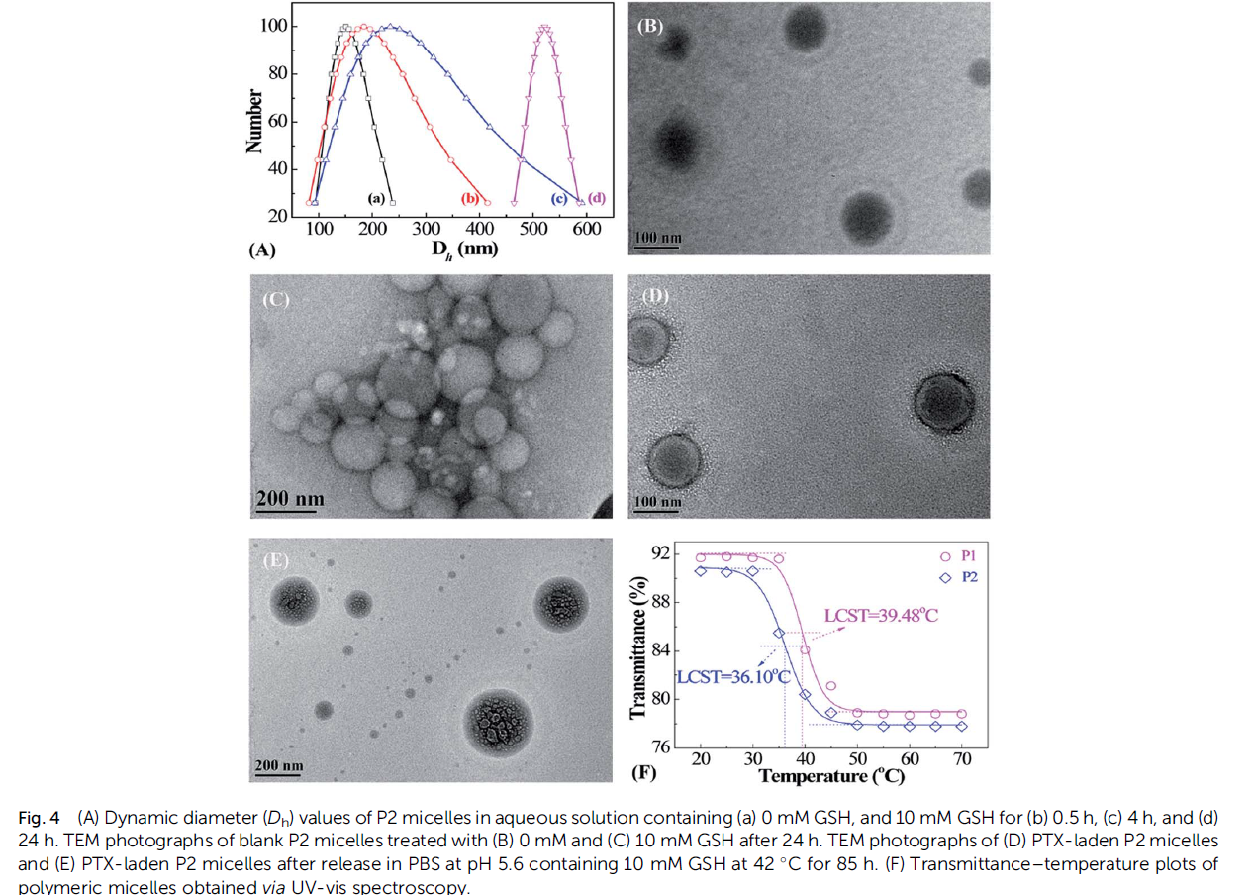
(D): the nanomicelles grew with increasing GHS concentration → reduction → H bond foration → larger micelles.

Slide 12
Uses:
Targeted Cancer Therapy:
These polymeric micelles are specifically designed for paclitaxel delivery in cancer treatment. The dual (tumor redox- pH) responsiveness ensures that paclitaxel is released in response to tumor-specific conditions, minimizing side effects on healthy tissues.
Enhanced Drug Delivery System:
The high drug loading and controlled release make these micelles highly effective for improving drug bioavailability and anticancer efficacy compared to free paclitaxel.
Biomedical Applications:
Beyond cancer therapy, these polymers could be used for delivering other hydrophobic drugs and therapeutic agents in various biomedical fields, including targeted drug delivery and controlled release systems.

Slide 13
Analyse critique et perspective
Sensibilité à la température et aux groupements réducteurs → Thérapeutiques ciblées
Étude in vivo → Réduction du volume tumoral de 1,34 fois supérieure à celle du traitement par PTX libre
Absence d'effets secondaires notables sur les principaux organes, contrairement au PTX classique
Indice de substitution → Impact sur l'encapsulation du PA
Données à moyen/long terme sur la stabilité des micelles
Methode difficile →Transposition d'échelle et les différentes étapes intermédiaires de polymérisation
Structuration de l’article
Utilisation dans d'autres maladies chroniques
Modèles tumoraux différents → D'autres types de cancer

Slide 14
THANKS FOR YOUR ATTENTION

