Slide 1
What are the cellular targets of ROS ?
Examples of degradations and their detections.
M2 - UE Oxydant stress - Huixue, Kirrthana, Lucas, Océane
Notes:
https://www.icp.universite-paris-saclay.fr/cpsysbio/thematiques/nadph-oxydase/detection-des-ros/#pll_switcher
https://joliot.cea.fr/drf/joliot/Pages/Entites_de_recherche/I2BC_saclay/SB2SM/lmb/especes-reactives-de-l-oxygene.aspx

Slide 2
Plan
Introduction
Main cellular targets
→ Lipids
→ DNA
→ Proteins
Detection
Conclusion
Notes:
https://www.researchgate.net/figure/Detection-of-ROS-by-using-different-biomarkers-ROS-can-be-assessed-in-vivo-either_fig8_235785676
https://www.nature.com/articles/s42255-022-00591-z

Slide 3
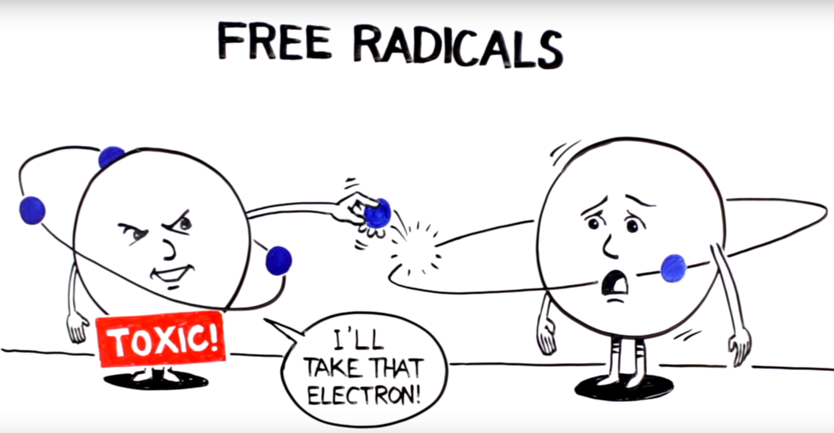
Introduction

Slide 4
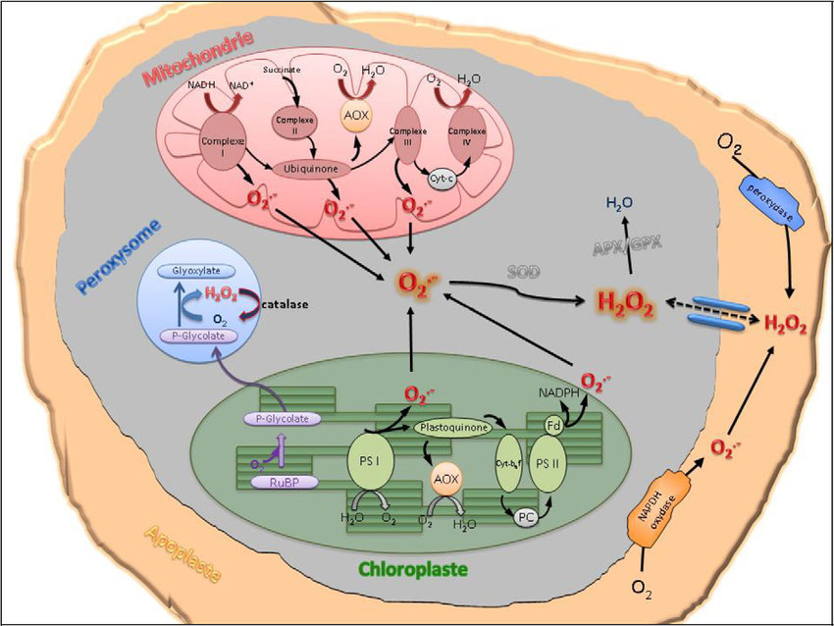
Introduction
ROS in cells

Slide 5
Introduction
ROS in cells
Cell Stress
ROS

Slide 6
Introduction
ROS in cells
Cell Stress
ROS
Cell Response
SOD, Catalase

Slide 7
Introduction
ROS in cells
Cell Stress
Cell Stress
ROS
ROS
Cell Response
SOD, Catalase
Cell damage
Death

Slide 8
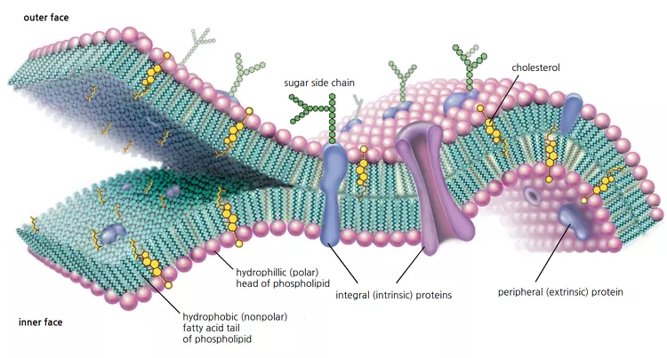
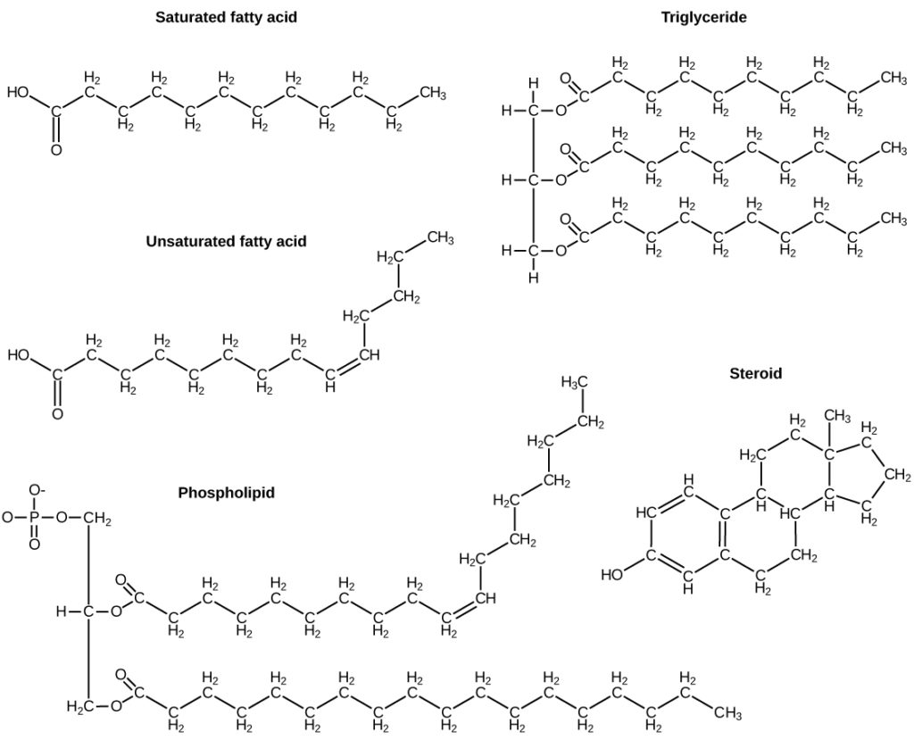
Main cellular targets → Lipids
Amphiphilic or Hydrophobe
Main component of the cell membrane
Cell Viability
Diverse

Slide 9
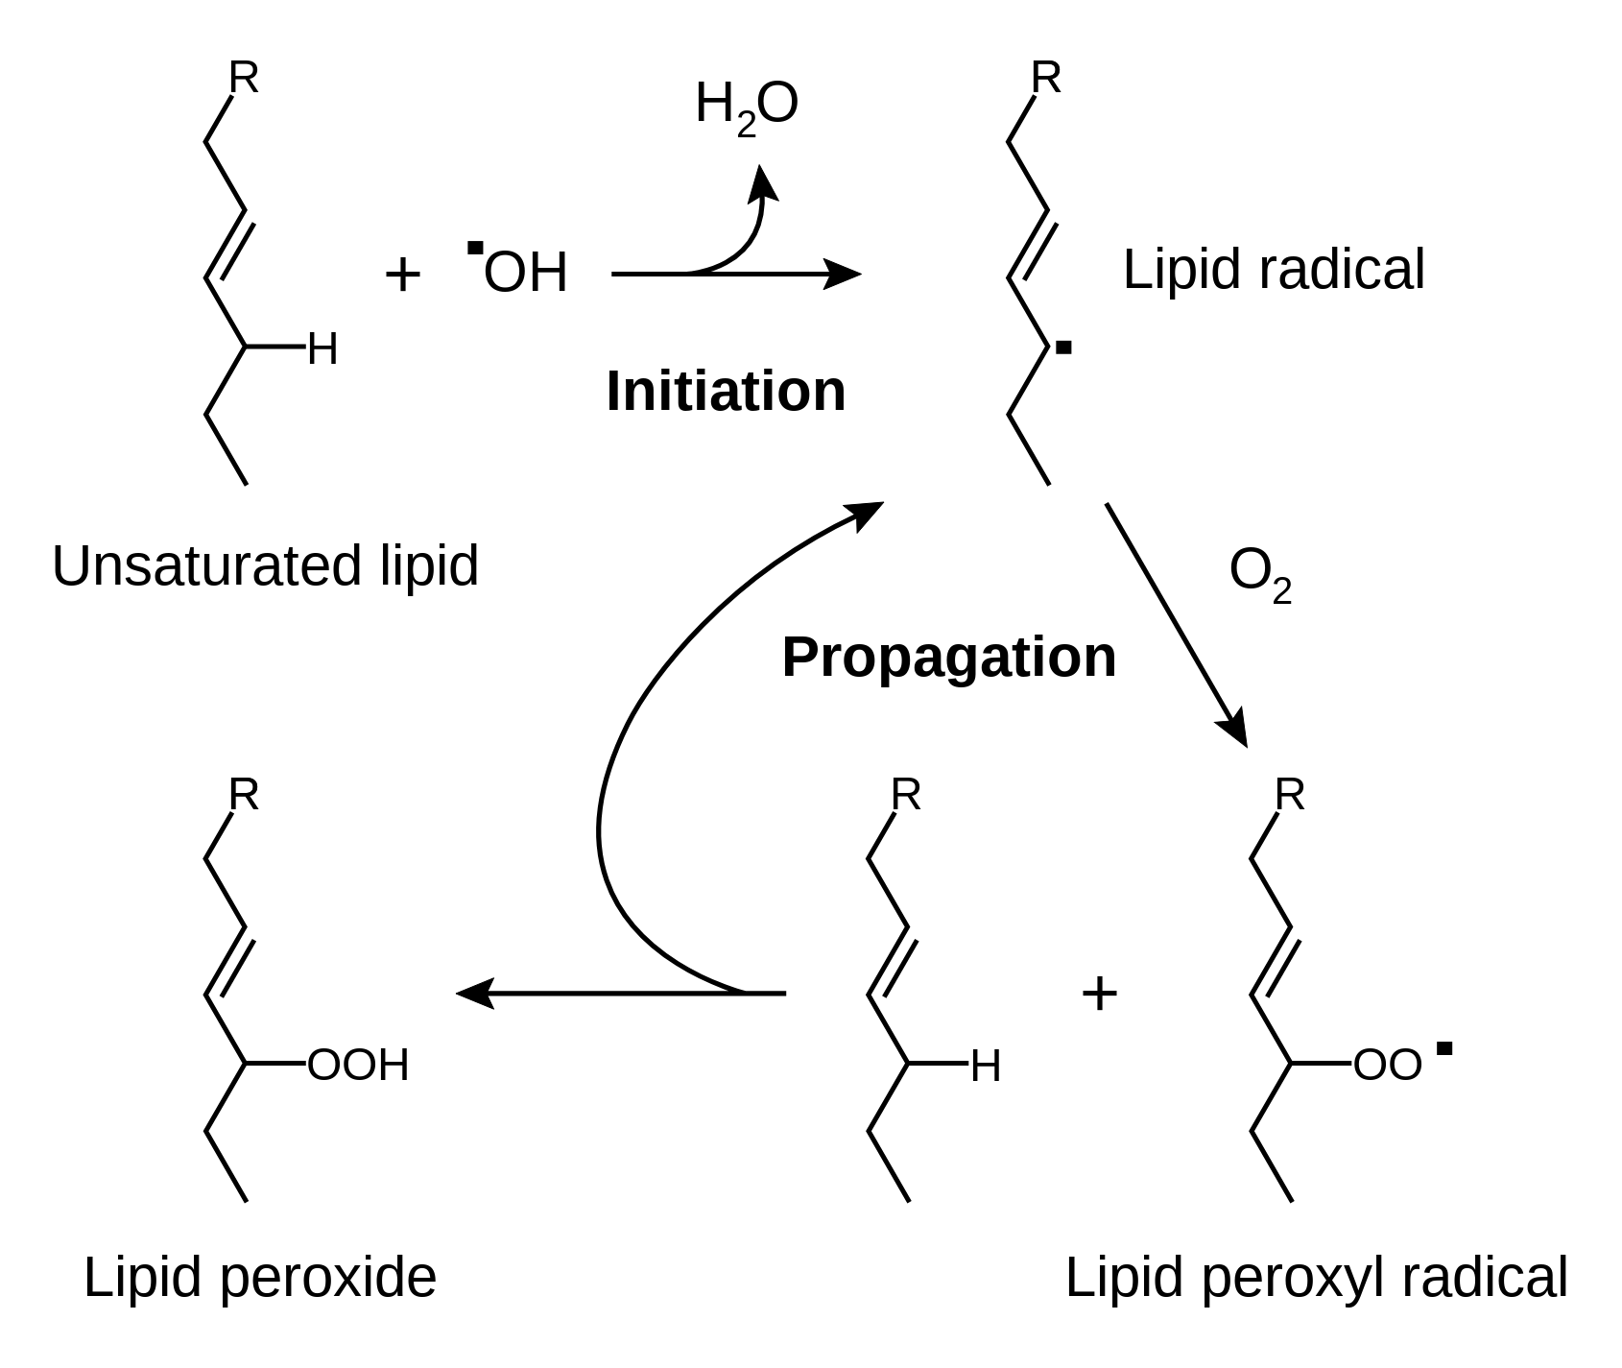
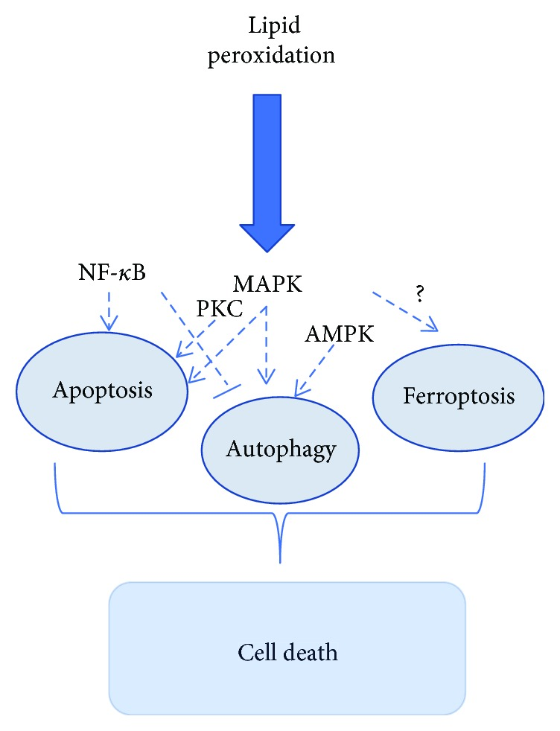
Lipid Peroxidation
Consequence of Lipid Peroxide formation:
Increase in polarity
Increase in fluidity
Efflux of cytosolic solutes
Loss of membrane−protein activities
⇒ Cell Death
Also described as an Autooxidation Reaction
Initiation can be done with HO・or HOO・
After initiation, a propagation chain take place

Slide 10
Lipid Peroxidation
Also described as an Autooxidation Reaction
Initiation can be done with HO・or HOO・
After initiation, a propagation chain take place

Slide 11
Lipid Peroxidation
Consequence of Lipid Peroxide formation:
Increase in polarity
Increase in fluidity
Efflux of cytosolic solutes
Loss of membrane−protein activities
⇒ Cell Death

Slide 12
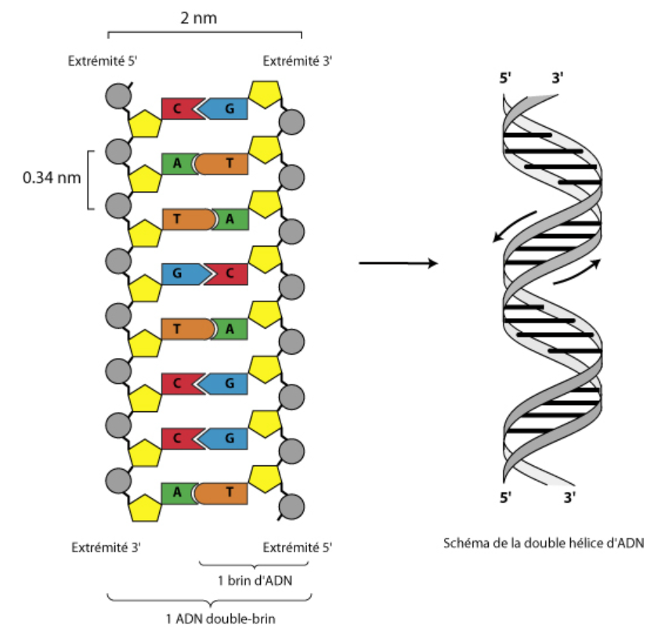
Main cellular targets → DNA
→ hydroxyl radical /DNA (Lucas)
Oxydation target :
Nucleic Base - ATGC
Sugar
Phosphate

Slide 13
Main cellular targets → DNA
→ hydroxyl radical /DNA (Lucas)
Oxydation target :
Nucleic Base - ATGC
Sugar
Phosphate

Slide 14
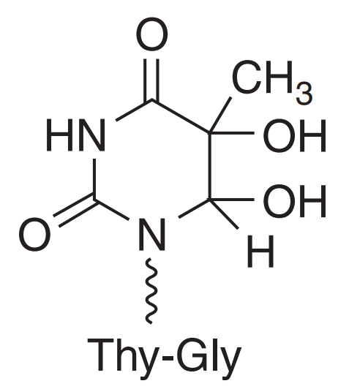
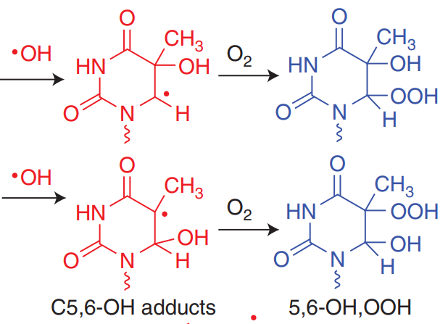
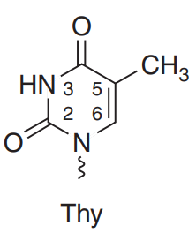
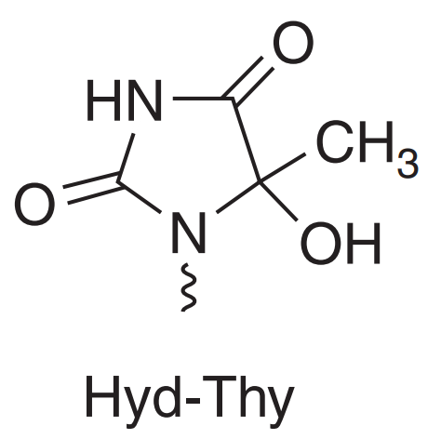
Main cellular targets → DNA
Thymine oxidation by
Paramagnetic / Diamagnetic

Slide 15
Main cellular targets → DNA
Thymine oxidation by
Paramagnetic / Diamagnetic

Slide 16
Main cellular targets → DNA
Thymine oxidation by
Paramagnetic / Diamagnetic

Slide 17
Main cellular targets → DNA
Thymine oxidation by
Paramagnetic / Diamagnetic

Slide 18
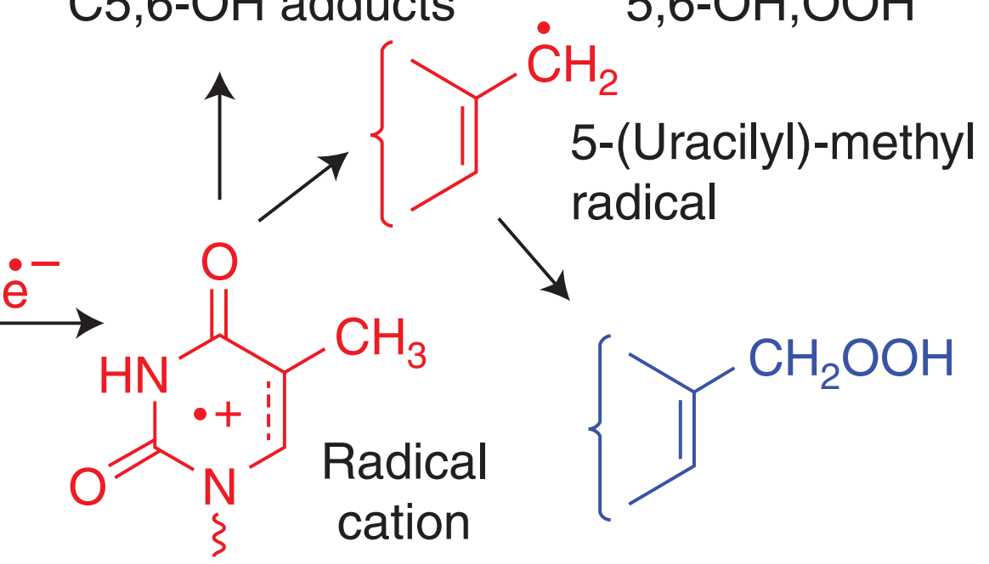
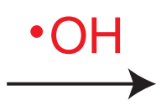
Main cellular targets → DNA
Thymine oxidation by
Paramagnetic / Diamagnetic

Slide 19
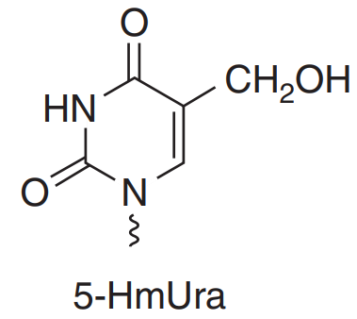
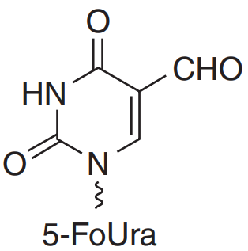
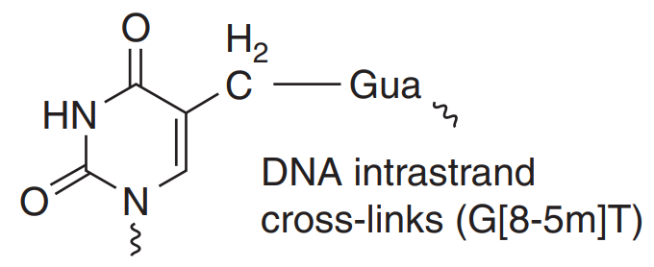
Main cellular targets → DNA
Thymine oxidation by

Slide 20
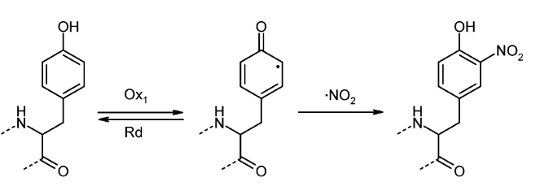
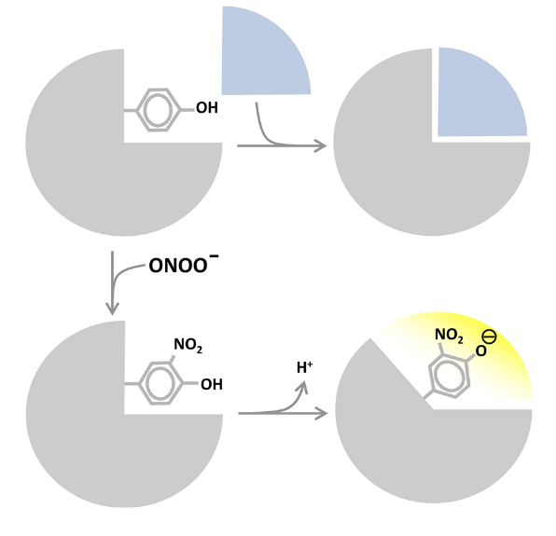
Main cellular targets → Proteins
Protein Tyrosine Nitration as a Free Radical Process
Peroxynitrite (ONOO−) is an oxidant produced by the reaction between nitric oxide (NO) and superoxide radicals (O2 − ).
Tyrosine residues in proteins typically constitute in average 3-4 mol %
Acc. Chem. Res. 2013, 46, 2, 550–559 https://doi.org/10.1021/ar300234c

Slide 21
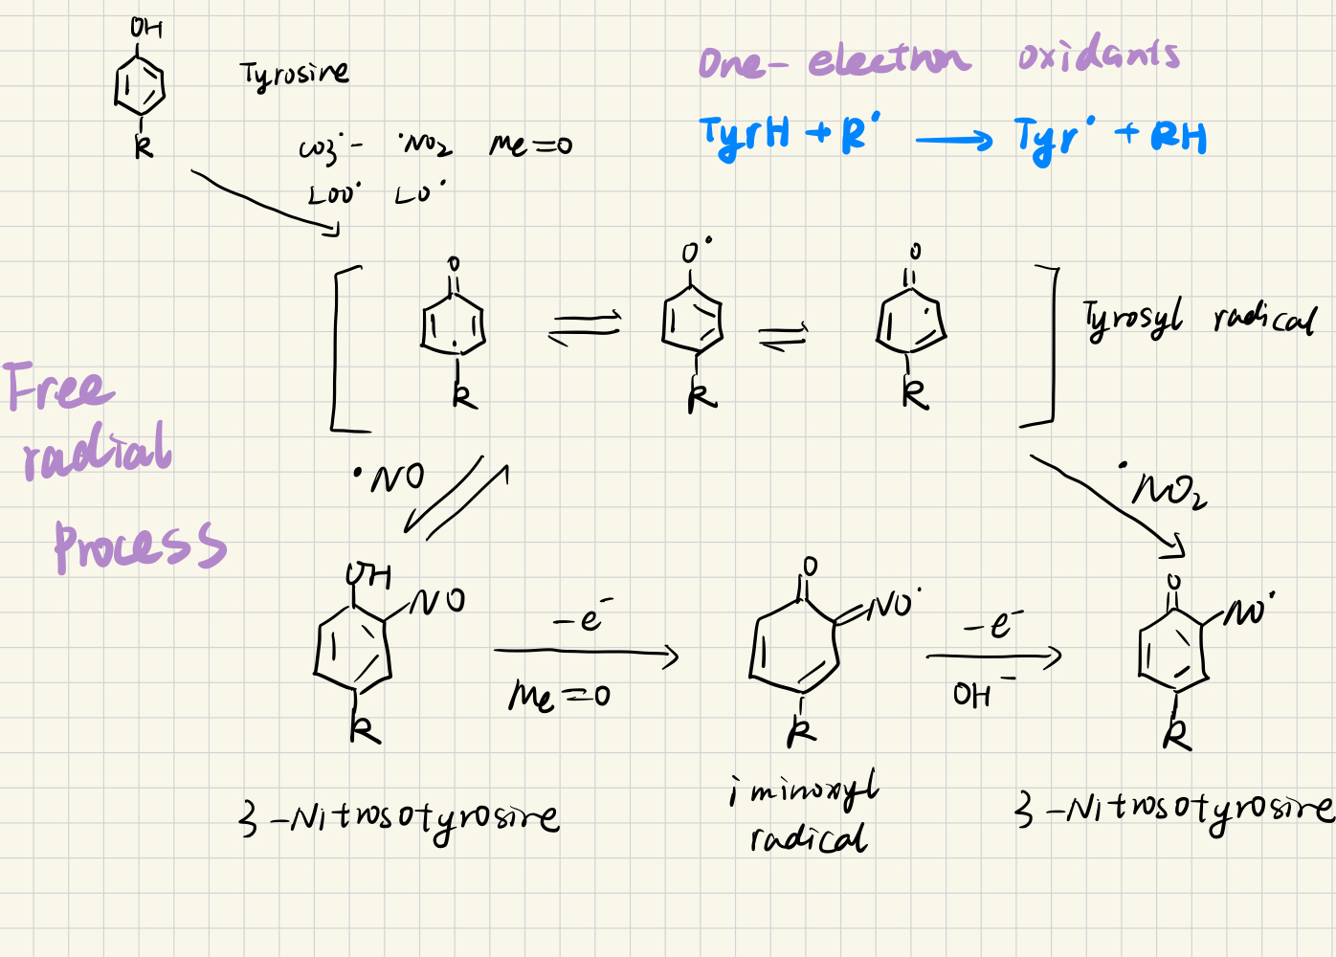
Main cellular targets → Proteins
Protein Tyrosine Nitration as a Free Radical Process
Acc. Chem. Res. 2013, 46, 2, 550–559 https://doi.org/10.1021/ar300234c

Slide 22
Main cellular targets → Proteins
the "site-directed" nitration involves three redox steps as follows
Acc. Chem. Res. 2013, 46, 2, 550–559 https://doi.org/10.1021/ar300234c

Slide 23
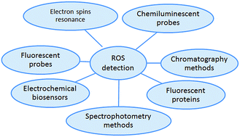
Detection
Anal. Methods, 2018,10, 4625-4638 (RSC)
Notes:
When investigating ROS in biological systems, it is important to detect and quantify the ROS of interest. Many means are available for ROS detection, they depend on where and how much is produced. (Royal Society of Chemistry).(Erard et al. 2018).

Slide 24
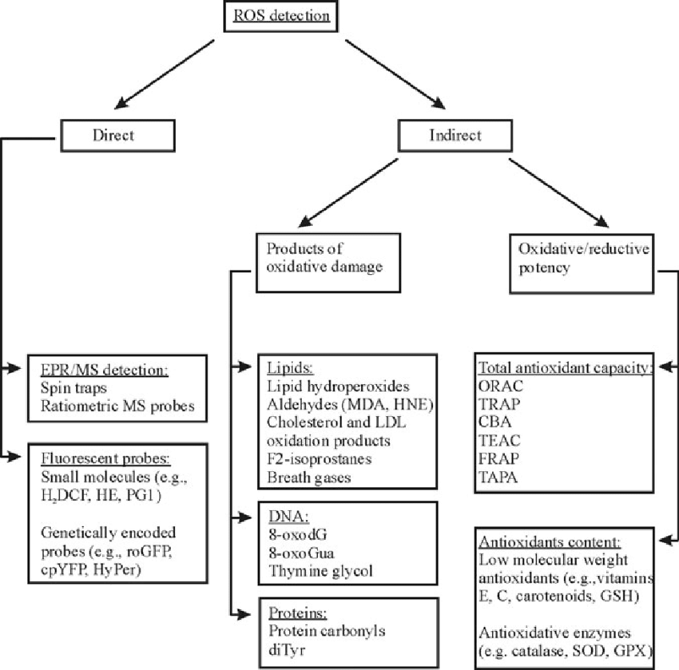
Detection
ANTIOXIDANTS & REDOX SIGNALING - Volume 19, Number 17, 2013 - Mary Ann Liebert, Inc. - DOI: 10.1089/ars.2012.4662
Notes:
ROS can be assessed either directly or indirectly. Direct methods include fluorescence-based probes and EPR. Indirect methods include measuring products of oxidative damage, total antioxidant capacity, and measuring levels/activities of low-molecular-weight antioxidants/ antioxidant enzymes.
https://www.nature.com/articles/s42255-022-00591-z
https://www.researchgate.net/figure/Detection-of-ROS-by-using-different-biomarkers-ROS-can-be-assessed-in-vivo-either_fig8_235785676

Slide 25
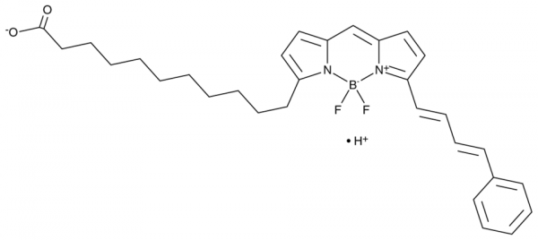
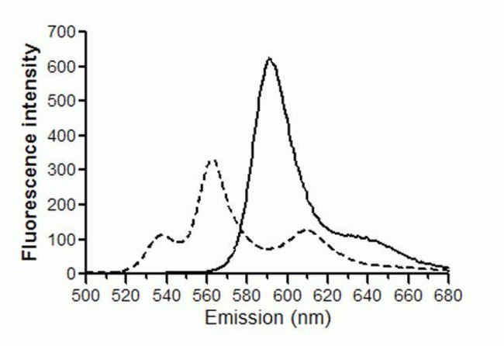
Detection → Lipid with fluorescent probes (direct method)
C11 BODIPY 581/591 (nonfluorescent)
BODIPY
C11 BODIPY 581/591 (nonfluorescent)
BODIPY 581/591 (fluorescent)
Notes:
™ Le kit de peroxydation des lipides Image-iT permet de détecter la peroxydation des lipides dans les cellules vivantes par oxydation™ du réactif C11 BODIPY 581/591. Ce réactif se localise aux membranes dans toutes les cellules vivantes et lors de l’oxydation par des hydroperoxydes lipidiques, affiche un décalage de l’émission de fluorescence maximale comprise entre ∼590 nm et ∼510 nm. La fluorescence des cellules vivantes passe du rouge au vert, fournissant une indication ratiométrique de la peroxydation lipidique compatible avec la microscopie à haute densité et traditionnelle, ainsi que la cytométrie en flux. Ce kit inclut également l'hydroperoxyde de cumène comme un composé témoin positif pour induire la peroxydation des lipides dans les cellules.

Slide 26
Detection → fluorescent probes (direct method)
Notes:
There is the classical and commonly used spectrophotometry methods. Small-molecule fluorescent probes are frequently used to assess ROS within cells.
Consider the widely used fluorescent probe 2',7'-dichlorodihydrofluorescein (DCFH), usually administered in its diacetate (DCFH-DA) form, which enters cells readily. DCFH is oxidized to the fluorescent product 2',7'-dichlorofluorescein (DCF) by several ROS. So it is not specific for any particular ROS6,7. DCFH is not oxidized directly by H2O2 (which it is often claimed to detect), but only after H2O2 is converted to more reactive species by redox-active metals or by haem proteins such as cytochrome c or peroxidases. Furthermore, the oxidation of DCFH and fluorescence of DCF are sensitive to local O2 levels and pH, and fluorescence yield may not be linear with increased ROS levels. This is not to say that DCFH, and other non-specific fluorescent probes, should never be used, but their limitations (selectivity, problems of quantification, linearity of response and susceptibility to artefact) should be understood and results interpreted cautiously by carrying out controls.

Slide 27
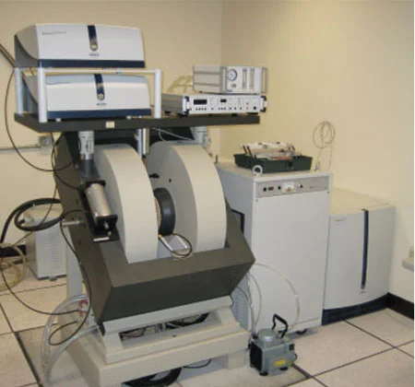
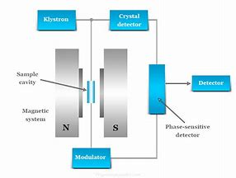
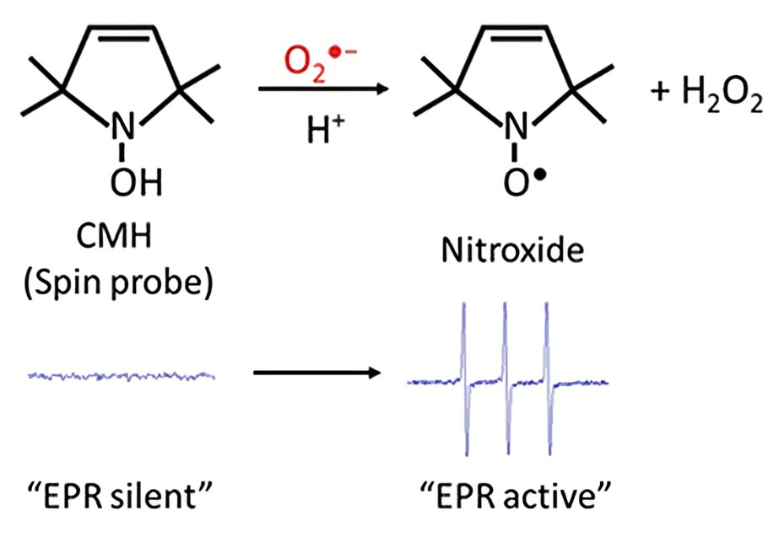
Detection → electron paramagnetic (spin) resonance (EPR/ESR)
(direct method)
Notes:
ROS detection can be done by measuring oxidative modifications (‘oxidative damage’, Box 1) in cells.
Direct detection of ROS and RNS is quite difficult or sometimes impossible in solution at room temperature due to their very short half-life. Additionally, ROS are usually generated in subcellular compartments, which require detection procedures directed for specific localization.
EPR allows us to detect ROS directly and it can also be used to monitor changes in the chemical forms of the oxidizable transition metal ions implicated in ROS generation [10]. EPR spectroscopy stands out from other methods because of its unique ability to detect either short- or long-lived radicals with high specificity and sensitivity in vivo cells.
Due to the low sensitivity of EPR, it is particularly challenging to measure ROS directly in vivo. The spin-trapping technique ESR is used to overcome this problem. By ysing the spin-trapping method, ROS are allowed to react with specially selected trap molecules to produce less reactive and more stable species that can be readily detected [11].

Slide 28
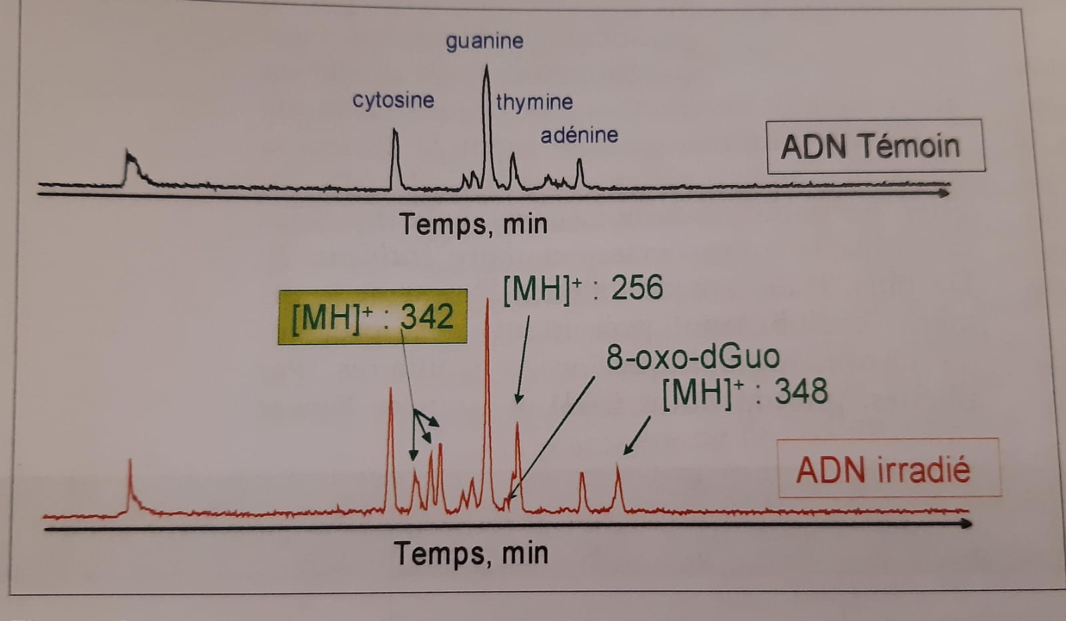
Detection → Quantitative detection by LC-MS (indirect method)
Notes:
ROS can be detected indirectly by using Non-denaturing LC-MS of proteins.
Size exclusion chromatography (SEC) and ion exchange chromatography (IEC) are typically non-denaturing methods that can separate proteins by size (SEC) or by charge (IEC). LC MS can also provide information on the mechanism of oxidation by ROS.
LC–MS-based methods have the advantages of high sensitivity, small sample volume requirements and the ability to detect multiple end products.

Slide 29
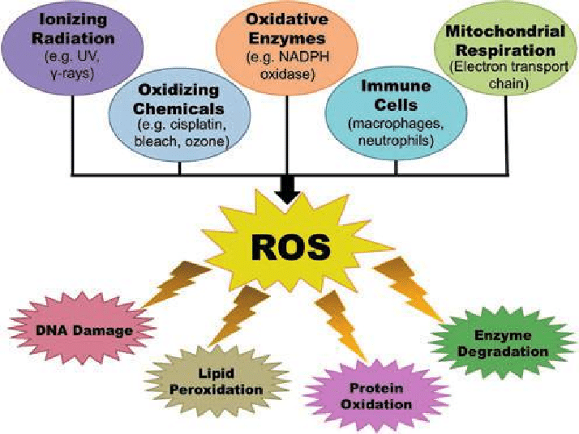
Conclusion

Slide 30
ANY QUESTIONS ?
(No Please 😭😭😭)

