Slide 1
Neuro-Développement et cellules souches
« Neural stem cells and nervous system development »
Lectures by experts in Neurodevelopment
Methodological sessions (document analysis and training to article writing) Paris-Saclay Institute of Neuroscience
You must be present at all conferences!
You should have read the corresponding review before!
You should discuss and ask questions during the conferences!

Slide 2
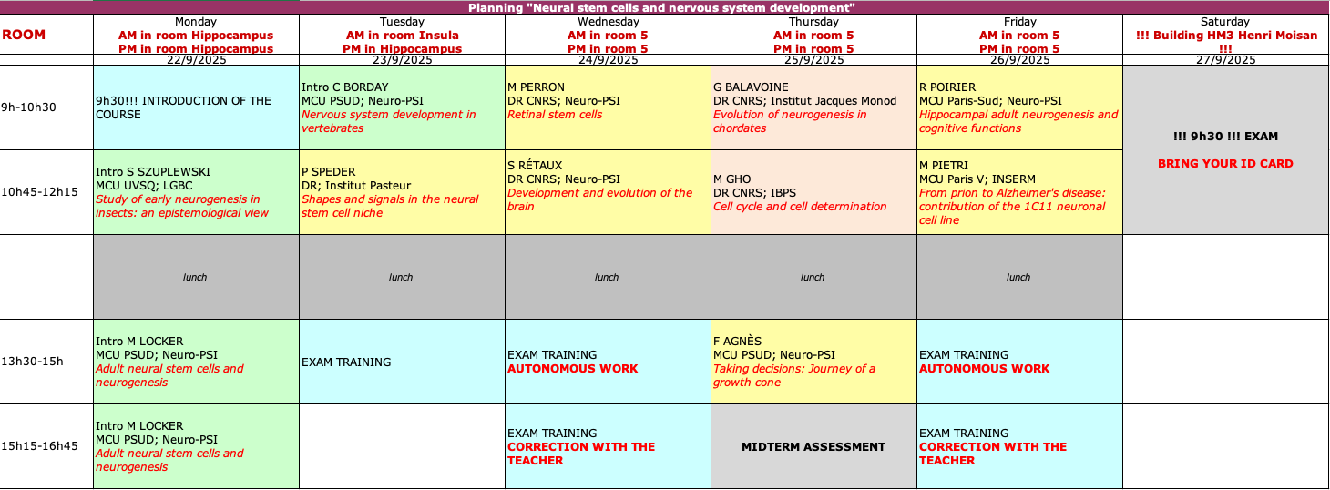
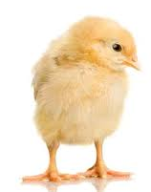
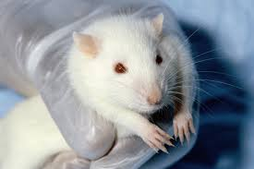
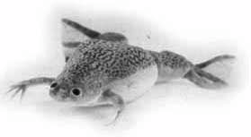
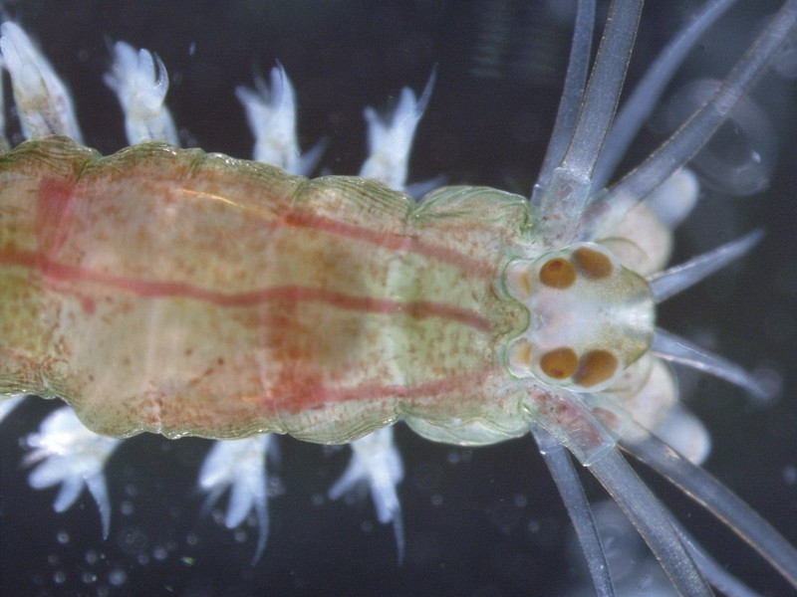
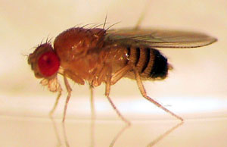
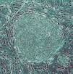
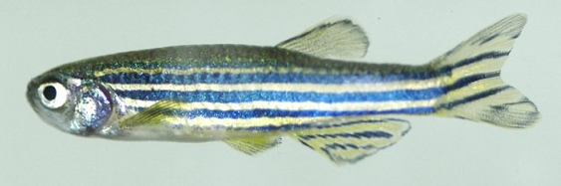
Neuro-Développement et cellules souches
« Neural stem cells and nervous system development »
Planning : https://docs.google.com/spreadsheets/d/1vZ7ij17DtkD8av-xRaa_38yjTBfBVQlR_XKhPo8W70w/edit?usp=sharing
!! 9h30 !!
Access to the eCampus course with all needed documents :
https://ecampus.paris-saclay.fr/course/view.php?id=155565&section=0

Slide 3
Neuro-Développement et cellules souches
« Neural stem cells and nervous system development »
All conferences are mandatory.
Be on time !!!
You can bring your food (microwave available) or have lunch on site. Please keep your cantine card until the end of the year !!!

Slide 4
Neuro-Développement et cellules souches
« Neural stem cells and nervous system development »
TESTS & EXAMS
In french or english: your choice (no documents authorized)!
Midterm assessment (contrôle continu; 0,4) :
Thursday 15h15-16h45: Two general questions related to the conferences you attended to + 1 Figure to analyze
Exam (examen final; 0,6): HM3, room ????. Take your ID card!!!!!!!
Saturday 9h30-12h30: Analysis of data from a scientific article dealing with neural development or neural stem cells (theme directly linked to one of the conferences you attended to)

Slide 5
What kind of questions will be asked for mid-term assessment ?
Interest of a specific model to address specific questions
Formulation of one/some problematics raised in the conferences
Formulation of questions that remain unresolved in the field
Major advances/limitations on a conference subject
Questions that you may ask yourself following a conference
Principles of a methodology presented in the courses or conferences
….
No need to learn everything by heart but need to acquire an overview of the conference contents: think, ask yourselves and speakers questions, identify problematics, understand model organism interest and methodologies… !!!

Slide 6
What is expected for the exam ?
You will be given 4 figures from an article + a truncated introduction.
YOUR OBJECTIVES :
Propose a general title (must be pertinent!)
Complete the introduction by formulating the biological context/general problematics in the field and/or the specific problematic of the study, as requested
For each figure analyse methodologically the provided data :
precise the objective of the experiment
describe the experimental strategy and the main results
Conclude
(4) Express 2-3 questions associated with the results
1
2
3
4

Slide 7
How to get prepared for the exam ?
Ask QUESTIONS and READ!
Identify the global problematics relative to the main treated themes in reviews and seminar introductions
Use provided reviews and seminar contents to:
Distinguish more specific questions related to each field
Understand the methodology and steps that allow building a demonstration (keep a critical mind! An abstract for instance can provide an overstated message…)
Identify significant advances, unresolved issues, potential contradictions… raised by novel data (discussion sections)

Slide 8
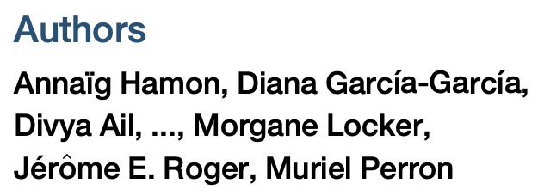
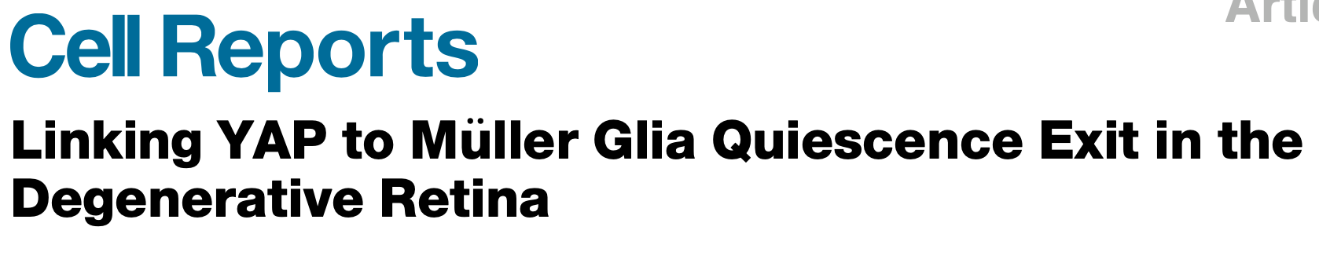
How is a classical introduction structured ?
1) Describe the general biological context of the study
Neurodegenerative retinal diseases, such as retinitis pigmentosa or age-related macular degeneration, ultimately lead to vision loss, as a consequence of photoreceptor cell death. Driving retinal self-repair from endogenous neural stem cells in patients represents an attractive therapeutic strategy. Among cellular sources of interest are Müller cells, the major glial cell type in the retina. In certain species, such as zebrafish or Xenopus, they behave as genuine stem cells, endowed with the ability to reprogram into a progenitor-like state upon retinal damage, proliferate, and regenerate lost photoreceptors.

Slide 9
How is a classical introduction structured ?
2) Raise the general problematic relative to your own objectives describing what is already known and what is not
In mammals, however, their proliferative response to injury is extremely limited… Suggesting that they nonetheless retain remnants of repair capacities, their proliferation and neurogenic potential can be stimulated, for instance by supplying exogenous growth factors such as heparin-binding epidermal growth factor (EGF)-like growth factor (HB-EGF). Our understanding of the genetic and signaling network sustaining Müller cell stemness potential is, however, far from being complete. Identifying novel molecular cues is thus of utmost importance to foresee putative candidates that could be targeted for regenerative medicine.

Slide 10
How is a classical introduction structured ?
3) Introduce the pertinent literature (including your own previous data) that will allow understanding the precise and specific objectives of the study
We here investigated whether the Hippo pathway effector YAP might influence Müller cell reactivation and how it would intersect with other critical signaling pathways. The Hippo pathway is a kinase cascade that converges toward two terminal effectors, YAP (Yes-associated protein) and TAZ (transcriptional coactivator with PDZ-binding motif). Both are transcriptional coactivators of TEAD family transcription factors. The Hippo pathway emerged as a key signaling in a wide range of biological processes, including stem cell biology… YAP status in adult neural tissue repair has hitherto never been investigated. We recently discovered that YAP and TEAD1 are specifically expressed in murine Müller cells, and that their expression and activity are enhanced upon retinal damage. We thus sought to determine whether YAP could be required for injury-induced Müller glia reactivation.

Slide 11
How is a classical introduction structured ?
4) Describe your major findings (optional)
We found in mouse that YAP triggers cell-cycle gene upregulation in Müller glial cells following photoreceptor cell death. In line with the idea of a conserved role in Müller cell-cycle re-entry, blocking YAP function in Xenopus results in a dramatically reduced proliferative response following acute retinal damage or photoreceptor cell ablation. Finally, we report that the limited proliferative response of murine Müller glia can be circumvented and significantly enhanced by YAP overexpression. We further show that such YAP mitogenic function relies on its interplay with epidermal growth factor receptor (EGFR) signaling. As a whole, this study highlights the critical role of YAP in driving Müller cells to exit quiescence and thus reveals a potential target for regenerative medicine.

Slide 12
How are data presented ?
1) Titles of the result section are informative: they concisely give the « take home message » of the paragraph, while remaining objective (ideally…)
✓ Yap Conditional Knockout in Mouse Müller Cells Does Not Compromise Their Maintenance under
Physiological Conditions
✓ Yap Deletion Impairs Mouse Müller Cell Reactivation upon Photoreceptor Degeneration
✓ Yap Knockout Prevents Cell-Cycle Gene Upregulation in Mouse Reactive Müller Cells
✓ Inhibition of YAP Prevents Müller Glia Proliferation upon Acute Retinal Damage or Selective Photoreceptor Cell Ablation in Xenopus laevis
✓ Forced YAP Expression in Mouse Müller Glial Cells Stimulates Their Proliferation Both Ex Vivo and In Vivo
✓ Interfering with Yap Expression Affects EGFR Signaling in Mouse Reactive Müller Cells
✓ YAP Mitogenic Effects on Müller Cells Requires EGFR Pathway Activity

Slide 13
How are data presented ?
2) Classical presentation of the data involves (i) presenting the aim of the experiment (linking it to the previous one), (ii) explaining the experimental strategy, (iii) faithfully describing the data (without neglecting the controls), and (iv) providing an experimental and/or a biological conclusion.
Based on the above data on Xenopus, we next wondered whether mouse Müller cell inability to proliferate upon injury (despite cell-cycle gene reactivation) might be linked to insufficient levels. To investigate this hypothesis, we decided to overexpress in mouse Müller cells a FLAG-tagged mutated YAP protein, YAP5SA, which is insensitive to Hippo pathway-mediated cytoplasmic retention. This constitutively active form of YAP was delivered by intravitreal injection of an adeno-associated virus (AAV) variant, ShH10, which selectively targets Müller cells… Only rare proliferative cells were observed in control retinas. In contrast, many EdU-positive cells were found in retinas transduced with AAV-YAP5SA. Co-labeling with glutamine synthetase or SOX9 on retinal sections confirmed that a majority of these had a Müller cell identity… Altogether, these data reveal that YAP overactivation is sufficient to override the dormancy of murine Müller glial cells and boost their proliferative potential.

