Slide 1
Scientific English Communication

Slide 2
Presentation of techniques in biology
2 groups in parallel, 1 student per technique
1-page description + 5 associated keywords
10 min of oral presentation for each students (max 10 slides) presenting:
  Purpose of the technique
  Basic principle
  Necessary material
  Method of analysis
  Limits of the technique

Slide 3
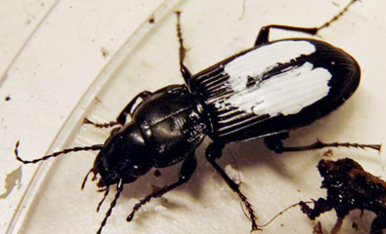
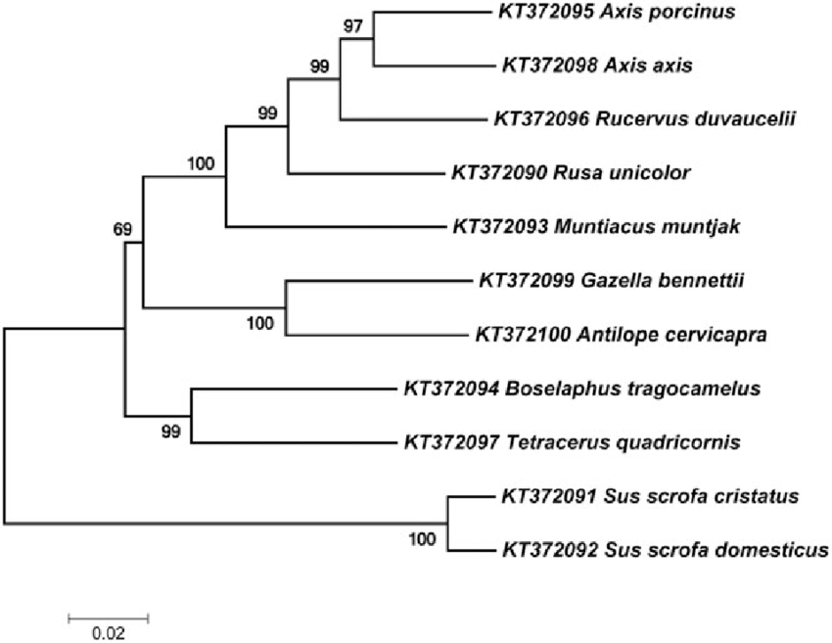
Methods in Ecology and Evolution
Mark and Recapture
Phylogenetic reconstruction using Neighbour-Joining algorithm

Slide 4
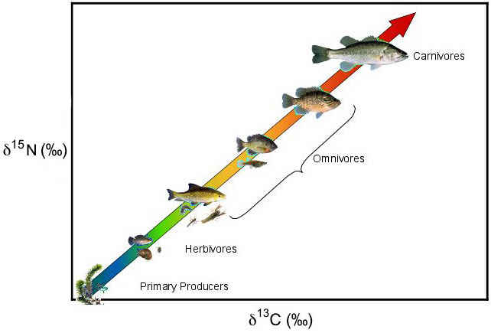
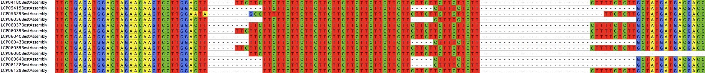
Methods in Ecology and Evolution
Reconstruction of trophic networks using stable isotopes
Genotyping using RAD-seq

Slide 5
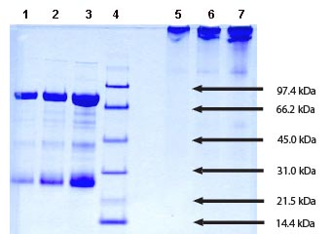
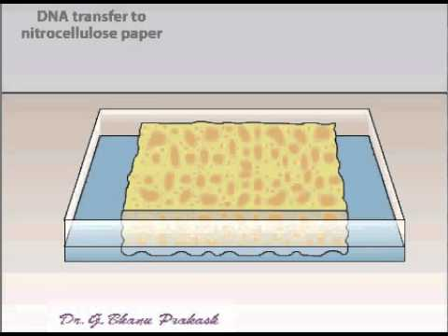
Methods in Molecular Biology
Protein electrophoresis (SDS-PAGE)
Southern Blot

Slide 6
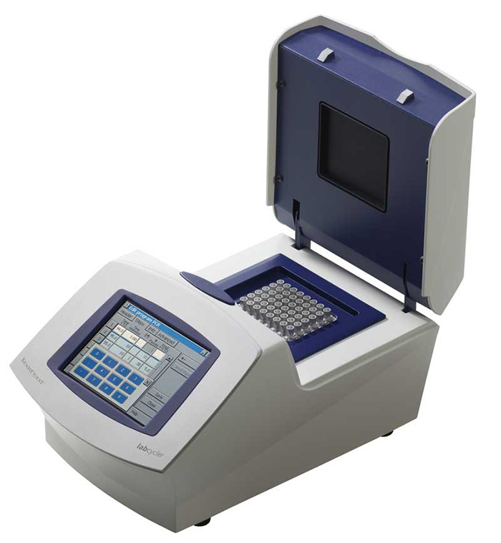
Methods in Molecular Biology
qPCR

Slide 7
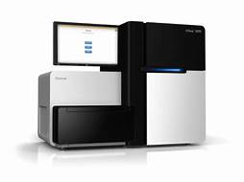
Methods in Molecular Biology
Sequencing using Illumina HiSeq technology

Slide 8
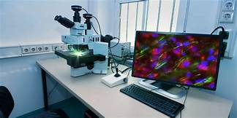
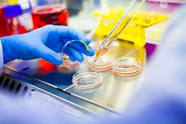
Methods in Cellular Biology
Microscopy
Cell culture

Slide 9
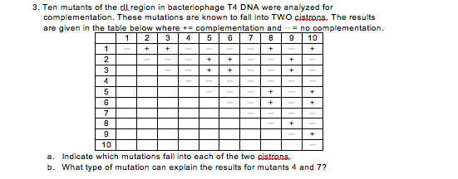
Methods in Genetics
Complementation test between auxotrophic mutants in yeast

